Slide 1
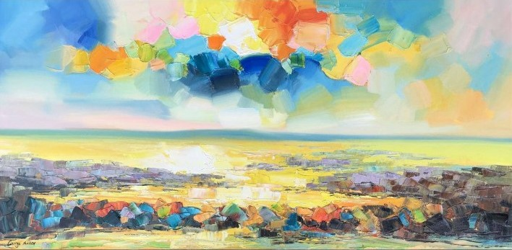
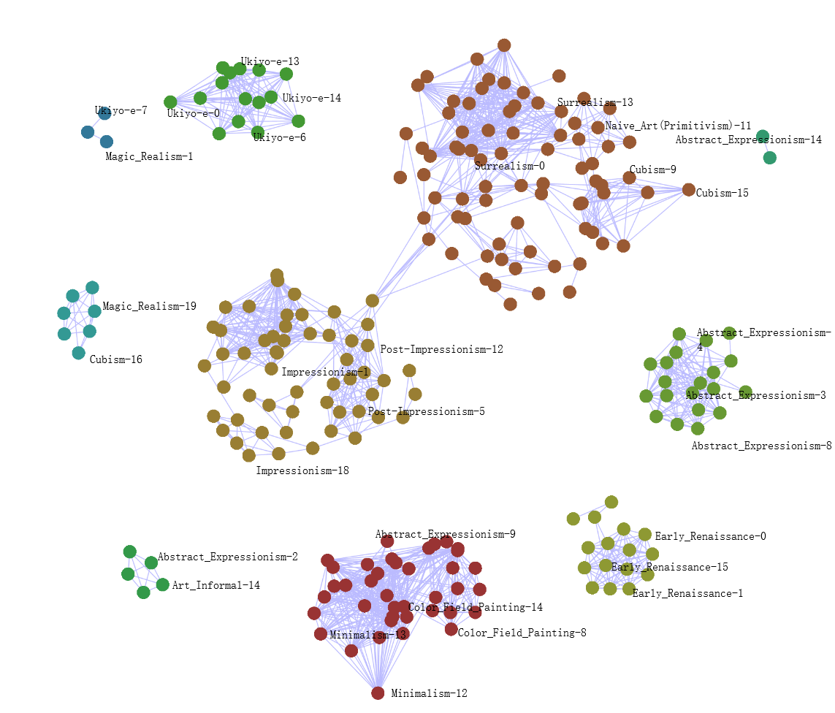
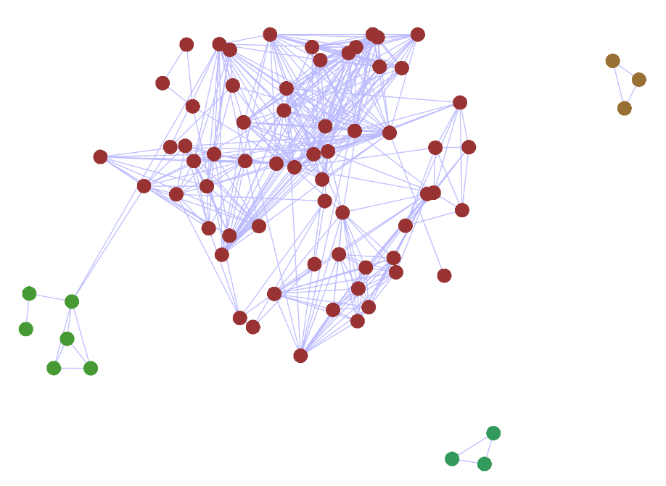
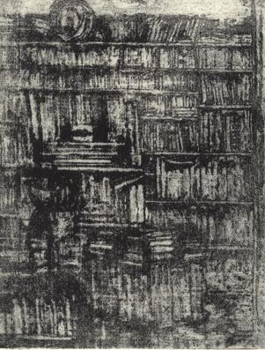
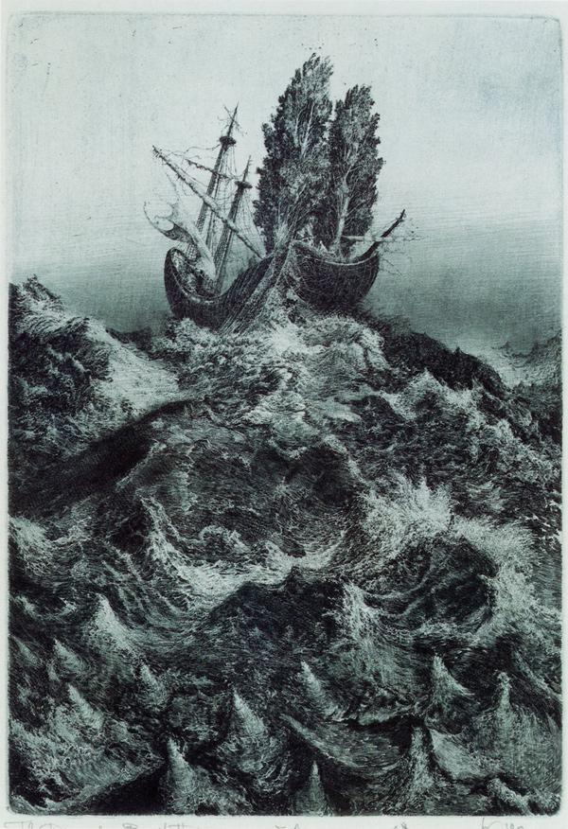
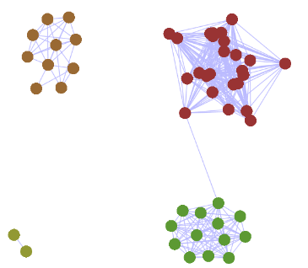
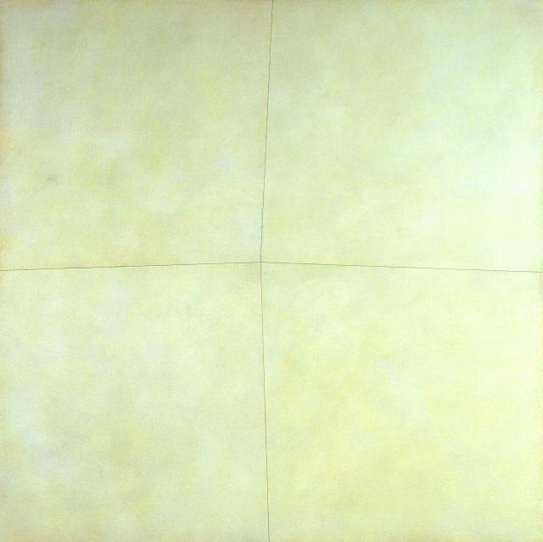
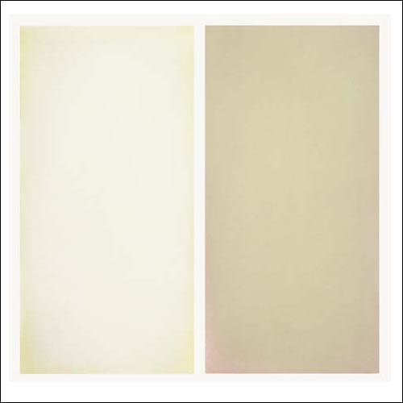
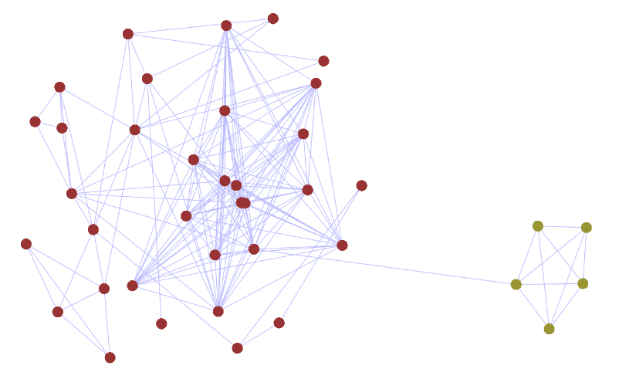
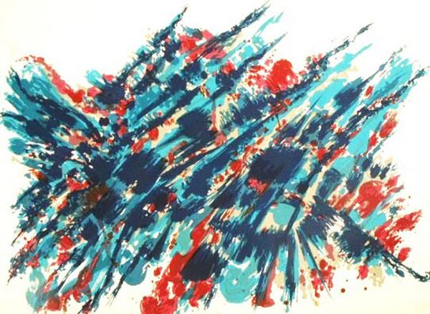
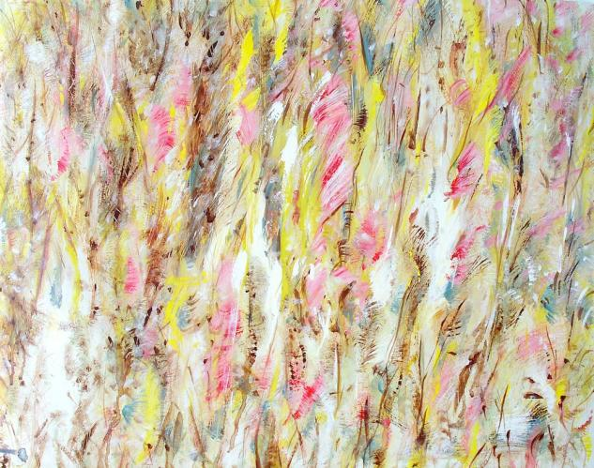
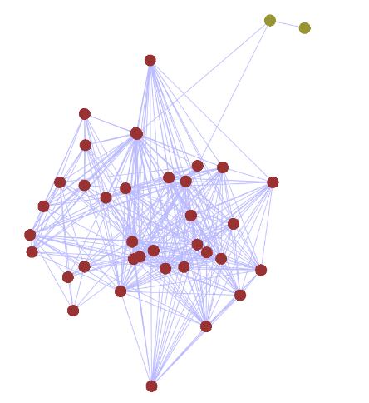
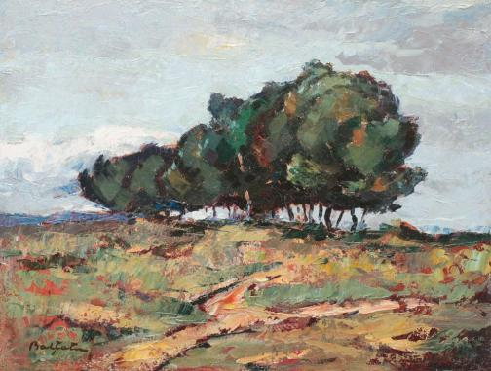
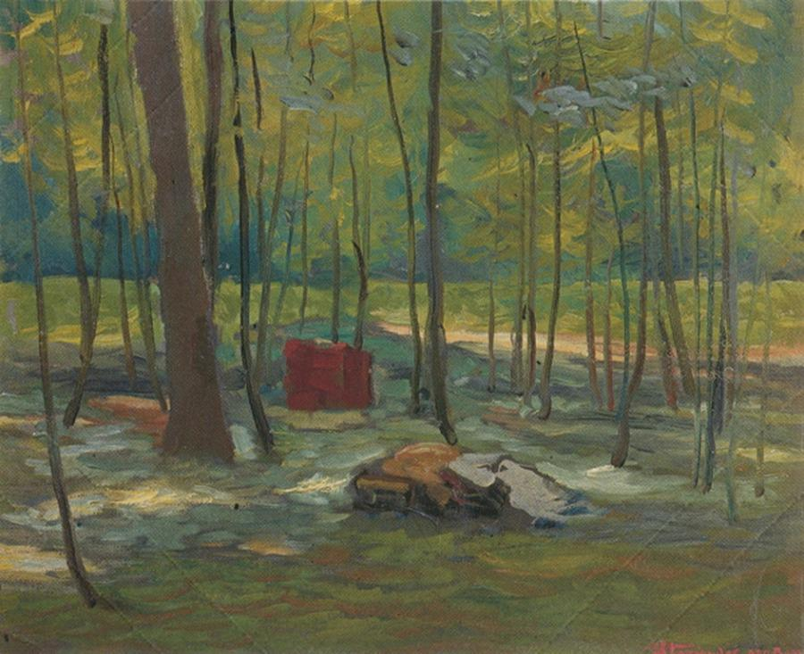
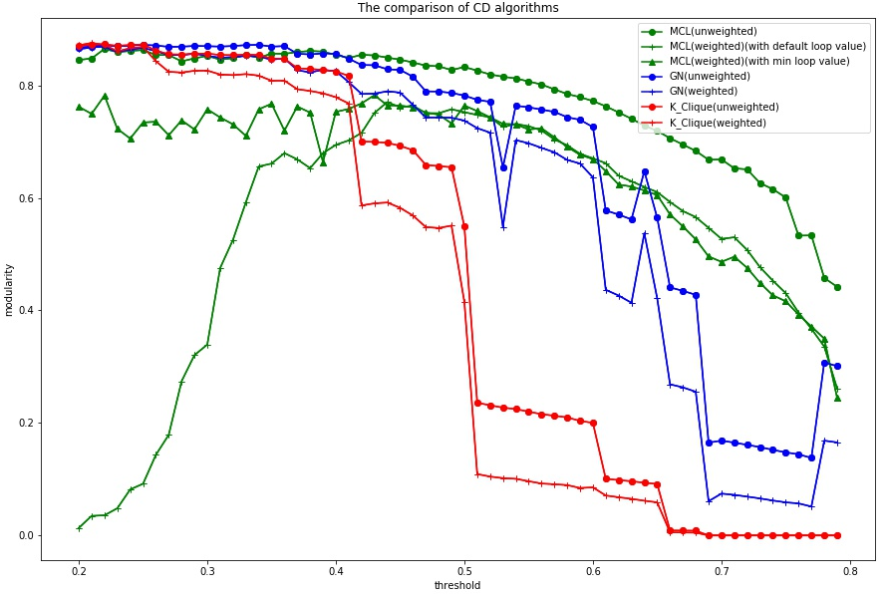
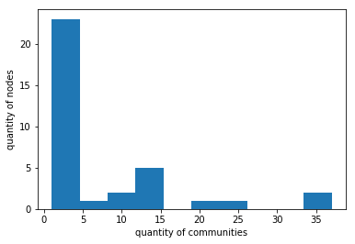
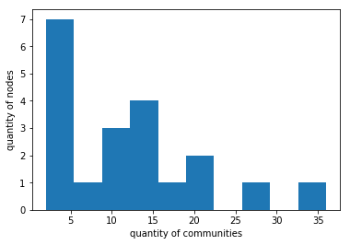
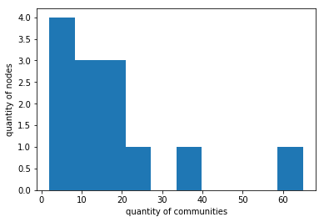
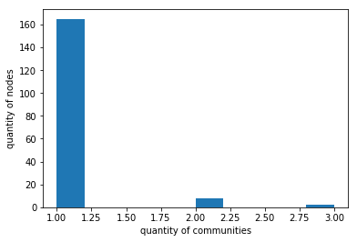
Team 05
SWS3001
Summer 2018
Nerd’s Gallery:
Communitiy detection on paintings
Project ID: 19
Jiang Shuyu Liu Ziqian Zhang Ming Zhang Jiacan
Introduction
Results & Analysis
Objective: In this project, we aim to identify styles of different paintings with community detection(CD) algorithms , compare various CD algorithms’ performance and take insights into the relationships of genres.
Dataset: We have paintings of 12 styles , and each style contains 20 paintings.
Algorithms: Girvan-Newman, Markov Clustering and Clique Percolation Method.
Details of Data & Methods Used
Data: Each painting is a RGB image labeled with a certain style(abstract art, naive art, etc.).
Feature vector: We use pre-trained CNN to get feature vectors. Feature vectors’ size is (12, 1), and the i^{th} value indicates the probability of belonging to the i^{th} style.
Dissimilarity matrix: For each pair of paintings, we compute the Euler distance of their feature vectors as their dissimilarities, set a threshold manually and remove all values that are greater than the threshold.
Graph: We use NetworkX to generate graphs. We compare algorithms’ performance on both weighted graphs and unweighted graphs.
Figure1: Community Detection using Girvan-Newman Algorithm
Results
Some communities are closed to others, and some are far from others. It shows that some painting styles are seperated while some are intertwined.
We have detected the unique or intertwined ones from figure 1.
Unique: Early Renaissance, Ukiyo-e
Intertwined: <Cubism, Magic Realism, Naive Art, Surrealism>, and <Abstract Expressionism, Color Field Painting, Minimalism> and <Abstract Expressionism, Art Informal> and <Impressionism, Post-Impressionism
Analysis of intertwined styles
CNN recognition accuracy is 81.25% for the 4 painting styles: Cubism, Magic Realism, Naive Art, and Surrealism.
Naive Art and Cubism are two communities, however, they have many connections.
Color Field painting and Minimalism are different styles while they have something in common with Abstract Expressionism.
Abstract Expressionism and Art Informal have strong connections. The CNN recognition
accuracy is 82.5%.
Impressionism and Post-Impressionism also have strong connections.
Findings
Color Field painting and Minimalism are developed from Abstract Expressionism which can be validated on Wikipedia and can support our results.
Abstract Expressionism and Art Informal are connected tightly in the communities. Actually they are called equally by artists.(ideelart.com)
Workflow
Magic realism
Surrealism
Project Proposal
Decide our project theme and gather dataset
Compute Dissimilarity
Calculate the dissimilarity matrix
Minimalism
Color Field
Form Graph
Construct graphs for paintings
Community Detection
Detect communities using GN ,CPM and MCL
Art Informal
Abstract Expressionism
Comparison of CD Algorithms
Threshold=0.6,Modularity=0.56
Impresssionism
Post-Impressionism
Figure 3.1: MCL(unweighted)
Threshold=0.6,Modularity=0.77
Figure 2: Modularity-threshold curve
Figure 3.2: MCL(weighted)
Conclusions & Lessons
All three algorithms perform better on unweighted graphs than weighted graphs.(see figure 2)
Markov Clustering is more stable than Girvan-Newman and K-Clique, and there are more fluctuations on GN’s curve.(see figure 2)
Modularity is not a good measurement when the threshold is very low, because we cut off so many edges that only few core communities can survive.
MCL tends to divide communities strictly and generate many single-node communities, especially on weighted graphs(see figure 3.[1,2,3]). That’s why the modularity is low on the MCL(weighted) curve even though the threshold is very low(see figure 3.4).
We find that if we set the self-loop value to be the minimum in dissimilarity matrix, then MCL performs similarly on weighted graphs like other algorithms.
Threshold=0.6,Modularity=0.77
Conclusions
Most of the relationships we find by the communities can be validated by the painting’s style development history and real genres. It shows the results of our analysis are good and reasonable.
The deep learning tool is helpful to do further work, whereas the CNN’s recognition accuracy of styles should be improved.
Lessons
Our project can be used in painting art research.
Teamwork is very important, and everyone's work is an indispensable part.
Figure 3.3: GN(unweighted)
Threshold=0.22,Modularity=0.36
Figure 3.4: MCL(weighted)

