Slide 1
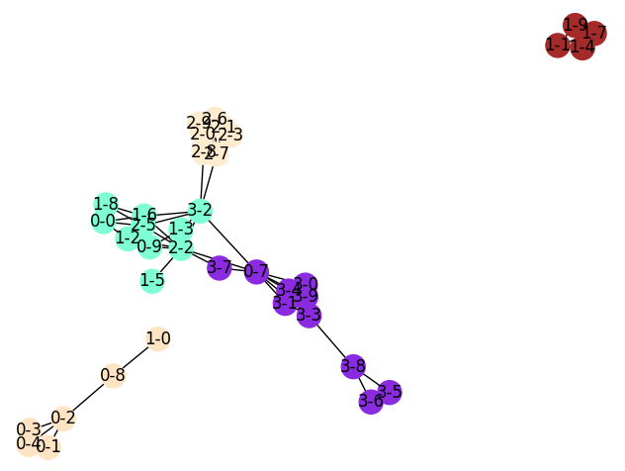
SWS3001
Summer 2018
Title of Project
Team 5
Name of Students (in alphabetical order)
Introduction
Results Obtained
Give general description (short sentences in point form)
Template describes major components of poster.
You can add/subtract components to your poster
Leave some margins on all 4 sides of the poster.
You are free to change the colour and layout.
Change the size of each block if needed.
Use suggested font types and sizes for easy viewing.
1. Results: we use the dissimilarity matrix to build graph and run CD algorithms, finally we get communities for different styles and we plot them.
2. Analysis: we use the <style-index> as painting's label, so we can easily tell which paintings are in the right communities and which are not by their style of labels.
3. Deeper analysis: By analyzing the closeness of nodes in the same community and the connections between nodes in different communities, as well as the number of nodes and the degree of misclassification in the community, we can get the accuracy of algorithms and come up with potential connections between different styles, maybe they come from the same faction such as impressionism and post-impressionism and so on.
Objective
Concise description of objective of project, eg
To identify and analyze communities in <some domain>;
describe the input data you use
Scope of project: We restrict our study to only <>
Overview of Your Study
More Results
Describe your input data,
Describe the labels (or subclasses) in your input,
and other relevant details (number of images, attrib…)
Describe what you hope to discover…
The picture below is a sample result:
For example, there are 4 styles with 10 paintings, the "1-8" means the node is the 8_{th} painting of the style 1 and the 4 styles are classified properly as the picture.
Overall Workflow of Study
Compute Dissimilarity
Dissimilarity matrix
Form Graph
Sparse graph
Modify this workflow as appropriate…
Community Detection
Communities
Analysis and Visualization
Facts & Actionable insights
Details of Data & Methods Used
Conclusions, Lessons Learnt
Give relevant details of data used (if appropriate)
Give details of methods (algorithms) used
including whatever changes you made/adjusted
Give details of the analyses you did
(This part is required only for the final poster.)
What are the conclusions you found? Are they good?
What are some shortcomings of this project
How can it be improved?
What are Lessons learnt from this project.
* Technical lessons
* Non-technical lessons learnt

