Slide 1
ECE1388 VLSI Design Methodology
Lecture 1: Introduction to CMOS Devices and Circuits
Adapted from Weste, Harris CMOS VLSI Design

Slide 2
Introduction
Integrated circuits: many transistors on one chip.
Very Large Scale Integration (VLSI): very many
Complementary Metal Oxide Semiconductor
  Fast, cheap, low power transistors
Today: How to build your own simple CMOS chip
  CMOS transistors
  Building logic gates from transistors
  Transistor layout and fabrication
Rest of the course: How to build a good CMOS chip
1: Introduction
Slide <number>

Slide 3
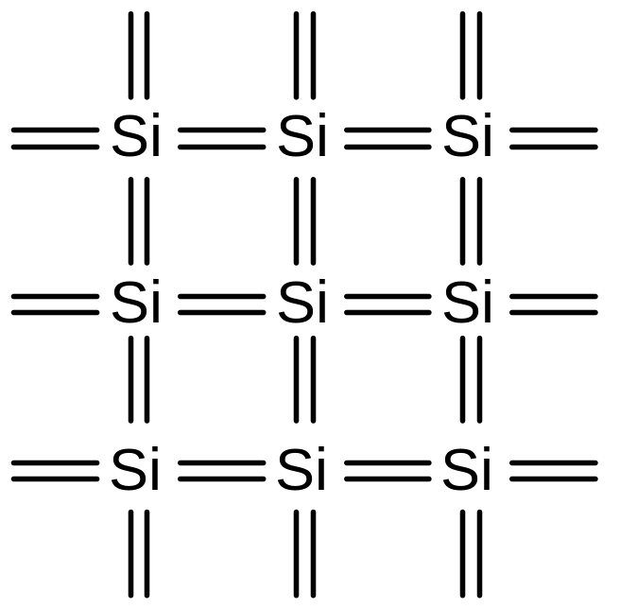
Silicon Lattice
Transistors are built on a silicon substrate
Silicon is a Group IV material
Forms crystal lattice with bonds to four neighbors
1: Introduction
Slide <number>

Slide 4
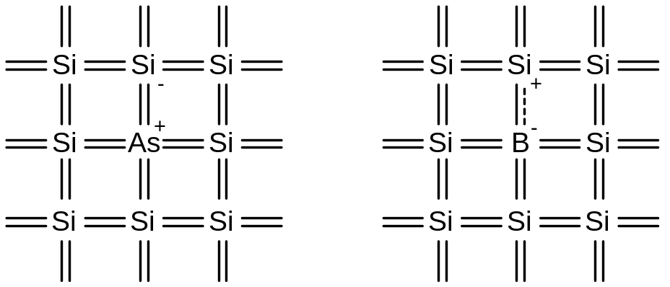
Dopants
Silicon is a semiconductor
Pure silicon has no free carriers and conducts poorly
Adding dopants increases the conductivity
Group V: extra electron (n-type)
Group III: missing electron, called hole (p-type)
1: Introduction
Slide <number>

Slide 5
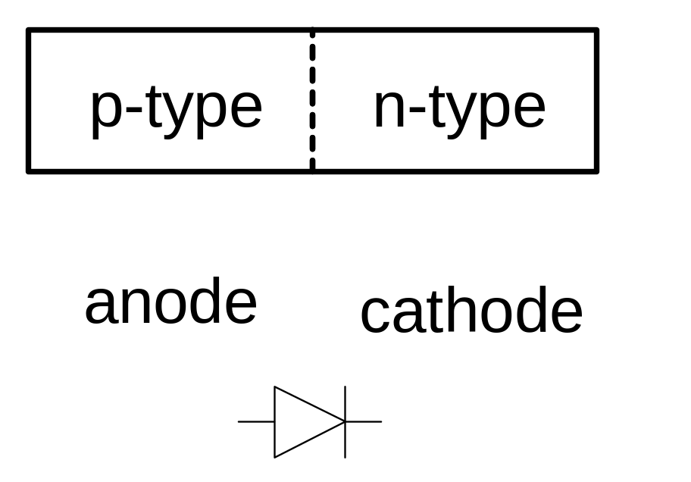
p-n Junctions
A junction between p-type and n-type semiconductor forms a diode.
Current flows only in one direction
1: Introduction
Slide <number>

Slide 6
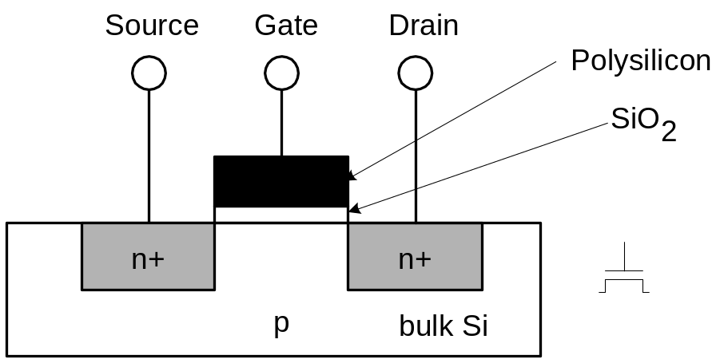
nMOS Transistor
Four terminals: gate, source, drain, body
Gate – oxide – body stack looks like a capacitor
  Gate and body are conductors
  SiO₂ (oxide) is a very good insulator
  Called metal – oxide – semiconductor (MOS) capacitor
  Even though gate is
  no longer made of metal
1: Introduction
Slide <number>

Slide 7
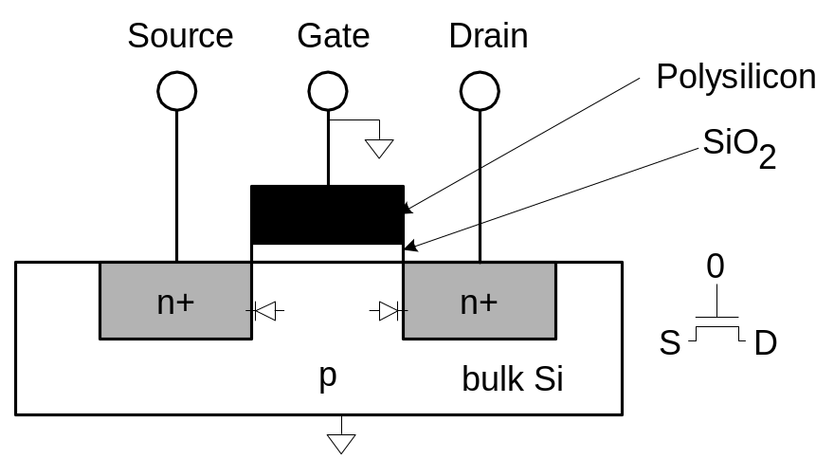
nMOS Operation
Body is commonly tied to ground (0 V)
When the gate is at a low voltage:
  P-type body is at low voltage
  Source-body and drain-body diodes are OFF
  No current flows, transistor is OFF
1: Introduction
Slide <number>

Slide 8

nMOS Operation Cont.
When the gate is at a high voltage:
  Positive charge on gate of MOS capacitor
  Negative charge attracted to body
  Inverts a channel under gate to n-type
  Now current can flow through n-type silicon from source through channel to drain, transistor is ON
1: Introduction
Slide <number>

Slide 9
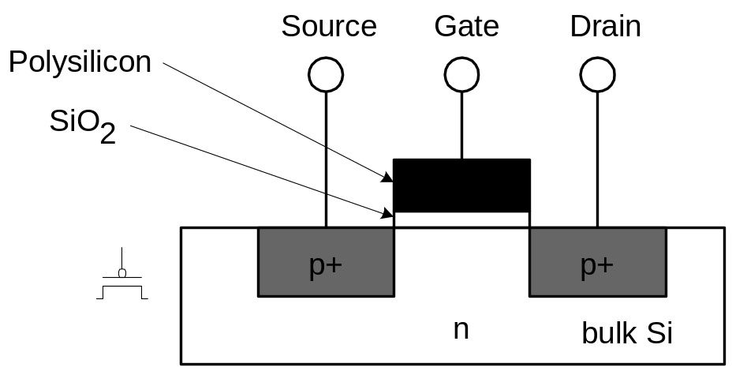
pMOS Transistor
Similar, but doping and voltages reversed
  Body tied to high voltage (V_{DD})
  Gate low: transistor ON
  Gate high: transistor OFF
  Bubble indicates inverted behavior
1: Introduction
Slide <number>

Slide 10
Power Supply Voltage
GND = 0 V
In 1980’s, V_{DD} = 5V
V_{DD} has decreased in modern processes
  High V_{DD} would damage modern tiny transistors
  Lower V_{DD} saves power
V_{DD} = 3.3, 2.5, 1.8, 1.5, 1.2, 1.0, …
1: Introduction
Slide <number>

Slide 11
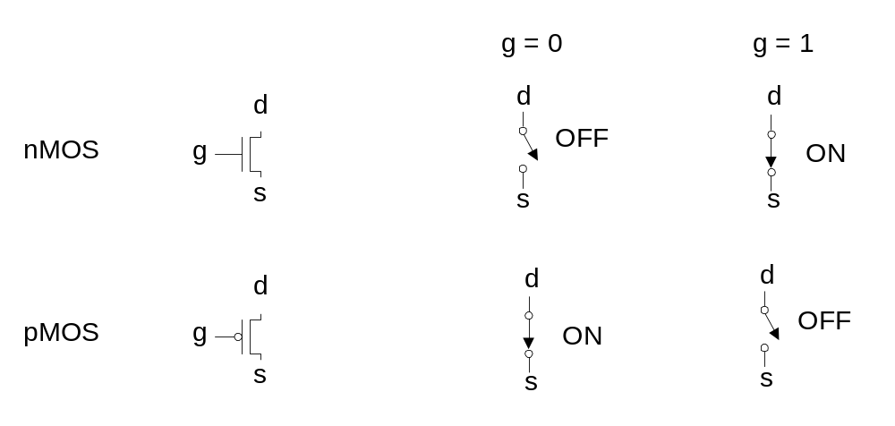
Transistors as Switches
We can view MOS transistors as electrically controlled switches
Voltage at gate controls path from source to drain
1: Introduction
Slide <number>

Slide 12
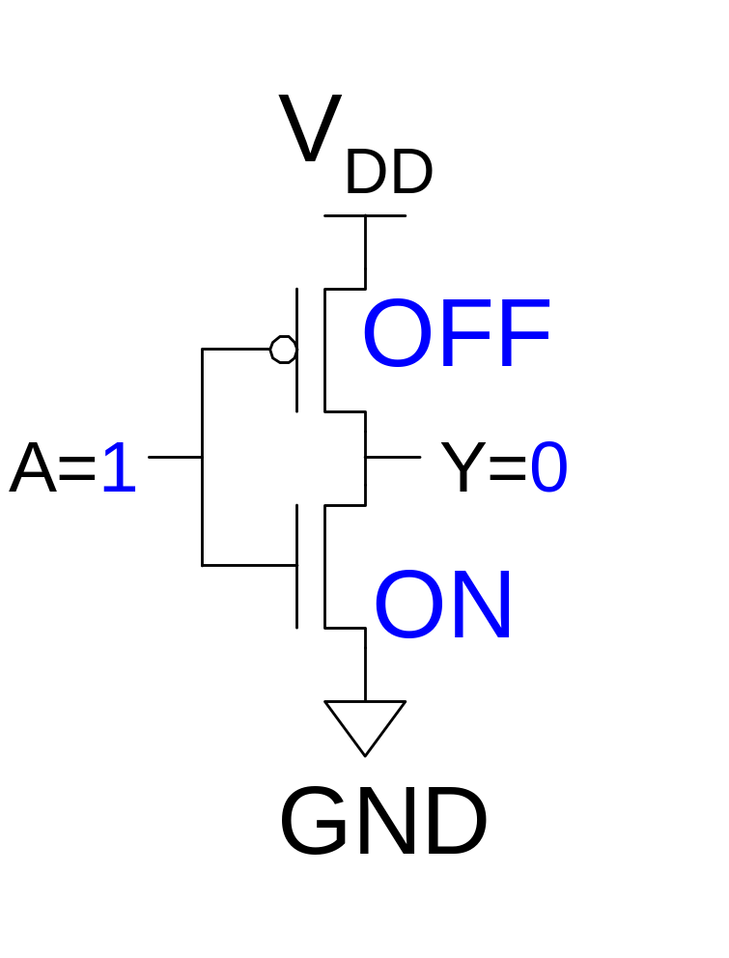
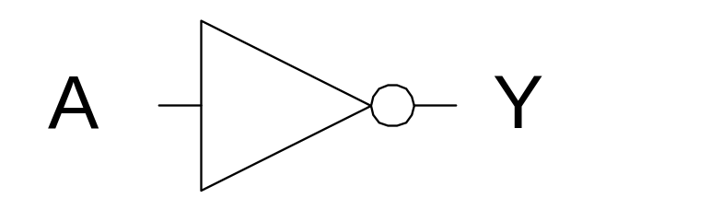
CMOS Inverter
A | Y
0
1 | 0
1: Introduction
Slide <number>

Slide 13
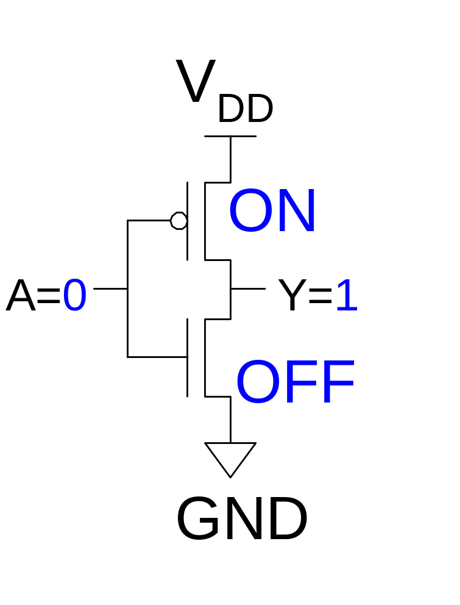
CMOS Inverter
A | Y
0 | 1
1 | 0
1: Introduction
Slide <number>

Slide 14
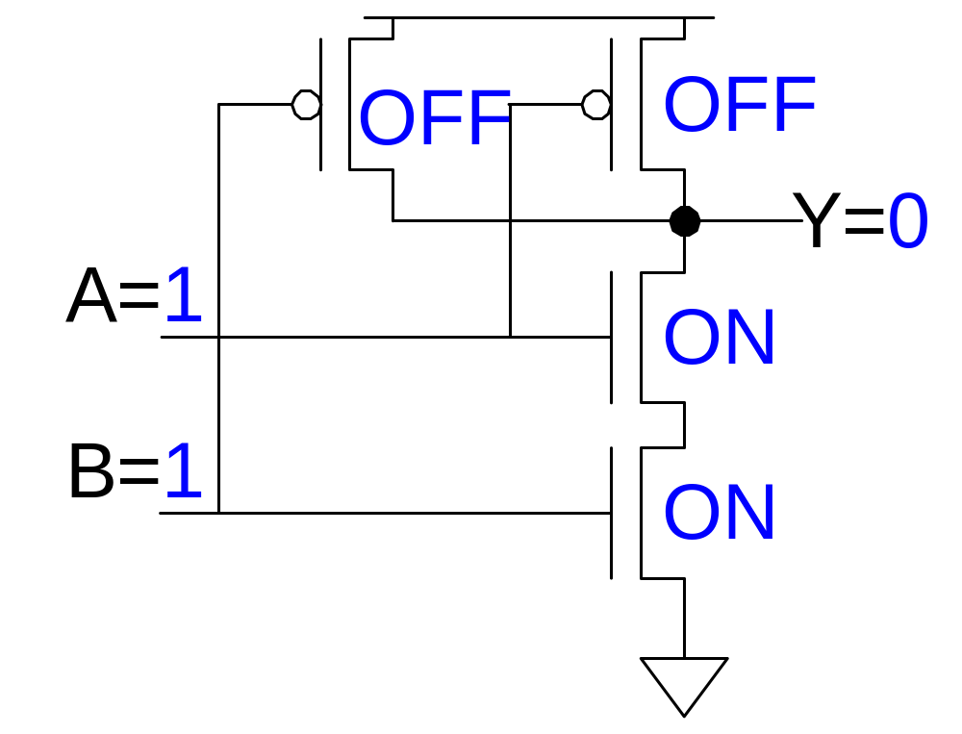
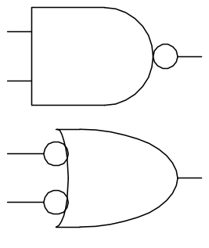
CMOS NAND Gate
A | B | Y
0 | 0 | 1
0 | 1 | 1
1 | 0 | 1
1 | 1 | 0
1: Introduction
Slide <number>

Slide 15
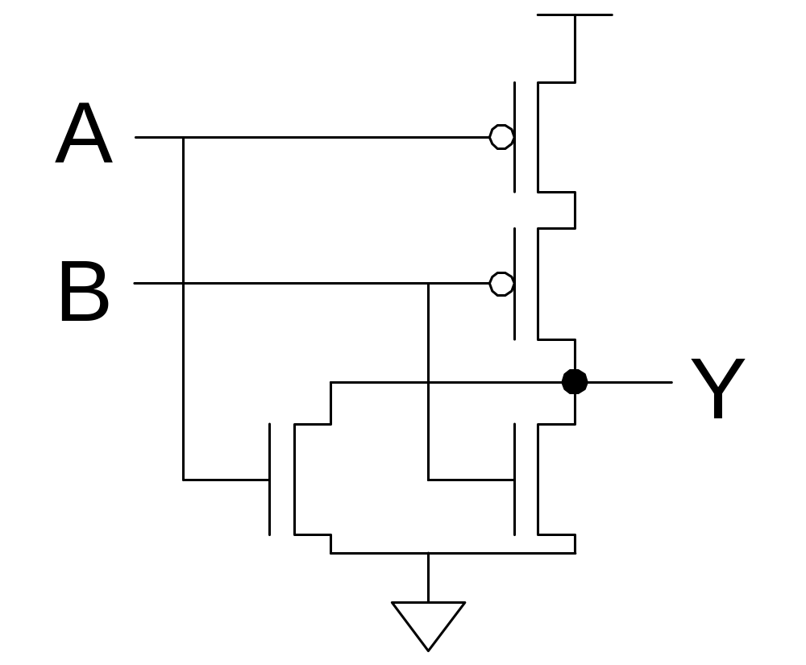
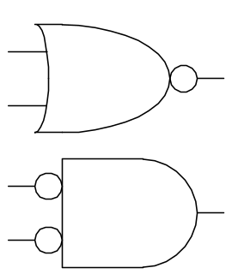
CMOS NOR Gate
A | B | Y
0 | 0 | 1
0 | 1 | 0
1 | 0 | 0
1 | 1 | 0
1: Introduction
Slide <number>

Slide 16
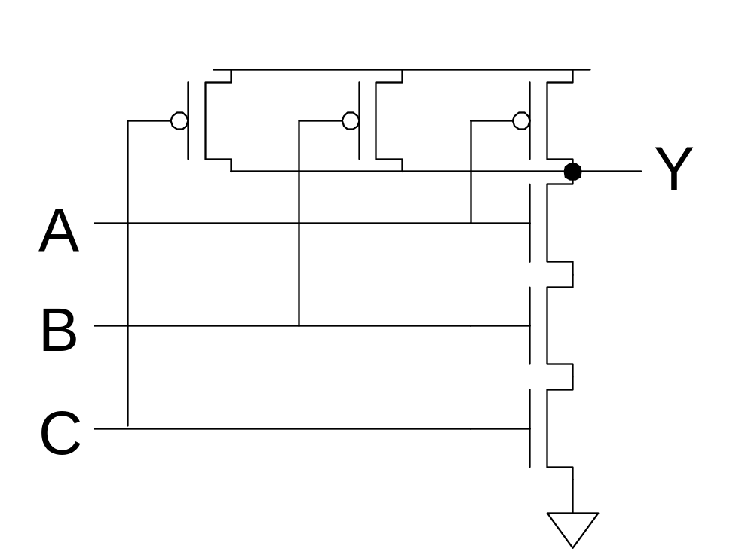
3-input NAND Gate
Y pulls low if ALL inputs are 1
Y pulls high if ANY input is 0
1: Introduction
Slide <number>

Slide 17
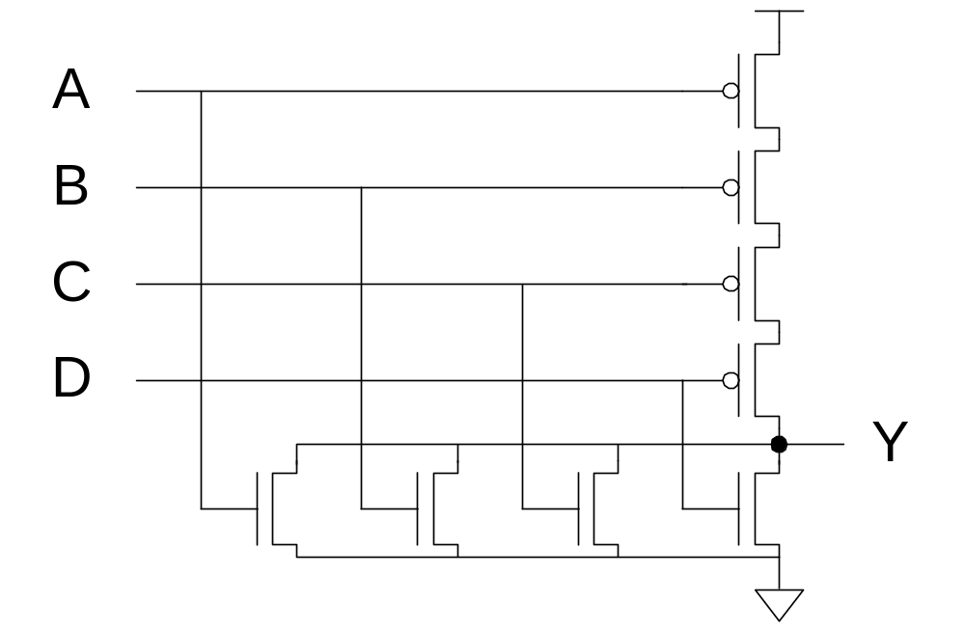
CMOS Gate Design
Activity:
  Sketch a 4-input CMOS NOR gate
2: Circuits & Layout
Slide <number>

Slide 18
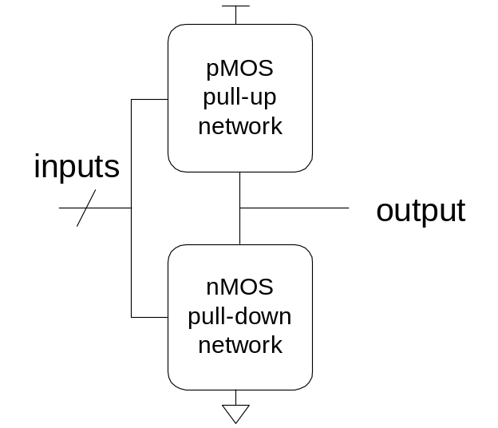
Complementary CMOS
Complementary CMOS logic gates
  nMOS pull-down network
  pMOS pull-up network
  a.k.a. static CMOS
 | Pull-up OFF | Pull-up ON
Pull-down OFF | Z (float) | 1
Pull-down ON | 0 | X (crowbar)
2: Circuits & Layout
Slide <number>

Slide 19
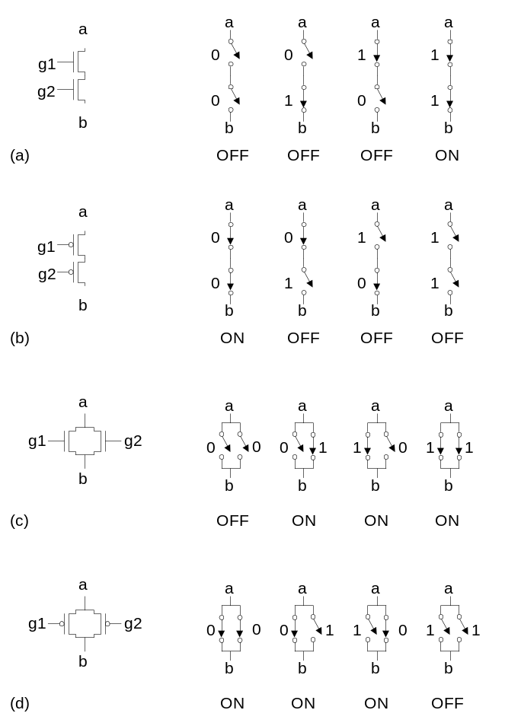
Series and Parallel
nMOS: 1 = ON
pMOS: 0 = ON
Series: both must be ON
Parallel: either can be ON
2: Circuits & Layout
Slide <number>

Slide 20
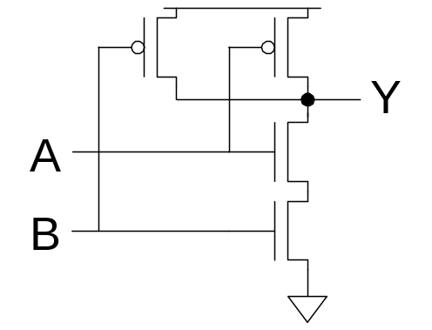
Conduction Complement
Complementary CMOS gates always produce 0 or 1
Ex: NAND gate
  Series nMOS: Y=0 when both inputs are 1
  Thus Y=1 when either input is 0
  Requires parallel pMOS
Rule of Conduction Complements
  Pull-up network is complement of pull-down
  Parallel -> series, series -> parallel
2: Circuits & Layout
Slide <number>

Slide 21
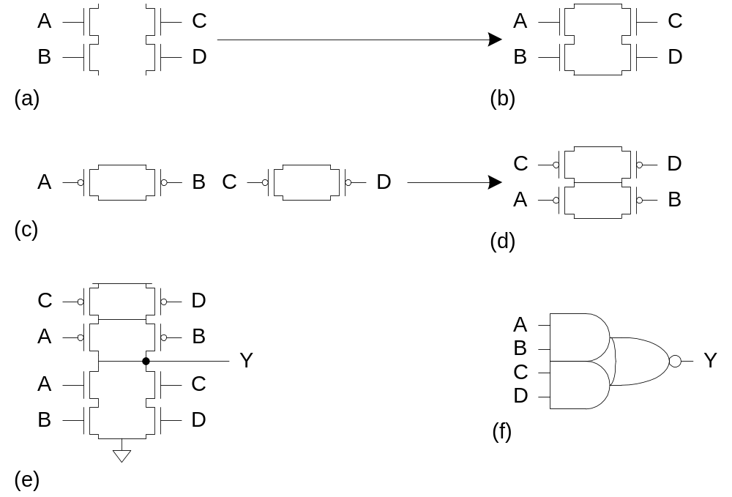
Compound Gates
Compound gates can do any inverting function
Ex:
2: Circuits & Layout
Slide <number>

Slide 22
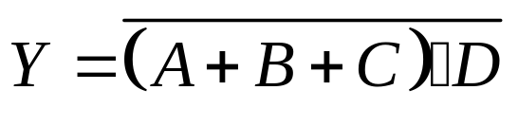
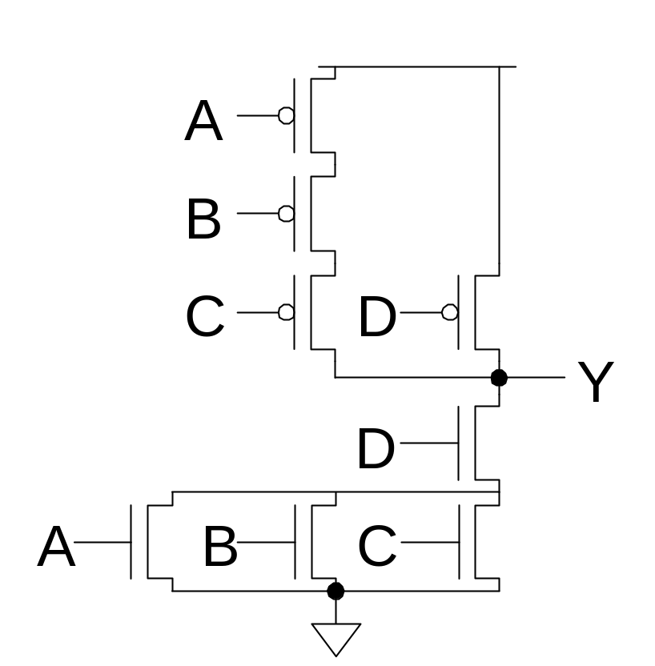
Example: O3AI
2: Circuits & Layout
Slide <number>

Slide 23
Signal Strength
Strength of signal
  How close it approximates ideal voltage source
V_{DD} and GND rails are strongest 1 and 0
nMOS pass strong 0
  But degraded or weak 1
pMOS pass strong 1
  But degraded or weak 0
Thus nMOS are best for pull-down network
2: Circuits & Layout
Slide <number>

Slide 24
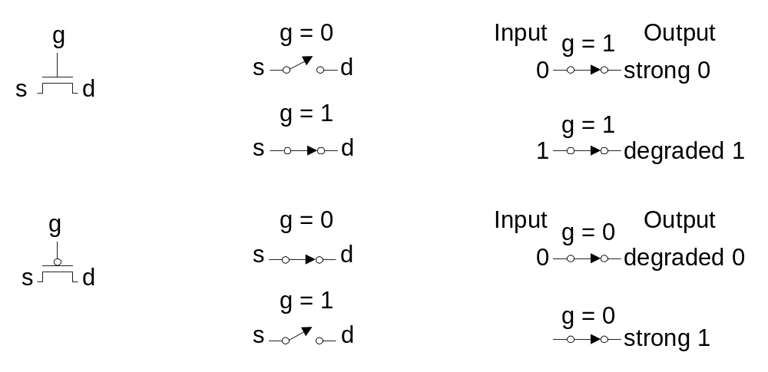
Pass Transistors
Transistors can be used as switches
2: Circuits & Layout
Slide <number>

Slide 25
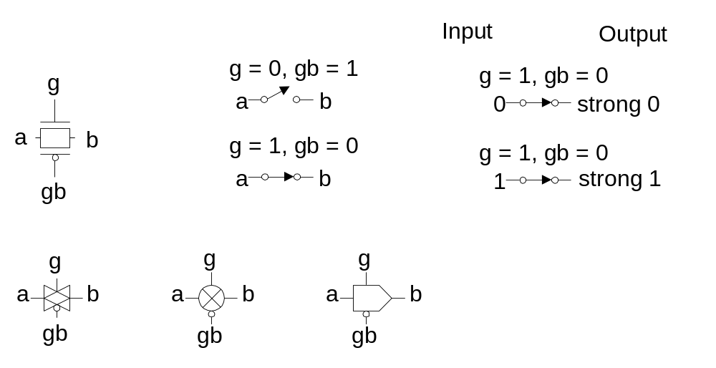
Transmission Gates
Pass transistors produce degraded outputs
Transmission gates pass both 0 and 1 well
2: Circuits & Layout
Slide <number>

Slide 26
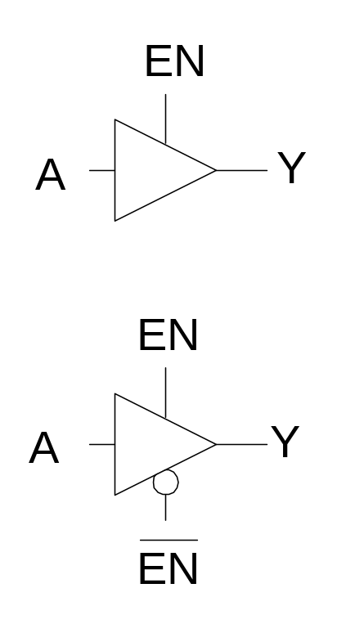
Tristates
Tristate buffer produces Z when not enabled
EN | A | Y
0 | 0
0 | 1
1 | 0
1 | 1
2: Circuits & Layout
Slide <number>

Slide 27
Tristates
Tristate buffer produces Z when not enabled
EN | A | Y
0 | 0 | Z
0 | 1 | Z
1 | 0 | 0
1 | 1 | 1
2: Circuits & Layout
Slide <number>

Slide 28
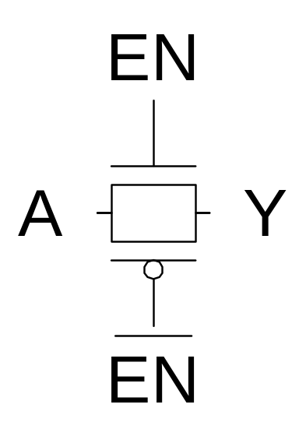
Nonrestoring Tristate
Transmission gate acts as tristate buffer
  Only two transistors
  But nonrestoring
    Noise on A is passed on to Y
2: Circuits & Layout
Slide <number>

Slide 29
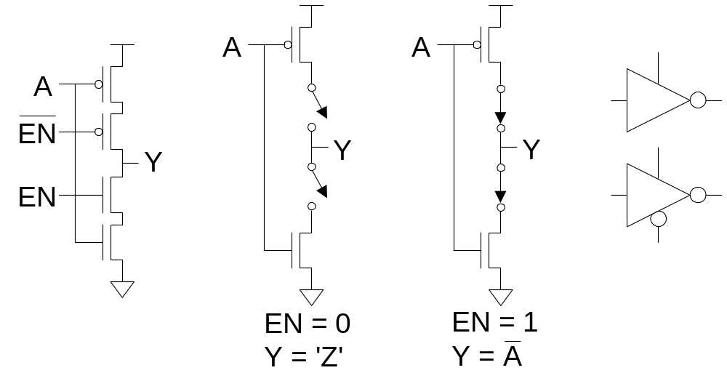
Tristate Inverter
Tristate inverter produces restored output
  Violates conduction complement rule
  Because we want a Z output
2: Circuits & Layout
Slide <number>

Slide 30
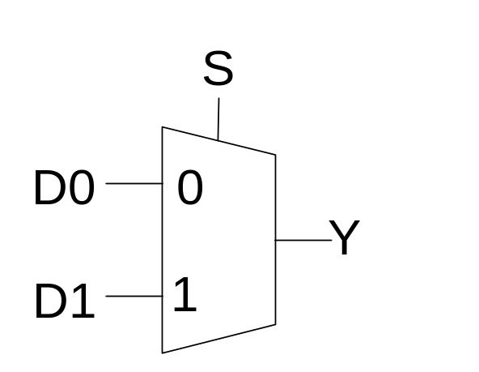
Multiplexers
2:1 multiplexer chooses between two inputs
S | D1 | D0 | Y
0 | X | 0
0 | X | 1
1 | 0 | X
1 | 1 | X
2: Circuits & Layout
Slide <number>

Slide 31
Multiplexers
2:1 multiplexer chooses between two inputs
S | D1 | D0 | Y
0 | X | 0 | 0
0 | X | 1 | 1
1 | 0 | X | 0
1 | 1 | X | 1
2: Circuits & Layout
Slide <number>

Slide 32
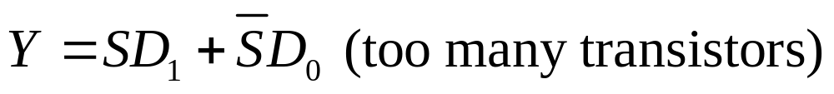
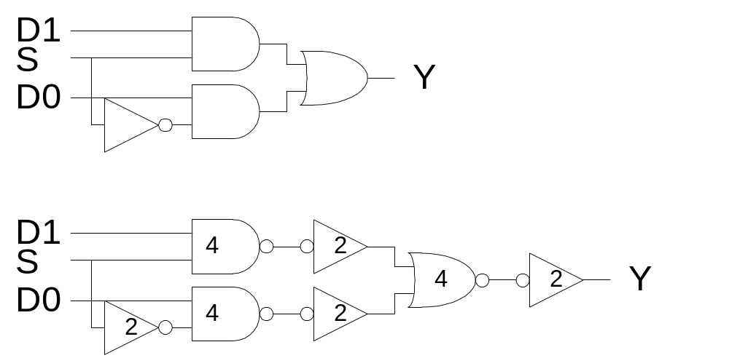
Gate-Level Mux Design
How many transistors are needed? 20
Can be further optimized to 14 transistors
2: Circuits & Layout
Slide <number>

Slide 33
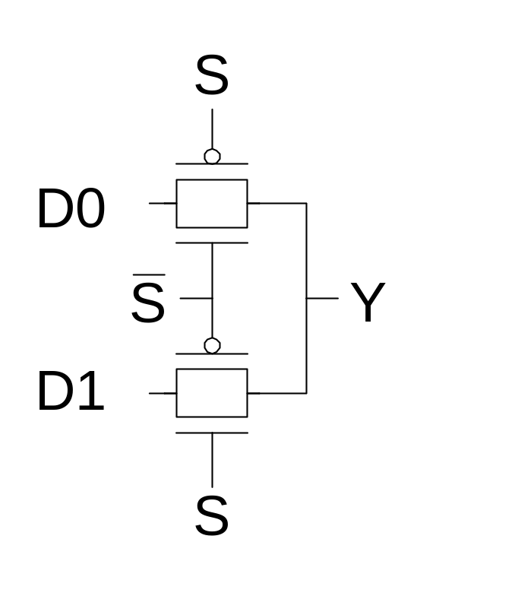
Transmission Gate Mux
Nonrestoring mux uses two transmission gates
  Only 4 transistors
2: Circuits & Layout
Slide <number>

Slide 34
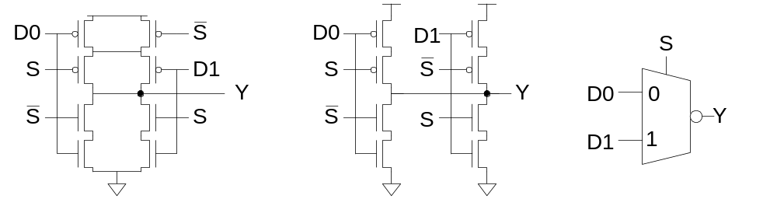
Inverting Mux
Inverting multiplexer
  Use compound AOI22
  Or pair of tristate inverters
  Essentially the same thing
Noninverting multiplexer adds an inverter
2: Circuits & Layout
Slide <number>

Slide 35
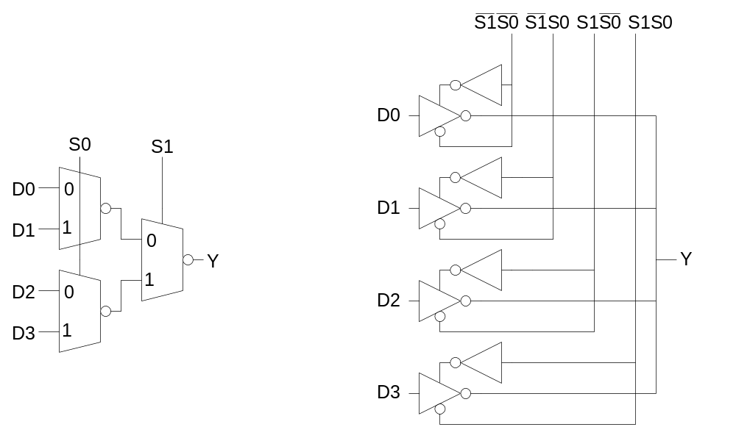
4:1 Multiplexer
4:1 mux chooses one of 4 inputs using two selects
  Two levels of 2:1 muxes
  Or four tristates
2: Circuits & Layout
Slide <number>

Slide 36
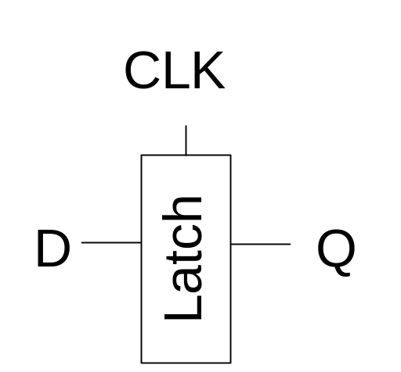
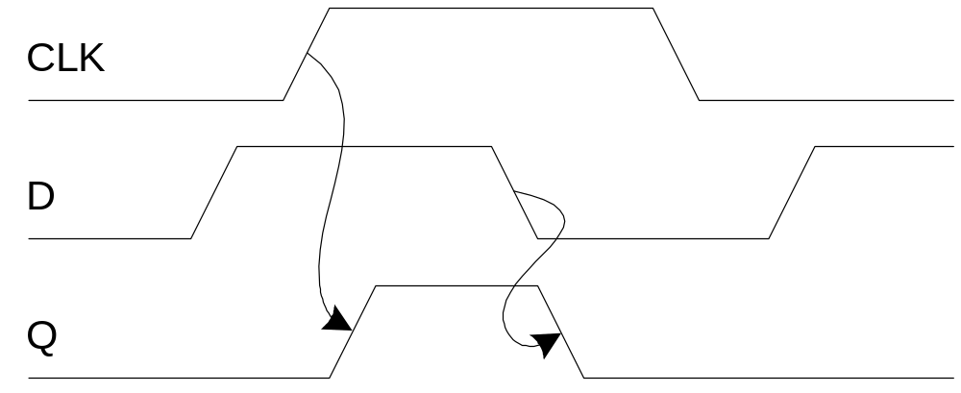
D Latch
When CLK = 1, latch is transparent
  D flows through to Q like a buffer
When CLK = 0, the latch is opaque
  Q holds its old value independent of D
a.k.a. transparent latch or level-sensitive latch
2: Circuits & Layout
Slide <number>

Slide 37
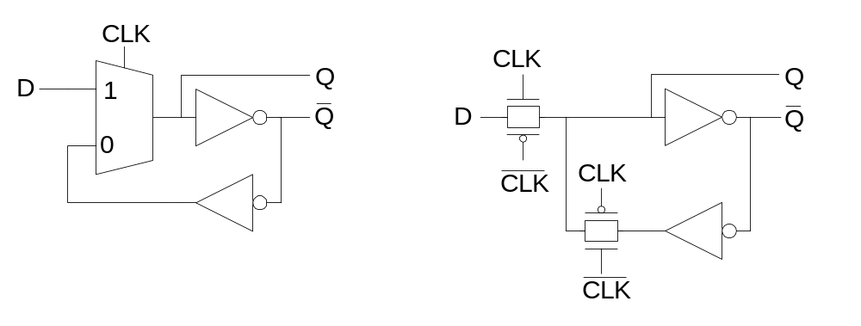
D Latch Design
Multiplexer chooses D or old Q
Design hint: always buffer latch outputs (e.g., in a shift register)
2: Circuits & Layout
Slide <number>

Slide 38
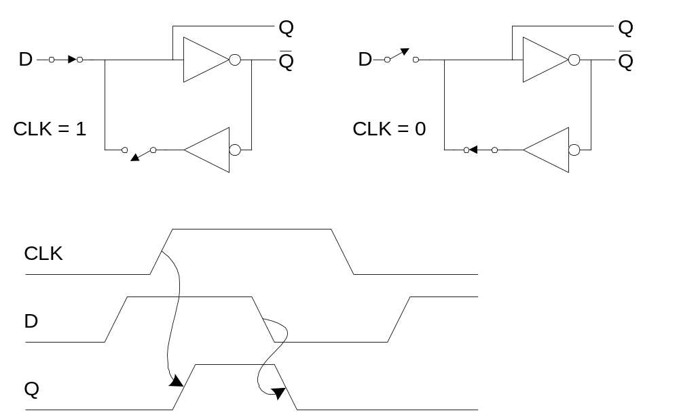
D Latch Operation
2: Circuits & Layout
Slide <number>

Slide 39
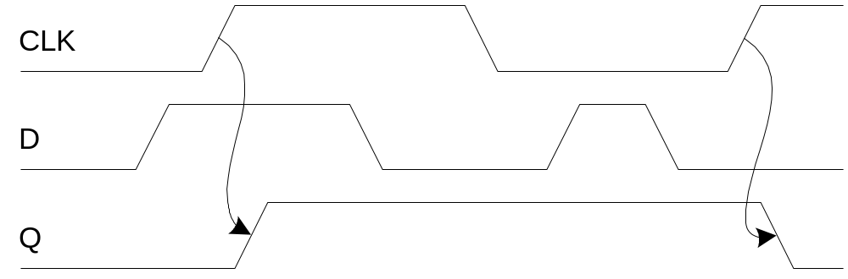
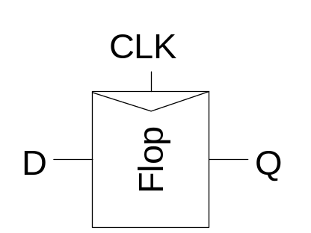
D Flip-flop
When CLK rises, D is copied to Q
At all other times, Q holds its value
a.k.a. positive edge-triggered flip-flop, master-slave flip-flop
2: Circuits & Layout
Slide <number>

Slide 40
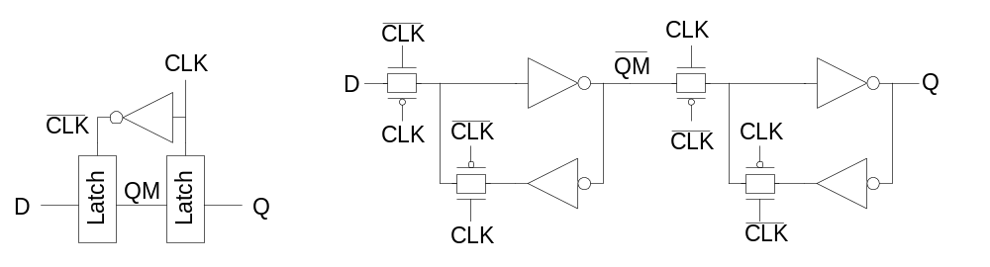
D Flip-flop Design
Built from master and slave D latches
2: Circuits & Layout
Slide <number>

Slide 41
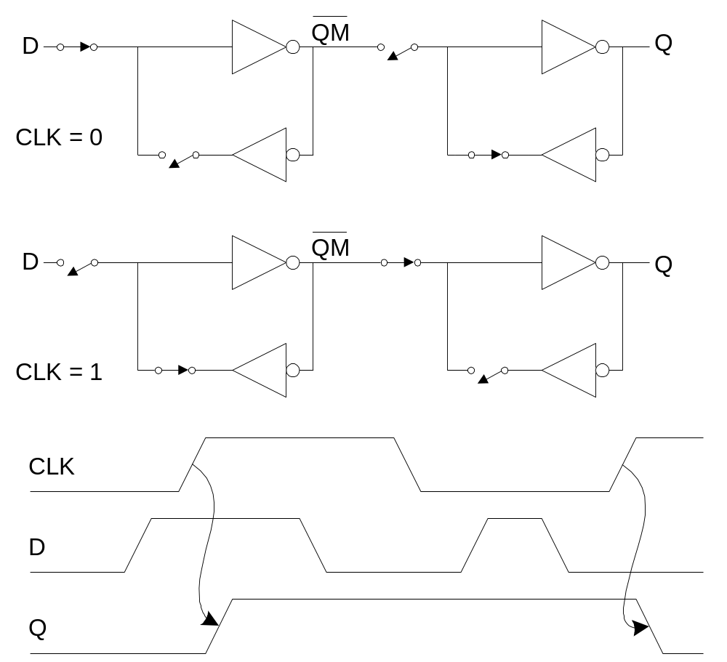
D Flip-flop Operation
2: Circuits & Layout
Slide <number>

Slide 42
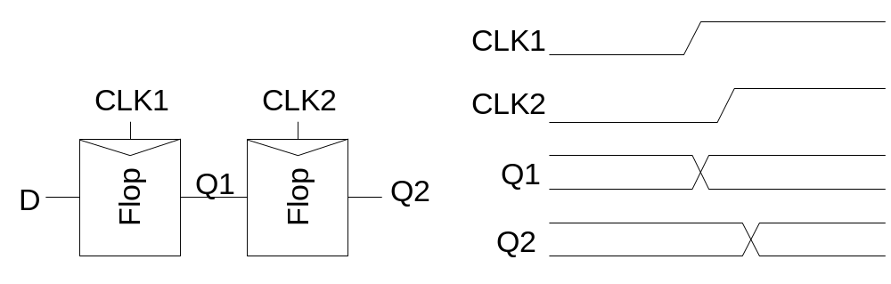
Race Condition
Back-to-back flops can malfunction from clock skew
  Second flip-flop fires late
  Sees first flip-flop change and captures its result
  Called hold-time failure or race condition
2: Circuits & Layout
Slide <number>

Slide 43
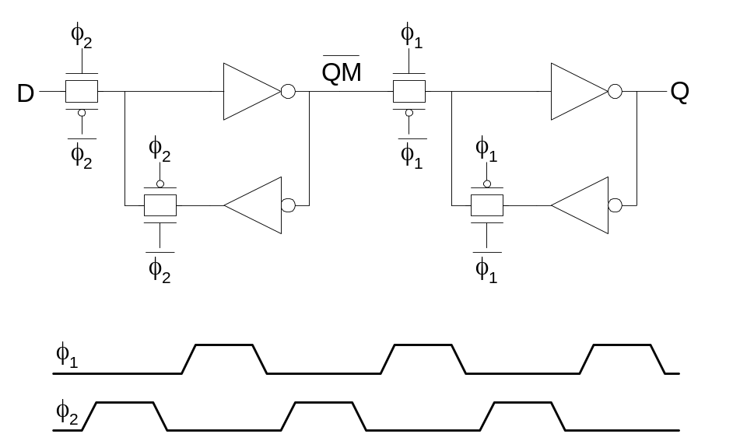
Nonoverlapping Clocks
Nonoverlapping clocks can prevent races
  As long as nonoverlap exceeds clock skew
  Allows for safer but slower design
2: Circuits & Layout
Slide <number>

