Slide 1
Physically-Based Simulation Project Plan: Position-Based Fluid
Group 8
Yufeng Xiao, Mingjie Li, Sebastian Heckers

Slide 2
Simulation Scenario
Different fluid simulations scenarios
Motivation: Use Position Based Dynamics to simulating some fluid phenomena.
Replication of the main results from the paper “Position Based Fluids”[1]
[1] M. Macklin, M. Müller (2013). Position Based Fluids. In Proceedings of the 2013 ACM Transactions on Graphics, SIGGRAPH

Slide 3
Simulation Methods
SPH (Smoothed-particle hydrodynamics)
Neighbor Search
Rigid Body Collision
Two-Way Coupling of Fluids with Clothing and Rigid Bodies

Slide 4
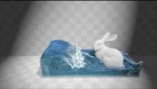
Related Work

Slide 5
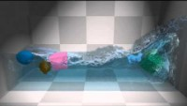
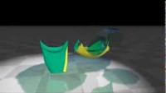
Related Work

Slide 6
Minimal Target
3D Position Based Fluid Simulation
Collision with static convex objects (spheres, cubes...)

Slide 7
Desired Target
Collision with dynamic simple objects and maybe static meshes
Properly modeled scene
Proper rendering

Slide 8
Bonus Target
Collision with sandcastle or cloth

Slide 9
Milestones
Setting up framework, extension for 3D pdf simulation (1-2 week)
Collision functions with static objects (3-4 week)
Setting up objects collision scenes and collision functions for simple dynamic objects (5-6 week)
Rendering and eventually bonus target (7-8 week)

Slide 10
Timeline
01.11.
Project Plan Presentation
29.11.
Mid-term Presentation
23.11.
Final Presentation

