Slide 1
BOD Concentration
Mingjun Ma

Slide 2
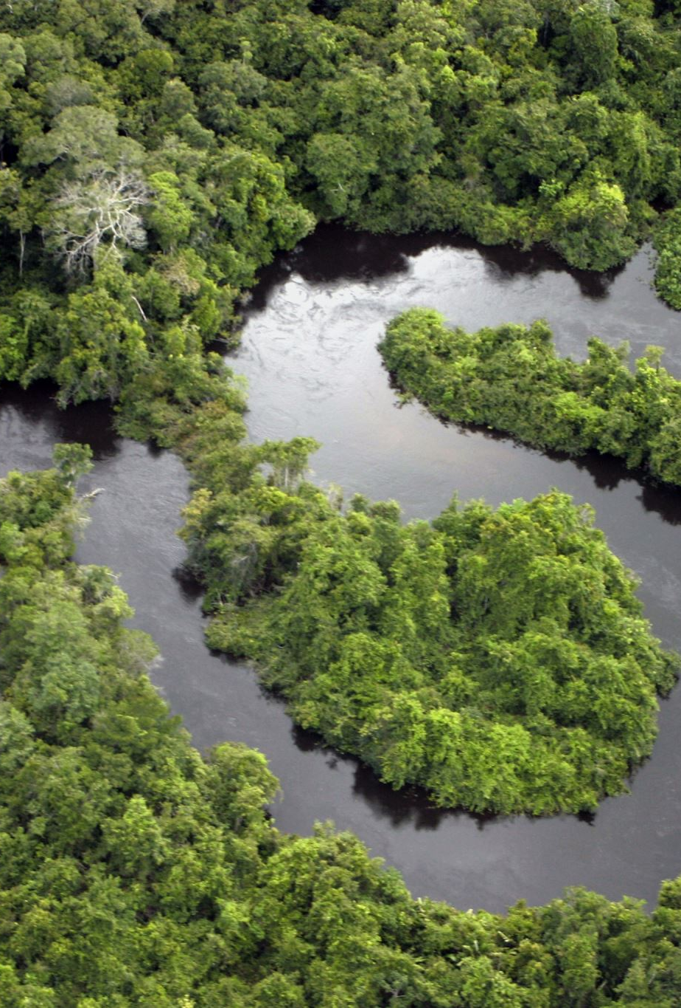
Goal
To find out the relationship between the downstream water quality to the upper stream
Does the distance from the upper stream station affect the quality of the downstream quality?

Slide 3
Dataset
Dataset from Kaggle.
There are seven 9 columns, 147 rows
Target is the output.
Target refers to the concentration of BOD in mg/L in downstream.
X1, X2, X3, X4, X5, X6, X7 are candidate inputs
BOD level in mg/L
X1 is the closest to the target, followed by X2, and X3...
X7 is the farthest station to the origin.
Source: https://www.kaggle.com/datasets/vbmokin/prediction-bod-in-river-water?select=train.csv

Slide 4
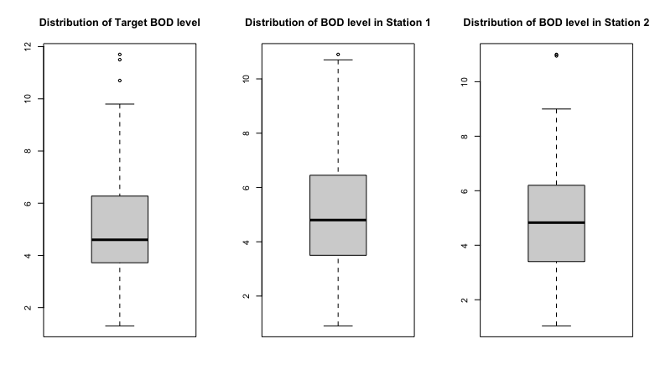
Notes:
Verma N, Singh AK. Development of biological oxygen demand biosensor for monitoring the fermentation industry effluent. ISRN Biotechnol. 2012 Nov 27;2013:236062. doi: 10.5402/2013/236062. PMID: 25969770; PMCID: PMC4403562.

Slide 5
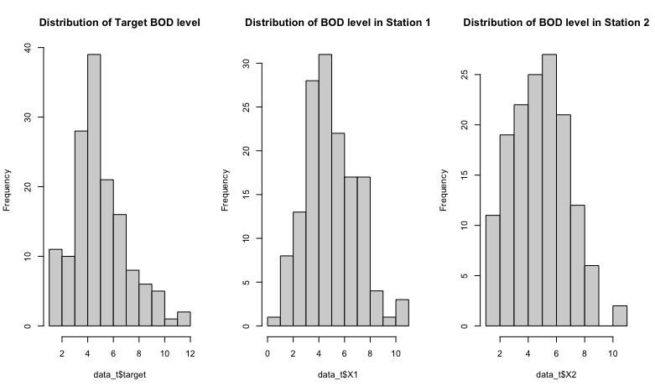

Slide 6
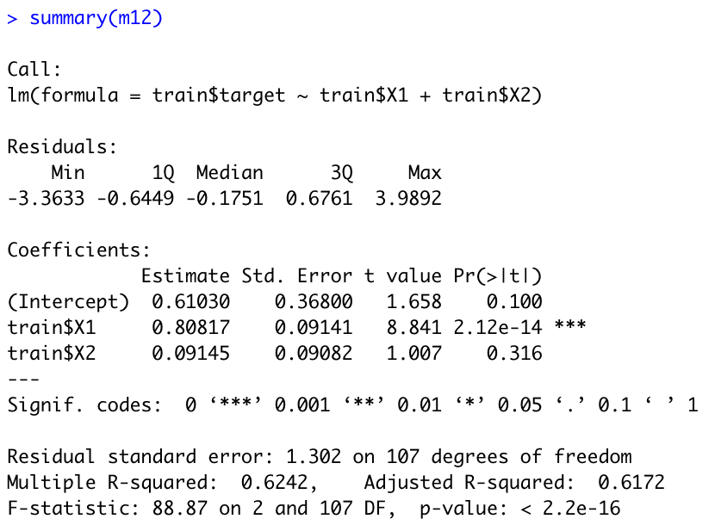
Best Model
In general, data is split into 70% for training and 30% for testing.
Selecting the linear regression model with independent variables of X1 and X2, without deleting outliers.
Training R-Squared Score is 0.624
The concentration in station 1 is affecting the target concentration.

Slide 7
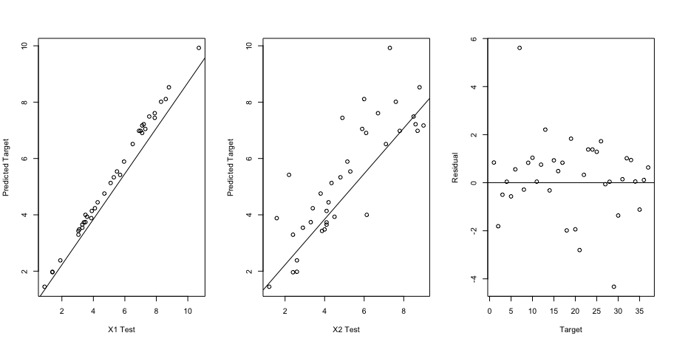
Test R-Squared Score is 0.913

Slide 8
Conclusion
The water quality of the stream close to the target stream greatly influences the water quality of the target stream
We don’t have evidence of how the water quality of the far stream from the target would affect the target.

Slide 9
Reference
1. Verma N, Singh AK. Development of biological oxygen demand biosensor for monitoring the fermentation industry effluent. ISRN Biotechnol. 2012 Nov 27;2013:236062. doi: 10.5402/2013/236062. PMID: 25969770; PMCID: PMC4403562.
2. Zach. (2022, April 12). How to split data into training & test sets in R (3 methods). Statology. Retrieved from https://www.statology.org/train-test-split-r/
3. Mokin, V. (2019, November 16). Prediction bod in river water. Kaggle. Retrieved from https://www.kaggle.com/datasets/vbmokin/prediction-bod-in-river-water?select=train.csv

