Slide 1


Psychological Data Analysis
Mingjun Ma

Slide 2
Objective
Visualize the data distribution of different psychological indications.
Predicting Psychological Indicator by Machine Learning Algorithms

Slide 3
Introduction
Symptom/Indicator includes: ﻿
Symptoms of Anxiety Disorder
Symptoms of Depression Disorder
﻿Symptoms of Anxiety Disorder or Depressive Disorder
Affected by time period, Phase, and Confidence Interval Values.
Grouped by Nation, State, Sex, Education Level

Slide 4
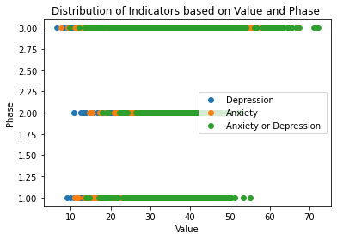
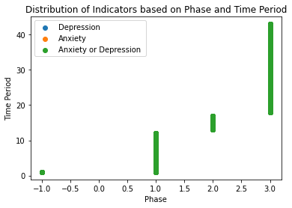
General Data Distribution

Slide 5
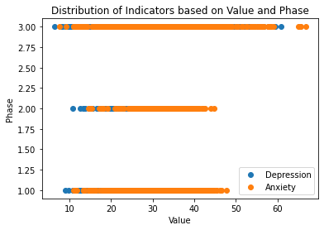
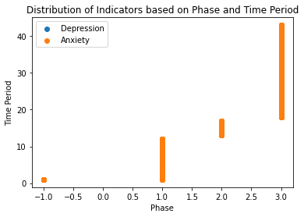
General Data Distribution Without Symptom of Anxiety or Depression

Slide 6
Observation
Points are clustered and overlapped together.
Symptom of Anxiety and Symptom of Depression are not independent to each other.
Notes:
Naïve Bayer’s Classifiers can not be applied.

Slide 7
Result With One Classifiers: Phase and Time Period
Algorithm | Classifier | accuracy
kNN (k = 11) | Time Period | 33.81%
kNN (k = 3) | Phase | 33.09%
Logistic Regression | Phase | 32.88%
Logistic Regression | Time Period | 32.98%
QDA | Phase | 32.88%
QDA | Time Period | 32.73%

Slide 8
Result With Two Classifiers: Phase and Time Period
Algorithm | accuracy
kNN (k = 11) | 33.71%
Logistic Regression | 32.76%
QDA | 32.49%

Slide 9
Conclusion and Next Step
Depression and Anxiety is hard to decide based on time duration and Phase.
kNN has a relatively higher accuracy on predicting clustered dataset.
Next Step:
trying to clean some data by ignoring null values from Value on Confidence Level and then do another test by kNN.

Slide 10
Reference
Publisher Centers for Disease Control and Prevention. (2022, April 21). Indicators of anxiety or depression based on reported frequency of symptoms during last 7 days. Indicators of Anxiety or Depression Based on Reported Frequency of Symptoms During Last 7 Days - CKAN. Retrieved March 15, 2022, from https://catalog.data.gov/dataset/indicators-of-anxiety-or-depression-based-on-reported-frequency-of-symptoms-during-last-7-

