Slide 1
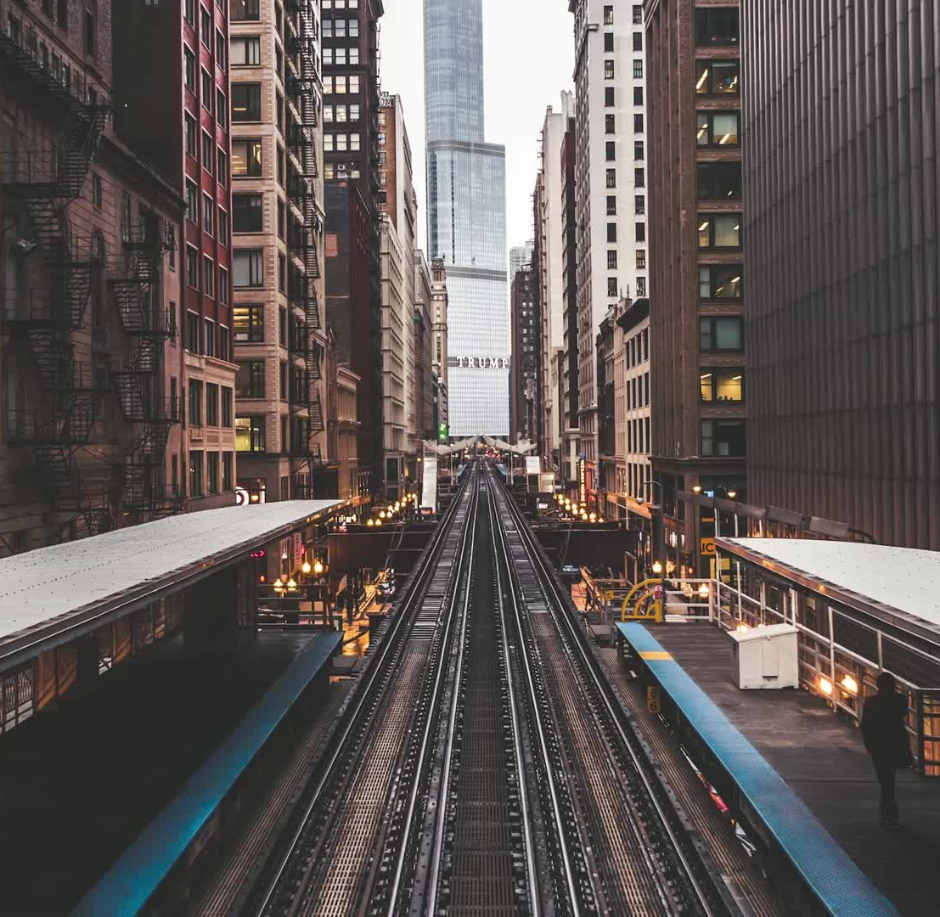
Railroad Delays Around NJ/NYC Area
Mingjun Ma

Slide 2
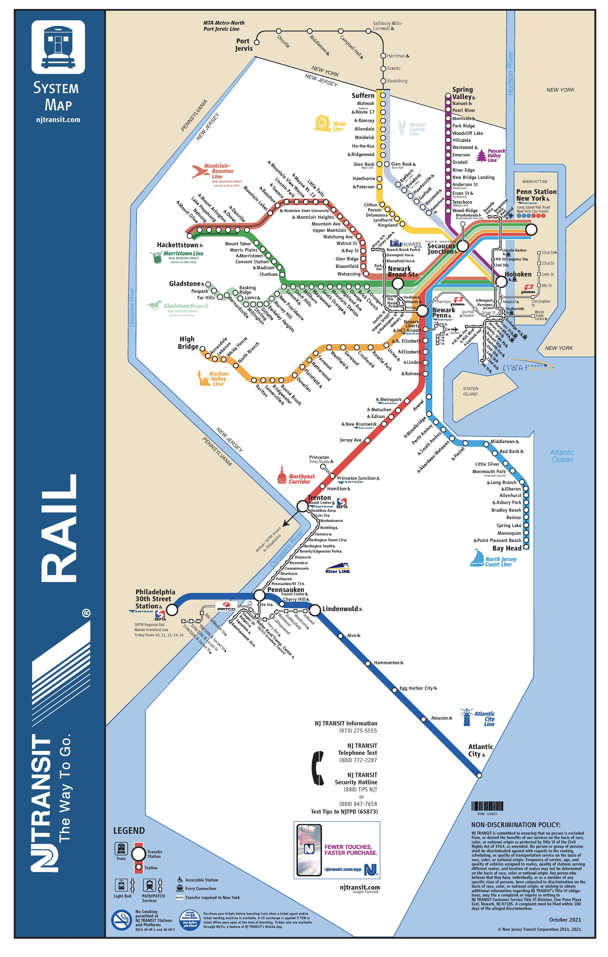
Objectives
Which line has the most delays?
Which line has the most severe delay?
Learning which hours of the day are most likely to make delays.
Notes:
https://transitprd-content.s3.amazonaws.com/public/NJ%20TRANSIT%20Rail%20System%20Map%20%E2%80%93%20October%202021.pdf

Slide 3
Background
Table 1. Distribution of Commuting Origin [3]
Table 2. Distribution of Commuting Ways [3]
Commuting From | Percentage
New Jersey | 42%
Long Island, NY | 31%
Lower-Hudson Valley, NY | 18%
Connecticut | 5%
Mid-Hudson Valley | 3%
Commuting Way | Percentage
Car | 38%
Rail | 32%
Bus | 17%
Subway/Path | 11%
Ferry | 2%
Notes:
https://www.nj.com/opinion/2021/11/new-jersey-commuters-driving-into-manhattan-are-only-part-of-the-problem-opinion.html

Slide 4
Assumptions
The dataset includes the delay information from NJ Transit and Amtrak trains. Because the delay data from Amtrak is not included from the dataset, the assumption is made that Amtrak trains are not included for the research
Based on personal perspective, the train delaying 5 minutes or greater are considered during research Minor delays.
The dataset for February 2020 is selected because the it is the latest month of pre-pandemic.

Slide 5
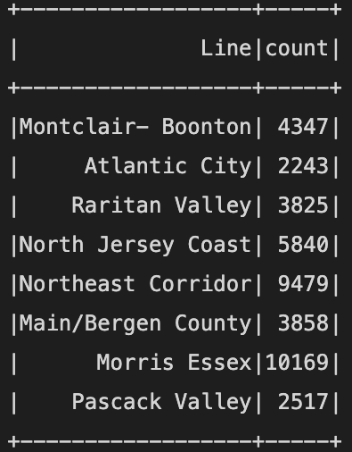
Result
Northeast Corridor and North Jersey Coast Lines are counted as Northeast Corridor, and there are 15,319 delay train.
Morris Essex, and Northeast Corridor are making the most severe delays.
Grouping by Hours of a day, the train at the hour of 6PM are making the most delays followed by the hours of 7PM and 5PM. The PM rush hours are making the most severe delays.
Montclair-Boonton, North Jersey Coast, Northeast Corridor are making the most extreme 50 delays.
Table 3. Total Number of Severe Delays Group By Line

Slide 6
Discussion
The dash lines on North Jersey Coast Line and North Boonton refer to non-electrified railroad. Diesel trains are serving the dash-section [2]
An electrified train travelling from Jersey City and New York City can not serve into the dash line.
The termination of trains and the transfer between trains are involved at Long Beach station from North Jersey Coast Line and Montclair State University station from Montclair-Boonton Line.

Slide 7
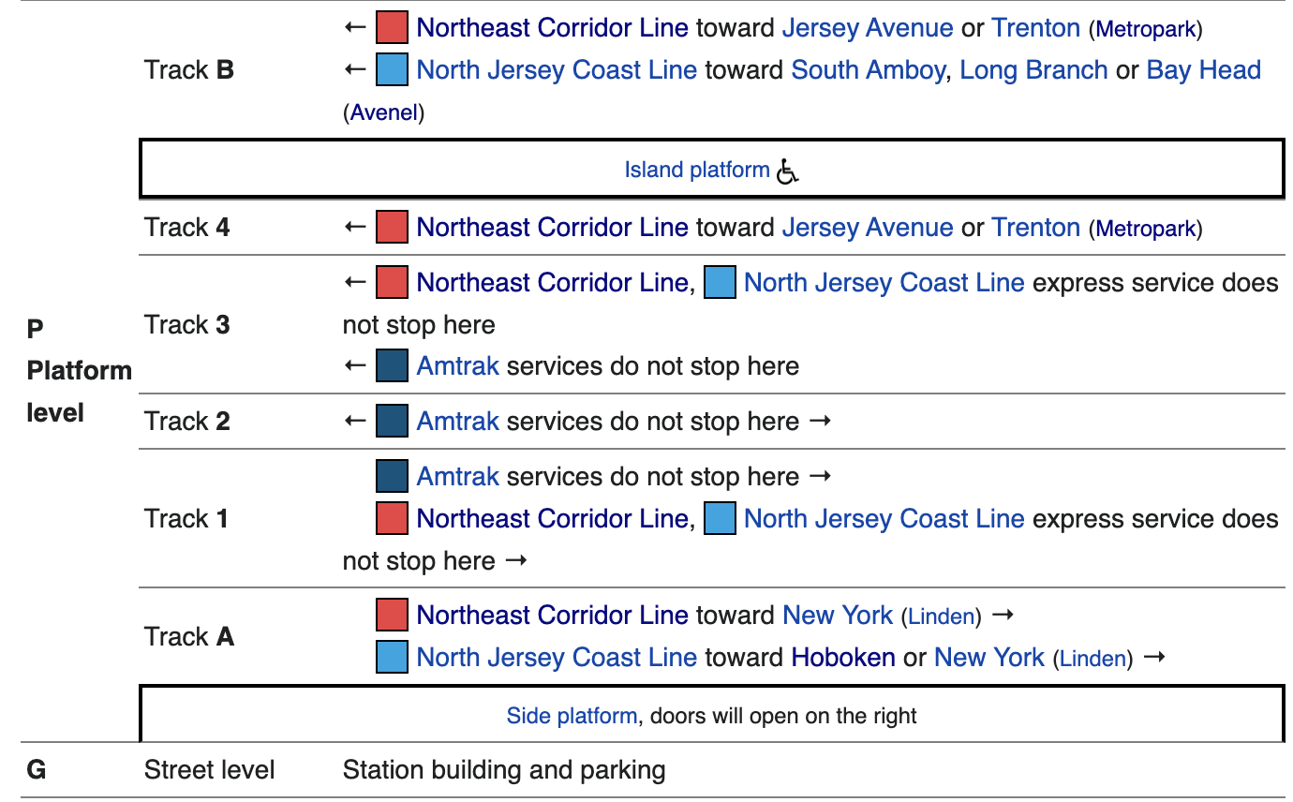
Discussion
Rahway Station in New Jersey is the join/split station between NE Corridor and North Jersey Coast Line of NJ Transit [4].
The join and split can be one of the primary reasons of delays between two lines.
In addition, many Amtrak trains stop at Metropark station in New Jersey that has only one platform from in each direction at outer track, and the central tracks have no platforms, which is based on my observation while taking the train.
Metropark station is one of the busiest stations [5]. Almost every NJ transit trains need to queue for the Amtrak trains while approach Metropark, which can cause great delays.
Figure 1. Track Map of Rahway Station [4]
Notes:
https://en.wikipedia.org/wiki/Rahway_station
https://en.wikipedia.org/wiki/Metropark_station

Slide 8
Conclusion
Morris Essex, and Northeast Corridor Lines are making the most severe delays, as well as the highest likely to make severe delays
The PM rush hours from 5 to 7PM are the most likely time to make delays

Slide 9
Reference
1. Badami, P. (2020, May 19). NJ Transit + Amtrak (NEC) rail performance. Kaggle. Retrieved July 26, 2022, from https://www.kaggle.com/datasets/pranavbadami/nj-transitamtrak-nec-performance
2. n.d.. (n.d.). System maps. NJ TRANSIT. Retrieved July 30, 2022, from https://transitprd-content.s3.amazonaws.com/public/NJ%20TRANSIT%20Rail%20System%20Map%20%E2%80%93%20October%202021.pdf
3. Columnist, S.-L. G. (2021, November 1). New Jersey commuters driving into Manhattan are only part of the problem: Opinion. nj. Retrieved August 8, 2022, from https://www.nj.com/opinion/2021/11/new-jersey-commuters-driving-into-manhattan-are-only-part-of-the-problem-opinion.html
4. Wikimedia Foundation. (2022, June 9). Rahway station. Wikipedia. Retrieved August 9, 2022, from https://en.wikipedia.org/wiki/Rahway_station
5. Wikimedia Foundation. (2022, July 22). Metropark station. Wikipedia. Retrieved August 9, 2022, from https://en.wikipedia.org/wiki/Metropark_station

