Slide 1

Sentiment Analysis on Flight Complains’ Tweet
Mingjuin Ma

Slide 2
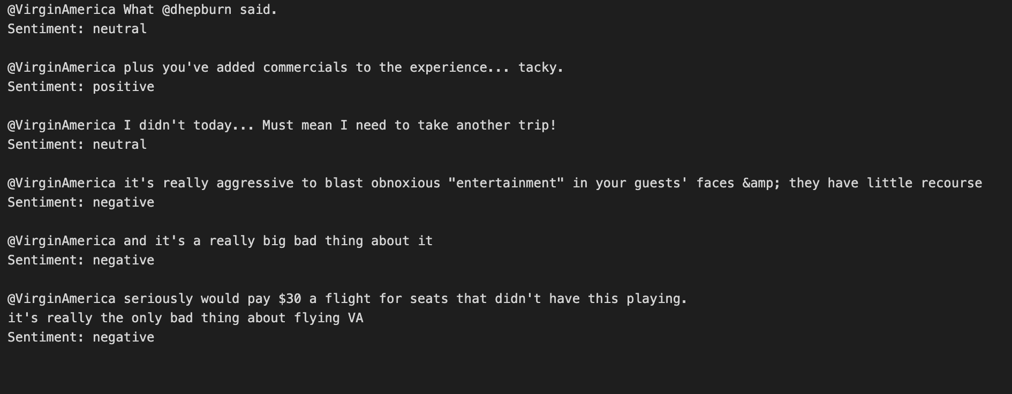

Slide 3
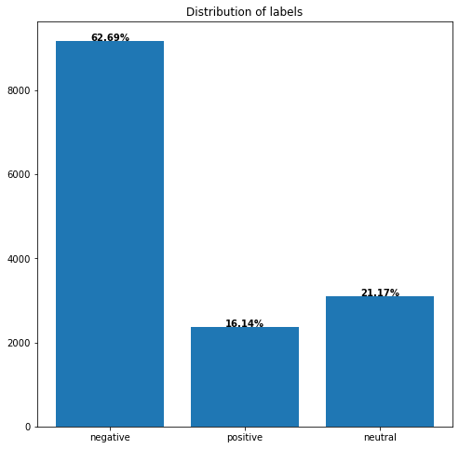
Before Bert Model and Sampling
Removing Punctuations and Emojis.
Stemming words
Sampling classes
Negative: 63%, Non-negative: 37%
Solution: Sampling Negative Class by 70%
Negative: 55%, Non-negative: 45%

Slide 4
Bert Model
Input: Input Id, and Attention Mask
Output: classification
Processing: Bert Model
Activation Function: Sigmoid
Number of Epochs = 1
Hidden Layer = 64
Number of Batches = 128

Slide 5
Evaluation
Accuracy = 57%， F-1 = 73%
TP = 340, FP = 255, TN = 0, FN = 0
Issue: Imbalanced classification
Next Step:
Trying different activation functions and adding one more hidden layer

Slide 6
Source
Eight, F. (2019, October 16). Twitter us airline sentiment. Kaggle. Retrieved April 16, 2023, from https://www.kaggle.com/datasets/crowdflower/twitter-airline-sentiment
Rohith, M. S. (2022, September 7). Fake news detection using Bert Model Python. Medium. Retrieved May 2, 2023, from https://pub.towardsai.net/fake-news-detection-using-bert-model-python-de005c5809ed
GeeksforGeeks. (2021, July 4). Display percentage above bar chart in Matplotlib. GeeksforGeeks. Retrieved April 25, 2023, from https://www.geeksforgeeks.org/display-percentage-above-bar-chart-in-matplotlib/
How to remove emoji from the text in Python. Educative. (n.d.). Retrieved May 1, 2023, from https://www.educative.io/answers/how-to-remove-emoji-from-the-text-in-python

