Slide 1
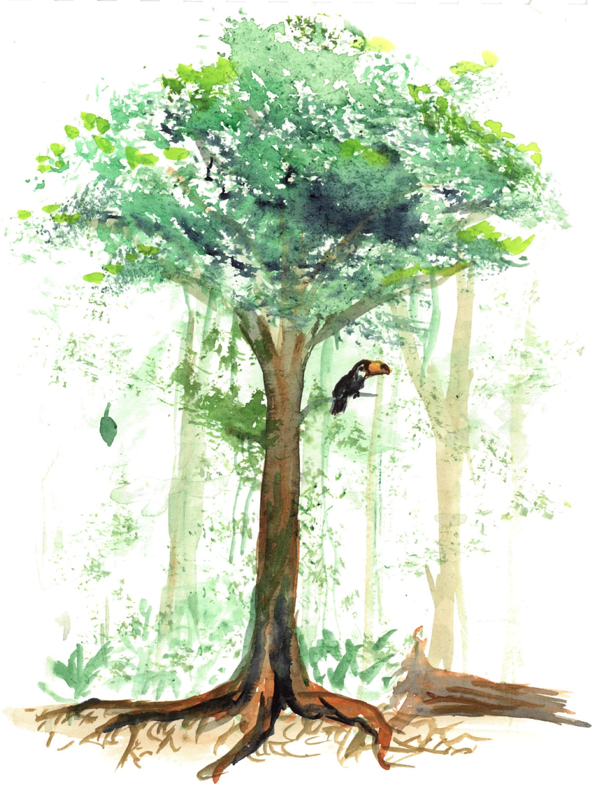

GPP
31.6 ± 6.7 (38/18/13)
NEE
-1.9 ± 2.3 (37/11/11)
legend
mean ± std
(n records/ n plots/ n areas )
R_{eco}
28.3 ± 8.2 (29/11/10)
R_{auto_ag}
R_{a}
21.2 ± 4.1 (9/8/5)
NPP
8.7 ± 3.7 (50/32/13)
ANPP_{folivory}
0.4 ± 0.3 (10/8/5)
R_{het}
ANPP
5.0 ± 2.4 (57/31/13)
foliage biomass
4.2 ± 1.3
(18/14/5)
ANPP_{repro}
aboveground biomass
133.9 ± 50.8
(203/118/42)
ANPP_{woody}
ANPP_{stem}
2.8 ± 1.0 (141/137/40)
R_{ag-het}
BNPP
3.1 ± 1.9 (34/30/12)
R_{root}
woody ag biomass
4.2 ± 1.3
(18/14/5)
ANPP_{foliage}
3.0 ± 1.2 (43/38/18)
R_{cwd}
total biomass
166 ± 14
(37/13/7)
ANPP_{branch}
standing dead wood
R_{soil-het}
7.5 ± 3.4 (18/16/9)
BNPP_{coarse}
0.4 ± 0.2 (29/27/10)
woody mortality
dead wood
17.6 ± 12.7 (9/9/5)
BNPP_{fine}
2.6 ± 1.7 (34/30/13)
ANPP_{litterfall}
3.6 ± 1.5 (17/16/10)
R_{soil}
13.5 ± 3.7 (24/19/12)
down dead wood
root biomass
26.5 ± 15.6
(39/22/12)
organic layer
6.8 ± 8.0 (3/3/3)
coarse root biomass
fine root biomass
8.5 ± 12.2 (11/8/8)

Slide 2
GPP
31.6 ± 6.7 (38/18/13)
NEE
-1.9 ± 2.3 (37/11/11)
legend
mean ± std
(n records/ n plots/ n areas )
R_{eco}
28.3 ± 8.2 (29/11/10)
R_{auto_ag}
R_{a}
21.2 ± 4.1 (9/8/5)
NPP
8.7 ± 3.7 (50/32/13)
R_{het}
ANPP
5.0 ± 2.4 (57/31/13)
foliage biomass
4.2 ± 1.3
(18/14/5)
ANPP_{folivory}
0.4 ± 0.3 (10/8/5)
ANPP_{repro}
aboveground biomass
133.9 ± 50.8
(203/118/42)
ANPP_{woody}
ANPP_{stem}
2.8 ± 1.0 (141/137/40)
R_{ag-het}
BNPP
3.1 ± 1.9 (34/30/12)
R_{root}
woody ag biomass
4.2 ± 1.3
(18/14/5)
ANPP_{foliage}
3.0 ± 1.2 (43/38/18)
R_{cwd}
total biomass
166 ± 14
(37/13/7)
ANPP_{branch}
standing dead wood
R_{soil-het}
7.5 ± 3.4 (18/16/9)
BNPP_{coarse}
0.4 ± 0.2 (29/27/10)
woody mortality
dead wood
17.6 ± 12.7 (9/9/5)
BNPP_{fine}
2.6 ± 1.7 (34/30/13)
ANPP_{litterfall}
3.6 ± 1.5 (17/16/10)
R_{soil}
13.5 ± 3.7 (24/19/12)
down dead wood
root biomass
26.5 ± 15.6
(39/22/12)
organic layer
6.8 ± 8.0 (3/3/3)
coarse root biomass
fine root biomass
8.5 ± 12.2 (11/8/8)

Slide 3
GPP
31.6 ± 6.7 (38/18/13)
NEE
-1.9 ± 2.3 (37/11/11)
R_{eco}
28.3 ± 8.2 (29/11/10)
legend
mean ± std
(n records/ n plots/ n areas )
R_{auto_ag}
R_{a}
21.2 ± 4.1 (9/8/5)
foliage biomass
4.2 ± 1.3
(18/14/5)
NPP
8.7 ± 3.7 (50/32/13)
∆AGB
aboveground biomass
133.9 ± 50.8
(203/118/42)
ANPP
5.0 ± 2.4 (57/31/13)
ANPP_{folivory}
0.4 ± 0.3 (10/8/5)
ANPP_{repro}
woody ag biomass
4.2 ± 1.3
(18/14/5)
total biomass
166 ± 14
(37/13/7)
ANPP_{woody}
BNPP
3.1 ± 1.9 (34/30/12)
ANPP_{stem}
2.8 ± 1.0 (141/137/40)
standing dead wood
Rroot
dead wood
17.6 ± 12.7 (9/9/5)
ANPP_{foliage}
3.0 ± 1.2 (43/38/18)
ANPP_{branch}
R_{soil-het}
7.5 ± 3.4 (18/16/9)
down dead wood
BNPP_{coarse}
0.4 ± 0.2 (29/27/10)
woody mortality
organic layer
6.8 ± 8.0 (3/3/3)
BNPP_{fine}
2.6 ± 1.7 (34/30/13)
ANPP_{litterfall}
3.6 ± 1.5 (17/16/10)
fine root biomass
8.5 ± 12.2 (11/8/8)
R_{soil}
13.5 ± 3.7 (24/19/12)
root biomass
26.5 ± 15.6
(39/22/12)
coarse root biomass

