Slide 1
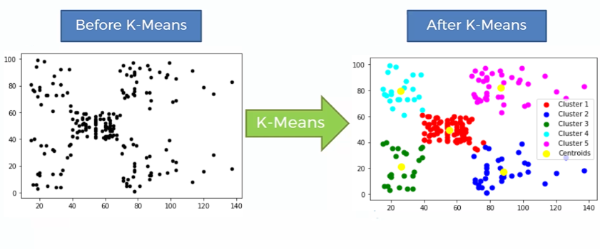
Analytics Toolkit: What is the K-Means Clustering Algorithm?
What is K-Means?
It’s a clustering algorithm
Unsupervised Algorithm → Data is not labeled
Computes the “closest setup” for k Centroids to each point clustered with that Centroid, resulting in k clusters
*Graphic Source: https://ai.plainenglish.io/what-is-k-means-clustering-3060791cb589

Slide 2
How does K-Means work?
Inputs
Process
Output
Number of Clusters
Data
1. Assign, often randomly, starting locations of Centroids
Split into
Clusters
Initialized Starting Centroids
2. Choose each data point and measure its distance from each Centroid
5. Repeat until the Centroids’ locations do not change. If they do not change, the algorithm finishes
Characteristics of Clusters:
Not necessarily of the same size
Do not overlap
Data
3. Assign each data point to the “closest” Centroid
4. Move all Centroids equal to the average of the points, basically the “center”

Slide 3
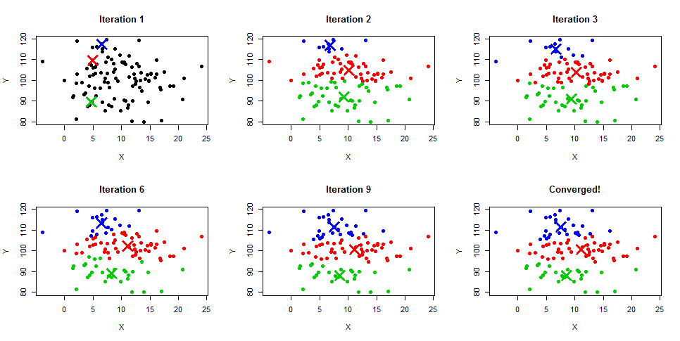
How does K-Means work? - Illustration
2-3
2-3, repeated
1
4-5
2-3, repeated
2-3, repeated
Note: No movement in Centroids
4-5,
repeated
4-5,
repeated
*Graphic Source: https://stackoverflow.com/questions/60312401/when-using-the-k-means-clustering-algorithm-is-it-possible-to-have-a-set-of-dat

Slide 4
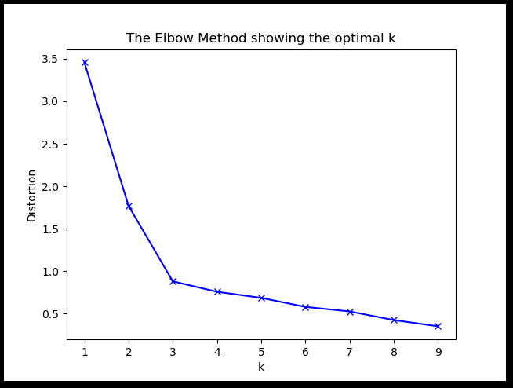
The Elbow Method, a Heuristic
How many clusters should I be choosing?
Run K-Means as many times as you deem appropriate.
Note that more clusters leads to a longer run time. When you are calculating distances for each point from each centroid, you a performing n x k calculations.
K-Means packages should be able to generate the distortion (aka SSE) of each model (for k=1,2,3…)
Sum of square distances from each point to its respective Centroid
Graph the distortion of each model versus the number of clusters for each model (k)
Note that, intuitively, as k increases, the distortion would always at least decrease.
Think of what happens when n=k
Choose the model that has the “elbow”, when there is no more significant improvement
*Graphic Source: https://www.geeksforgeeks.org/elbow-method-for-optimal-value-of-k-in-kmeans/

Slide 5
Pros and Cons with the Model
Pros:
Fast compared to other Clustering algorithms → can handle more data
K-nearest neighbors
Etc…..
Intuitively simple to understand
Great “get started” algorithm
Cons:
You’re stuck with a visual (elbow method), way to determine the number of clusters, k
Outliers impact your model a lot (SSE & K-Means distancing)
May need to manually remove them or set an “outer bound”
Does not handle high dimensions well
See: “Curse of dimensionality”
Base algorithm requires some manipulation/analysis after it finishes
May lead to local maxima
It’s not magic

Slide 6
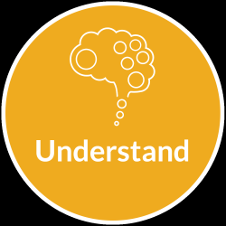
It’s not Magic!
Q: Can I just download sklearn, “plug and play”, and get good results?
A: NO
Caveats and ways to address them:
Some k-means packages do automatically standardize your values for you (normalize, indexing, etc) but not all do
Sklearn does not unless you preprocess
Why is this an issue? Large unit values will impact clustering. (ex: having a dimension in inches will make have a larger effect on clustering than in feet)
Maybe I do want some observations to be weighted more than others. How do I do this?
Weighted K-Means → Have to dive into features in Kmeans packages
Some points will be “weighed” more than others
Common example is setting up Starbucks locations in a state. Cities with larger populations get weighted more
Maybe I want some dimensions to be weighted more than others. How do I do this?
After standardization, you can weigh these dimensions more
By how much... → ???????

Slide 7
Example Time
Business Case:
For poular articles (let’s say 500k page views or more) for May 2021, which articles are more impacted by Super Users, which by Casuals, etc?
Step 1:
Imagine what the data should look like going into the Kmeans algorithm. Then, write the SQL query for it. Make sure to test query to ensure it’s functioning correctly
Step 2:
Load data into Python or statistical software. Run K-Means function/package of your choice.
Step 3:
Show results! Take output and visualize/explain as you please

Slide 8
Example Output... …It’s Magic!
Articles in May 2021 on the Fox News mobile app come in 4 flavors:
Articles where traffic is almost completely driven by Super Users and Involved Users but much more by Super users
Cluster 3 in example
73 articles, averaging 642k PVs/article
Articles where traffic is almost completely drive by Super Users and Involved Users by similar amounts
Cluster 2 in example
73 articles, averaging 845k PVs/article
Articles where traffic is driven a bit by Casual Users along with the Involved Users and Super Users
Cluster 0 in example
20 articles, averaging 750k PVs/article
Articles where traffic is predominantly driven by Casual and Involved Users
Cluster 1 in example
6 articles, averaging 846k PVs/article

Slide 9
The Future…
Upgrade K-Means function for something that is more “plug and play”
New Features:
Include fillna(0)
“Auto Elbow Method”
Auto Standardization Option
Spits out another output that includes range of each cluster/other stats
New Topics
Linear Regression?

