Slide 1



SpeechQoE: A Novel Personalized QoE Assessment Model for Voice Services via Speech Sensing
Chaowei Wang, Huadi Zhu, Ming Li
MobiSec Lab
The University of Texas at Arlington
Notes:
Good afternoon, everyone, my name is …, Today I am going to present our work, SpeechQoE…

Slide 2











Motivation
Millions of people using voice services
It is important for network/service providers to get in-depth understanding of user experience
Recorded usage surges during pandemic
Notes:
(C) Since online voice services was introduced in 1995, millions of people make millions of calls everyday.
(C) Especially, during the pandemic, shelter-in-place, work-from-home, and other hybrid lifestyles have been adopted globally. Many of the telecommunication apps have been reported with recorded surges, ranging from the usage time to the number of registered customers.
(C) Therefore, user’s satisfactory levels of service quality is always the center of interest for service providers.

Slide 3


Motivation
It is important for network/service providers to get in-depth understanding of user experience
Protocol design
Codec development
Resource management
……
Quality of Experience (QoE)
QoE reflects the actual user experience in voice services
Difficult to derive accurate and convenient QoE assessment
Notes:
so that they can take actions in service management, such as protocol design, codec development, resources management so on and so forth..
(C) One critical metric is quality of experience, or QoE in short, which is a measure about how users subjectively perceive an application or service.
(C) On the one hand, QoE reflects the actual user experience..
(C) On the other hand, however, it is difficult to measure QoE accurately and conveniently from external indicators.
(C) How to access QoE accordingly is an open question.

Slide 4
Related Work
Subjective-based solutions: Manual reports and surveys
– time consuming and inconvenient
Objective-based solutions
Network parametric models
Speech quality-based models
E-model
PESQ
Incomplete, Uniform
Inapplicable, Uniform
GAP-model
P.563
Personalized, accurate, human-labor free!
Artificial Neural Network
Vector Quantization
Psychophysiolgy-based models.
EEG
Impractical
ECG
EDA
Notes:
(C) In nowadays audio services, user’s QoE is mainly obtained by asking people to manually report their perceived quality or through surveys after an audio session.
(C) Such procedures are time-consuming and inconvenient, so in reality, most people would simply skip this procedure.
(C) To address this issue, prior efforts have been devoted to developing objective-based QoE assessment schemes. These schemes can be divided into three categories.
(C) Network parametric models leverage network QoS to infer QoE, one of the representative is E-model (C) defined by International Telecommunication Union.
(C) However, QoE is a human subjective perception. The network parametric models cannot exhaust all factors have an impact on QoE. Furthermore, network parametric models fail to consider user diversity. For example, some users may be more sensitive to echoing sound, while others care more about latency. A one for all model inevitably performs poorly.
(C) Speech quality-based models estimate QoE by analyzing speech quality. They can be classified as full-reference and reference-free models. In full-reference models, both the original and degraded speech files are required. The distortion is converted to a QoE score. PESQ is the representative (C). Reference-free models, such as P.563 and Vector Quantization (C) directly extract distortion from degraded speech files to derive QoE score.
(C) Since Speech quality-based models do not take into account network latency, it is not useful in a conversational context. Moreover, similar to the parametric models, Speech quality-based models are not able to provide personalized QoE assessment.
(C) Psychophysiology-based models utilize physiological and psychological signals, such as EEG and ECG (C), to infer QoE.
(C) However, those sensors are not available in most PCs and personal terminals. It is infeasible for QoE assessment in a commercial setting.
(C) Can we design a QoE assessment system which is personalized, accurate and labor free?

Slide 5

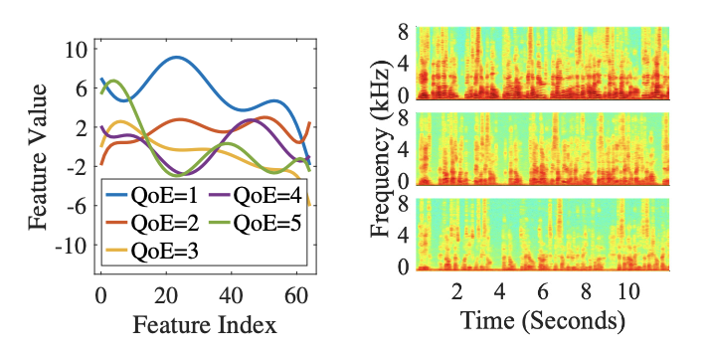


Key Observations: Measurement Study
Speech as a cue for subjective perceptions
Speech patterns correlate with perceived QoE
QoE 1
QoE
1
3
5
QoE 2
Speech pattern reflect human perception
Notes:
(C) Our motivation is inspired by a day-to-day phenomenon: people’s speech pattern is different based on their perception of voice service.
(C) For example, people may speak loudly when they cannot hear the other’s speaking. (C)(C) while they speak with normal loudness level when they satisfy about the services. (C)
(C) To validate our motivation, we conduct a pilot study consist of six subjects, and record their speech files and corresponding subjective QoE scores. (two of them form a pair to conduct calls under various network conditions in separate rooms. After each call, the subjects are asked to rate the service quality from 1 to 5, with 1 the worst and 5 the best.)
(C) We extract a standard acoustic parameter set consists of 65 features, such as pitch, jitter, and MFCC etc.. We find features exhibit high interclass difference. (C)
(C) We also transform speech signals to frequency domain using STFT. (C)We observe the intensity is higher at a lower QoE score.
Those indicate human speech patterns correlate with perceived QoE.

Slide 6
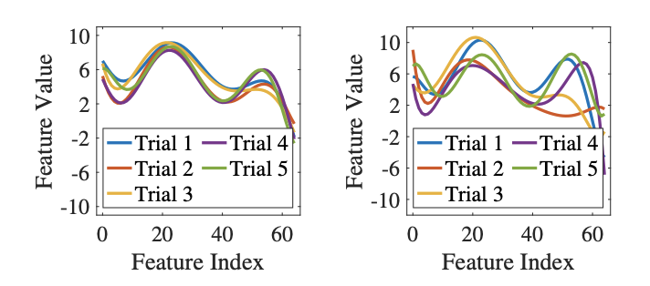
Key Observations: QoE – Speech-based Cues
Speech-QoE correlation is consistent
High inter-class difference
Low intra-class difference
Pattern is diverse among users
a. Identical conversation
b. Unique conversation
Notes:
(C) We compare feature vectors in five trials under the same QoE level in two cases.
(C) In the case of identical conversation, the features exhibit high consistency.
(C) In the case of unique conversation, the consistency is still observed, although some variations are introduced.
The speech-QoE correlation is consistently exist in both cases.
(C) In conclusion, in our pilot study, the speech-QoE correlation exhibit high inter-class difference and low intra-class difference.
These two findings encourage us to leverage speech cues for QoE assessments.
(C) However, we find speech pattern is diverse among users.

Slide 7


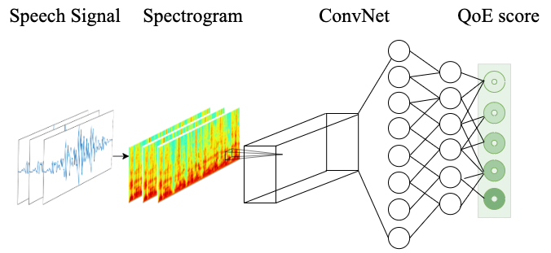






A Vanilla Approach – Basic Model
CNN as network architecture
Model-agnostic Meta-learning (MAML)
A framework in few-shot learning
Fine-tune parameters with few-shot
Steps:
Train base model by existing users
Adapt base model by a few shots from a new user
Source Dataset
Base Model
Adapted Model
Step 1
Step 2
Training
Adapting
• • •
Target Dataset
Adapting
Notes:
(C) We use CNN as the architecture of our basic model. The input is speech signal in frequency domain and the output is QoE score.
(C) We utilize MAML as our model’s training strategy. Specifically, MAML is a framework in few-shot learning. The goal of few-shot learning is to fine-tune parameters with few data samples.
Only two steps are involved in MAML. (C) (C) Step 1: Train base model by existing users and (C) (C) step 2: Adapt base model by a few shots from a new user.

Slide 8
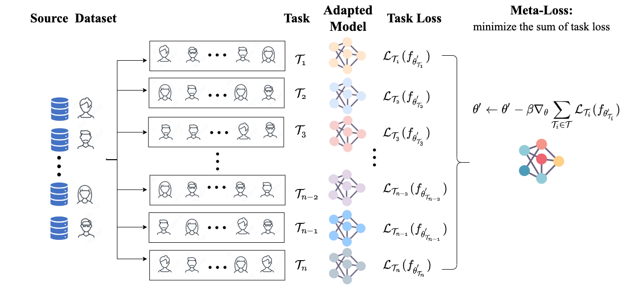
Dealing with User Heterogeneity
Notes:
(C) The training strategy in MAML enables model the capability to deal with user heterogeneity.
(C) We first sample multiple tasks from source dataset. Each task consists of a support and a query set.
(C)(C) The support set is used to train its task-specific model.
(C)(C) Once the task specific model is trained, we further calculate the model’s own loss with its query set.
(C)(C) Eventually, we sum up all task-specific losses and optimize network parameters by this meta-loss through stochastic gradient descent.
Please refer to our paper for more details.

Slide 9
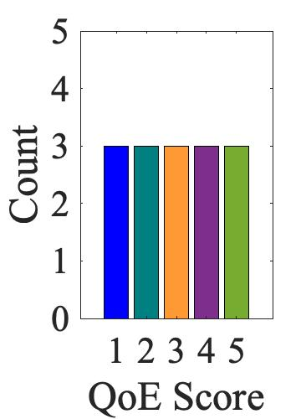

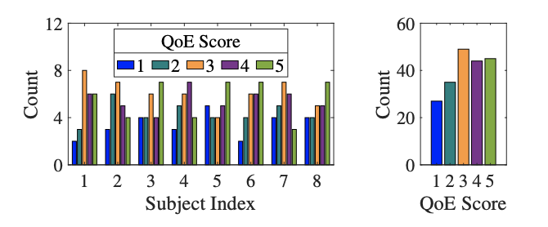
Limitation of the Basic Model
New User
Evenly distributed
Few-shot
Network barely downgrade to unacceptable conditions
Unevenly distributed
Impractical
Reluctant to assign low scores
Notes:
(C) While the MAML training strategy enable our basic model the ability of personalized QoE assessment, it still requires a few-shot (C) to adapt base model to a new user’s preference.
(C) Take 3-shot as an example, to get the base model adapted, (C) we need at least 3 data samples for each label. Even though we need only 9 samples totally in theory, in practice, it may require much more effort to get 3 samples for each label.
This is not a trivial task in a commercial voice services setting.
(C) First, due to the advances in wired and wireless networks nowadays, network barely downgrade to unacceptable conditions. Therefore, users rarely experience poor network conditions. Low QoE scores could hardly gain in practice.
(C) Second, according to studies in psychology, people reluctant to assign low scores to their received service. This make it even harder to get low QoE scores.
(C) To validate our assumption, we hired 8 subjects and ask them to rate 200 times. The subjective ratings are highly unbalanced (C) Particularly, lower scores are less reported.
(C) It is impractical to get few-shot directly from new users in voice services.
We design a novel data synthesizing scheme to overcome this challenge.

Slide 10
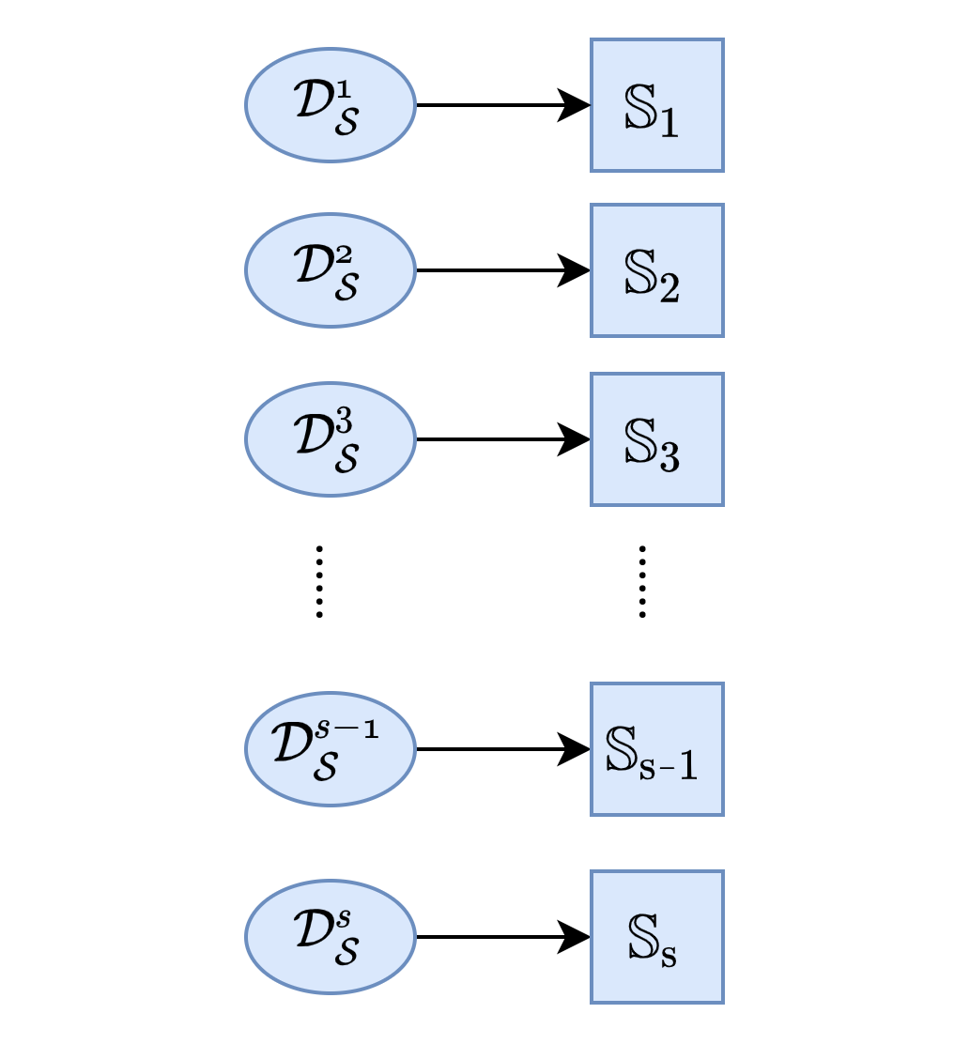
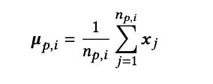

Advanced Model – Dealing with Data Scarcity
Step 1
Step 2
Step 3
Step 1: Source user profiling
Portray user via statistics
Multivariate Gaussian distribution
Mean of vector
Covariance matrix
User
Source User Profile
Existing User
Calibrated New User
Selected Users
• • •
Biased New User
Notes:
our data synthesizing scheme only need 3 or 4 samples without any distribution requirements. However, the distribution represented by these few data may be biased (C). To overcome this issue, we leverage existing users who are close to the new user(C) to calibrate the biased distribution of new users (C). And then generate adequate samples from the calibrated distributions.
The proposed scheme is composed of three steps: (C)source user profiling, (C)(C)identifying close neighbors, and (C)(C) generating new user data samples.
In source user profiling, (C)(C) we portray user via statistics. Namely, (C)(C)calculating the mean of vector and covariance matrix for each source user.

Slide 11
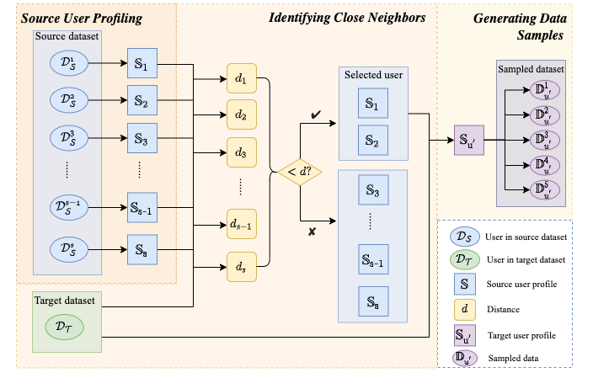
Advanced Model – Dealing with Data Scarcity
Step 2: Identifying Close Neighbors
Inspired by k-NN
Identify close neighbors
Step3: Generating Target Data Samples
Calibrate statistics of target user
Sampling data
Notes:
(C) In the identifying close neighbors stage(C), which is inspired by k-NN, we simply calculate the Euclidean distance between target user and each source user. The close neighbors are those source users where the distance is less than an empirical threshold.
(C)(C) In the Generating Samples stage, We leverage statistics from close neighbors to estimate the target user’s data distribution. With the calibrated distribution, we are able to generate sufficient samples covering all QoE scores.

Slide 12
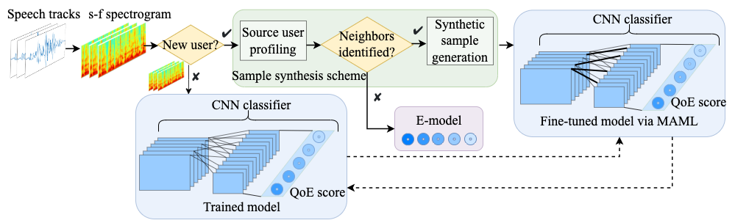
Piecing All Together
Speech signal transform
Inference with adaption
E-model integration
Inference without adaption
Notes:
(C) Here we outline the overall architecture of SpeechQoE.
(C) We take spectrogram which is transformed from speech tracks as input.
(C)(C) If the current user is an existing user, we use her own adapted model directly.
(C)(C) Otherwise, our proposed synthesis scheme will help to produce adequate data samples for adaption.
(C)(C) Please be aware, we also integrate traditional network-centric model, E-model, to avoid catastrophic behavior which will take place when no close neighbors are identified in source dataset. Our evaluation show that 3 out of 38 subjects find no close neighbors, the performance of SpeechQoE is similar to that of E-model for those 3 subjects.

Slide 13
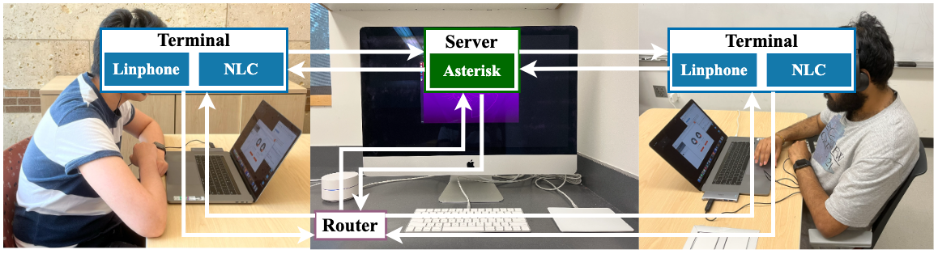
Evaluation
Experiment setup
Server: Asterisk
Calling terminal: Linphone
Network Control: Network Link Conditioner
Data collection
6-month campaign
Two subjects work on Richard’s task
38 participants × 200 sessions × 90 seconds= 190 hours
Notes:
We set up a VoIP testbed for our data collection campaign.
(C)(C) Two laptops are used as calling platform with an open-source VoIP software installed.
(C)(C) A server is set up to establish a connection between the two platforms
(C) (C) Also, a router is deployed to connect the three entities .
(C) (C) A network controller is installed on both terminals to simulate various calling environment.
(C)(C) A total of 38 subjects are recruited for our experiments. Two subjects form a pair to complete 200 calling sessions, each lasting 90 seconds. They sit in two separate rooms to finish a Richard’s task which is like charades (shr·aydz). Two subjects take turns describing a shape for the other to guess. The entire data collection campaign lasts for 6 months result in a 190 hours speech traces.

Slide 14
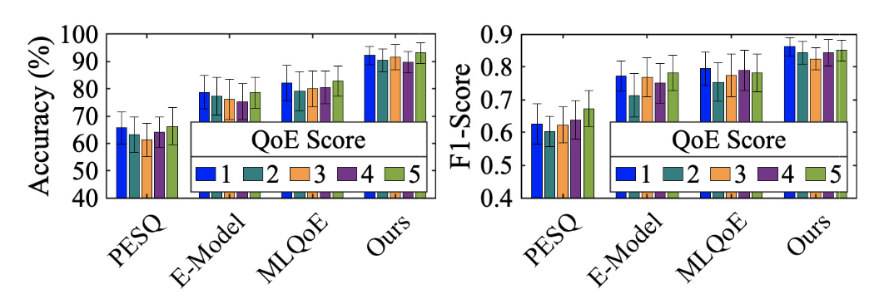
Evaluation
Comparison with state-of-the-arts
PESQ – speech-based model
MLQoE – map QoS to QoE
E-model – network parametric model
Best Performance
Best Performance
a. Accuracy
b. F-1 score
Notes:
(C) We compare SpeechQoE with three baselines. (C) PESQ is a speech quality based approach. (C) MLQoE maps network metrics into a QoE score. And (C) E-model is a classical parametric model.
(C) We find SpeechQoE consistently outperforms the baselines for all QoE scores (C).

Slide 15
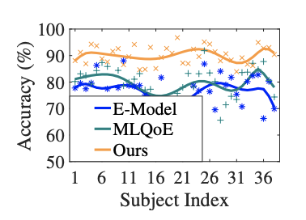
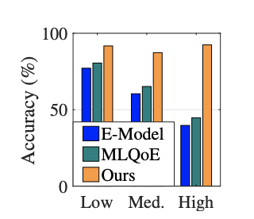
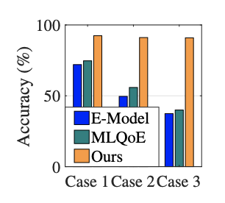
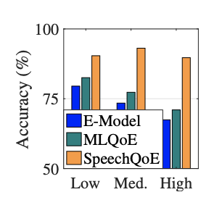
Evaluation
Performance breakdown
User diversity
Background noise
Quality perception of the peer
Fatigue
SpeechQoE achieves ≈ 2x higher accuracy under asymmetric network condition. > 30% higher accuracy if user is tired.
SpeechQoE achieves ≈ 2x more stable than baselines. 2x higher accuracy in noisy environment.
Notes:
(C) We evaluate SpeechQoE in various conditions.
(C) SpeechQoE perform consistently over 38 subjects.
(C) It particularly perform well under loud noise environment.
(C)(C) In a highly asymmetric network conditions experienced by the uplink and downlink, (C) SpeechQoE outperform baselines about 2 times better in terms of accuracy.
(C) SpeechQoE also perform 30% better comparing to baselines for users who are tired.

Slide 16
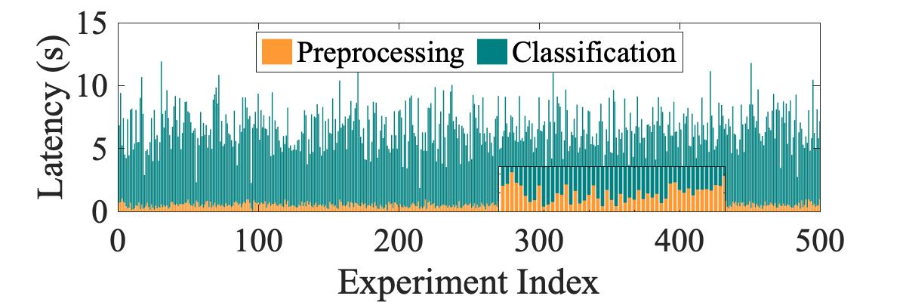
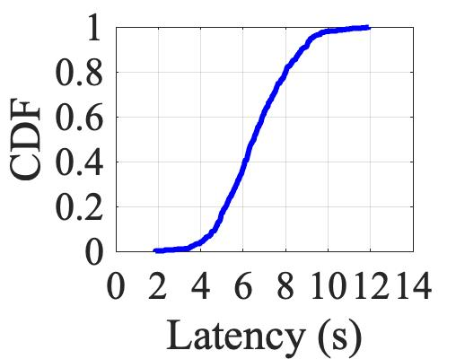
Evaluation
Computation latency
Preprocessing: extremely low
Classification: moderate
Acceptable time consumption
- Average time: 6.5 sec
- 90% measurements ≤ 8.7 sec
Notes:
(C) We further evaluate the computation latency of SpeechQoE. The latency comes from two operations, including preprocessing, which incurs extremely low latency, and classification, which incurs moderate latency
(C) Overall, the time consumption of SpeechQoE is acceptable, with an average of 6.5 seconds, and 90% can be finished within 8.7 seconds.

Slide 17


Conclusions
We present SpeechQoE, a novel QoE prediction model for voice services via speech sensing
We have collected and publicized our extensive voice services QoE assessment dataset
Comprehensive evaluations show that SpeechQoE outperforms existing solutions
For more details, please refer to our paper ☞
Our dataset is publicly available ☞
Notes:
(C) In conclusion, we present SpeechQoE, a novel QoE prediction model for voice services via speech sensing
(C) In the experiments, we have collected an extensive dataset which has been publicized to benefit research community.
(C) Our comprehensive evaluations show that SpeechQoE advances existing solutions.
(C) For more details, please refer to our paper.

Slide 18
Thank you!
For more details, please refer to our paper ☞
Our dataset is publicly available ☞

