Slide 1
is air Pollution in beijing Less?

Slide 2
Data
Source: Beijing Municipal Environmental Monitoring Center
36 detectors
1/1/2015 – 12/31/2018
Every hour
PM2.5 (Dirty, Foggy Air)
SO2 NO2 … (Invisible)
Notes:
PM2.5: Particulate matter that is 2.5 micrometers in diameter or smaller, the most harmful air pollutant
SO2 NO2
Sulfur dioxide
Nitrogen dioxide

Slide 3
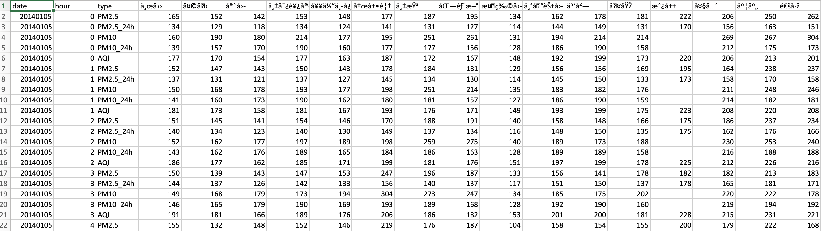
Columns: date, hour, type, each detector
Rows: 120
365 * 4 csv files

Slide 4
Data Cleaning
Merge
Groupby
Mean
Each Month

Slide 5
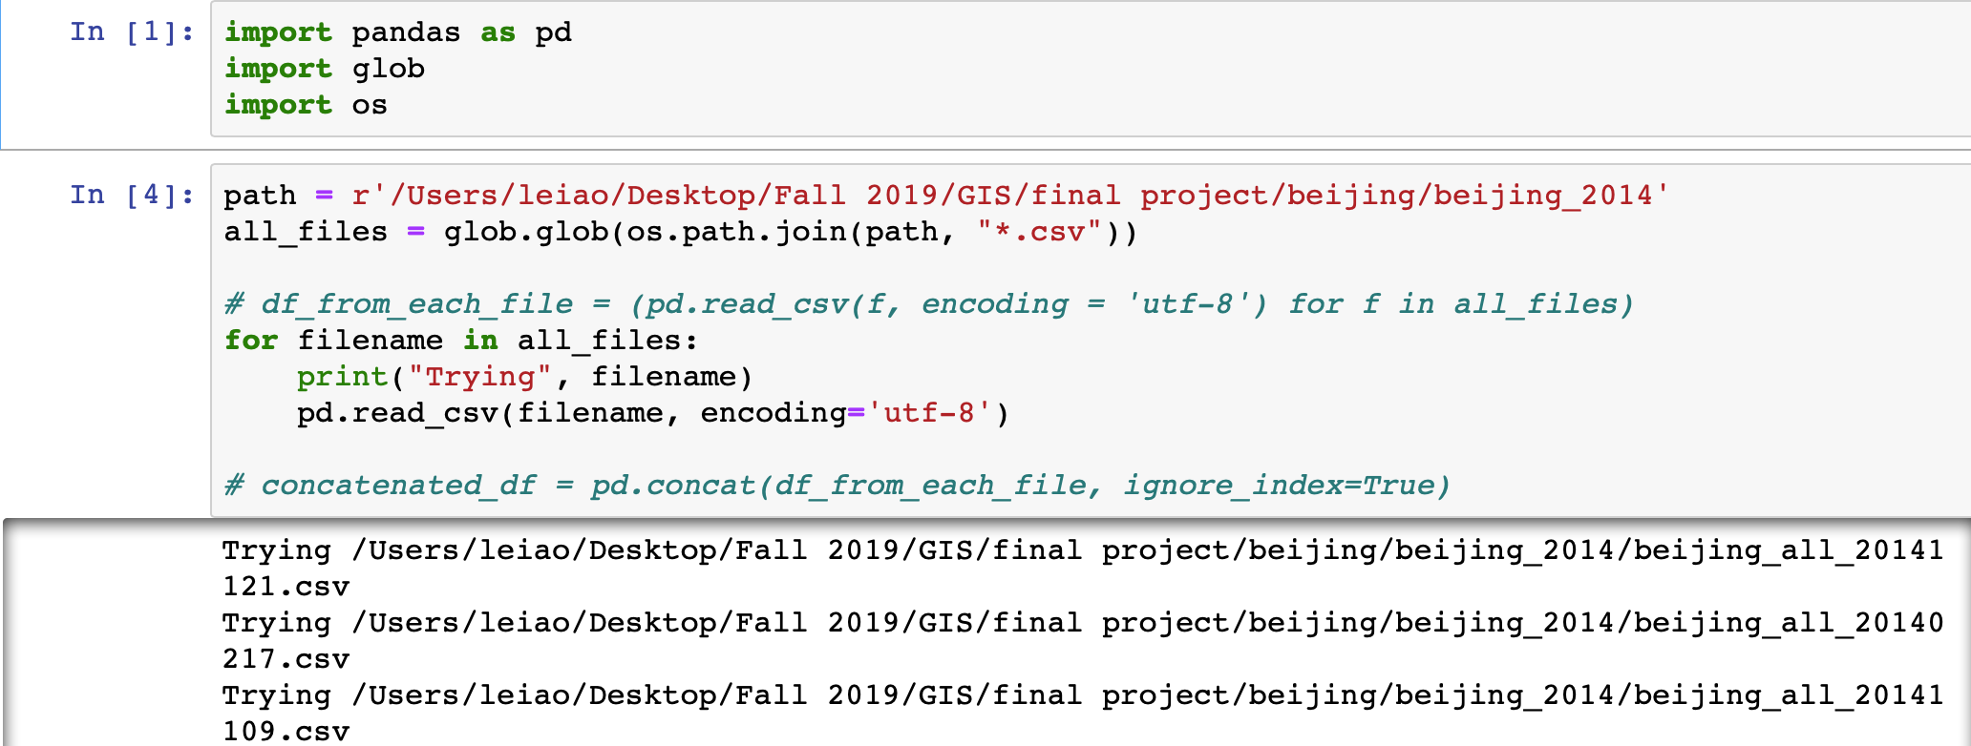
Merge is the Hardest
Notes:
Check which one went wrong and manually correct that

Slide 6
What is “Pollution”?
Indicator: PM2.5
PM2.5 > 100 μg/m3
SO2
NO2

Slide 7
Analysis
Average Level of PM2.5 in Each Month from 2014.1 to 2018.1 Chart
Average Level of SO2 NO2 in Each Month from 2014.1 to 2018.1 Chart
Number of Pollution Days for Each Detector from 2014 to 2018 Map

Slide 8
https://mingligraphics.github.io/beijing-air/
Charts: pandas, matplotlib, Adobe illustrator and ai2html
Maps: Qgis, Adobe illustrator, Mapbox and D3.js

