Slide 1
World of Tanks
Zhe Lu
Ming Ma
Ting Wang
Xiaoqiao Mu

Slide 2
Introduction
1. Two players: Player 1(green tank) and Player 2(red tank)
2. Keyboard Control: Player 1(W, S, A, D, Space)
and Player 2(I, K, J, L, Enter)
3. Monsters shoot bullets automatically in a fixed position.
4. How to win: One tank has been hitted by bullet 3 times (both the opponent and monsters),
the opponent will win
or destroy the opponent’s base 1 time.

Slide 3
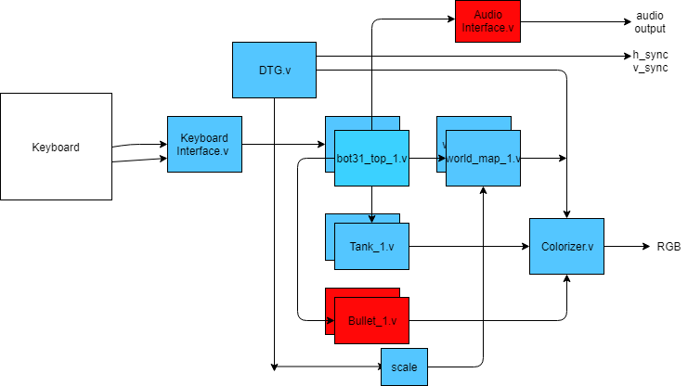
Block Diagram

Slide 4
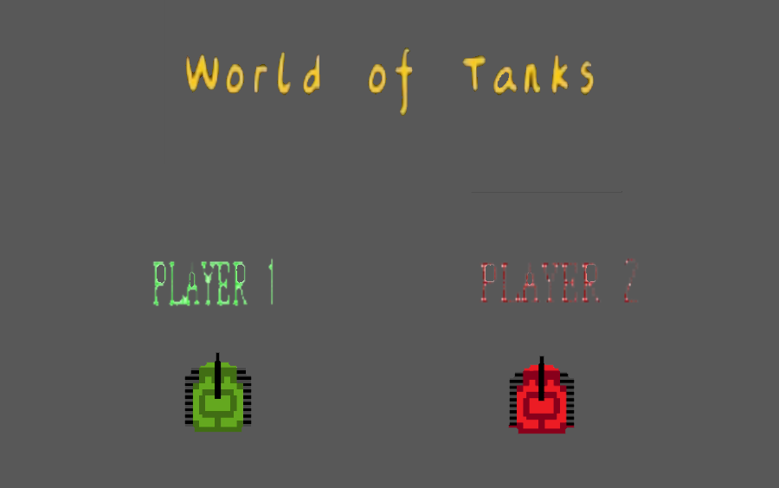
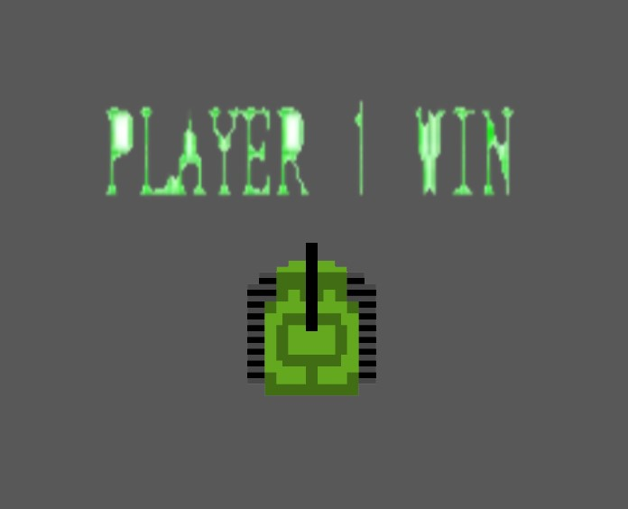
Software Flowchart
Initialize BGM, introduction frame
any tap
Show game frame up, initialize chance
Read keyboard to control two tanks
yes
check hit
Show burst
Chance -1
Input | Output
keyboard | Bot_ctrl
tank_hit | Frame_select
base_hit | BGM_select
Chance = 0?
No
back to Initialization position
No
yes
yes
check base
No
Record winner
Show winner frame and change BGM

Slide 5
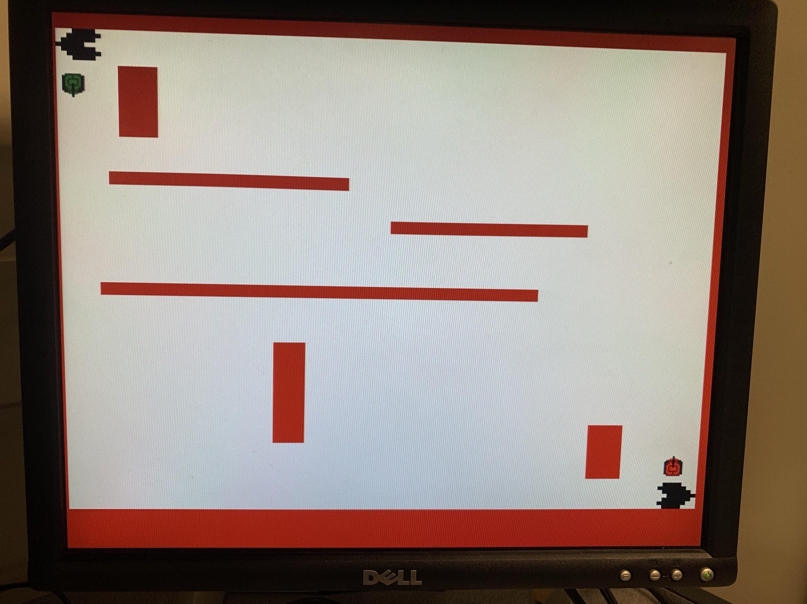

Slide 6
Problem and Solution
Change initial position of the Rojobot.
How to implement the Keyboard
Implement two Rojobot.
How bullet hit the tank.

Slide 7
Future plan...
Have done:
We have finished the main pixel .coe files
The temp map
Showing two tanks
Two tanks can be control successfully
Must:
Figure out how bullet hit the tanks
Figure out how bullet hit the base.
Figure out how monsters shoot bullets automatically.
Add BGM
If we have time…
The bullet can destroy the wall.
The monsters can move and shoot automatically.

Slide 8
Thank you !

