Slide 1

A Practical Verification Framework for Preemptive OS Kernels
Fengwei Xu Ming Fu Xinyu Feng
Xiaoran Zhang Hui Zhang Zhaohui Li
University of Science and Technology of China
July 22, 2016 CAV2016
http://staff.ustc.edu.cn/~fuming/research/certiucos/
Notes:
Hello everyone, my name is Ming. The title of my talk is “a practical verification framework for preemptive OS kernels”.

Slide 2






Motivation of OS Verification
Computer System
Notes:
First let us start with the motivation OS verification, computer systems have been widely used in many safety critical areas, so it is very important to make the computer system reliable.

Slide 3
Motivation of OS Verification
Applications
Operating System
Hardware
Correctness of OS is crucial for safety and security of the whole system.
Notes:
A computer system usually consists of hardware, OS and applications. The operating system is the most foundational software in the computer system, so its correctness is crucial for the safety and security of the whole system.

Slide 4
Challenges of OS Verification
Many challenges:
C/Assembly code
Concurrency
Preemption
Interrupts
Large code base
Device & I/O
…
Concurrency caused by preemptions is particularly challenging.
Notes:
Verifying the correctness of OS has many challenges, such as, the verification of the C and assembly code, concurrency, preemption, interrupts, large code base, device and so on. Among these challenges, concurrency caused by preemptions is particular challenging.

Slide 5
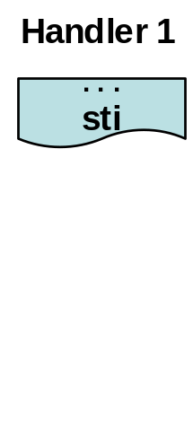
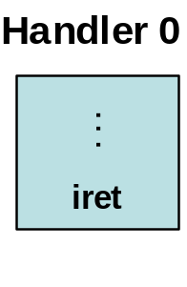

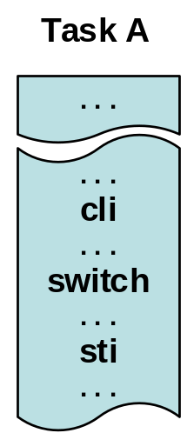
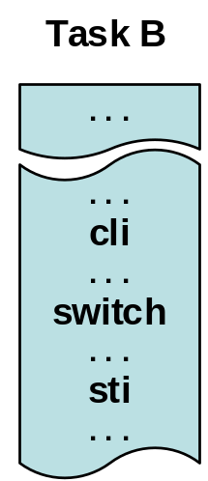

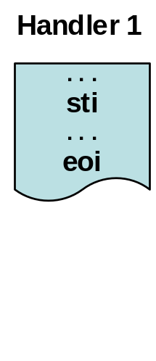
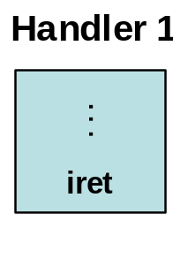
Preemption
Preemption is the act of temporarily interrupting a task without requiring
its cooperation.
nested multi-level interrupts
irq0
irq1
Kernel-Level preemption
. . .
cli
. . .
switch
. . .
iret
preempt
irq1
irq1
. . .
iret
Preemptions and multi-level interrupts are indispensable to achieve
real-time guarantees in RTOS.
Preemptive OS kernel is highly concurrent and complex.
Notes:
Preemption is the act of temporarily interrupting the execution of a task without requiring its cooperation. For example, the execution of Task A might be preempted by the interrupt handler 1, and handler 1 might be further preempted by handler 0 which has the higher priority, then the nested execution of multi-level interrupts happens. After handler 0 returns to handler 1. Instead of returning to task A, Handler 1 switches to task B, where the kernel-level preemption happens. That is, the execution of task A is preempted by task B which is more emergent. This kind of execution is quite common in real-time OS. Preemptions and multi-level interrupts are indispensable to achieve real-time guarantees, and they make the kernel highly concurrent and complex.

Slide 6
Challenges of Concurrent
Kernel Verification
Verifying concurrent programs is difficult
  Non-deterministic interleaving
Verifying concurrent kernel is more challenging
  OS verification is usually based on refinement verification
  Concurrent kernel verification requires combination of verifying refinement and concurrency
    Difficult to do it compositionally
    Theoretical problems have not been solved until recently [Liang et al. PLDI’13, LICS’14] [Turon et al. POPL’13, ICFP’13]
Concurrency caused by preemptions and multi-level interrupts
are avoided by previous OS verification projects
e.g. seL4 [Klein et al. SOSP‘09], CertiKOS [Gu et al. POPL’15]
Notes:
It is difficult to do concurrent kernel verification. As we know, concurrent programs are difficult to verify because of the non-deterministic interleaving of running threads. Verifying concurrent kernels is even more challenging. As we know, OS kernel verification is based on refinement verification, concurrent kernel verification requires us to combine refinement verification and concurrency verification together. It is difficult to do it compositionally because of non-deterministic interrupts and multitasking, and theoretical problems about compositional refinement verification of concurrent programs have not been solved until recently. For the above reasons, previous OS verification projects, such as seL4 and CertiKOS usually avoid concurrency which is caused by preemptions and multi-level interrupts for simplifying the verification.

Slide 7


Our Contributions
Verification framework for preemptive OS kernel
  Refinement of concurrent kernels
  Multi-Level interrupts
Verification of key modules of a commercial OS kernel μC/OS-II in Coq
The first mechanized verification of
a commercial preemptive OS kernel.
Notes:
Here are our contributions, first we have proposed a verification framework for preemptive OS kernels, and our framework is able to verify refinement of concurrent kernel programs involved with kernel-level preemption and multi-level interrupts. We have successfully applied our framework to verify key modules of a commercial real-time kernel uC/OS-II, all the proofs have been mechanized in Coq. This is the first mechanized verification of a commercial preemptive OS kernel.

Slide 8
Outline
OS Correctness
Verification Framework
  Program logic for refinement and multi-level interrupts
Verifying μC/OS-II
Notes:
This is the outline of my rest talk. First I am going to talk about how to formally define OS correctness.

Slide 9
OS Correctness
OS provides abstraction for programmers
  Hide details of the underlying hardware
  Provide an abstract programming model
OS Correctness : refinement between high-level abstraction and low-level concrete implementation
Notes:
As we know, OS hides details of the underlying hardware and provides an abstract programming model for application-level programmers. The implementation of the OS kernel must ensure the consistency between high-level abstraction and low-level concrete implementation. Therefore, OS correctness can be considered as refinement between the high-level abstraction and low-level concrete implementation.

Slide 10
OS Correctness
Applications
High-Level
Abstract Machine
C + Abstract primitives
Low-Level
Abstract Machine
C +Assembly
High-Level
Abstract Primitives
Low-Level Concrete Implementations
Notes:
As shown in this slide, in the eyes of programmers, applications are running on the high-level abstract machine, and they are written with C plus abstract primitives of system APIs. Then these high-level abstract primitives can be refined to their low-level concrete implementations, which are written with C and assembly. They are running on the low-level abstract machine. OS correctness requires that the refinement should be correct.

Slide 11
Refinement
High-Level
Abstract Primitive
System Call
⊇
Applications
System Call
Low-Level
Concrete
Kernel Impl.
Notes:
What is the refinement? That is, if an application does a system call, then executing the low-level concrete implementation should have no more observable behaviors than executing its high-level abstract primitive.

Slide 12
Contextual Refinement
For all applications
High-Level
Abstract Primitive
System Call
⊇
…
System Call
Low-Level
Concrete
Kernel Impl.
Notes:
A correct OS requires that the refinement holds for all applications.

Slide 13
Contextual Refinement as
OS Correctness
O ⊆_{ctxt} S iff
∀A.
ObsBeh(A[O]) ⊆ ObsBeh(A[S])
The set of observable behaviors
A：Application
O：OS Concrete Impl.
S：Abstract Prim.
Notes:
OS correctness can be formally defined as contextual refinement between O and S, O is for the concrete implementations, and S is for their abstract primitives. And it says, for all applications, the set of observable behaviors of running applications with O is the subset of those of running applications with S.

Slide 14
Outline
OS Correctness
Verification Framework
  Program logic for refinement and multi-level interrupts
Verifying μC/OS-II
Notes:
I am going to talk about our verification framework for proving OS correctness.

Slide 15
OS Correctness
Applications
High-Level
Abstract Machine
C + Abstract primitives
Low-Level
Abstract Machine
C +Assembly
High-Level
Abstract Primitives
Low-Level Concrete Implementations
Notes:
To define contextual refinement, we first need to model the low-level and high-level abstract machines. .

Slide 16
Our Verification Framework
Relational Assertion
Entailment
CSL-Style Refinement-Based Program Logic
Contextual Refinement
B. Refinement-Based Verification
Verification Condition
Generator
High-Level Language
High-Level Operational Semantics with Configurable Schedulers
Domain-Specific Solvers
High-Level
Spec. Language
C Subset
Assembly Primitives
…
A. Modeling of
OS Kernels
Low-Level Operational Semantics with Context Switch and Interrupts
C. Coq
Tactics
Low-Level Language
Refinement-Based Verification Framework
Notes:
Therefore the first part of our framework is the modelling of the two machines, where a practical C subset has been formalized for implement our target OS kernel. The second part is our program logic for proving the contextual refinement. The third part is our coq tactics for automated verification support. In the rest of my talk, I am going to focus on the program logic.

Slide 17
Program Logic for Refinement and Multi-Level Interrupts
Relational program logic for proving simulation relation
Ownership-Transfer semantics for reasoning about multi-level interrupts
Combining above two for our CSL-Style relational program logic
Notes:
Here is our approach for developing the program logic, first we use relational program logic to prove simulation relation which implies refinement, and ownership-transfer semantics is used to reason about multi-level interrupts, then we combine the above two for our relational program logic, which is able to prove contextual refinement of concurrent kernel programs involved with multi-level interrupts. First let us discuss the simulation.

Slide 18
Refinement Verification Via Simulation
S
call, ret
e
High (A[S]):
≤
≤
≤
≤
≤
call
ret
e
Low (A[O]):
O
Notes:
We can prove refinement by establishing the simulation relation between O and S, and the simulation relation guarantees the consistency between the two levels to be preserved at each step.

Slide 19
Simulation with Interrupts & Multitasking
call, ret
e
High (A[S]):
≤
?
S
≤
?
O
call
ret
e
Low (A[O]):
IRQ
iret
Interrupt handler:
switch
switch
Another task:
How to do compositional verification?
Notes:
To verify concurrent kernels, the interrupts and multitasking should be considered in the simulation relation. The low-level execution of O might be interrupted by an interrupt handler, then switches to another task. An interrupt requests are non-deterministic and the execution of another are also non-deterministic, then the low-level behavior of O are non-deterministic. Then how to establish the simulation relation between O and S? How to do compositional verification?

Slide 20
Simulation with Interrupts & Multitasking
call, ret
e
High (A[S]):
≤
S
≤
O
call
ret
e
Low (A[O]):
Use invariant “I” to
specify non-deterministic interference
IRQ
iret
Interrupt handler:
switch
switch
Another task:
Notes:
Our solution is to use a global invariant to specify the non-deterministic interference from interrupt handlers and tasks. The invariant can be considered as the abstraction of behaviors from environments. That is, whatever they have done, they should not break the invariant. Then using the invariant help us to abstract away non-deterministic behaviors and achieve compositional verification.

Slide 21
Simulation with Interrupts & Multitasking
call, ret
e
High (A[S]):
≤
I
I
I
I
I
I
≤
call
ret
e
Low (A[O]):
Env. steps
Adaption of RGSim [Liang et al. POPL’12] and the relational program logic [Liang et al. PLDI’13]
Notes:
Then the simulation relation can be established like this, initially, the low-level and high-level are consistent by satisfying the invariant I, then each step guarantees not to break the invariant, and we assume that environment steps do not break the invariant either. Our solution comes from by adapting the existing compositional simulation relation RGSim and the relational program logic.

Slide 22
Invariant for Interrupt Reasoning
Program invariant [O'Hearn CONCUR’04]
There is always a partition of resource among concurrent entities, and each concurrent entity only accesses its own part.
But note:
The partition is dynamic: ownership of resource can be dynamically transferred.
Interrupt operations can be modeled as operations that trigger resource ownership transfer. [Feng et al. PLDI’08]
Tasks and interrupt handlers
Notes:
Now we have the invariant for compositional refinement verification, but how to define the invariant for reasoning about multi-level interrupts? By following concurrent separation logic, the program invariant enforces that there is always a partition of resource among concurrent entities, such as tasks and interrupt handlers, and each of them only accesses its own part. But note that, the partition is dynamic, which means the ownership of resource can be dynamically transferred. Interrupt operations can be modeled as operations that trigger the ownership transfer of resource.

Slide 23
Ownership-Transfer Semantics for Single-Level Interrupt
IF = 1
I0
IF = 0
I0
cli
Resource
B1
B0
B1
B0
Task
Handler 0
sti
B1
B0
B1
B0
I0
I0
I0 {p} cli {p * I0}
I0 {p * I0} sti {p}
Notes:
First I am going to talk about ownership-transfer semantics for single-level interrupt. Suppose we have only one task and single-level interrupt. Because the interrupt handler has the higher priority to preempt the execution of the task, then we let the interrupt handler to select its required resource first, handler 0 selects B0, the remaining resource is assigned to the only task. If the IF bit is one, which means interrupt is enabled, the interrupt may come at any program point, to ensure the safe execution of the handler code, the block B0 needs to be well-formed with respect to the invariant I0. Now the task can only access its local block B1. If it needs to access block0, it has to first disable the interrupt by cli, the ownership of B0 is transferred from public to task-local. Correspondingly, sti which enables interrupts will transfer the ownership of B0 from task-local to public. The inference rule for cli and sti can be formalized using the separating conjunction in separation logic to enforce the logical partition, then cli rule acquires the ownership of the resource block specified by I0 in the postcondition, and sti will lose the ownership.

Slide 24
Memory Model for Multi-Level Interrupts
IN
IN-1
…
I2
I1
I0
Resource
BN
BN-1
…
B2
B1
B0
N-1
…
2
1
0
Task
Lowest Priority
Highest Priority
Higher-priority handler has priority to select its required resource
N blocks are assigned to interrupt handlers at N levels
Each well-formed resource block is specified by a resource invariant
Notes:
To give the ownership-transfer semantic for multi-level interrupts, we need to extend the memory model of single-interrupt.
Here we let the higher-priority handler to select its require resource first, then one by one following the order of their priorities.
Then interrupt handlers at N levels are assigned with N resource blocks, and each well-formed resource block is specified by a resource invariant.

Slide 25
Difference for Multi-Level Interrupts
ISR Register in 8259A
Ownership-transfer is determined by IF bit and ISR register together
Higher Priority
Higher Priority
7
6
5
4
3
2
1
0
7
6
5
4
3
2
1
0
eoi
0
0
0
0
1
0
0
0
0
0
0
0
0
0
0
0
ISR Register
ISR Register
Block interrupt
requests with lower or equal priorities
IF = 1
IF = 1
Notes:
Here are some difference for multi-level interrupts. In addition to the IF bit. The ISR register is also used to control the interrupts. For example, if interrupt is enabled, and the level-3 handler is currently in service, where the corresponding bit is set to one in ISR, then it will blokc interrupt requests with lower or equal priorities. eoi command can clear the bit to unblock the requests. Therefore the ownership-transfer is determined not only by IF bit but also by ISR.

Slide 26
Ownership-Transfer Semantics for Multi-Level Interrupts
iret
IF=1
IF=1
ISR = [1 0 1 0 0 0]
eoi
ISR = [1 0 0 0 0 0]
T
B5
B4
B3
B2
B1
B0
T
B5
B4
B3
B2
B1
B0
irq 1
cli
sti
cli
sti
iret
IF=0
IF=0
IF=0
ISR = [1 0 1 0 1 0]
ISR = [1 0 1 0 0 0]
eoi
ISR = [1 0 0 0 0 0]
T
B5
B4
B3
B2
B1
B0
T
B5
B4
B3
B2
B1
B0
T
B5
B4
B3
B2
B1
B0
Notes:
Then we extend the ownership-transfer semantics for multi-level interrupts, as shown in this slide.

Slide 27
Inference Rules for Interrupt Operations
IF=1
ISR = [1 0 1 0 0 0]
T
B5
B4
B3
B2
B1
B0
cli
IF=0
ISR = [1 0 1 0 0 0]
T
B5
B4
B3
B2
B1
B0
ISR(k) = 1
I { [ISR, 1, k] * p } cli { [ISR, ,k]* p * }
0
I [0… k-1]
Notes:
Then we can formalize the inference rules with the ownership-transfer semantics. Disabling interrupts transfers the ownership of some resource blocks from public to taks-local, then in the inference rule, the corresponding resource invariants are added into the post-condition with the separating conjunction operator.

Slide 28
CSL-Style Relational Program Logic
Relational separation logic assertions for
pre-/post- condition
Judgement
Relational Invariants
p
[|s|]
q
{ * } { * [|end|] }
I
C
High-Level
abstract primtive
S
High-Level
abstract states
x,…,z
≤
Low-Level
concrete code
Low-Level
concrete states
…
C
x
z
Notes:
Here is our CSL-Style relational program logic, the judgement of our logic is used to prove the simulation relation between the low-level code C and its high-level primitive S, and we have low-level concrete states and high-level abstract states. This is our judgment, C is the low-level code, s in the precondition is the high-level abstract primitive refined by C. The precondition is a relational separation logic assertion, which relates low-level concrete states and high-level abstract states together. I is the global relational invariant.

Slide 29
Top Rule for Proving O ⊆_{ctxt} S
Verifying internal functions
Verifying kernel APIs
Verifying interrupt handlers
χ, I ηi : Γ
Γ, χ, I ηa : φ
Γ, χ, I θ : ε
Side
conditions
O ⊆_{ctxt} S
The set of abstract primitives_x000c_for kernel APIs
The set of kernel APIs
(ηa, θ, ηi)
(φ, ε, χ)
The set of interrupt handlers
The set of internal functions
The set of abstract primitives for interrupt handlers
The abstract scheduler
Notes:
Here is the top rule for proving the contextual refinement between O and S. The low-level O contains the set of kernel APIs, the set of interrupt handlers and the set of internal functions. The high-level S contains the set of primitives for kernel APIs, the set of primitives for interrupt handlers and the abstract scheduler for specifying the scheduling policies. Then to prove contextual refinement, we need to verify refinement for kernel APIs, interrupt handlers and internal functions.

Slide 30
Outline
OS Correctness
Verification Framework
  Program logic for refinement and multi-level interrupts
Verifying μC/OS-II
Conclusion

Slide 31
Verifying μC/OS-II
Multi-level
Interrupts
Priority-Based Scheduler
Message Queue
Mutex
Semaphore
Mail Box
Synchronization Mechanisms
D. Verifying key modules of uC/OS-II
C. Coq Tactics
B. Refinement-Based Verification
A. Modeling of OS Kernels
Refinement-Based Verification Framework
Notes:
We have successfully applied our framework to verify key modules of a commercial real-time OS uC/OS-II, which has been widely used in industry.

Slide 32
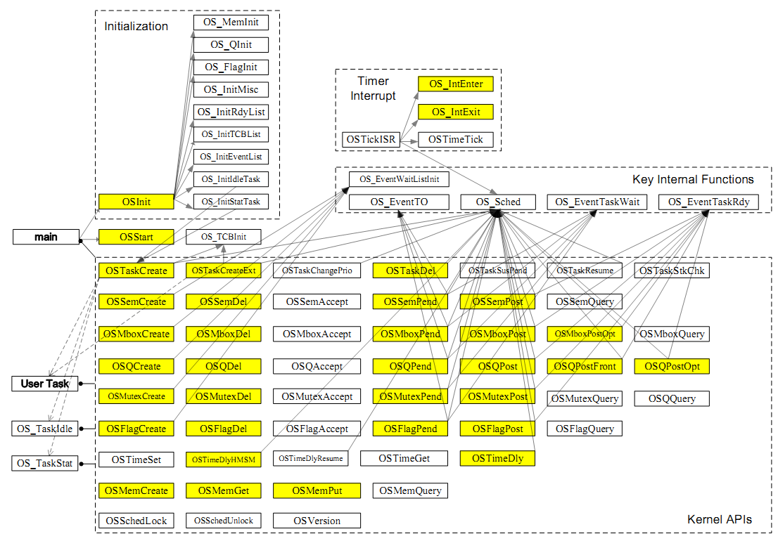
Frequently Used APIs：
Notes:
Here the yellow boxes represent the frequently used APIs in uC/OS-II, they are identified according to the official document.

Slide 33
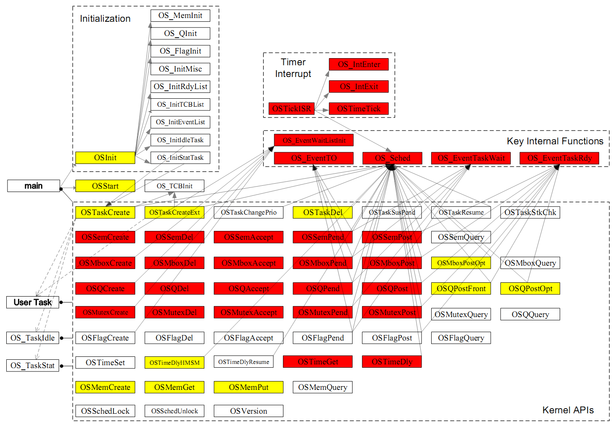
Verified APIs：
Timer interrupt handler
cover 63% of the frequently used APIs
Scheduler
Semaphore
Mailbox
Message queue
Mutex
Time management
Notes:
Our verified APIs cover 63% of them. These verified code include the timer interrupt handler, the scheduler, time management, and four synchronization mechanism including semaphore, mailbox, message queue and mutex

Slide 34
Proving Priority Inversion Freedom
Contextual Refinement
Relational Assertion
Entailment
CSL-Style Refinement-Based Program Logic
Priority inversion freedom of mutex in uC/OS-II
B. Refinement-Based Verification
Verification Condition
Generator
High-Level Language
High-Level Operational Semantics with Configurable Schedulers
PIF of Mutex
Domain-Specific Solvers
High-Level
Spec. Language
C Subset
Assembly Primitives
…
A. Modeling of
OS Kernels
Low-Level Operational Semantics with Context Switch and Interrupts
C. Coq
Tactics
Low-Level Language
Refinement-Based Verification Framework
Notes:
We have also proved the system-wide property priority inversion freedom for mutex in uC/OS-II based on the high-level abstract machine.

Slide 35
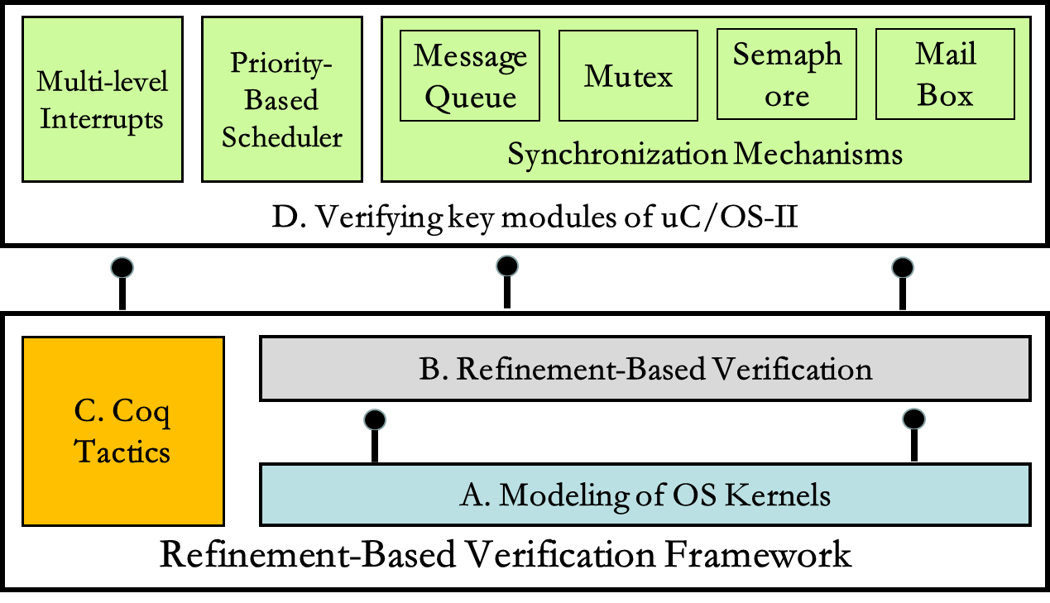
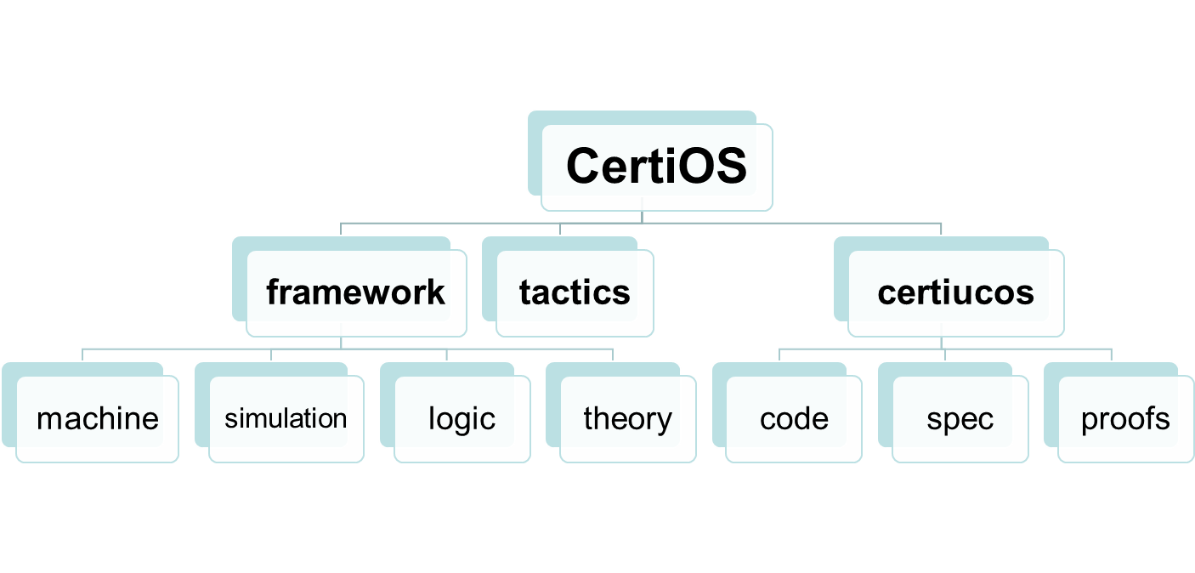
Coq Implementations
210,000
5.5 person years
55,000
20,000
135,000
Notes:
The Coq implementation contains around 210,000 lines of code and proofs, and the work takes us around 5.5 person years.

Slide 36
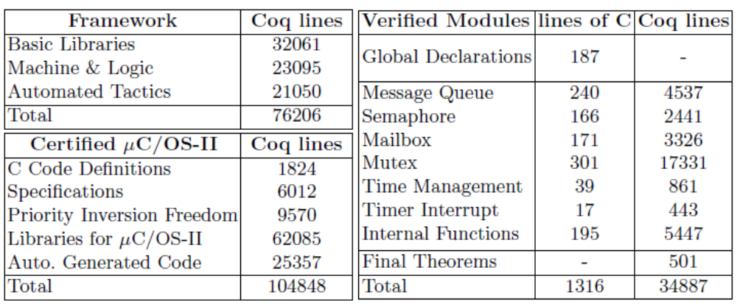
Coq Implementations
Correspond to around 3250 lines of code in their original format
34,887 lines for 1,316 lines C Code
Ratio: 26:1
See http://staff.ustc.edu.cn/~fuming/research/certiucos/
Notes:
We have verified around 1300 lines of C code without counting comments and empty lines. Note these verified code corresponds to around 3250 lines of code in their original format where comments and empty lines are counted in. Around 35,000 lines of coq proofs are written for them. Thanks to our coq tactics, the ratio of proof scripts to code is around 26:1. More details and Coq code can be found in our website.

Slide 37
Summary
Contextual refinement as OS correctness
Verification framework for preemptive OS kernels
  Adapting RGSim for compositional refinement verification
  Reasoning multi-level interrupts with ownership-transfer semantics
  CSL-Style relational program logic
Verifying a commercial preemptive OS kernel
Notes:
In summary, first we use contextual refinement to define OS correctness. Second we developed a verification framework for preemptive OS kernels by adapting RGSim for compositional refinement verification, and reasoning about multi-level interrupt handlers with owner-ship transfer semantics, then combing them together for a our CSL-style relational program logic. Finally we have applied our framework to verifying a commercial preemptive OS kernel.

Slide 38
Thank you!
Notes:
That is it! Thank you for your attentions!

Slide 39
Backup Slides

Slide 40
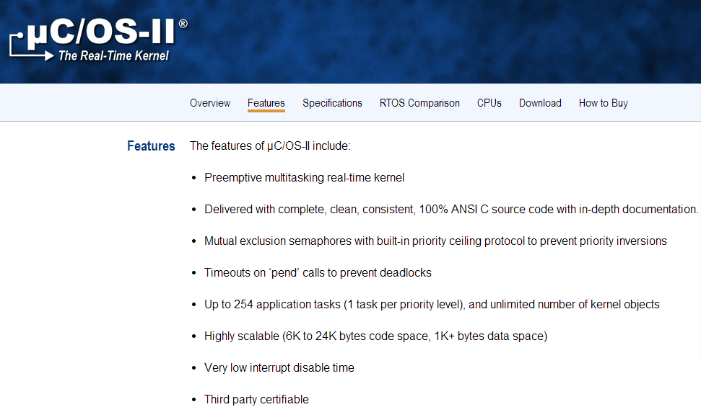
Limitation of Mutex
Nested use of mutex will lead to priority inversions
Notes:
我们发现的主要bug是关于互斥锁优先级反转的bug，这是它官方主页上描述的它的互斥锁实现可以保证没有优先级反转，但是在验证过程中我们发现如果允许嵌套使用互斥锁则可能发生优先级反转，我们构造出了相关的反例证实了这一点。

Slide 41
The Low-Level Abstract Machine
A practical subset of C + assembly primitives
Small-step operational semantics with context switch and hardware interrupts on single CPU
Atomic assembly primitives are used to encapsulate the assembly code.
i ::= switch x | encrt | excrt | …
switch to the target task x
enter a critical region by
disabling interrupts
exit the current critical region
Notes:
The kernels are usually implemented in C with inline assembly. However, giving semantics directly to C with inline assembly requires us to expose stacks and registers, and it makes the semantics overly complex. To avoid this problem, we extend the C statements with assembly primitives to encapsulate the assembly code. switch x switches to the target task x. encrt enters a critical region by disabling interrupts. excrt exits the current critical region. We give small-step operational semantics to the language. To model concurrency and hardware interrupts, both commands and expressions could be executed in multiple steps, and each step corresponds to the granularity of a single machine instruction.

Slide 42
The High-Level Abstract Machine
A practical subset of C + Abstract specifications
The high-level specification language
Small-step operational semantics parametrized with a configurable abstract scheduler χ
s ::= sched | γ(v) | end | s;s | s+s | …
specify explicitly when the scheduler is invoked
instantiate r(v) to specify any atomic
transitions over abstract states
λΣ, t . t has the highest priority in Σ
High-Level abstract states
Priority-Based scheduling policy
Task ID
Notes:
The high-level language consists of a practical subset of C and a specification language for specifying kernel implementations. The high-level specification language provides an abstract “sched” command, allowing us to specify explicitly when the scheduler is invoked in synchronization primitives or interrupt handlers. Semantics of sched is parameterized over abstract scheduling policies, for example priority-based or round-robin. Expressiveness about these details are necessary to specify system-wide scheduling properties. γ(v) takes v as arguments and maps a high-level abstract state to another. It can be instantiated to specify any atomic transitions over high-level abstract states. end represents the end of abstract specification code, others are statements for sequential composition and non-deterministic choices. We give small-step operational semantics to the language. The operational semantics is parametrized with a configurable abstract scheduler, which allows us to specifying details of the scheduling policies, instead of leaving the scheduler unspecified. For example, we can instantiate abstract scheduler like this, sigma is the high-level abstract state, which records the information of each task, t is the task identifier. Then the priority-based scheduling policy requires that the selected task t has the highest priority in sigma.

Slide 43

Example: A System API
encrt
void OSTimeDly (INT16U ticks)
{
if (ticks > 0) {
OS_ENTER_CRITICAL();
……
OS_EXIT_CRITICAL();
OS_Sched();
}
}
__asm__("pushf \n\t cli")
/*Disable interrupts*/
Update the task status from ready to waiting and set
the delayed ticks in TCB
__asm__("popf")
/*Enable interrupts*/
Interrupted by the timer interrupt and switch to a ready task
Switch to a ready task
excrt
Notes:
This is a system API from uCOS-II, which is used to delay execution of the currently running task until the specified number of system ticks expires. No delay will result if the specified delay is 0. If the specified delay is greater than 0 then, a context switch will be done at the end. Because this API needs to access the data structure TCBList, which is shared with interrupts and other tasks, it first disables interrupts, note that the assembly code is replaced with our assembly primitive, then updates the status of currently running task from ready to waiting for specified system ticks inside the critical region, finally exit the critical region by enabling interrupts. After that, the current task might be interrupted by the timer interrupt and switch to another ready task insider the interrupt handler. Or it may switch to another ready task by calling the scheduling function OS_Sched( ) at the end.

Slide 44
Example: API and Specification
The concrete implementation refines Its specification code
void OSTimeDly (INT16U ticks)
{
if (ticks > 0) {
OS_ENTER_CRITICAL();
……
OS_EXIT_CRITICAL();
OS_Sched();
}
}
the error case when ticks = 0
γerr(ticks)
+
γdly(ticks);sched
The atomic behavior of updating the status of the current task from "ready" to "waiting“ with the duration set to ticks when ticks > 0
How to prove the refinement?
Notes:
Then we need to write the specification code for the API with our specification language.
According the low-level implementation, we can write the specification code like this: it specifies two possible cases with a non-deterministic choice statement. The top specifies the error case when the argument ticks is 0, while the bottom defines the atomic behavior of updating the status of the current task from “ready” to “waiting" with the duration set to ticks when ticks is greater than 0, and the following abstract “sched” command switches to another ready task, following the scheduling policy specified by the abstract scheduler. How to prove the refinement?

Slide 45
μC/OS-II
A commercial preemptive real-time multitasking OS kernel developed by Micrium.
6,316 lines of C & 316 lines of assembly code.
Multitasking & Multi-Level interrupts & Preemptive priority-based scheduling & Synchronization mechanism
Deployed in many real-world safety critical applications
  Avionics and medical equipments, etc.

Slide 46
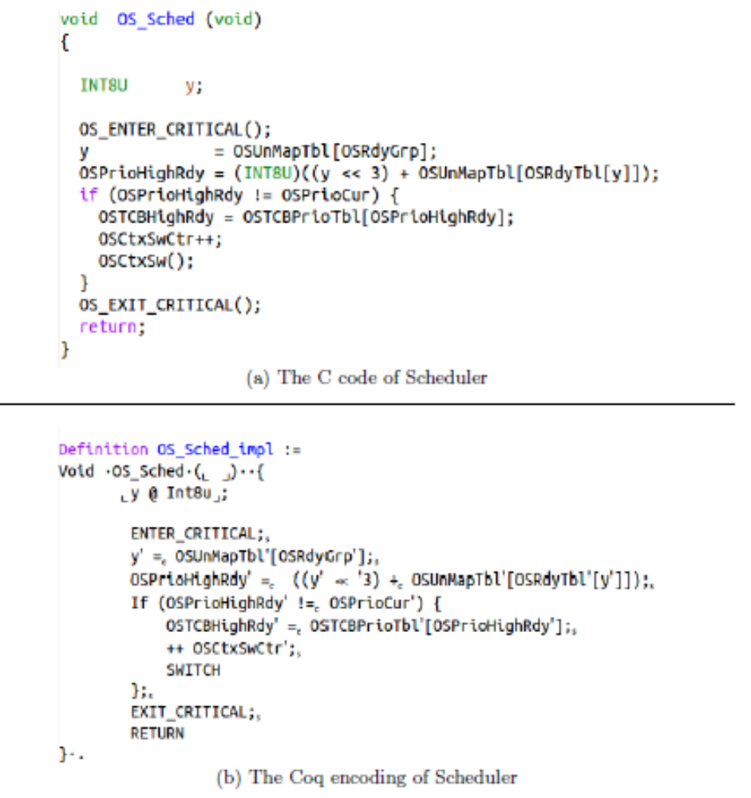

Slide 47
Example : OSTimeDly
Transfer relational states satisfying the invariant from public to local when entering the critical region
void OSTimeDly (INT16U ticks)
{
ticks → v * [|rerr(v)+rdly(v);sched|]
if (ticks > 0) {
ticks → v * [|rerr(v)+rdly(v);sched|] * (v>0)
OS_ENTER_CRITICAL();
ticks → v * [|rerr(v)+rdly(v);sched|] * (v>0) *
ticks → v * [|rerr(v)+rdly(v);sched|] * (v>0) *
ticks → v * [|sched|] * (v>0) *
OS_EXIT_CRITICAL();
ticks → v * [|sched|] * (v>0)
OS_Sched();
ticks → v * [|end|] * (v>0)
}
ticks → v * [|end|]
}
I0
TCBList
RdyTbl
AbsTCBList
…
TCBList’
RdyTbl’
AbsTCBList
TCBList’
RdyTbl’
AbsTCBList’
I0
Reestablish the invariant for transferring from local to public
when exiting critical region

