Slide 1

Safe and Scalable
Concurrency for
OpenHarmony
Ming Fu
Huawei Fields Lab
OpenHarmony Concurrency & Coordination TSG
2026 OpenHarmony Technical Conference (Global)
3 October 2026, Prague
Notes:
SLIDE 1. 00:00 to 01:27. 152 spoken words. 0 reveal clicks.
Pacing guide: 115 spoken words per minute plus 8 seconds for pauses, pointing and slide changes.
Read speech paragraphs only. Bracketed directions and references are silent.
[Opening slide stays visible. Pause after the question.]
Hello everyone. I'm Ming Fu from Huawei Fields Lab. I also lead the OpenHarmony Concurrency and Coordination TSG.
A quick show of hands: have you ever written a lock, a concurrent queue, or a stack? Or debugged a program stuck in one?
[PAUSE for 4 seconds. Look around the room. Do not invite spoken answers.]
This began with a task at Huawei: implement the big kernel lock for the HarmonyOS microkernel.
Soon after, tasks started getting stuck in its spin loop. Testing was blocked for more than two weeks. Since I had written the lock, everyone looked at me. Those were stressful days.
Eventually, we found the cause. The lock itself was not the problem. The calling context was wrong.
I was relieved. But next time, how could I show that the lock was correct, instead of just saying, "I think it is"?
Today I will show how we build that confidence, improve performance for mobile workloads, and learn what verification alone cannot tell us.
[NEXT SLIDE: advance once.]
REFERENCE NOTES - NOT SPOKEN
References
https://www.openharmony.cn/

Slide 2
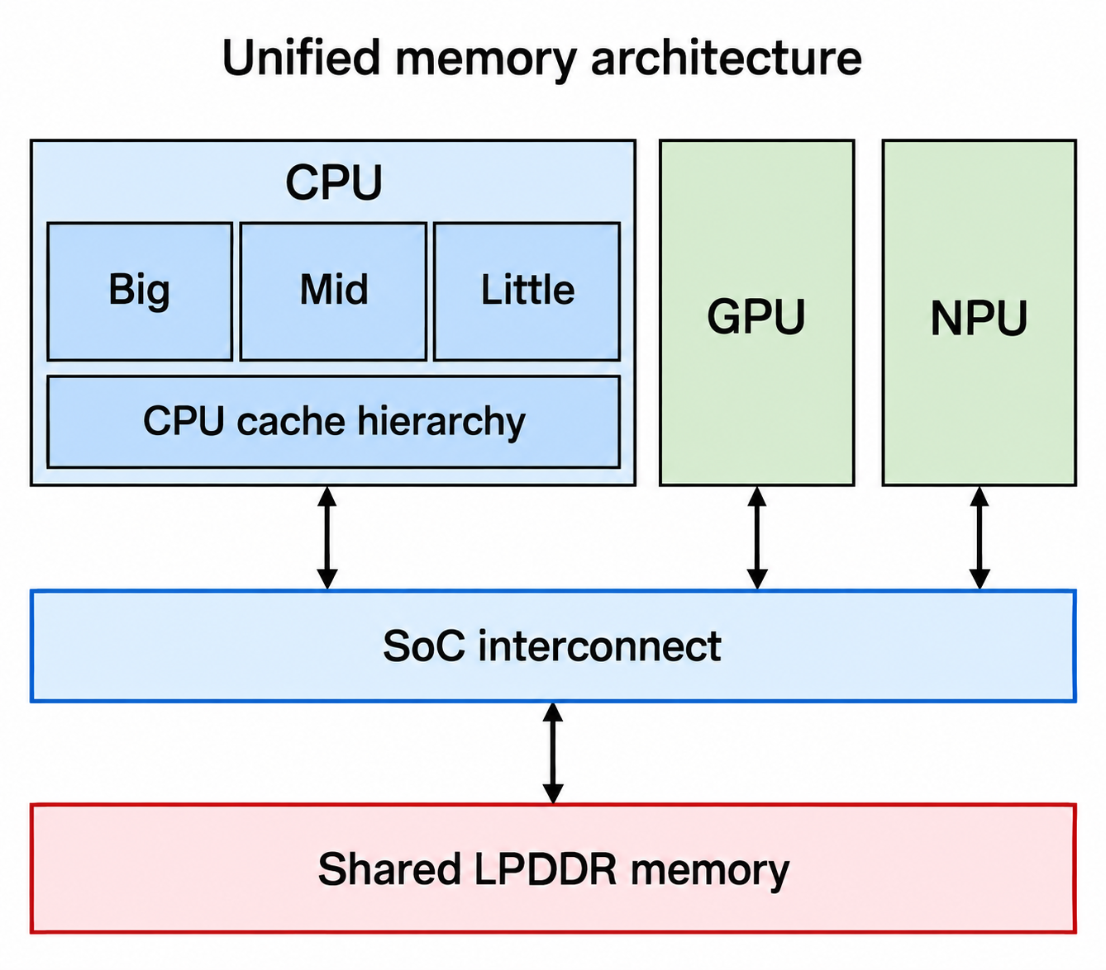
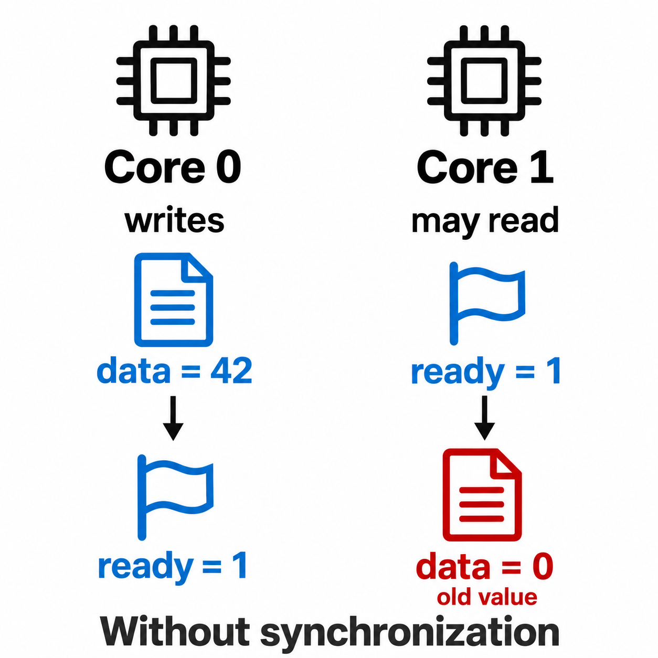
Concurrency Gets Harder as Hardware Scales
More Cores
Heterogeneous Compute
Weak Memory
Trends of Core Count and Frequency over Years
250
Core Count
10000
200
Frequency
1000
150
100
Core Count
Frequency (MHz)
100
10
50
1
0
1970
1980
1990
2000
2010
2020
0.1
Year
Stronger Ordering
Weaker Ordering
Performance relies on parallelism.
Different engines share DRAM.
Fewer behaviors
Potentially higher cost
More freedom
Potentially faster
Keep the ordering required for correctness.
02
Notes:
SLIDE 2. 01:27 to 02:32. 114 spoken words. 2 reveal clicks.
Pacing guide: 115 spoken words per minute plus 6 seconds for pauses, pointing and slide changes.
Read speech paragraphs only. Bracketed directions and references are silent.
[Start with the core-count chart on the left.]
The hardware makes that question harder. Clock speed no longer gives us easy performance gains. We rely more on parallel work, which means more coordination.
[CLICK 1: Reveal the mobile SoC and shared DRAM. Pause briefly, then speak.]
On a mobile chip, the cores are also different. Big, middle and little CPU cores work alongside a GPU and an NPU. These engines still share memory resources.
[CLICK 2: Reveal weak memory and the ordering takeaway. Pause briefly, then speak.]
Now look at the flag example. Without the right synchronization, a reader can see the ready flag but still observe old data. Atomic accesses alone need not order these two locations.
Stronger ordering rules out more behaviors, but may cost more. Weaker ordering gives hardware more freedom. Our goal is to keep the ordering required for correctness, then measure the performance.
[NEXT SLIDE: advance once.]
REFERENCE NOTES - NOT SPOKEN
The flag example concerns ordering between atomic locations; a release store paired with an acquire load that reads that store supplies the required relationship. The historical processor chart is not a mobile-only dataset.
References
https://www.arm.com/technologies/big-little
https://newsroom.arm.com/blog/arm-total-compute
https://www.usenix.org/system/files/osdi26-xin.pdf
https://developer.arm.com/community/arm-community-blogs/b/architectures-and-processors-blog/posts/how-to-use-the-memory-model-tool

Slide 3
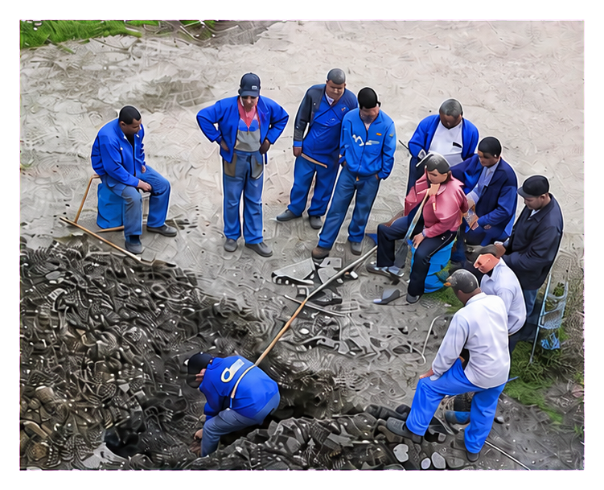
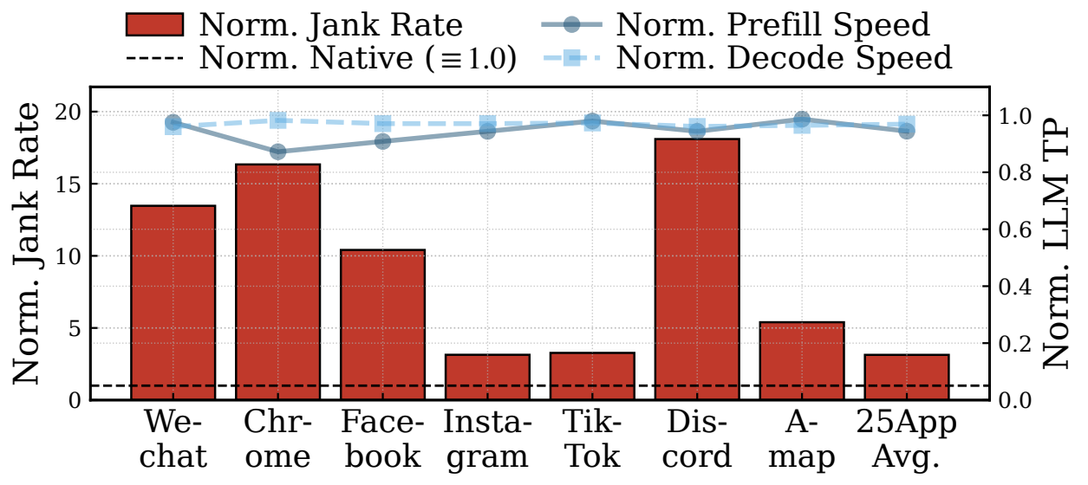

More Compute Does Not Guarantee a Responsive UI
Parallel workers need coordination,
not merely more headcount.
NPU inference can stall the UI
through shared memory bandwidth.
Core10
Core9
Core8
GPU
Core5
Core7
Core4
Core6
Core3
Core2
Core1
OnePlus 13 / Snapdragon 8 Elite / Llama-3.1-8B
Reliability risk:
Idle-work risk:
+153% aggregate foreground jank rate
Too many cooks
cause mistakes.
Workers wait or redo
because of conflicts.
LLM throughput drops by less than 2%.
External Android study, 25 apps. Chart shows per-app ratios.
Shared memory needs coordination across CPU, GPU and NPU.
03
Notes:
SLIDE 3. 02:32 to 03:24. 92 spoken words. 1 reveal clicks.
Pacing guide: 115 spoken words per minute plus 4 seconds for pauses, pointing and slide changes.
Read speech paragraphs only. Bracketed directions and references are silent.
[Start with the worker analogy on the left.]
More workers do not automatically finish the job sooner. They can interfere, wait, or repeat work. The same is true inside a phone.
[CLICK 1: Reveal the mobile inference study and conclusion. Pause briefly, then speak.]
Sereno, an external Android study, makes this concrete. In that setup, NPU inference increased foreground jank, or visible frame stutters, by a hundred and fifty-three percent overall. Yet inference throughput fell by less than two percent.
The inference engine looked healthy. The user experience did not. Shared memory bandwidth connected the two. So we need to evaluate coordination at the device level, not only the speed of one component.
[NEXT SLIDE: advance once.]
REFERENCE NOTES - NOT SPOKEN
External Android experiment, not an OpenHarmony measurement. Aggregate foreground jank change and per-application normalized bars use different aggregation. No battery-life or universal hardware claim.
References
https://www.usenix.org/system/files/osdi26-xin.pdf
The chart plots per-app normalized ratios (including their mean); +153% is the separately reported aggregate foreground jank-rate change. These are different aggregations, not the same bar.

Slide 4


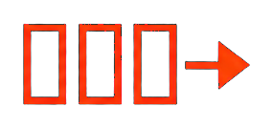

Concurrency Behind the OpenHarmony User Experience
Workloads
Mobile Applications
On-device AI
Device Services
(Inference / Assistants)
(I/O / Tracing)
Memory
Allocators
Management
Highly concurrent allocation and
cross-thread freeing
Thread
Locks
Queues / Work Stealing
Communication
Synchronous ownership
and exclusion
Asynchronous data and
task exchange
Mobile
Hardware
CPU
GPU
NPU
LPDDR
Display
UFS
Big / mid / little
Graphics
Inference
Shared memory
Screen / touch
Flash storage
04
Notes:
SLIDE 4. 03:24 to 04:12. 86 spoken words. 0 reveal clicks.
Pacing guide: 115 spoken words per minute plus 3 seconds for pauses, pointing and slide changes.
Read speech paragraphs only. Bracketed directions and references are silent.
[Static overview. Point from workloads down to hardware.]
Here is where these components sit in OpenHarmony.
Applications and device services rely on locks to protect shared state, queues to exchange data and tasks, and allocators to manage memory. One thread may create an object and another may free it.
Underneath, CPU, GPU and NPU activity shares resources with graphics, storage and other device work. A delay deep inside a queue or allocator can become a pause on the screen.
That is why this talk focuses on the mobile workload as well as the algorithm.
[NEXT SLIDE: advance once.]
REFERENCE NOTES - NOT SPOKEN
References
https://developer.arm.com/cfs-file/__key/communityserver-blogs-components-weblogfiles/00-00-00-20-66/siggraph_5F00_mmg_5F00_2024_5F00_Mobile101.pdf
https://developer.arm.com/community/arm-community-blogs/b/architectures-and-processors-blog/posts/whitepaper-optimizing-performance-for-an-arm-mobile-memory-subsystem

Slide 5
A Shared Foundation for OpenHarmony Components
Synchronous Communication
Asynchronous Communication
Concurrent Memory Management
CLoF
BBQ
jwmalloc
SOSP 2021
USENIX ATC 2022
OSDI 2026
Locks and ownership
Data exchange
Best Paper Award nominee
Objects
Pages
Block partitioning
NUMA-aware locks
BWoS
BTrace
Objects, pages, lifetimes
Task scheduling
Mobile tracing
Reuse and reclaim memory
OSDI 2023
ASPLOS 2025
NVIDIA/stdexec
OpenHarmony
OpenHarmony
Verification & Optimization Foundation
VSync
ASPLOS 2021 Distinguished Paper
Safety, liveness, weak-memory optimization
05
Notes:
SLIDE 5. 04:12 to 04:46. 60 spoken words. 0 reveal clicks.
Pacing guide: 115 spoken words per minute plus 3 seconds for pauses, pointing and slide changes.
Read speech paragraphs only. Bracketed directions and references are silent.
[Static research map. Point to the foundation and the two mobile cases.]
This map connects the work. VSync checks synchronization and memory ordering. Above it are locks, queues, task scheduling and memory allocation.
I will keep the verification foundation brief and focus on two mobile cases: BTrace, which preserves debugging history, and jwmalloc, which manages application memory. CLoF stays on the map as related NUMA research. Today, our focus is mobile devices.
[NEXT SLIDE: advance once.]
REFERENCE NOTES - NOT SPOKEN
CLoF remains part of the research map but has no separate case-study segment in this mobile talk. Do not claim all six systems are deployed upstream in OpenHarmony.
Scope note: CLoF is NUMA-oriented research. It appears in the research map, not as a claim that mobile OpenHarmony devices use NUMA hardware or that CLoF is deployed there.

Slide 6
Verification and Optimization with VSync
Synchronous Communication
Asynchronous Communication
Concurrent Memory Management
CLoF
BBQ
jwmalloc
SOSP 2021
USENIX ATC 2022
OSDI 2026
Locks and ownership
Data exchange
Best Paper Award nominee
Objects
Pages
Block partitioning
NUMA-aware locks
BWoS
BTrace
Objects, pages, lifetimes
Task scheduling
Mobile tracing
Reuse and reclaim memory
OSDI 2023
ASPLOS 2025
NVIDIA/stdexec
OpenHarmony
OpenHarmony
Verification & Optimization Foundation
VSync
ASPLOS 2021 Distinguished Paper
Safety, liveness, weak-memory optimization
06
Notes:
SLIDE 6. 04:46 to 04:57. 18 spoken words. 0 reveal clicks.
Pacing guide: 115 spoken words per minute plus 2 seconds for pauses, pointing and slide changes.
Read speech paragraphs only. Bracketed directions and references are silent.
[Static section marker. Advance promptly.]
We begin with the foundation: how can we change a concurrency primitive without relying only on stress tests?
[NEXT SLIDE: advance once.]
REFERENCE NOTES - NOT SPOKEN
Scope note: CLoF is NUMA-oriented research. It appears in the research map, not as a claim that mobile OpenHarmony devices use NUMA hardware or that CLoF is deployed there.

Slide 7
VSync Framework: Search, Check, and Report
Propose cheaper memory orders, then check safety and await-loop termination.
Await Model Checking
(AMC)
% vsyncer optimize sync_prim.c
input IR
mutation
checker
mutated IR
AMC
sync_prim.c
clang
result
imports
barrier-mode
combination
status
VSync
atomics
generic
client code
barrier
analyzer
ALR
optimizer
optimization
report
#barriers
Adaptive Linear Relaxation
(ALR)
1
Expose Ordering Choices
2
Search with ALR
3
Check with AMC
Identify memory-order choices
and optimization sites.
ALR searches progressively
relaxed configurations.
AMC checks safety and await
termination under supported
assumptions.
Checked
Optimization
Report
VSync: Push-Button Verification and Optimization for Synchronization Primitives on Weak Memory Models (ASPLOS 2021)
07
Notes:
SLIDE 7. 04:57 to 06:05. 120 spoken words. 1 reveal clicks.
Pacing guide: 115 spoken words per minute plus 5 seconds for pauses, pointing and slide changes.
Read speech paragraphs only. Bracketed directions and references are silent.
[The framework is visible. Trace the loop without naming every box.]
VSync takes a synchronization implementation and a small concurrent test program. The test describes the interactions and properties we want to check.
The optimizer, ALR, proposes weaker memory ordering. The checker, AMC, explores the resulting behaviors and feeds its answer back into the search. We still benchmark the checked result to find out whether it is actually faster.
[CLICK 1: Reveal the three-step summary and checked report. Pause briefly, then speak.]
The search algorithm reduces the configurations to try. The model checker handles polling loops and checks safety and possible endless waiting under supported assumptions.
This turns an intuition about performance into a candidate we can check.
The evidence still has a scope: the test program, the properties and the memory model. A checked lock does not automatically make every calling context correct.
[NEXT SLIDE: advance once.]
REFERENCE NOTES - NOT SPOKEN
Verification is scoped to the modeled client, properties, memory model and supported progress assumptions. A timeout does not establish correctness.
https://arxiv.org/pdf/2102.06590 — VSync paper: AMC assumptions and bounded client scope.
Paper and publication: https://mingmfu.github.io/papers/asplos2021-vsync.pdf (ASPLOS 2021). A maximally relaxed configuration is not a guarantee of the fastest measured implementation.

Slide 8
Asynchronous Communication for OpenHarmony
Synchronous Communication
Asynchronous Communication
Concurrent Memory Management
CLoF
BBQ
jwmalloc
SOSP 2021
USENIX ATC 2022
OSDI 2026
Locks and ownership
Data exchange
Best Paper Award nominee
Objects
Pages
Block partitioning
NUMA-aware locks
BWoS
BTrace
Objects, pages, lifetimes
Task scheduling
Mobile tracing
Reuse and reclaim memory
OSDI 2023
ASPLOS 2025
NVIDIA/stdexec
OpenHarmony
OpenHarmony
Verification & Optimization Foundation
VSync
ASPLOS 2021 Distinguished Paper
Safety, liveness, weak-memory optimization
08
Notes:
SLIDE 8. 06:05 to 06:16. 17 spoken words. 0 reveal clicks.
Pacing guide: 115 spoken words per minute plus 2 seconds for pauses, pointing and slide changes.
Read speech paragraphs only. Bracketed directions and references are silent.
[Static section marker. Advance promptly.]
With that foundation, we can ask a design question: how much coordination does each operation really need?
[NEXT SLIDE: advance once.]
REFERENCE NOTES - NOT SPOKEN
Scope note: CLoF is NUMA-oriented research. It appears in the research map, not as a claim that mobile OpenHarmony devices use NUMA hardware or that CLoF is deployed there.

Slide 9
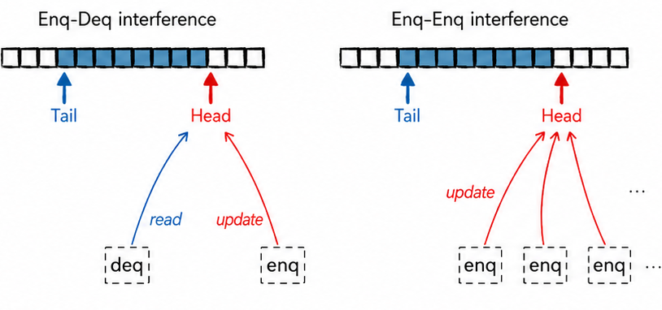
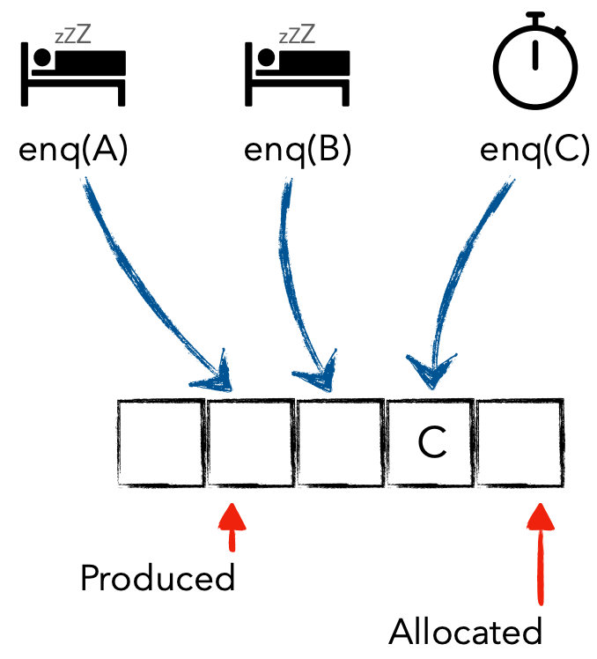
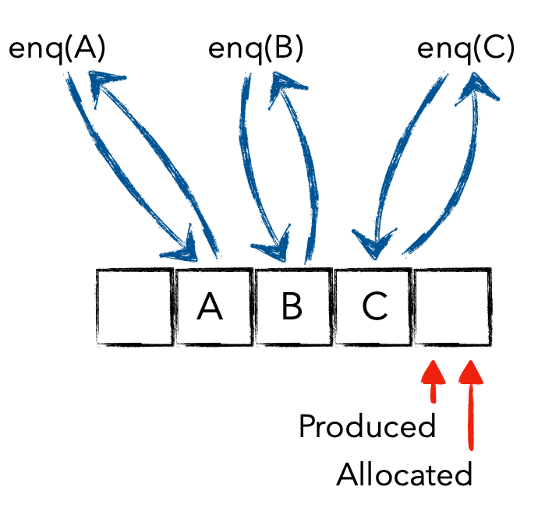
Why Asynchronous Communication Is Hard
Two costs: shared-cache traffic and waiting for earlier operations.
Spatial Interference
Temporal Dependency
Shared Head/Tail updates create cache-line ping-pong.
A producer can be delayed after reserving a slot.
Enq–Deq and Enq–Enq serialize on common metadata.
Later completion waits even when useful work is ready.
The dominant cost depends on the workload.
BBQ: shared state BWoS: stealing overhead BTrace: uneven buffer demand
09
Notes:
SLIDE 9. 06:16 to 07:16. 104 spoken words. 2 reveal clicks.
Pacing guide: 115 spoken words per minute plus 6 seconds for pauses, pointing and slide changes.
Read speech paragraphs only. Bracketed directions and references are silent.
[Start with spatial interference on the left.]
Queues look simple until many threads touch them at once. On the left, producers and consumers update shared metadata. Cache lines move between cores, and useful work turns into coordination traffic.
[CLICK 1: Reveal temporal dependency on the right. Pause briefly, then speak.]
On the right, a producer reserves a queue slot and then gets delayed. In this design, later producers may have written their data but still wait for that earlier operation to commit. This is a waiting problem as well as a cache problem.
[CLICK 2: Reveal the workload comparison at the bottom. Pause briefly, then speak.]
The dominant cost changes with the workload. Data exchange suffers from shared state. Work stealing can disturb the owner. Mobile tracing suffers when fixed buffers do not match recording activity.
[NEXT SLIDE: advance once.]
REFERENCE NOTES - NOT SPOKEN
References
https://mingmfu.github.io/papers/BBQ-slides.pdf
https://mingmfu.github.io/papers/BBQ.pdf

Slide 10
Block-Based Coordination Across Three Workloads
A shared design principle with different ownership, ordering and lifetime rules
FIFO MPMC Queue
BBQ: Block-Based MPMC FIFO
1. FIFO Data
Exchange
queue
partition the
shared queue
Shared metadata limits scaling
Local fast paths · boundary coordination
Traditional Work-Stealing Queue
BWoS: Block-Based Work Stealing
Worker 0
Worker 1
Worker 2
Worker 3
Worker 0
Worker 1
Worker 2
Worker 3
2. Task
Scheduling
queue
queue
queue
queue
transfer ownership
by block
Fine-grained steals are costly
Fast local path · balanced stealing
Per-Core SPSC Queues
BTrace: Block-Based Mobile Tracing
Core 0
Core 1
Core 2
Core 3
Core 0
active block
3. Mobile
Tracing
queue
queue
queue
queue
Core 1
closed block
mobile constraints +
block lifecycle
Core 3
skipped block
Core 2
reclaimed slot
partition · close · skip · reclaim
Fast but imbalanced · fixed capacity
Longer continuous recent history
10
Notes:
SLIDE 10. 07:16 to 08:24. 115 spoken words. 3 reveal clicks.
Pacing guide: 115 spoken words per minute plus 8 seconds for pauses, pointing and slide changes.
Read speech paragraphs only. Bracketed directions and references are silent.
[The three existing designs remain visible on the left.]
We explored a common idea: coordinate around blocks, so frequent operations can do more work locally.
[CLICK 1: Reveal BBQ in the first row. Pause briefly, then speak.]
BBQ partitions a shared first-in, first-out queue into blocks. Producers can complete independently, without one long commit chain. Consumers still preserve order, so a delayed producer can still delay consumption.
[CLICK 2: Reveal BWoS in the second row. Pause briefly, then speak.]
For BWoS, blocks organize task ownership. Local work and remote stealing interfere less, while workers can balance the load. A task must never disappear or run twice.
[CLICK 3: Reveal BTrace in the third row. Pause briefly, then speak.]
For BTrace, blocks let recording capacity follow activity across cores. Their lifecycle controls which history remains available and when memory can be reused.
Across all three, we change the unit of coordination. Each workload still needs its own ownership and ordering rules.
[NEXT SLIDE: advance once.]
REFERENCE NOTES - NOT SPOKEN
Primary sources for the three different block protocols:
https://mingmfu.github.io/papers/BBQ.pdf
https://www.usenix.org/conference/osdi23/presentation/wang-jiawei
https://wangjwchn.github.io/papers/ASPLOS2025.pdf
The commonality is coordination at block granularity, not identical ownership or progress properties. Delayed producers may still delay FIFO consumption in BBQ.

Slide 11
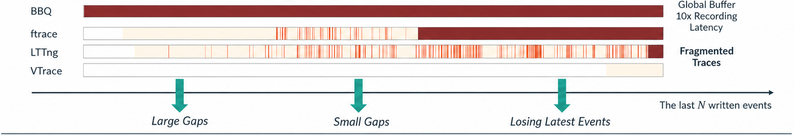
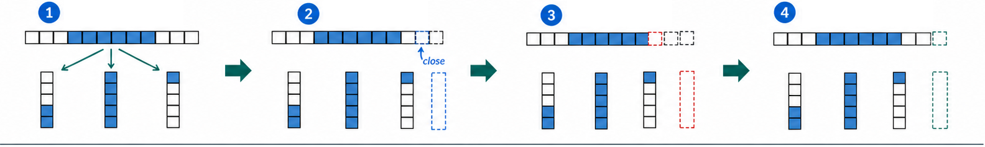
BTrace: Longer Tracing History in OpenHarmony
The cause may disappear long before the symptom appears.
Global buffer
Higher recording
overhead
Block partitioning
Block closing
Block skipping
Implicit reclaiming
Longer History
Low Recording Overhead
In OpenHarmony
About 2× continuous history
vs. ftrace, same buffer budget.
53 ns vs. 63 ns per entry (ftrace).
Geometric mean in reported workloads.
Producer completion saves
extra synchronization.
200+ long-causality bugs
in reported beta deployment.
Enabling Efficient Mobile Tracing with BTrace (ASPLOS 2025)
11
Notes:
SLIDE 11. 08:24 to 10:27. 212 spoken words. 2 reveal clicks.
Pacing guide: 115 spoken words per minute plus 12 seconds for pauses, pointing and slide changes.
Read speech paragraphs only. Bracketed directions and references are silent.
[Start with the trace histories at the top.]
Suppose a thread spins, heats the chip, and then exits. Later, thermal control reduces CPU frequency and the user sees dropped frames.
A short trace shows the dropped frames but misses the thread that caused them. The cause has disappeared before the symptom arrives.
Fixed per-core buffers make recording cheap. But a busy core may overwrite useful history while another still has space. A single shared buffer avoids that rigid split, but adds recording overhead.
[CLICK 1: Reveal the block lifecycle. Point across the four mechanisms. Pause briefly, then speak.]
BTrace keeps recording local while cores draw blocks from shared capacity. Space can follow activity.
Block closing lets a core finish with a partly filled block. Block skipping lets recording move past a block held by a delayed writer. Completing a block also signals that its producer has finished accessing the data for this round.
That signal saves extra synchronization on the recording path. Consumers still need epoch-based protection for safe reclamation.
[CLICK 2: Reveal history, latency and deployment results. Pause briefly, then speak.]
Within the same buffer budget, BTrace preserves about twice the recent continuous history of ftrace in the reported workloads. The geometric mean recording latency is fifty-three nanoseconds per entry, compared with sixty-three for ftrace.
BTrace is deployed in OpenHarmony. In the reported beta deployment, it helped diagnose over two hundred bugs whose causes occurred much earlier than their symptoms. Longer history made those connections possible.
[NEXT SLIDE: advance once.]
REFERENCE NOTES - NOT SPOKEN
The 53 ns and 63 ns recording numbers are measured geometric-mean per-entry latencies. Longer history does not imply zero event loss. The reported 200+ diagnoses and performance setting should not be generalized to every OpenHarmony release or device.
References
https://mingmfu.github.io/papers/BTrace-slides.pdf
https://mingmfu.github.io/papers/btrace.pdf
https://wangjwchn.github.io/papers/ASPLOS2025.pdf — Section 5: 12 MB buffer per tracer. Table 2: geometric-mean latest continuous entries, 10.8 MB vs 5.4 MB for ftrace. Section 6: more than 200 long-causality bugs in beta deployment.
Paper and publication: https://mingmfu.github.io/papers/btrace.pdf (ASPLOS 2025), Table 1 and Section 6.3. Recording latency is a geometric mean, not a tail bound.

Slide 12
Concurrent Memory Management in OpenHarmony
Synchronous Communication
Asynchronous Communication
Concurrent Memory Management
CLoF
BBQ
jwmalloc
SOSP 2021
USENIX ATC 2022
OSDI 2026
Locks and ownership
Data exchange
Best Paper Award nominee
Objects
Pages
Block partitioning
NUMA-aware locks
BWoS
BTrace
Objects, pages, lifetimes
Task scheduling
Mobile tracing
Reuse and reclaim memory
OSDI 2023
ASPLOS 2025
NVIDIA/stdexec
OpenHarmony
OpenHarmony
Verification & Optimization Foundation
VSync
ASPLOS 2021 Distinguished Paper
Safety, liveness, weak-memory optimization
12
Notes:
SLIDE 12. 10:27 to 10:41. 23 spoken words. 0 reveal clicks.
Pacing guide: 115 spoken words per minute plus 2 seconds for pauses, pointing and slide changes.
Read speech paragraphs only. Bracketed directions and references are silent.
[Static section marker. Connect the two mobile cases.]
BTrace makes better use of a fixed memory budget. Now let us look at the allocator that manages memory for the application itself.
[NEXT SLIDE: advance once.]
REFERENCE NOTES - NOT SPOKEN
Scope note: CLoF is NUMA-oriented research. It appears in the research map, not as a claim that mobile OpenHarmony devices use NUMA hardware or that CLoF is deployed there.

Slide 13
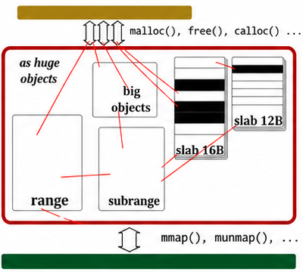
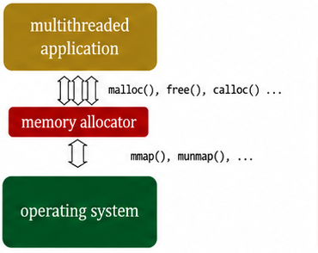
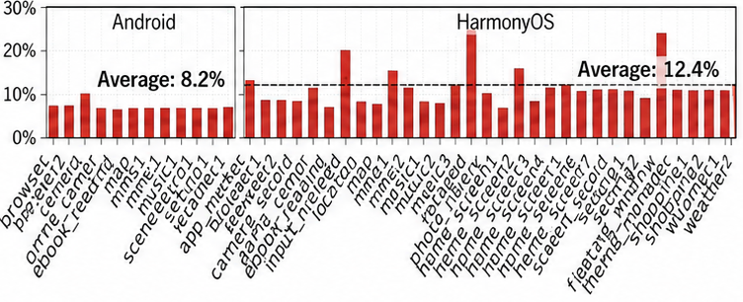
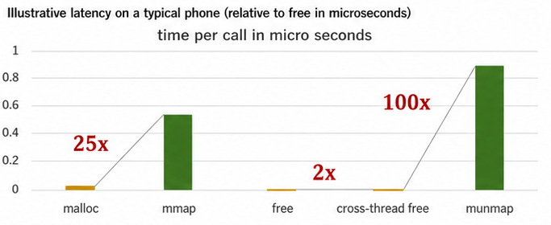
Memory Allocation on Mobile Devices
Memory Allocator: System Interface
Opportunities in Mobile Workloads
Manage application objects over OS memory ranges.
Frequent allocation meets limited mobile DRAM.
Retained pages increase memory pressure and can trigger background-app kills.
Instruction share with jemalloc: 8.2% on Android; 12.4% on HarmonyOS.
Illustrative timings (µs), not a mobile-workload benchmark
13
Notes:
SLIDE 13. 10:41 to 11:41. 106 spoken words. 1 reveal clicks.
Pacing guide: 115 spoken words per minute plus 5 seconds for pauses, pointing and slide changes.
Read speech paragraphs only. Bracketed directions and references are silent.
[Start with the allocator and OS interface on the left.]
An allocator connects small application objects to larger memory ranges from the operating system. It reuses space without an expensive OS call for every object.
The small timing chart illustrates that difference; it is not a mobile benchmark.
[CLICK 1: Reveal the mobile workload opportunity. Pause briefly, then speak.]
On a phone, applications share limited DRAM. Keeping unused memory can push other applications out. Returning it too aggressively creates work when it is needed again.
With jemalloc, allocation accounts for about eight percent of instructions on Android and twelve percent on HarmonyOS in the measured workloads.
So a fast malloc is only part of the goal. We also need timely release and short delays on user-critical threads.
[NEXT SLIDE: advance once.]
REFERENCE NOTES - NOT SPOKEN
8.2% and 12.4% are allocator instruction shares in the measured Android/HarmonyOS workloads. The small mmap/munmap timing chart is illustrative, not the phone workload evaluation.
References
https://mingmfu.github.io/papers/osdi26-paper51.pdf
https://mingmfu.github.io/papers/jwmalloc-slides.pdf
https://www.usenix.org/system/files/osdi26-wang-jiawei.pdf — Figure 1 measures allocation instruction shares using jemalloc (8.2% Android, 12.4% HarmonyOS).

Slide 14
jwmalloc: Four Ideas for Mobile Workloads
< 2 KB
2 KB - 16 KB
>16 KB - 4 MB
> 4 MB
jwmalloc in OpenHarmony
Frontend
Midend
Backend
Direct OS mapping
Frontend
Midend
1
TLS
Frontend: per-thread 4 KB slabs
for objects smaller than 2 KB.
Direct map
Size class [0 B, 8 B]
Local
count=3
Objects
slab
slab
slab
...
offset
offset
offset
offset
offset
offset
Current
Partial
Empty
...
Size class (8 B, 16 B]
Cross
count=2
Midend: shared slabs
for 2-16 KB objects.
slab
slab
slab
...
offset
Current
Partial
Empty
Slab
Backend: CST for large objects
and slab backing ranges.
Slab pooling
In-use
Nest
Slab:
0110...
Bitmap
Objects
...
Manager
Backend
1
Unified Slab
Nest (mapped)
3
4
2
Closed sibling tree
Knit
Active
2
Closed Sibling Tree
Size class
[0 B, 4 KB]
Work-stealing queue
Defer list
range
range
range
range
in-use
Standby
Work-stealing queue
mapped
3
Generational Reclamation
...
range
range
unmapped
range
4
Lock-Based Lock-Free
Thrift
Nest (unmapped)
root range
root range
Backend index: updated queue-based implementation; evaluation results are from the published version.
jwmalloc: A Verified Memory Allocator for Mobile Devices (OSDI 2026)
14
Notes:
SLIDE 14. 11:41 to 12:43. 112 spoken words. 0 reveal clicks.
Pacing guide: 115 spoken words per minute plus 4 seconds for pauses, pointing and slide changes.
Read speech paragraphs only. Bracketed directions and references are silent.
[Static architecture map. Name the four ideas without reading every label.]
This is jwmalloc. A slab is a page or group of pages divided into equal-sized objects. Small objects use per-thread slabs. Medium-sized objects use shared slabs in the middle layer. The CST backend supplies larger objects and the memory behind slabs. Very large requests go directly to the OS.
The four ideas answer practical questions.
Can an empty slab serve another size class cheaply? Can every split leave a usable remainder? When should free pages return to the OS? How can we avoid waiting for a preempted lock owner?
This backend includes an updated search index built from work-stealing queues. The performance results later in the talk refer to the published version.
[NEXT SLIDE: advance once.]
REFERENCE NOTES - NOT SPOKEN
Current author-supplied implementation: Active and Standby free-range search indexes use work-stealing queues, with a separate deferred list. The published bitmap/list containers served the same search role. The Midend slab bitmap has a different purpose and remains in this diagram.
References
https://mingmfu.github.io/papers/osdi26-paper51.pdf
https://mingmfu.github.io/papers/jwmalloc-slides.pdf
Version note: The work-stealing queues depict the updated implementation described by the author. The published OSDI paper uses a bounded bitmap plus locked list. Published evaluation results on slide 19 are not a separate benchmark of the updated queue-based backend.
Routing thresholds apply to application object sizes. The backend also supplies small slab backing ranges, including a 4 KB frontend slab; its range size space is not restricted to application objects larger than 16 KB (Section 4.1).
Paper and publication: https://mingmfu.github.io/papers/osdi26-paper51.pdf (OSDI 2026). The queue-based index is the author update. Do not attribute it or new performance results to the published bitmap/list implementation.

Slide 15
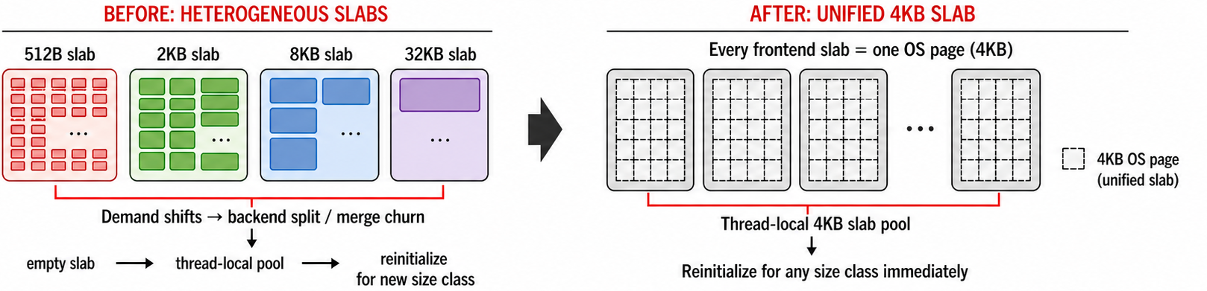
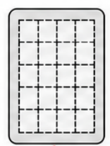
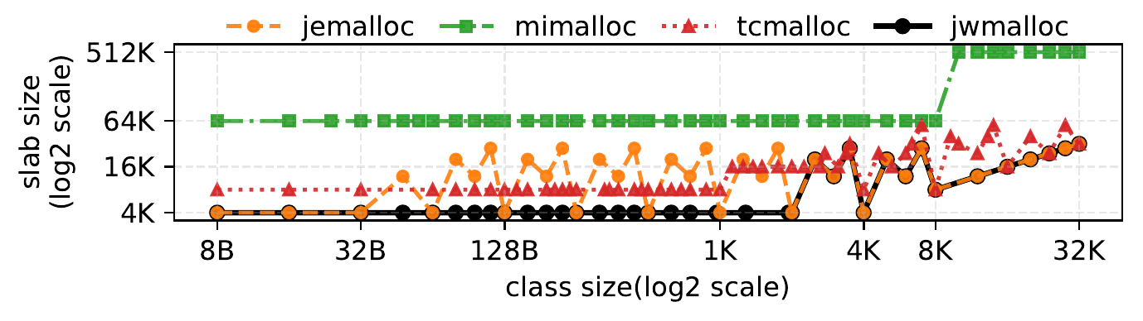
Unified Slabs: Reuse Pages as Demand Changes
Before: Heterogeneous Slabs
After: Unified 4 KB Slab
Slab A
Slab B
Slab C
Slab D
Every frontend slab uses one 4 KB OS page.
Reuse an empty slab for a new size class,
without a backend split or merge.
Size classes limit unused space at the end of a slab.
Slab size by object size class, up to 32 KB
Default allocator configurations; 4 KB OS pages
15
Notes:
SLIDE 15. 12:43 to 13:47. 113 spoken words. 1 reveal clicks.
Pacing guide: 115 spoken words per minute plus 5 seconds for pauses, pointing and slide changes.
Read speech paragraphs only. Bracketed directions and references are silent.
[The before-and-after diagram is visible. Point to the common 4 KB size.]
A mobile application's allocation mix changes as it opens a page, decodes content, or changes activity. Different slab sizes can make that change expensive: empty space may need backend splitting or merging before it can serve another class.
jwmalloc gives each frontend slab one OS page, four kilobytes in this configuration.
[CLICK 1: Reveal the reuse explanation and size comparison. Pause briefly, then speak.]
Once a slab is completely empty, we can return it to the local pool and reinitialize it for another small-object class. No backend split or merge is needed for that reuse.
The slab must be completely empty; live objects do not move. The size classes also limit unused space at the slab's end. A uniform container makes changing demand easier to serve.
[NEXT SLIDE: advance once.]
REFERENCE NOTES - NOT SPOKEN
References
https://mingmfu.github.io/papers/osdi26-paper51.pdf
https://mingmfu.github.io/papers/jwmalloc-slides.pdf

Slide 16
Closed Sibling Tree: Size Classes and Compact State
Same request: 33 KB. Same starting range: 256 KB.
Buddy Allocator (R = 1)
1 Size Classes and Fragmentation
256 KB
x = n × 2ᵐ, 1 ≤ n ≤ 2ᴿ
Roundup fragmentation ≤ 1 / 2ᴿ⁻¹
R = 3: at most 25% relative to the request.
128 KB
128 KB
64 KB
64 KB
32 KB is too small
64 − 33 = 31 KB rounding waste
2 One Common Unit per Sibling Group
CST (R = 3)
p = np × 2ᵐ, cᵢ = nᵢ × 2ᵐ
np = Σ nᵢ, 1 ≤ np, nᵢ ≤ 2ᴿ
Adjacent sibling merges preserve size classes.
256 KB
m = 5: 8 = 2 + 6
8 × 2⁵ KB
64 KB
192 KB
3 Compact Sibling State
2 × 2⁵ = 8 × 2³ KB
6 × 2⁵ KB
40 KB
24 KB
m = 3: 8 = 5 + 3
Pack sibling states into one atomic word.
Keep split and merge results in the size-class set.
5 × 2³ KB
3 × 2³ KB
1 ≤ n ≤ 8 for every node
40 − 33 = 7 KB rounding waste
Dark: allocated White: free Gray: subdivided
16
Notes:
SLIDE 16. 13:47 to 15:17. 148 spoken words. 2 reveal clicks.
Pacing guide: 115 spoken words per minute plus 13 seconds for pauses, pointing and slide changes.
Read speech paragraphs only. Bracketed directions and references are silent.
[Start with the upper Buddy tree. Point to the 64 KB allocated leaf.]
The second idea is the Closed Sibling Tree, or CST. Both examples start with two hundred and fifty-six kilobytes and request thirty-three.
Buddy allocates sixty-four kilobytes, leaving thirty-one unused inside the allocated block. The white nodes remain free.
[CLICK 1: Reveal the lower CST tree and its 7 KB rounding waste. Pause briefly, then speak.]
CST offers finer size classes. Here, R is three, so a sibling group can use up to eight units. We split the root, then split the smaller child into forty and twenty-four kilobytes.
Forty is enough for this request, leaving only seven kilobytes unused inside that block. Both white remainders remain reusable.
[CLICK 2: Reveal the size-class rule, common-unit invariant and compact sibling state. Point to five units plus three.]
Within each sibling group, the parent and children share one unit. Five units plus three make eight. This keeps adjacent sibling merges in the size-class set. Sibling states also fit in one atomic word.
The design gives us flexible sizes with compact state. The smaller rounding waste here is an example, not a claim about total application memory.
[NEXT SLIDE: advance once.]
REFERENCE NOTES - NOT SPOKEN
Illustrative 33 KB request from a 256 KB free range. Buddy R=1 allocates 64 KB with 31 KB internal rounding waste. CST R=3 splits 256 into 64+192 using 32 KB units, then 64 into 40+24 using 8 KB units. It allocates 40 KB with 7 KB internal rounding waste. White nodes remain reusable; they are not internal waste. Sizes ignore allocator metadata and other implementation overhead. The common-unit invariant is local to each sibling group. Request-relative worst rounding bound at R=3 is 25%, not a bound on total memory fragmentation. The corrected algorithm derives the split unit from parent(X), not X.
References
https://mingmfu.github.io/papers/jwmalloc-slides.pdf
https://mingmfu.github.io/papers/osdi26-paper51.pdf
Compact state: Section 4.2.3, p. 9, packs all sibling states under one parent into a single atomic variable. This is a representation benefit, not a measured superiority claim against jemalloc or a 64-bit bound for arbitrary resolution.

Slide 17
Generational Reclamation: A Useful Limit to Waiting
Generational hypothesis: Objects that survive for a while tend to live much longer.
Streaming workload: 90% of pages become unused within 33.55 ms of allocation.
Why waiting has a useful limit
How Young / Old work
Free
Short-lived (live)
Long-lived (live)
Both pools hold free, reusable ranges.
Now
A
B
C
L
D
E
F
free
reuse
reuse
Short wait
A + B + C
L
D + E + F
swap roles
every Δ
Longer wait
A + B + C
L
D + E + F
L stays live: no merge across it.
Reclamation calls
Memory retention cost
Young
Old
merge
Merge adjacent free ranges
reclaim
knee
wait time
knee
wait time
Either pool; result returns to Young
madvise
Conceptual curves; the knee varies by workload.
Reclaim ranges that remain in Old for an interval.
17
Notes:
SLIDE 17. 15:17 to 17:14. 200 spoken words. 2 reveal clicks.
Pacing guide: 115 spoken words per minute plus 13 seconds for pauses, pointing and slide changes.
Read speech paragraphs only. Bracketed directions and references are silent.
[Start with the generational hypothesis and the Now row. Point to the red live separator.]
Knowing how to merge is not enough. How long should free pages wait before returning to the OS?
The generational hypothesis says that objects surviving for a while tend to live much longer. The streaming measurement shows a short-lived majority and a long-lived tail.
Green pages are free. Their blue neighbors may soon become free, but the red page keeps the clusters apart.
[CLICK 1: Reveal Short wait, Longer wait and both conceptual curves on the left. Compare the persistent red page, then point to the knee.]
A short wait lets each cluster merge. While the red page stays live, extra waiting brings little more benefit. Too short a wait causes more reclamation calls. Too long a wait retains memory that other applications need. The useful delay depends on the workload.
[CLICK 2: Trace free into Young, periodic role swaps, merging back into Young, and reclamation from Old.]
Young and Old both hold free, reusable ranges. They describe how long a free range has waited, not the age of a live object. Newly freed ranges enter Young. Old is the normal reclamation exit. Here, madvise releases physical pages while keeping the virtual address range.
Periodically swapping pool roles implements the wait without a timer for every range.
Eligible adjacent ranges from either pool can merge. The result enters Young, restarting the wait. Ranges remaining in Old through an interval become eligible for reclamation. Under memory pressure, the allocator can reclaim earlier.
[NEXT SLIDE: advance once.]
REFERENCE NOTES - NOT SPOKEN
Source evidence: jwmalloc paper, Figure 5 (PDF p. 3), Section 2.3 observation 3 (p. 4), and Section 3.3 (pp. 6-7). The original jwmalloc slides, logical slide 8 / PDF p. 11, explicitly identify live ranges as barriers to coalescing and introduce Young / Old pools. Author-provided discussion with Jonas Oberhauser, supplied 26 September 2026, motivates the explicit saturation insight and conceptual curves.
90% within 33.55 ms measures page-granularity allocation lifetime in the streaming workload. It is not a time since free, a conditional distribution of neighboring frees, or a universal reclamation delay. No 40 ms deadline, 90/10 benefit-cost result, or measured optimal interval is asserted. The paper's Section 4.2.4 (p. 9) uses a 500 ms futex timeout in that setting, subject to earlier wake-up. The conceptual knee here is not that implementation parameter.
The left diagram shows one illustrative sibling group with merge-compatible A/B/C and D/E/F. Initially A and D are free. While L remains live, no coalescing can cross it, but both free clusters can still be returned separately. The number and placement of blocks do not depict the measured 90% fraction. No allocation or reuse occurs during this illustrative interval.
The two curves on the left are qualitative, not measurements or a proven optimality result. They describe reclamation calls saved through coalescing and the cost of retaining free memory as the delay grows. They do not assert that all system calls, reuse benefits, or total performance must plateau, or that retention is universally linear. A long-lived page is not immortal. The useful waiting window depends on workload and memory pressure; the insight is diminishing additional coalescing while the live barriers persist.
Merge semantics: Section 3.3, p. 7, places freed and coalesced ranges in the active buffer (Young). Section 4.2 and Figure 11, p. 8, describe place(r) repeatedly acquiring adjacent siblings and joining them before rel(r). Section 4.2.3, p. 9, bases eligibility on adjacent siblings, ownership, and mapped/unmapped state, not Young/Old membership. Ranges from either generational buffer can therefore participate when the adjacency, state and concurrency conditions are satisfied; the result enters Young, resetting the waiting opportunity. The Old-to-Young merge arrow indicates this reset if an Old range participates. It does not imply bulk copying of Old into Young, nor separate scans of the two pools. The free blocks depict cached pool contents, not address adjacency.
Merging is performed along the place() path when ranges are returned; deferred releases later retry place(), either in the background reclamation thread or synchronously on demand (Sections 4.2.3-4.2.4, p. 9). The paper does not restrict background merging to Young, and does not describe a background scan of only Young for coalescing.
The curved arrows exchange pool roles. In the normal generational reclamation path, ranges remaining in Old are reclaimed after their Old interval; they are not reclaimed immediately upon entering Old. Both pools hold reusable free ranges. The separate memory-pressure path can reclaim newly freed ranges immediately and advance swapping; it is omitted here. The reclamation exit uses madvise to release physical pages while retaining the virtual address range. Reclaimed ranges move to the unmapped Nest (Section 4.2.4, p. 9). The drawing describes the normal path; pressure can trigger early reclamation. The useful knee is qualitative and workload dependent, not the measured 33.55 ms page lifetime or a universal timeout.
References
https://mingmfu.github.io/papers/osdi26-paper51.pdf#page=7
https://mingmfu.github.io/papers/osdi26-paper51.pdf#page=8
https://mingmfu.github.io/papers/osdi26-paper51.pdf#page=9
https://mingmfu.github.io/papers/jwmalloc-slides.pdf#page=11
The labels Young and Old denote free-range aging. The normal madvise path discards physical backing and retains the virtual address range. Memory-pressure reclamation may shorten the wait (Sections 3.3 and 4.2.4).

Slide 18
Lock-Based Lock-Free: Avoid Waiting for a Lock Owner
Global lock: a preempted owner stalls the UI
One tree-wide lock
can stall the UI.
Low-priority
owner
acquire lock
(holds it)
descheduled
release lock
lock released
UI-critical
caller
Lock
unavailable
Waiting for owner
continues
Use local try-locks.
Track unfinished work for later.
waiting ends only after release
time
1 Optional Sibling Merge
2 Record Free Ranges
3 Defer on Failure
Fine-grained sibling lock
Fine-grained work-stealing queue lock
Lock-free deferred queue
Try sibling lock
Acquired
Try queue lock
Busy
R
...
Merge siblings
Busy
Acquired
Enqueue R and return
Keep R unmerged
Continue to step 2
Allocation entry
P
Q
R
Other threads retry
insertion into the index.
Insert R, unlock, return
Invariant: valid indexed ranges ⊆ free CST ranges
18
Notes:
SLIDE 18. 17:14 to 19:11. 197 spoken words. 2 reveal clicks.
Pacing guide: 115 spoken words per minute plus 14 seconds for pauses, pointing and slide changes.
Read speech paragraphs only. Bracketed directions and references are silent.
[Start with the lock-owner timeline. Keep the lower protocol hidden.]
We can let free memory wait briefly. We should not make the UI wait for a thread that has lost the CPU.
One lock around CST creates that risk. Even a short critical section can cause a long delay when its owner is preempted.
[CLICK 1: Show the optional sibling merge. Both success and busy paths continue to publication; then show allocation entering the index.]
For an optional sibling merge, we try the local lock. If it is busy, we keep the range unmerged and retain ownership. Either way, the free range still needs publication.
Our current search index uses work-stealing queues. It helps find a candidate range; CST determines whether that range is available. If the local queue lock is available, we publish the free range, unlock and return.
New range allocations start from this index, then claim or split the range in CST.
[CLICK 2: Reveal deferred insertion and the subset invariant. Pause briefly, then speak.]
If publication cannot get the queue lock, we track the range in a lock-free deferred queue. Other operations help finish publication later.
The index can temporarily expose fewer free ranges than CST tracks. This temporarily reduces reuse opportunities, but deferred ranges remain tracked until publication completes. They are not permanently lost.
We preserve ownership without waiting for one particular lock owner. This does not make every malloc call wait-free, especially across OS calls.
[NEXT SLIDE: advance once.]
REFERENCE NOTES - NOT SPOKEN
Current implementation follows the author update of 22 September 2026. Allocation of a new range enters through the work-stealing search index; existing frontend object allocation need not enter CST. The lower diagram shows publication, not a mandatory sequence for every malloc. A busy node-lock exit is local to that attempt and does not abandon a free or its ownership. Stage 2 success inserts the range and returns; only failure defers it. Valid queued free ranges are a subset of logically free allocatable CST ranges, not a comparison of unsynchronized raw node counts. Queue entry alone does not prove this invariant: claim, split, merge and publication must preserve ownership and remove obsolete records. The latest work-stealing index is not claimed as the published paper implementation.
References
https://mingmfu.github.io/papers/osdi26-paper51.pdf
https://mingmfu.github.io/papers/jwmalloc-slides.pdf
Invariant scope: Compare logical valid indexed ranges with free CST ranges. Raw queue records may require validation and ownership acquisition. Failed node try-lock exits a local attempt; it does not silently discard a user free. The queue-based auxiliary index is the updated implementation supplied by the author.
The busy-node branch is local to an attempted tree operation. An optional sibling merge may be skipped, leaving an unmerged range that still requires publication or deferred tracking. Retained ownership is not permission to drop the user free. Current queue-index details remain author-provided; no new code verification is claimed.
The optional-merge busy branch explicitly continues to publication. R denotes the currently owned free range, enlarged if the merge succeeds. This simplified protocol is the author-provided current implementation, not the paper Figure 11 CAS pseudocode.

Slide 19
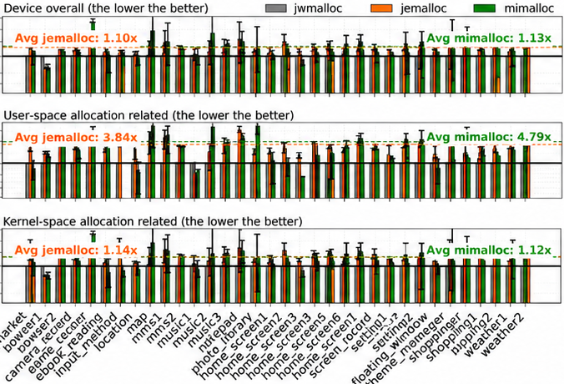
jwmalloc: Verification, Performance and Deployment
Verification
Published-Version Results
Rocq
CST algorithm invariant
Micro-Benchmarks
Phone Workloads
4-core server
Mate 70 Pro / HarmonyOS 5.1
+74% average throughput
Device instructions (jwmalloc = 1)
Frama-C
C refinement, pointer arithmetic
and alignment properties
vs. jemalloc
jemalloc 1.10× mimalloc 1.13×
P99.99: 1.5 µs vs. 5.9 µs
CPU-cluster power: −5–11%
mstress-10N, best competitor
Reading / video; vs. jemalloc
Concurrent executions
under weak memory
Deployment update: 60M+ Huawei users
VSync / GenMC
7 bugs across these checks
One CST bug surfaced in ~10 seconds
after thousands of stress-test hours.
Scoped checks, not a whole-allocator proof.
19
Notes:
SLIDE 19. 19:11 to 20:36. 147 spoken words. 1 reveal clicks.
Pacing guide: 115 spoken words per minute plus 8 seconds for pauses, pointing and slide changes.
Read speech paragraphs only. Bracketed directions and references are silent.
[Start with verification and its scope on the left.]
How did we check the design? Each method addresses a different risk.
Rocq checks the tree invariant. Frama-C checks C-level refinement, pointer arithmetic and alignment. VSync and GenMC examine concurrent executions under weak memory.
Together, these scoped checks found seven bugs. One was found in about ten seconds after escaping thousands of hours of stress testing. This is not a proof of the entire allocator.
[CLICK 1: Reveal results and deployment. Point to Phone Workloads first, then the server results. Pause briefly, then speak.]
The performance results here are for the published version, before the queue-based index update. On Mate seventy Pro, reading and video workloads used five to eleven percent less CPU-cluster power than with jemalloc. Device-level instruction counts are lower too.
On four server cores, average microbenchmark throughput was seventy-four percent higher than jemalloc. Tail latency was also lower in the reported test.
Our deployment update reports more than sixty million users in Huawei mobile products. That reach makes the next lesson especially important.
[NEXT SLIDE: advance once.]
REFERENCE NOTES - NOT SPOKEN
Microbenchmarks: 4 server cores, average throughput versus jemalloc. Tail-latency comparison: P99.99 in mstress-10N against the best competing allocator for that case. Phone evaluation: Mate 70 Pro, HarmonyOS 5.1. Ratios refer to instructions with jwmalloc normalized to one. Power is CPU-cluster power in reading/video, not battery life. 60M+ users is the author-supplied Huawei mobile product update, not an OpenHarmony ecosystem user count. Seven bugs across scoped verification checks do not establish a machine proof of the entire allocator.
References
https://mingmfu.github.io/papers/osdi26-paper51.pdf
https://mingmfu.github.io/papers/jwmalloc-slides.pdf
Phone power comparison is against jemalloc and concerns CPU-cluster power, not whole-device battery life. Server and phone measurements evaluate the published implementation. The product user count is a separate author update.

Slide 20
Deployment Exposes Hidden Application Assumptions
Changing the allocator can expose bugs in existing applications.
1 Hidden Assumptions
2 Rare Bugs Become Frequent
T *p = malloc(...);
...
foo(p[0]); // read before initialization
A different allocator design exposed an app's
existing memory-corruption bug more often.
jemalloc: about once a week
jwmalloc: about once a day
jemalloc happened to leave these bytes as zero.
jwmalloc used the space for metadata,
exposing the application's uninitialized read.
Observed in one deployment
We could not change the app.
We adjusted jwmalloc to lower the crash rate.
malloc never promised zero-initialized memory.
Lower crash frequency,
but the application bug remains.
Verification assumes valid use. Product deployment also requires
compatibility testing and mitigation of application bugs.
20
Notes:
SLIDE 20. 20:36 to 21:56. 140 spoken words. 1 reveal clicks.
Pacing guide: 115 spoken words per minute plus 7 seconds for pauses, pointing and slide changes.
Read speech paragraphs only. Bracketed directions and references are silent.
[Initial view: the first deployment example.]
Passing our checks did not mean every application would work after the change.
One app read memory before initializing it. With jemalloc, those bytes happened to be zero. jwmalloc used that space for metadata, exposing the bug. malloc never promised zero-filled memory. The app depended on an accident.
[CLICK 1: reveal the second story and the lesson. Pause briefly, then speak.]
The second case was harder. An app had a rare memory-corruption bug: about one crash a week. With jwmalloc, it happened about once a day in this deployment.
The bug was in the app, but we could not modify that code. So we adjusted jwmalloc to reduce the crash rate. That protected users without fixing the underlying bug.
This brings us back to my opening story: the calling context matters. Verification checks a component under stated assumptions. Compatibility testing asks what happens when real software breaks them. A reliable OS needs both.
[NEXT SLIDE: advance once.]
REFERENCE NOTES - NOT SPOKEN
References and scope
https://mingmfu.github.io/papers/jwmalloc-slides.pdf
The weekly-to-daily story is the author's deployment experience supplied on 24 September 2026. These are approximate observations in one deployment, not a benchmark or a general allocator comparison. No root-cause repair or universal mitigation guarantee is claimed.

Slide 21
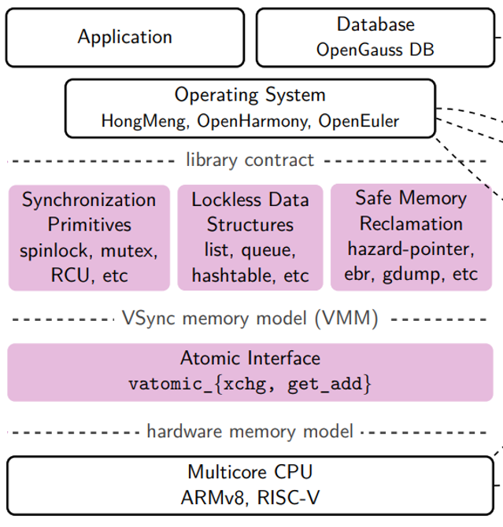

Open S4C: Resources for Concurrency Research
Source code
&
GenMC/Dat3M
Benchmarks
&
Parameters
vsyncer
benchkit
Correctness through Verification
Verification
&
Optimization
Performance
&
Visualization
Open source on GitHub / Gitee
https://github.com/open-s4c
vsync@huawei.com
VSync tutorial: ASPLOS 2024
OpenHarmony tutorial: ASPLOS / EuroSys 2025
https://openharmonyos.org/tutorial/
libvsync at SV-COMP
21
Notes:
SLIDE 21. 21:56 to 22:34. 68 spoken words. 0 reveal clicks.
Pacing guide: 115 spoken words per minute plus 3 seconds for pauses, pointing and slide changes.
Read speech paragraphs only. Bracketed directions and references are silent.
[Static resource page. Leave the QR code visible throughout.]
The Open S4C tools give you a place to start. libvsync provides concurrency components, vsyncer supports verification, and benchkit supports repeatable measurements.
Choose one bottleneck in your own workload. State what must remain correct, then compare a small change against the baseline. The tutorials here can help you run that experiment.
For the OpenHarmony Concurrency and Coordination TSG, reproducible workloads and counterexamples are valuable contributions alongside new algorithms.
[NEXT SLIDE: advance once.]
REFERENCE NOTES - NOT SPOKEN
References
https://openharmonyos.org/tutorial/

Slide 22
Future Directions: Concurrency for On-Device AI
Workload-Aware Queues
Lifetime-Aware Memory
Cross-XPU Coordination
Android 17's DeliQueue removes
the MessageQueue lock for
apps targeting SDK 37+.
Meta's 2026 jemalloc roadmap
targets purging, huge pages
and AArch64.
Sereno (OSDI '26): foreground
jank rose 153% in the tested
NPU inference setup.
Co-design ordering, cancellation
and batching for frame deadlines,
not just queue throughput.
Coordinate CPU heaps and
tensor pools. Balance memory
reuse against timely reclamation.
Joint memory management and
scheduling across CPU / GPU /
NPU sharing DRAM bandwidth.
Building on
BBQ / BWoS / BTrace
Building on
jwmalloc
Extending hardware
and workload awareness
How can we keep OpenHarmony responsive while making room for on-device AI?
22
Notes:
SLIDE 22. 22:34 to 23:34. 102 spoken words. 2 reveal clicks.
Pacing guide: 115 spoken words per minute plus 7 seconds for pauses, pointing and slide changes.
Read speech paragraphs only. Bracketed directions and references are silent.
[Initial view: workload-aware queues.]
On-device AI makes these questions more urgent. For apps targeting SDK thirty-seven or later, Android seventeen removes the MessageQueue lock. For OpenHarmony, queues should account for frame deadlines, cancellation and batching.
[CLICK 1: reveal lifetime-aware memory. Pause briefly, then speak.]
Meta's renewed jemalloc work highlights memory reclamation and modern hardware. Our question is how CPU heaps and AI tensor pools should share a limited memory budget.
[CLICK 2: reveal cross-XPU coordination and the closing question. Pause briefly, then speak.]
Sereno brings us back to the start: a busy NPU can leave inference fast while the UI suffers. Scheduling and memory management need to account for shared bandwidth.
These are research directions. The goal is to make room for on-device AI while keeping OpenHarmony responsive.
[NEXT SLIDE: advance once.]
REFERENCE NOTES - NOT SPOKEN
References and scope
https://android-developers.googleblog.com/2026/02/under-hood-android-17s-lock-free.html
https://engineering.fb.com/2026/03/02/data-infrastructure/investing-in-infrastructure-metas-renewed-commitment-to-jemalloc/
https://www.usenix.org/conference/osdi26/presentation/xin
Sereno measurements refer to the Android/NPU configuration identified on slide 3, not an OpenHarmony measurement. The proposed CPU-heap/tensor-pool and cross-XPU directions are research opportunities, not completed implementations.
Android DeliQueue is the new MessageQueue implementation for apps targeting SDK 37 or later; the statement concerns its queue lock, not an assurance that all UI work is lock-free.

Slide 23
Thank You
Synchronous Communication
Asynchronous Communication
Concurrent Memory Management
CLoF
BBQ
jwmalloc
SOSP 2021
USENIX ATC 2022
OSDI 2026
Locks and ownership
Data exchange
Best Paper Award nominee
Objects
Pages
Block partitioning
NUMA-aware locks
BWoS
BTrace
Objects, pages, lifetimes
Task scheduling
Mobile tracing
Reuse and reclaim memory
OSDI 2023
ASPLOS 2025
NVIDIA/stdexec
OpenHarmony
OpenHarmony
Verification & Optimization Foundation
VSync
ASPLOS 2021 Distinguished Paper
Safety, liveness, weak-memory optimization
Ming Fu, Huawei Fields Lab mingmfu.github.io github.com/open-s4c
Notes:
SLIDE 23. 23:34 to 24:10. 59 spoken words. 0 reveal clicks.
Pacing guide: 115 spoken words per minute plus 5 seconds for pauses, pointing and slide changes.
Read speech paragraphs only. Bracketed directions and references are silent.
[The full overview stays visible for questions. No extra reveal clicks.]
I began with a lock that everyone suspected. The lesson reaches beyond locks: choose coordination that fits the workload, verify the design under clear assumptions, and test how real software uses it. BTrace and jwmalloc show why these belong together. Bring one difficult workload, trace or reproducer to the TSG, and we have a concrete next experiment. Thank you.
[END OF TALK. Leave this slide visible for questions.]
REFERENCE NOTES - NOT SPOKEN
Scope note: CLoF is NUMA-oriented research. It appears in the research map, not as a claim that mobile OpenHarmony devices use NUMA hardware or that CLoF is deployed there.

