Slide 1
ADN 代际特征讨论 ODD 视角
V1 Min He 8/17/2021
All information are from public source and intended for public consumption

Slide 2
Content
ODD
Apply ODD to AND
Few more perspectives
Discussion

Slide 3
ODD （Operation Design Domain, 运行设计域）
A description of the specific operating conditions in which the automated driving system is designed to properly operate, including but not limited to roadway types, speed range, environmental conditions (weather, daytime/nighttime, etc.), prevailing traffic law and regulations, and other domain constraints [Waymo 2017]
描述自动驾驶系统设计用于正常运行的具体操作条件，包括但不限于道路类型、速度范围、环境条件（天气、白天/夜间等）、现行交通法规和其他领域限制
ODD = Vehicle Capabilities + Geographic Domain + Traffic & Situational Environment

Slide 4
ODD Examples

Slide 5
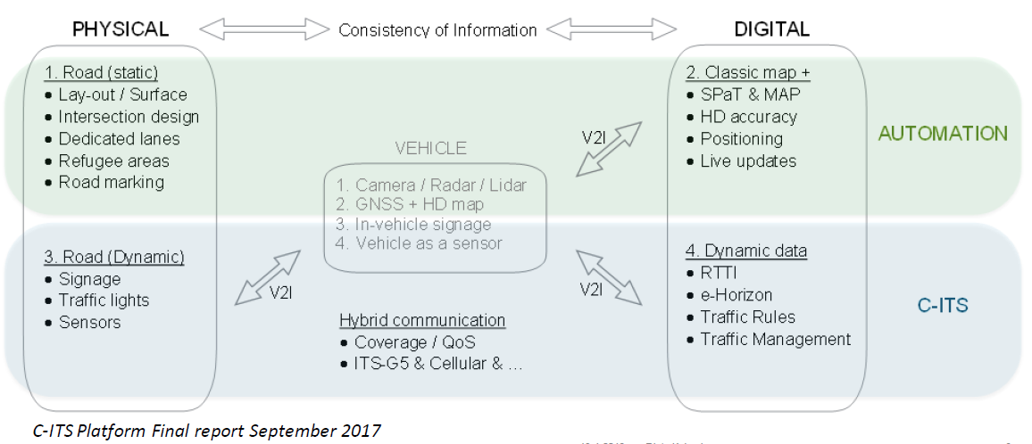
ODD and Physical and Digital Infrastructure

Slide 6
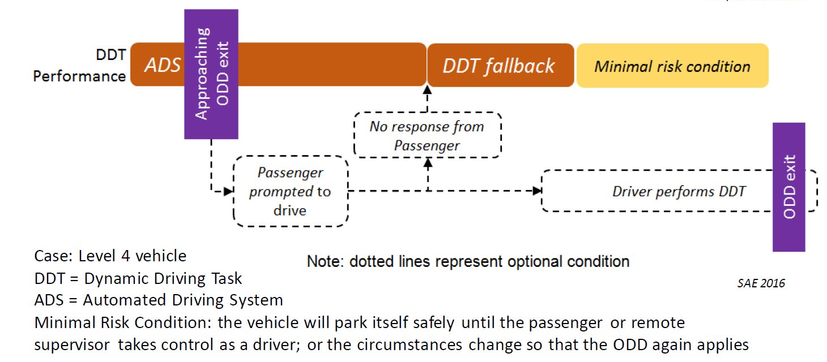
Differentiate L3/L4 By Examining DDT Fallback Strategy

Slide 7
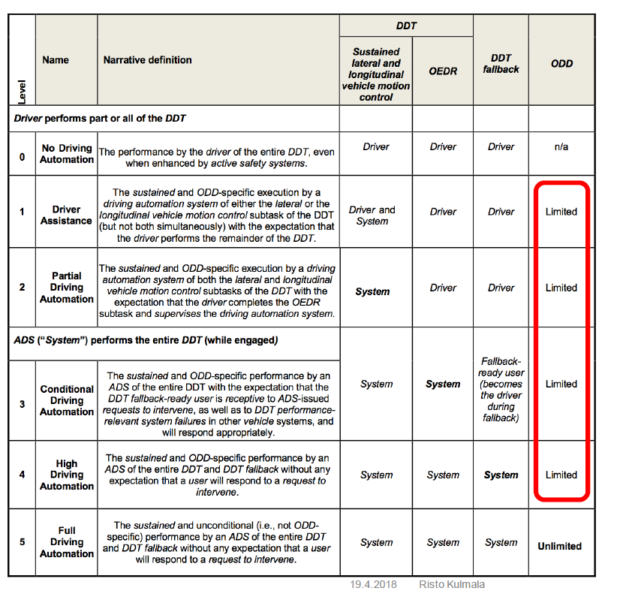
Four Dimensions to Define Autonomy Levels
Driving Control
OEDR
DDT Fallback
ODD
DDT -- Dynamic Driving Task
OEDR --- Object and Event Detection and Response
OOD -- Operational Domain

Slide 8
Scenario: Optical Transport Fault Resolution ODD = Autonomous Domain Capabilities + Physical + Software + Situational Environment
Physical
Software
Situational Environment
Network Domain
Optical
OTN
SDH
SONET
DWDM
NE
Types
Vendors
Hardware version
Configurations
Topology
Linear
Ring
Mesh
Links
Fiber
Multi-vendor
NE
Software version
Configurations
OSS
Trouble Ticket Management
Service Quality Management
Workforce Management
Performance Management
User usage management
Protocol
Data plane
Management Plane
Impacted Services
Platinum (Highly Protected)
Gold (Protected)
Silver (Unprotected)
Regular(Preemptable)
Fault Root Cause Types
Transmission
Quality of services
Software processing
Equipment
Environment
Continuity supervision
dLOS
dUNEQ
dLTC
Connectivity Supervision
dTIM
Signal Quality Supervision
dEXC
dDEG
Payload
dPLM
dUPM
dEPM
Alignment Supervision
dLOA (loss of alignment defect)
dLFD (Loss of Frame Delineation defect)
Maintenance
AIS (AIS defect)
RDI/ODI (Remote/Outgoing Defect Indicator defect)
CSF (Client Signal Fail defect)
Protocol supervision
dFOP (Failure of Protocol defect)

Slide 9
ADN Example: Mapping Optical Transport Self-healing Scenario with ODD
All Steps
No OSS integration
Multi-vendor
close
verify
resolve
inform
isolate
collect
service restore
detect
Always and All Conditions
Highly
Protected
LOS
OTN
Multi-vendor
Ring
…
dDEG
OTN
Single-vendor
Ring
…
dPLM
OTN
Single-vendor
Mesh
ODDs

Slide 10
ADN Fallback Strategy
L3 --- Assume human handles fallback.
L4 --- Human may not be there to handle the fallback.

Slide 11
几种角度的关联性
 | L3 代际特征 | L4 代际特征 | L5 代际特征 | 适用场景
ODD | Limited product ODD Frequent in/out ODD Assume human always there to help | Broader but still Limited product ODD Long time in ODD Assume human not there to help. | No ODD No human help required | 构建 开发 架构
Digital Co-worker （Digital worker， Digital employee， Virtual assistant） | Junior skill, limited user/client ODD Frequent help from human Assume human is there to help | Senior skill in broader user/client ODD Complete more complex work Assume human not always there to help | Has all the required skills to complete the task under all condition No human help required. | 人机界面设计 Conversational Intent NLP 自动化能力包装上市 Sell by digital worker Sell by skills Sell by usage
Human in the Loop | Human on the loop Limited, relatively narrow ODD Human is there to help | Human out of the loop Assume human may or maynot be there to help Limited, but broader ODD than L3 | Human out of the loop No need help from human No ODD, all conditions | 科普

Slide 12
讨论
自动驾驶汽车的ODD思路对ADN有帮助吗？
如果有帮助，ADN场景下如何定量化定义ODD
按自动化场景百分比？
按完成流程步骤？
其他？
自动驾驶汽车里定义的L3到L4代际差异点：
ODD增大
Fallback Strategy的差异
这对ADN适用吗？如果定义Fallback Strategy
如何融合产品使用者ODD和产品生产者ODD？

