Slide 1
Outline
NaaS is Current Industry’s Answer to CSP’s Challenges
Only Full Automation Can Allow CSPs to Realize the Full Promise of NaaS
Industry Effort on Autonomous Network Initiatives
Call for MTN to Participate and Contribute to Industry’s AN Initiative
Conclusion

Slide 2

Challenges of Telecom/ICT Industry
Complexity
Silo, Fragmented
Agility
Costs reduction
Time to market
Excellent User Experience
OpEx ratio: 50%->67%,
1.9%
75B devices by 2025
TCO ＞Revenue
OpEx Vs CapEx: 3:1
Last 5 years
Infrastructure & Operations
Cost & Growth
Simplification
Automation
Intelligence
Collaboration
Efficiency
Manual, error-prone
Isolation
Lack of global business collaboration
3
vs
300+
OTT Vs Telco to maintain
The whole industry is facing the challenges of revenue growth, business collaboration, operations efficiency and TCO, which led to the reduction of profit margin, sales and innovation
Architectural Innovation to Solve the Structural Problems
Notes:
TCO：OpEx占比 67%, 过去x年，增加了x%；(Ovum) Operating expenses (opex) were 67% of revenues in 2015; opex outweighs capex >3:1; globally, network operations was the largest expense category in 2015, at 23% of opex, followed by operational sales (21%), devices (15%), and G&A (10%).
Revenue，过去5年增加了1.9%，2013：2781BUSD，2017：2997BUSD；CapEx增加1%，

Slide 3
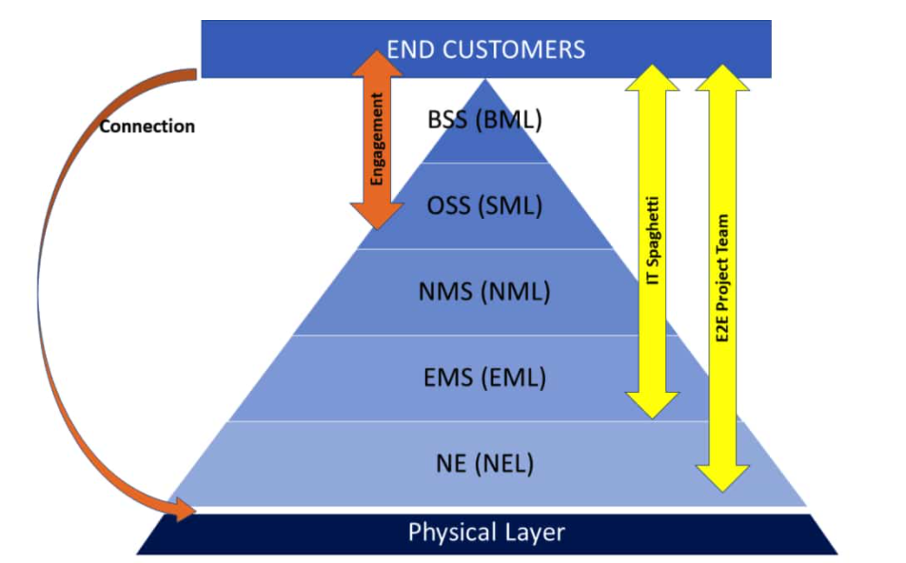
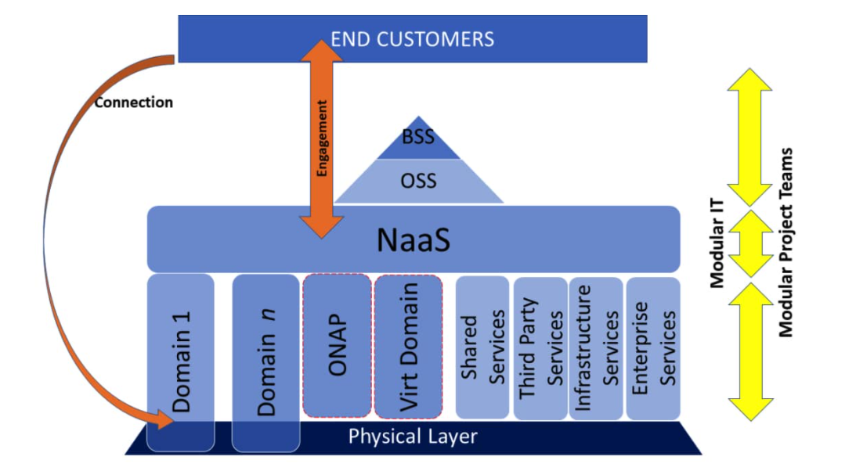
The Answer to Simplify IT and CT Interaction: NaaS
Decouple BSS/OSS and Network Layers and Utilize X-as-a-Service Model
Model-driven abstraction to decouple the OSS and network layers.
Avoid spaghetti IT integration, Network domains expose services so that the IT systems don’t have to know about or configure anything at the resource level anymore.
De-risk and accelerate new service and technology introductions and increase revenue by combining any mix of physical and virtual elements and resources to create a broad and highly differentiated service portfolio for their consumer, enterprise, and wholesale customers.
Improve customer experience by enabling error-free service activation in minutes, not months, and by reducing the time it takes to remediate issues when they develop. With this agility, CSPs can offer services on-demand—and with flexible consumption and subscription-based models.
The operational processes and network domains are tightly coupled.
New network elements or services must be integrated with (B/OSS)
This integration is cumbersome and expensive, and it typically takes 12 to 18 months to roll out new services.
prevent CSPs from offering enterprises the flexible, cloud-like services they want.
https://disruptive.asia/naas-to-networks-what-agile-to-software/

Slide 4
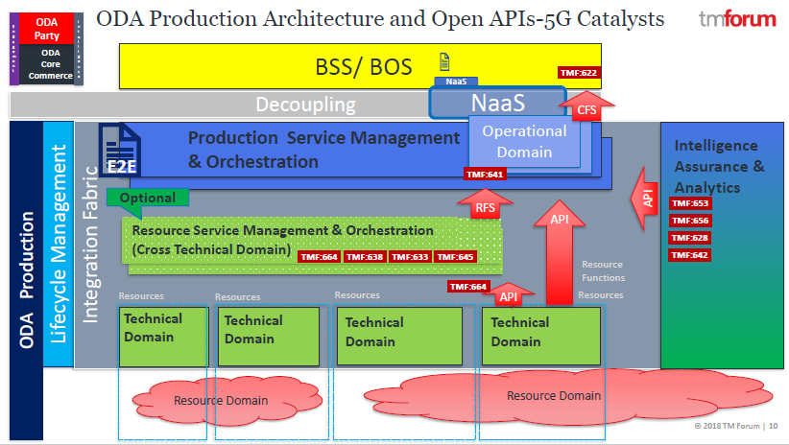
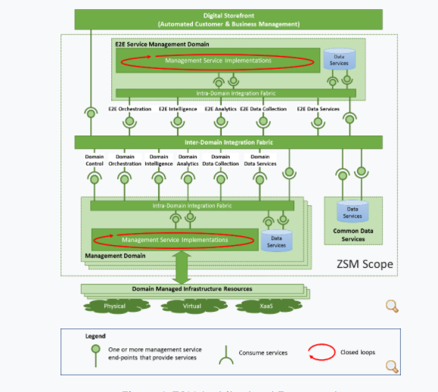
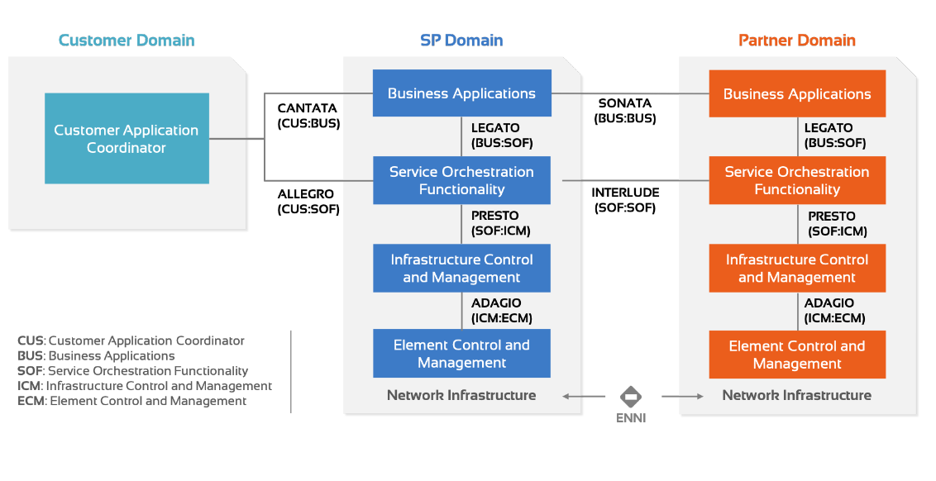
Same Principles and Different Focuses
TMF ODA Architecture
ETSI ZSM（Zero Touch Management) Architecture
MEF LSO（Life-cycle Service Orchestration) Architecture
NaaS
NaaS
NaaS
Simplify BOS and Network Integration
Simplify Multi-vendor Service Orchestration
Simplify Inter-CSP E2E Service Orchestration

Slide 5
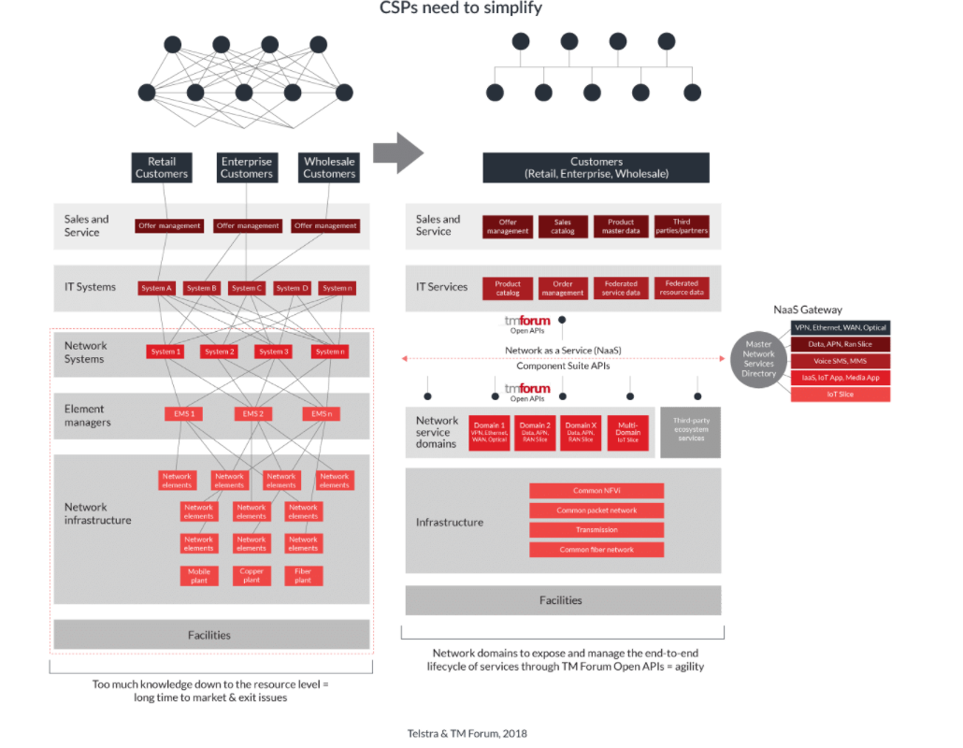
NaaS Simplifies Network and Operations Transformation Simultaneously
All of the network’s capabilities and resources—virtual and physical—are summarized and published in a service catalog.
Industry-standard APIs are used to expose these summarized capabilities to the B/OSS layer.
The entire service lifecycle is managed in a closed loop, using customer intent, policy, analytics, and AI to provide ongoing service assurance and optimization.
NaaS simplifies both IT and Network Architecture
https://inform.tmforum.org/casestudy/bringing-telstra-naas-life/
https://exchange.telstra.com.au/networks-and-digital-technology-the-building-blocks-of-telstras-strategy/

Slide 6
CSPs on NaaS Journey
Telstra Embraces NaaS architecture as the core of massive network modernization effort.
Telstra NaaS platform went live in 2018
Started with internal use, now available for partners
Telstra was instrumental in creating TM Forum’s new NaaS API Component Suite
In bid to be the Telco AWS
Telus Develops New Products with NaaS
Delivering cloud-based SD-WAN
Customer can build and manage their own network thought a self-service portal
Priorities and routes traffic locally so branch offices can access cloud-based apps directly
Advanced firewall protection
Application traffic management
Backup wireless LTE connection
Vodafone uses NaaS internally first, then aims at verticals
The umbrella organization treats its 25 operating companies as customers by offering NaaS internally, and the operating
“co-creation model”, which allows the company and its customers to collaborate on developing services, in IoT, Industry robotics in Warehouse
Telefonica Business Solution Embraces NaaS for transformation
Fullstack transformation, digitizing end to end, from IT to Network
Solution is operational and offers cloud-security, IP VPN, BOD
Reported Benefits
reduce network deployment time by up to 80 per cent
reduce new product introduction time from 12-14 months to 2-4 months
greatly simplify interactions among ITs and Networks
“Businesses looking to grow can be challenged by lengthy lead times and the complex IT required to build or change a network,” said Navin Arora, Senior Vice-President of Business Solutions at TELUS. “TELUS Network as a Service is a game-changer for Canadian businesses, helping them optimize their IT and reduce costs. Our cloud-based integrated connectivity platform is fast, easy to install and has self-serve capabilities; making it convenient for businesses looking for managed services.”

Slide 7
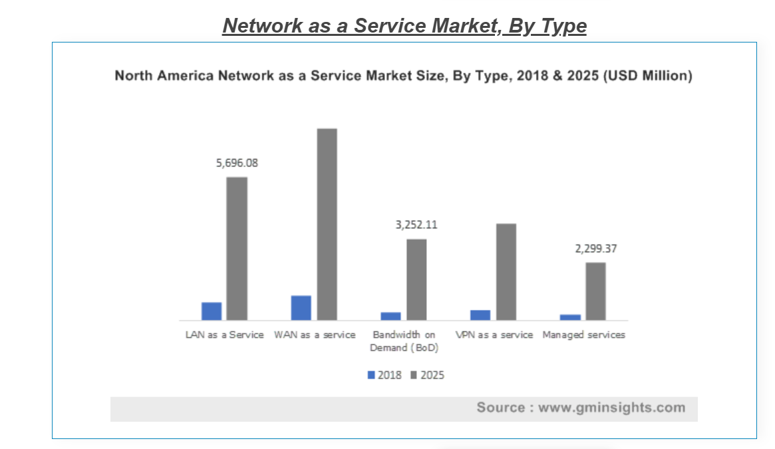
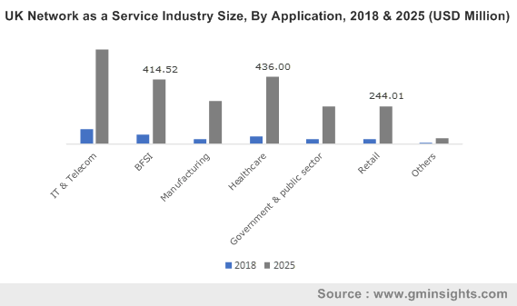
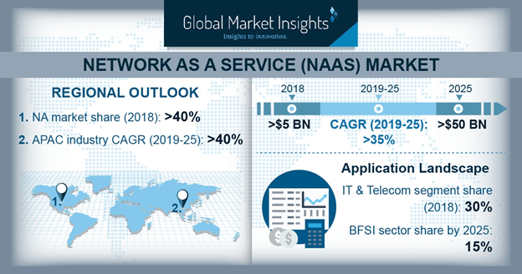
NaaS Adaption Accelerating in Global CSPs
Network as a Service (NaaS) Market size is set to exceed USD 50 billions by 2025
Drivers:
The rising demands for network virtualization technologies, SDN and NFV.
The cloudification movement.
Enterprises switching toward SDN-enabled NaaS, which help in providing on-demand network services to customers.
The rising trend of pay-per-use business model in enterprises. The NaaS model enables them to use or provide network services on a subscription-based pricing model, eliminating the need to rearchitect their networks.
SMEs use the NaaS model as it provides them with the flexibility to scale up or down the network resources .
“Another factor contributing to market growth is an extensive adoption of network virtualization technologies such as Software-defined Networking (SDN) and Network Functions Virtualization (NFV). These technologies provide a platform for Network as a Service and enable enterprises to sell network services to customers virtually, on a subscription basis.”
“The Network as a Service market growth is attributed to the rapid usage of cloud technology as enterprises are increasingly migrating their workloads to the cloud.”

Slide 8
Strategies for implementing NaaS
Agility,
Costs reduction
Time to market
Run
- Think about differentiated services
- Plan out how to monetize NaaS
- Embrace abstraction and open APIs
- Partner with customers and suppliers
- Re-image OSS/BSS to take advantage of flexibility, programmability and user control provided by NaaS
- Work with Network Vendors to Implement open APIs
- Internal Usage of NaaS
- Product innovation though gained agility
- Automation of NaaS
- Open NaaS to partners
- Monetize NaaS
Build
Prepare
“The hard cash benefits of NaaS are in cost avoidance based on the reuse of components, but the true benefit comes in the more positive effects of building revenue through agility”

Slide 9
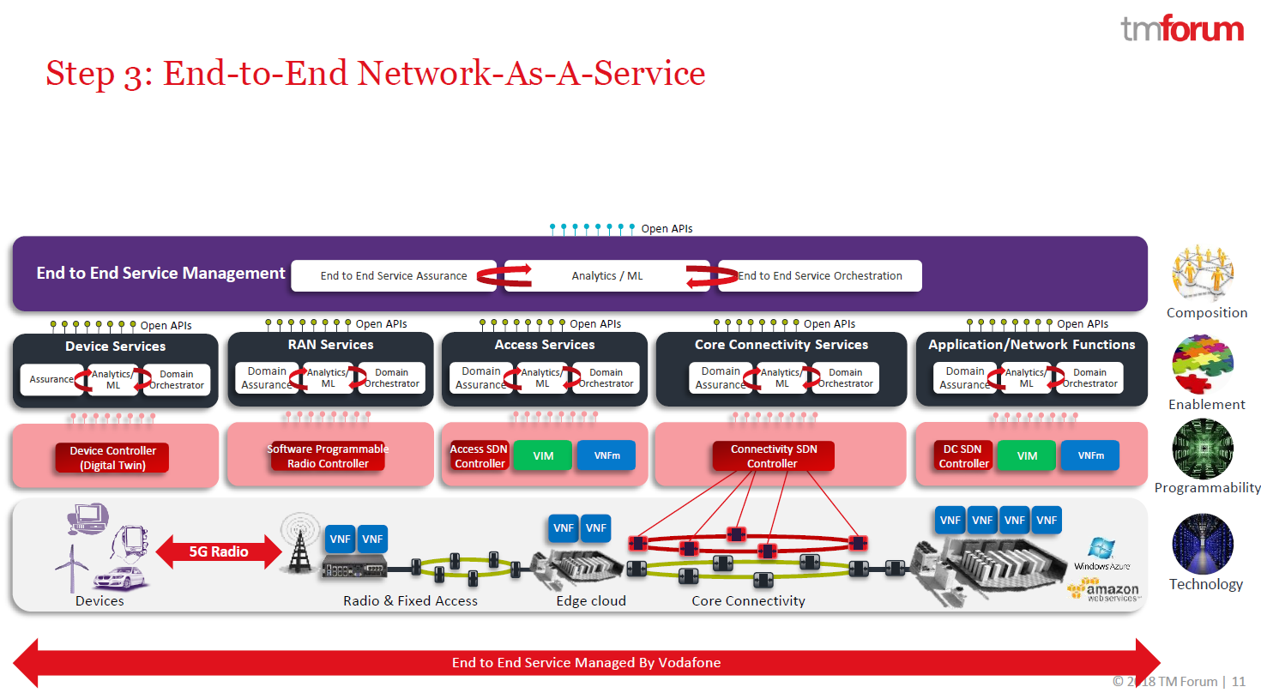
APIs is the Key for Realizing NaaS

Slide 10
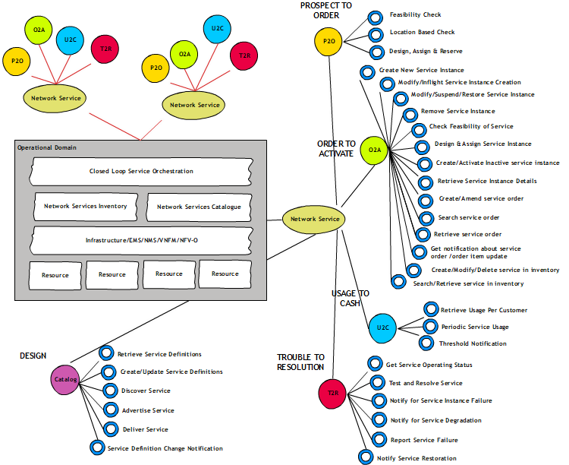
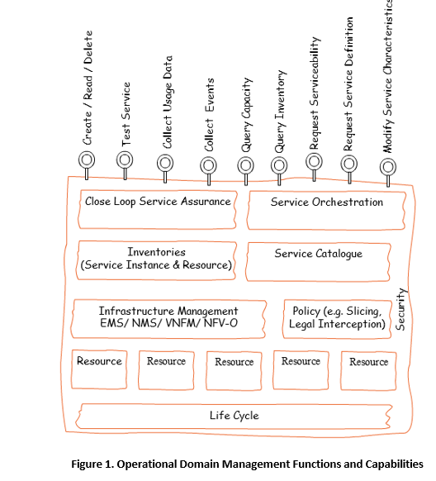
TMF 909 NaaS Management REST API Specifications
NaaS API component suite classified in the main lifecycle areas

Slide 11
TMF OpenAPIs
TM Forum Open APIs | Document Number
Account Management API | TMF666
Agreement Management API | TMF651
AI Management API Component Suite | TMF915
Alarm Management API | TMF642
Appointment API | TMF646
Change Management API | TMF655
Communication API | TMF681
Customer Bill Management API | TMF678
Customer Management API | TMF629
Document Management API | TMF667
Entity Catalog Management API | TMF662
Federated Identity API | TMF691
Geographic Address Management API | TMF673
Geographic Location Management API | TMF675
Geographic Site Management API | TMF674
Loyalty Management API | TMF658
Network as a Service (NaaS) API Component Suite | TMF909
Partnership Type Management API | TMF668
Party Interaction Management API | TMF683
Party Management API | TMF632
Party Role Management API | TMF669
Payment Management API | TMF676
Payment Methods API | TMF670
Performance Management API | TMF628
Performance Management Threshold API | TMF649
Prepay Balance Management API | TMF654
Process Flow Management API | TMF701
Product Catalog Management API | TMF620
Product Inventory Management API | TMF637
Product Offering Qualification API | TMF679
Product Ordering API | TMF622
Promotion API | TMF671
Quote Management API | TMF648
Recommendation API | TMF680
Resource Catalog Management API | TMF634
Resource Function Activation and Configuration API | TMF664
Resource Inventory Management API | TMF639
Resource Ordering Management API | TMF652
Resource Pool Management API | TMF685
Sales Management API | TMF699
Self Care API Component Suite | TMF910
Service Activation and Configuration API | TMF640
Service Catalog API | TMF633
Service Inventory Management API | TMF638
Service Ordering Management API | TMF641
Service Problem Management | TMF656
Service Qualification API | TMF645
Service Quality Management API | TMF657
Service Test Management API | TMF653
Shipment Tracking API | TMF684
Shopping Cart API | TMF663
SLA Management API | TMF623
Trouble Ticket API | TMF621
Usage Consumption Management API | TMF677
Usage Management API | TMF635
User Roles & Permissions API | TMF672

Slide 12
Challenges of Telecom/ICT Industry
Complexity
Silo, Fragmented
Agility,
Costs reduction
Time to market
Excellent User Experience
OpEx ratio: 50%->67%,
1.9%
75B devices by 2025
TCO ＞Revenue
OpEx Vs CapEx: 3:1
Last 5 years
Infrastructure & Operations
Cost & Growth
Simplification
Automation
Intelligence
Collaboration
Efficiency
Manual, error-prone
Isolation
Lack of global business collaboration
3
vs
300+
OTT Vs Telco to maintain
The whole industry is facing the challenges of revenue growth, business collaboration, operations efficiency and TCO, which led to the reduction of profit margin, sales and innovation
Notes:
TCO：OpEx占比 67%, 过去x年，增加了x%；(Ovum) Operating expenses (opex) were 67% of revenues in 2015; opex outweighs capex >3:1; globally, network operations was the largest expense category in 2015, at 23% of opex, followed by operational sales (21%), devices (15%), and G&A (10%).
Revenue，过去5年增加了1.9%，2013：2781BUSD，2017：2997BUSD；CapEx增加1%，

Slide 13
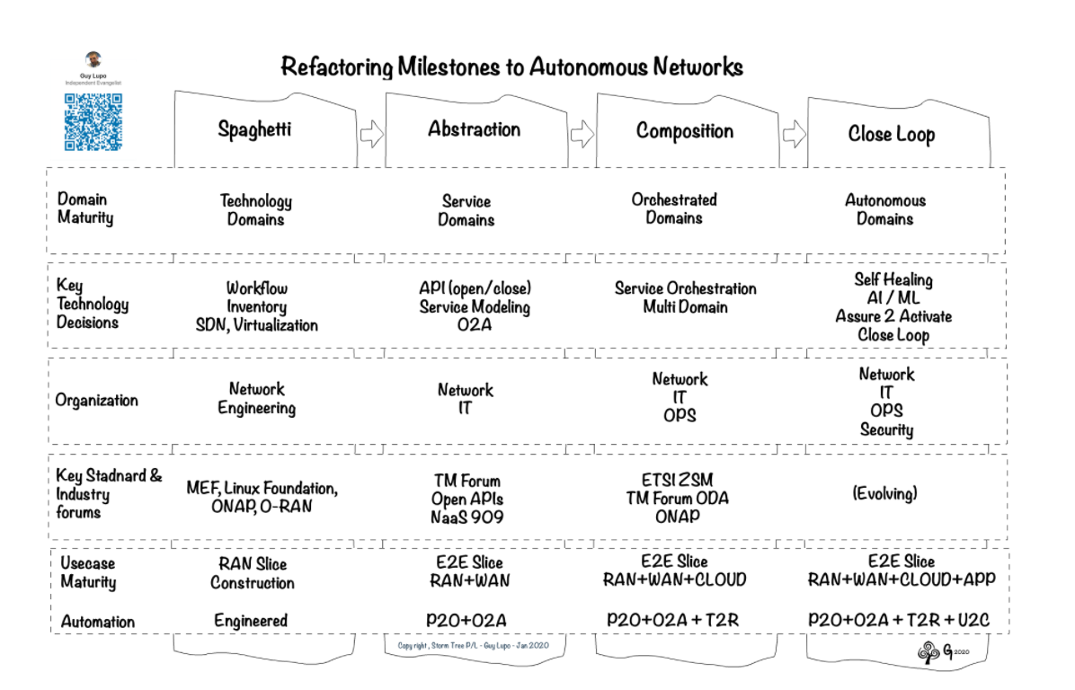
Refactoring Network to Autonomous
Guy Lupo, Head of Orchestration & Data 2020, Telstra
Source: http://www.stormtree.biz/2020/02/04/network-refactoring-roadmap-matrix/

Slide 14
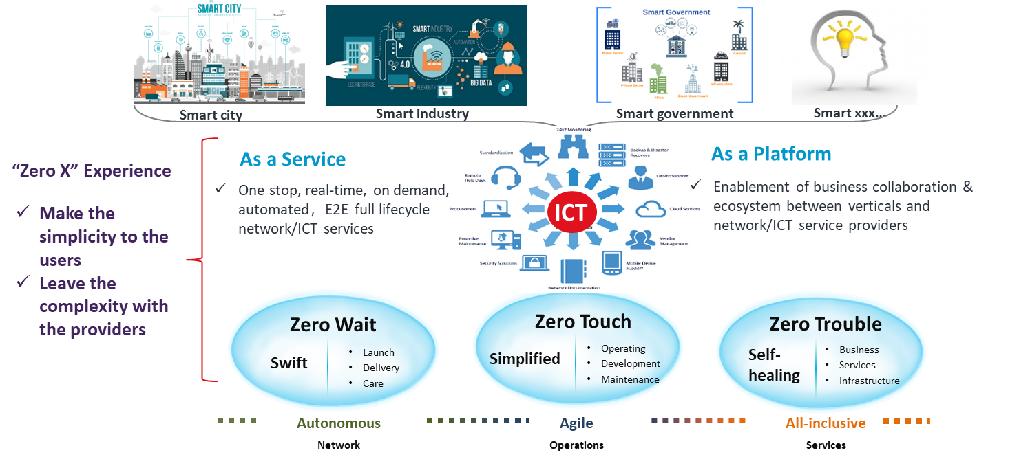
Autonomous Network Vision

Slide 15
Why Autonomy?
Automation Level is Limited When Human in the loop
Human is the Riskiest Factors for Network Stability
Piece Meal Automation can not Bring Big Enough Closed-loop That Provide Significant ROI.
Enabling Technologies are Getting Mature:
Cloud
Steaming Telemetry
Knowledge Base
Data Driven Predictive
AI/ML Based Decision Making and Optimization
RPA/Process Mining/BPMS

Slide 16
Autonomous Framework Defined by TMF
Personalized Services
Real time experience
+
Automated O&M
Smart City
Self driving
Smart Manufactory
Business transformation
Efficiency:
Agile operations
Revenue:
Digital enabling
On-demand business
Ecosystem business
Business intent
Business operations
(Business) Operations transformation
- Customer centric
- Ecosystem oriented
- Collaboration enabled
Commerce
Service intent
Business closed loop
Services operations
(Network) Operations transformation
- Full lifecycle automation
- Data/Knowledge driven & Platform based
- Knowledge as a Service
Resource intent
Production
Service closed loop
Resource operations
Resource operations
Resource closed loop
Resource closed loop
(Architectural) Network transformation
- Extremely Simplified Architecture
- Autonomous domains collaboration
- Enablement of on-demand production
- Support for collaborative production
PNE
PNE
VNE
VNE
Autonomous domain
x
Autonomous domain
y

Slide 17
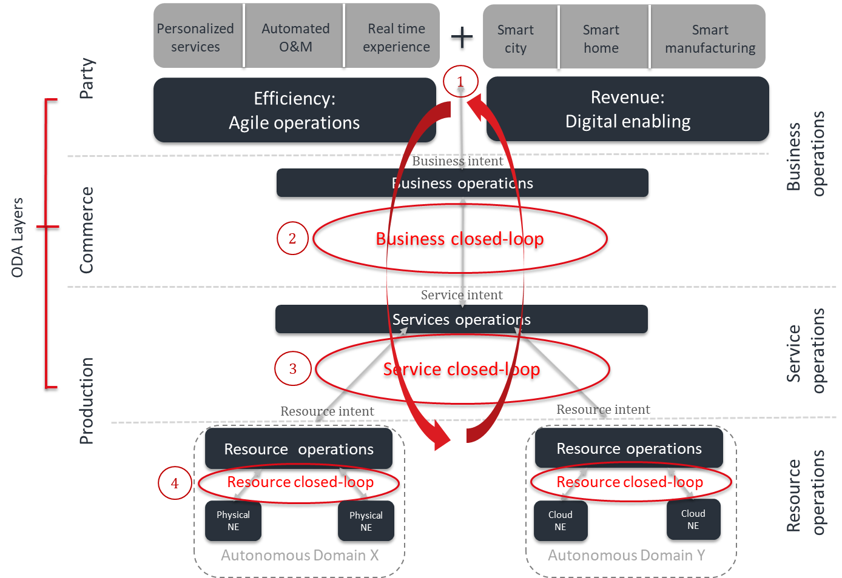
TMF Autonomous Network Architecture Alignment
ODA
Layers
Autonomous Networks
Architecture
Product
Categories
AIOps
Products that enable intelligent IT/CT operations, deliver Business closed-loop and User closed-loop
NaaS
Intent and API driven interfaces
XXX
Products that enable intelligent NW service, deliver NW Service closed-loop and NW Resource closed-loop
Products that provides Network Services

Slide 18
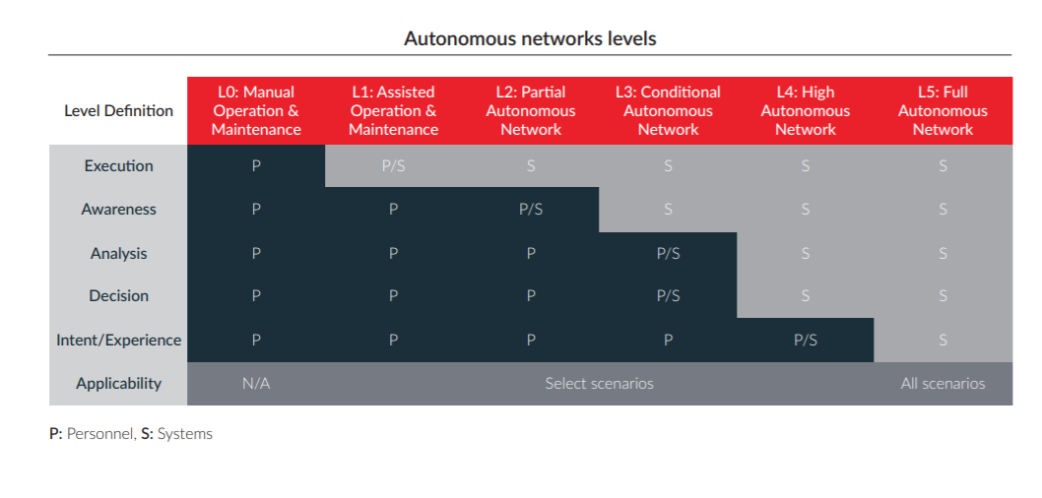
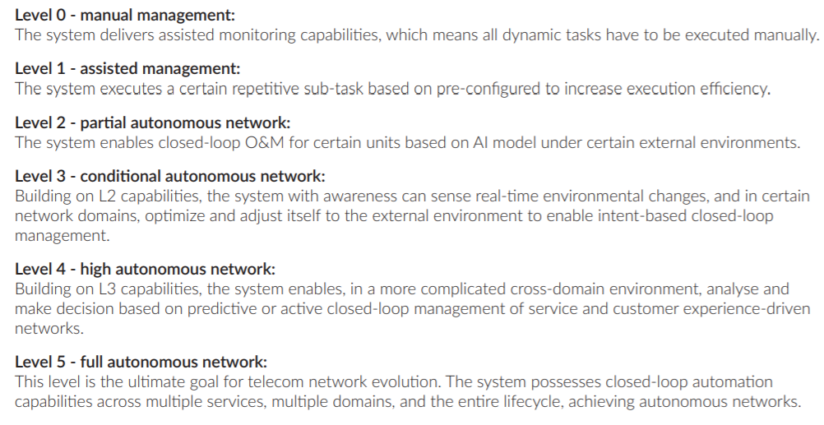
Stepwise Approach for Autonomous Network
Source: TMF Autonomous Network White Paper

Slide 19
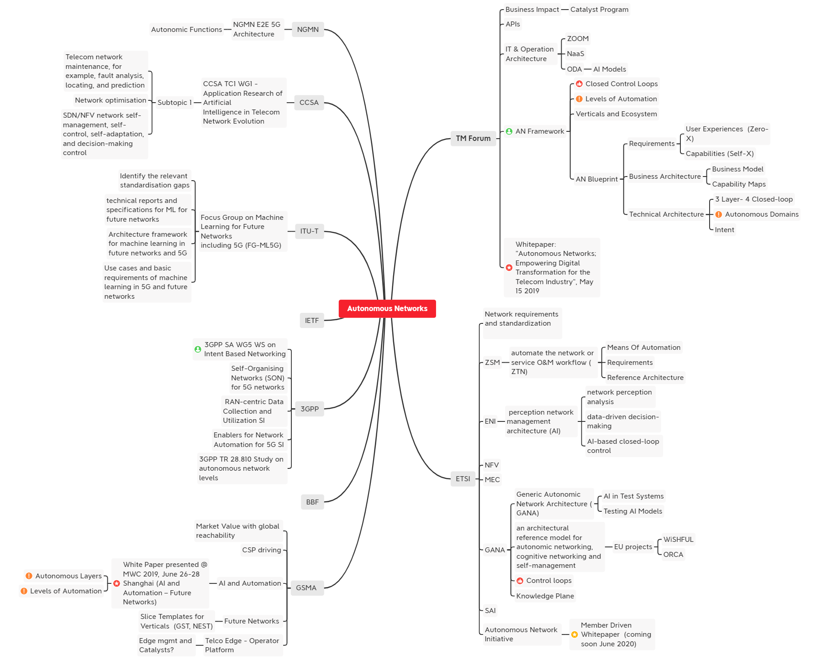
International Standard Bodies’ Actions on Autonomous Network

Slide 20
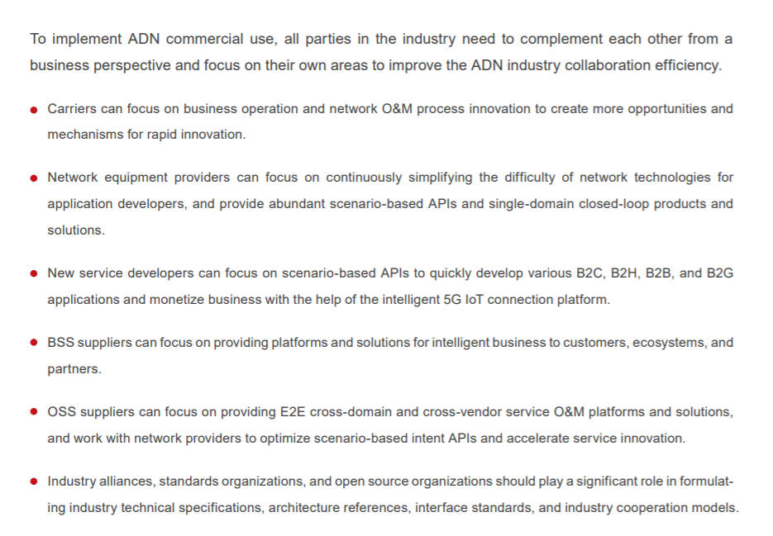
Autonomous Network Vision Can Only Be Realized with Industry Collaborations
Carriers
Network Equipment Vendors
New Service Developers
Academia Researchers
BOS Suppliers
Standard Organizations
Open Source Communities
Business Operations
High Impact Use Case Definition
Process Innovation
Requirements
Provide reference implementation
Explore and overcome technical hurdles
Accelerate product development
Simplify network
Provide scenario-based APIs
Single-domain closed-loop solutions
Management, control and analytics
Define collective vision
Define terminology and taxonomy
Define reference architecture
Define interface standards
Facilitate industry collaboration
B2C, B2H, B2B,B2G applications
Develop scenario-focus use cases
Integrate AN services through Intent
Provide intelligent business platform
Integrate business, customer and partners
Support new business development
Provide E2E cross-domain, cross-vendor solutions
Fundamental research
Develop new algorithms
Develop new methodologies

Slide 21
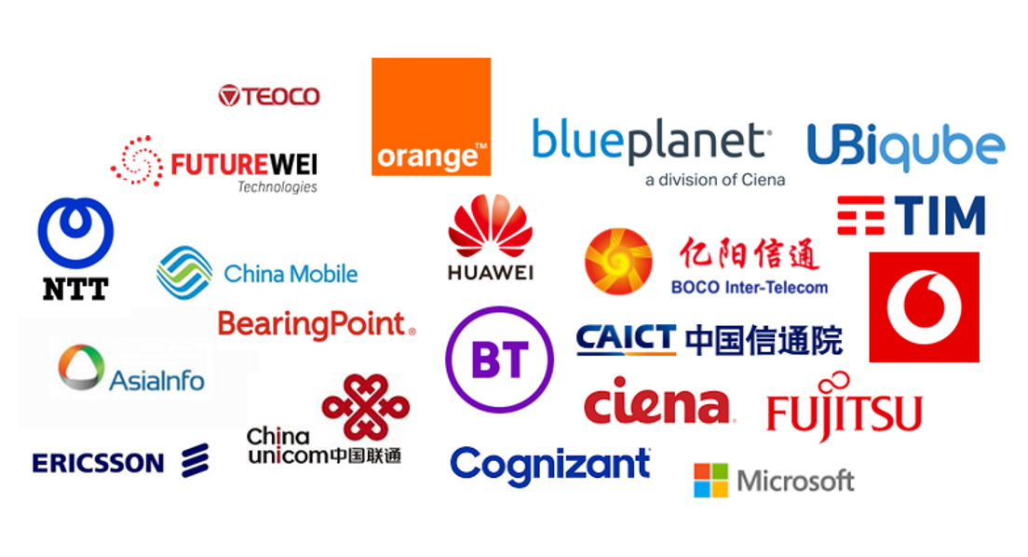
Call for MTN to Participate into Industry Autonomous Network Initiatives
1
2
3
Define a hierarchical measurement system
Define an autonomous network reference architecture
Define the critical use cases and scenarios
Unified technical and architectural languages. Technical perspective, define the medium- and long-term autonomous network reference architecture, to ensure architectural stability and advanced.
Determine use cases that bring most value The priority of closed-loop scenarios, business process innovations, new product development scenarios, human and system interaction efficiency
Determine the assessment and measurement system. Production and delivery perspective, can measure landing, guide production practice activities.
Join TMF Autonomous Network Project

