Slide 1

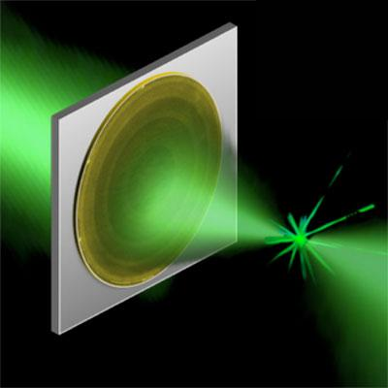
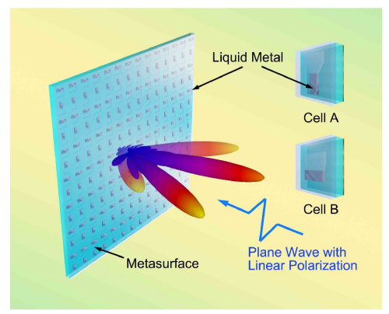
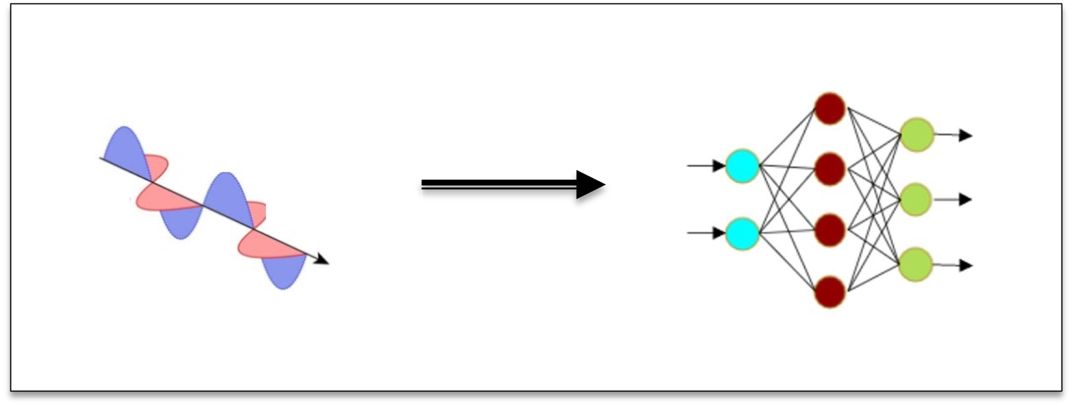
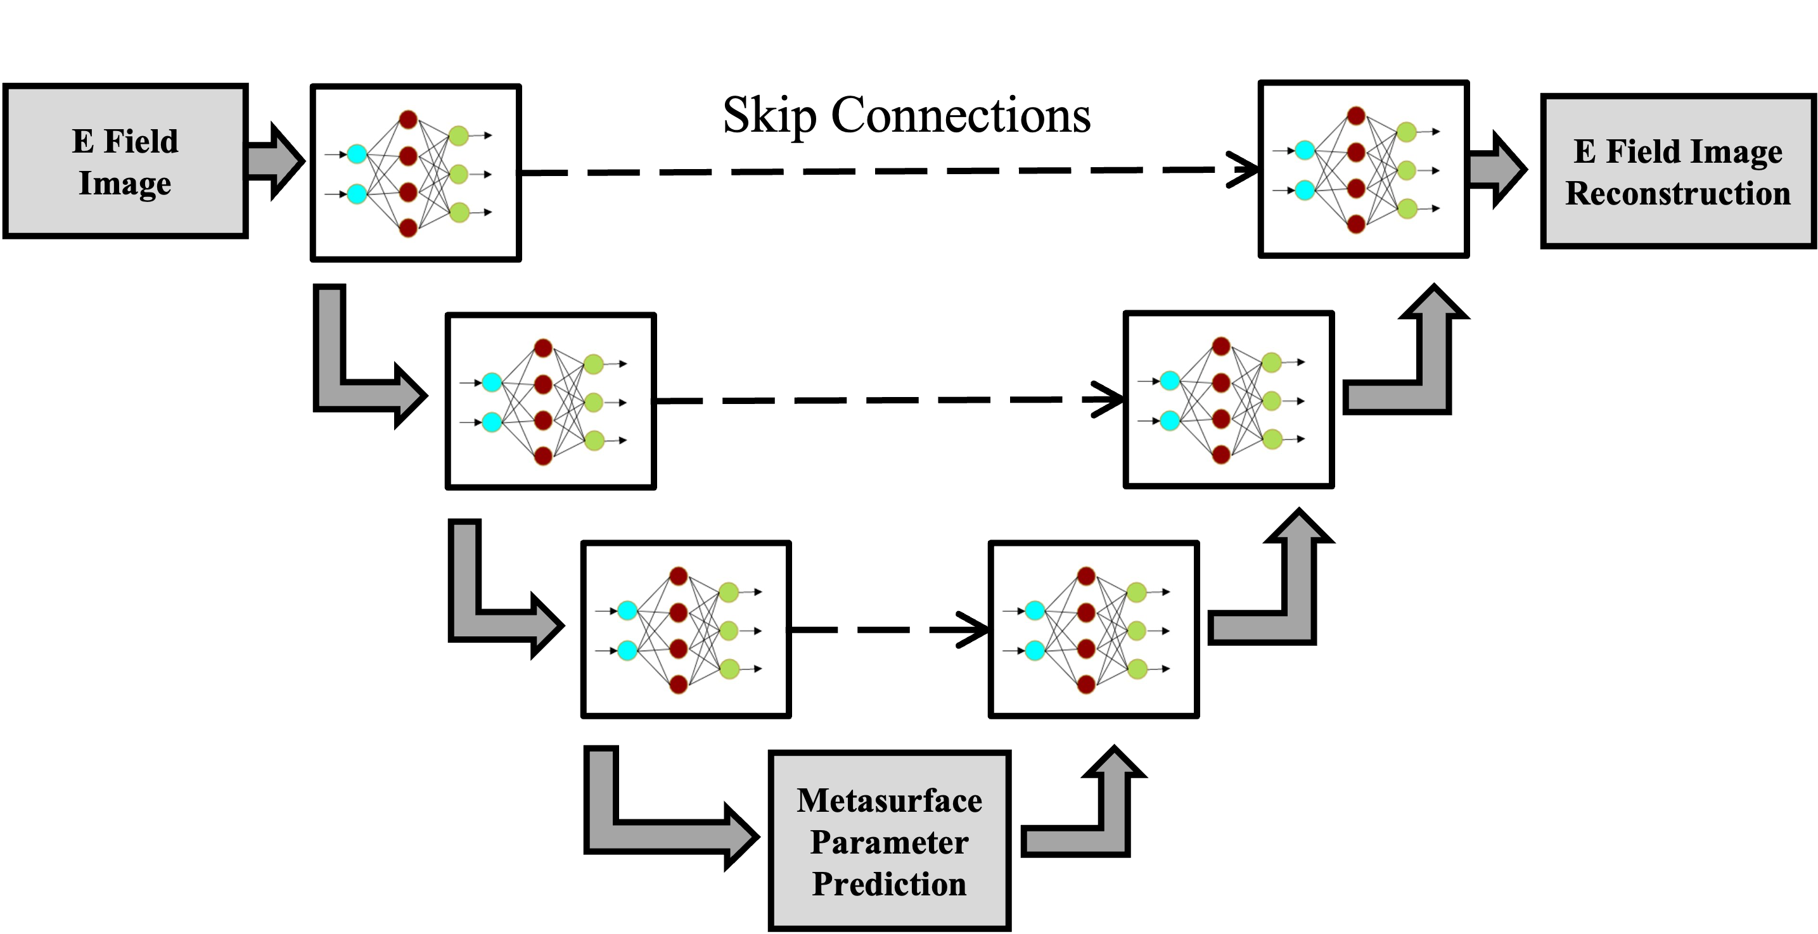

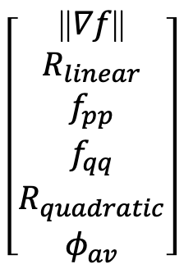
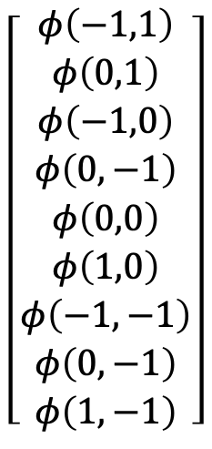
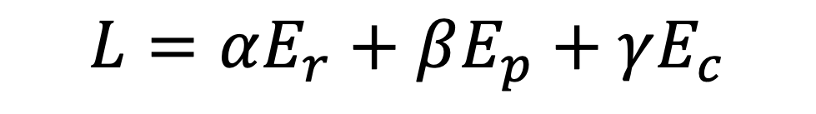
Mapping Meta-atoms to Near Field Response for Inverse Design of Optical Metasurfaces
Andy G Varnerª
Marshall B. Lindsay, Charlie T. Veal, Scott D. Kovaleski, Derek T. Andersonª
Electrical Engineering and Computer Science Department, University of Missouri, Columbia, MO
Motivation
Process Overview – Prior Work
Optical metasurfaces are awesome! But they are very difficult to design. They are:
Computationally expensive
Not general
Unintuitive
The u-net is trained with a multi-criteria loss function,
$$L=αE_{r}+βE_{p}+γE_{c}$$
$$\left[\begin{aligned}φ\left(−1,1\right) \\ φ\left(0,1\right) \\ φ\left(−1,0\right) \\ φ\left(0,−1\right) \\ φ\left(0,0\right) \\ φ\left(1,0\right) \\ φ\left(−1,−1\right) \\ φ\left(0,−1\right) \\ φ\left(1,−1\right)\end{aligned}\right]$$
$$\left[\begin{aligned}\text{||}∇f\text{||} \\ R_{linear} \\ f_{pp} \\ f_{qq} \\ R_{quadratic} \\ φ_{av}\end{aligned}\right]$$
We want to translate an electromagnetics/physics design problem for a machine learning model.
Reconstruction
Phase
Curvature
Preliminary Experiments and Results
Can the u-net can make phase predictions and / or learn a latent space representation of the curvature produced by a 3x3 set of phases?
Since the encoder-decoder architecture is great at image reconstruction, does this actually help with learning?
Is it “easy” to learn phase and curvature if reconstruction error is low?
Qualitative –
Single sample, validation dataset
Quantitative –
Entire validation dataset
|Difference| Reconstruction Truth
This Project – Break the Skip Connections
Results
Preliminary results show very good image reconstruction, and sort of good phase and curvature predictions. There isn’t a one-to-one comparison, but how much are the skip connections helping? It’s hard to know if reconstruction error is helping the model learn in the latent space, so we break the skip connections and see if 1. the reconstructed images are as good, and 2. if we say any improvement or degradation in performance for latent space predictions.
Predicted Phase Delays
Conclusion
More Future Work

