Slide 1
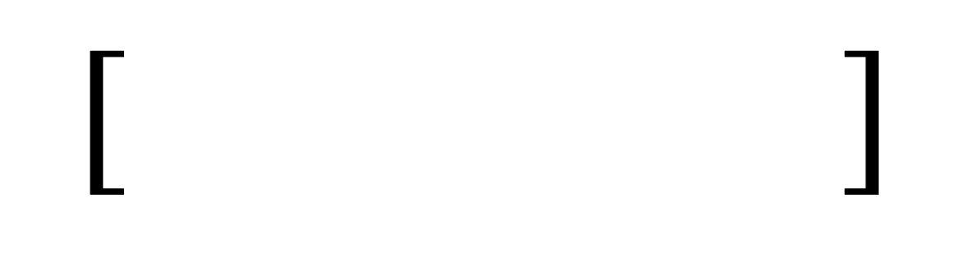
player_idx = 0
piece_idx = 1
file_idx = 2
rank_idx = 3
mod_idx = 4
piece_map = {'pawn': 0, 'N': 1, 'B': 2, 'R': 3, 'Q': 4, 'K': 5}
file_map = {'a': 0, 'b': 1, 'c': 2, 'd': 3, 'e': 4, 'f': 5, 'g': 6, 'h': 7}
rank_list = np.arange(1,9)
mod_map = {'O-O-O': 0, 'O-O': 1, 'x': 2, '+': 3, '#': 4, '=': 5} # queenside castle, kingside castle, capture, check, mate, promo
$$[ ]$$
0
Player
1
Piece
2
File
3
Rank
4
Mod
Map – Encoding Values
Vector Index and Designation
 | 0 | 1 | 2 | 3 | 4 | 5 | 6 | 7
[0] Player | White | Black | − | − | − | − | − | −
[1] Piece | − (pawn) | N (knight) | B (bishop) | R (rook) | Q (queen) | K (king) | − | −
[2] File | A | B | C | D | E | F | G | H
[3] Rank | 1 | 2 | 3 | 4 | 5 | 6 | 7 | 8
[4] Mods | O-O-O (queenside castle) | O-O (kingside castle) | x (capture) | + (check) | # (checkmate) | = (promotion) | − | −

Slide 2
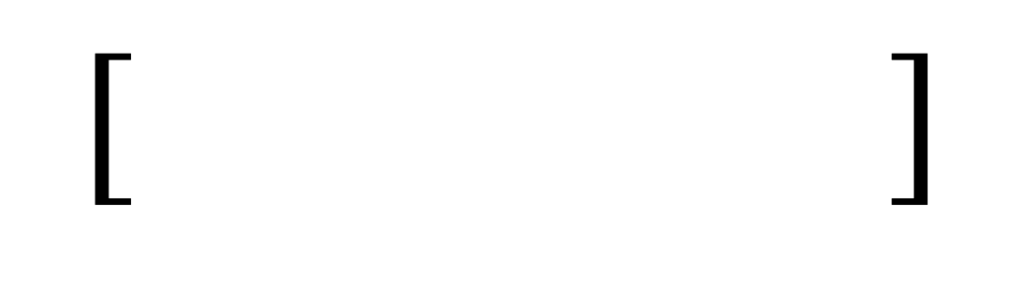
$$[ ]$$
0
Player
1
Piece
2
File
3
Rank
4
Mod
Map – Encoding Values

Slide 3
Map – Encoding Values

Slide 4
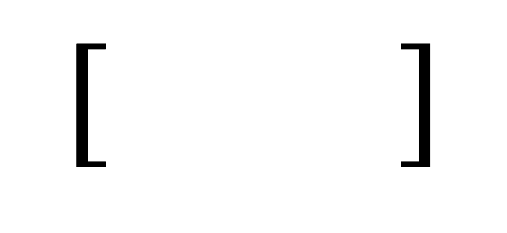
RNN
$$[ ]$$
0
1

Slide 5
Dataset | Number of Moves
1 | 10
2 | 20
3 | 50

Slide 6
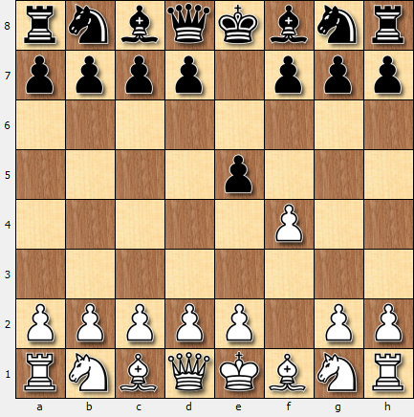
https://www.knightschessclub.org/writing_algebraic_notation.html
File
8
7
Algebraic Notation
Custom Vector Encoding
Human Language Translation
6
5
f4
[0, 0, 5, 5, -1]
White moves a pawn to f4
4
0: white
5: rank 4
3
0: pawn
-1: no mods
2
5: file f
1
a b c d e f g h
Rank

Slide 7
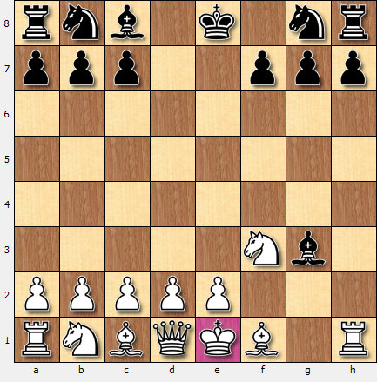
6. hxg3 Bxg3++ Whites pawn "P" on "h" takes "x" blacks Queen on g3.
Blacks Bishop "B" takes "x" whites Pawn on "g3" checkmating "++" the white King.

Slide 8
Algebraic Notation | Custom Vector Encoding | Human Language Translation
f4 | [0, | 1
f5 | White | Black
hxg3 | − (pawn) | N (knight)
Bxg3++ | A | B

Slide 9




E₀
E₁
E₂
E₃
E₄
$$\frac{∂E_{3}}{∂s_{3}}$$
$$\frac{∂s_{1}}{∂s_{0}}$$
$$\frac{∂s_{2}}{∂s_{1}}$$
$$\frac{∂s_{3}}{∂s_{2}}$$
s₀
s₁
s₂
s₃
s₄
Input 0
Input 1
Input 2
Input 3
Input 4

Slide 10
Algebraic Notation | Custom Vector Encoding | Human Language Translation
f4 | [0, 0, 5, 5, -1] | White moves a pawn to f4.
f5 | [1, 1, 5, 6, -1] | Black moves a pawn to f5.
hxg3 | [ | White moves a pawn to g3, capturing
Bxg3++ | A | B
Algebraic Notation
Custom Vector Encoding
Human Language Translation
f4
[0, 0, 5, 5, -1]
White moves a pawn to f4
0: white
5: rank 4
0: pawn
-1: no mods
5: file f

Slide 11
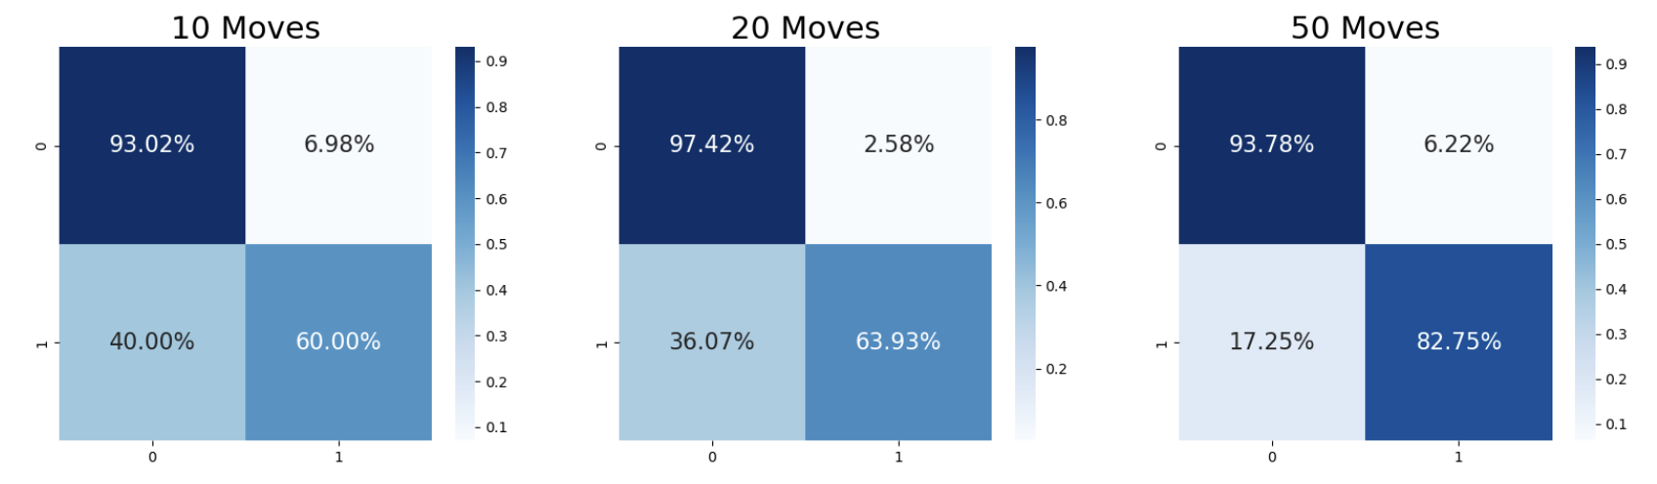
Acc = 82.5%
Acc = 82.7%
Acc = 88.6%

Slide 12
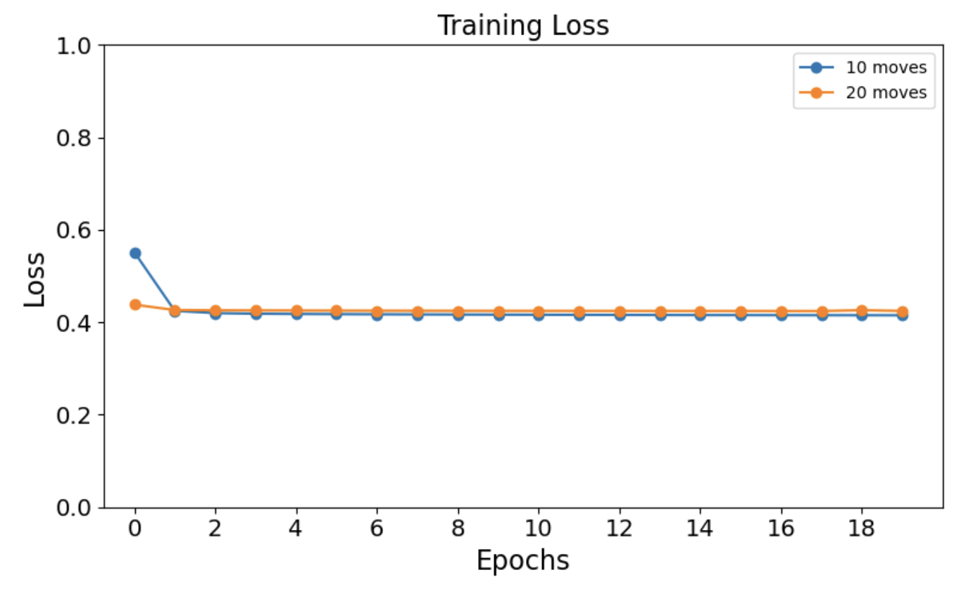
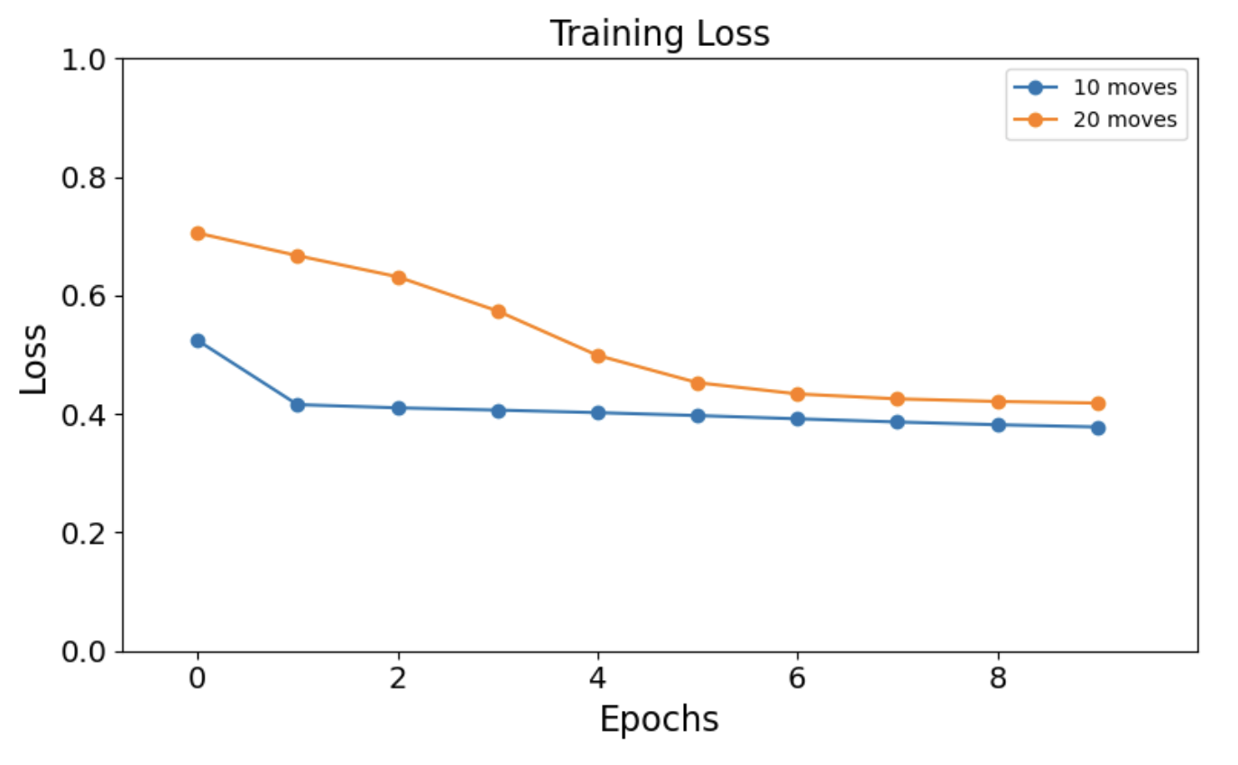
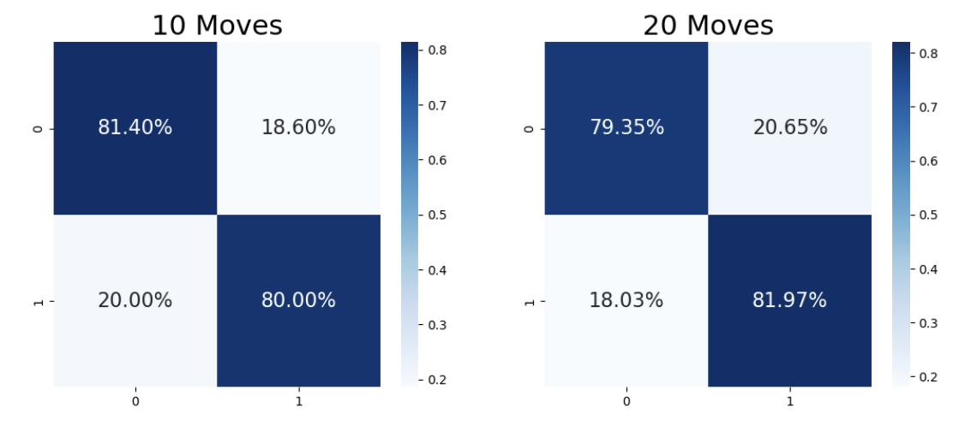
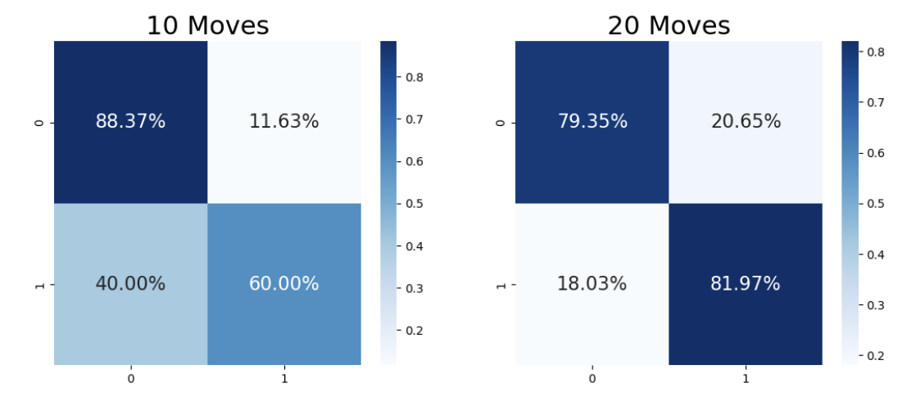
Increase number of layers to 8
Decrease number of layers to 2
Acc = 80.9%
Acc = 80.5%
Acc = 79.4%
Acc = 80.5%

