Slide 1
Movie Night Planner
CS4398 Software Engineering — Final Presentation
May 12, 2025

Slide 2
System Purpose
Collaborative web app for planning movie nights with friend groups
Core features: user auth, friend system, groups, sessions, voting, AI recommendations, watchlists
Problem: deciding what to watch as a group is tedious — this app automates suggestions and voting
Target users: friend groups who regularly watch movies together
🎬
Watch Together
Vote Together
Decide Together

Slide 3
Technology Stack
Frontend
Backend
React 19 + Vite
JavaScript / JSX
Node.js + Express + TypeScript
Prisma ORM + MongoDB
JWT access + refresh token auth
TMDB API (movie metadata)

Slide 4
Layered Backend Architecture
HTTP Request
Routes
Middleware (Auth · RBAC · Validation)
Controllers
Services
Repositories
MongoDB (via Prisma)
Frontend SPA (React) ↔ REST /api/v1 ↔ Express Backend ↔ Prisma ↔ MongoDB

Slide 5
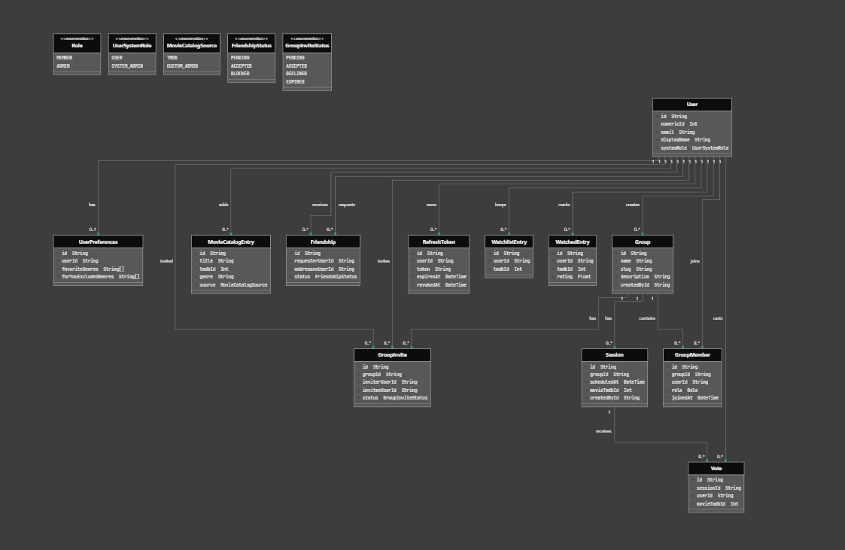
UML Class Diagram

Slide 6
UML Class Diagram — Key Models
User
Group
id · email · displayName · systemRole
id · name · slug · description
has → UserPreferences, WatchlistEntry[], WatchedEntry[], GroupMember[], Vote[]
has → GroupMember[], Session[], GroupInvite[]
GroupMember
Session
groupId · userId · role: MEMBER|ADMIN
groupId · scheduledAt
junction: User ↔ Group
has → Vote[]
Vote
Friendship
sessionId · userId · movieTmdbId
requesterUserId · addresseeUserId · status
1 per user per session
status: PENDING | ACCEPTED | BLOCKED
MovieCatalogEntry
title · tmdbId · genre · source
source: TMDB | CUSTOM_ADMIN
* Movies stored as tmdbId (int) only — metadata fetched on-demand from TMDB API

Slide 7
Statechart: User Authentication
Unauthenticated
Register / Login
Authenticated
Logout
Refresh OK
Token expires (401)
Refresh expired →
Refreshing Token
Unauthenticated → [Register or Login] → Authenticated
Authenticated → [Access token expires] → RefreshingToken → Authenticated
RefreshingToken → [Refresh token revoked/expired] → Unauthenticated
Authenticated → [Logout] → Unauthenticated
Refresh token is one-time-use: rotation prevents stolen-token replay attacks

Slide 8
Statechart: Session & Vote Lifecycle
SESSION
Created
Voting Open
Movie Selected
Completed
Cancelled
(DELETE /sessions/:id — admin at any point)
VOTE (per user per session)
No Vote
Vote Cast
Vote Changed

Slide 9
Acceptance Test Cases
AT-1: User Registration — new user registers, lands on homepage with session
AT-2: Login / Logout — credentials accepted; session cleared on logout
AT-3: Create Group — group created, creator is ADMIN
AT-4: Invite Friend & Join Group — friend request sent/accepted; invite sent/accepted
AT-5: Search & Watchlist — TMDB search results shown; movie added to watchlist
AT-6: Create Session — session with date/time created under group
AT-7: Vote on Movie — members cast votes; results aggregated in real time
AT-8: AI Recommendations — group gets ranked suggestions with explanations
AT-9: Admin Catalog — SYSTEM_ADMIN adds movie to global catalog
AT-10: Mark Watched & Rate — user marks movie watched, submits 1–5 star rating

Slide 10
Unit Test Coverage
Framework: Vitest (both frontend and backend packages)
backend/src/utils/jwt.test.ts — sign/verify access and refresh tokens
backend/src/database/schema.prisma.test.ts — Prisma schema structure validation
frontend/src/App.test.jsx — top-level app render and route guards
frontend/src/HomePage.test.jsx — home page component rendering
frontend/src/GroupPage.test.jsx — group listing and navigation
npm run test:backend · npm run test:frontend · npm run test:all

Slide 11
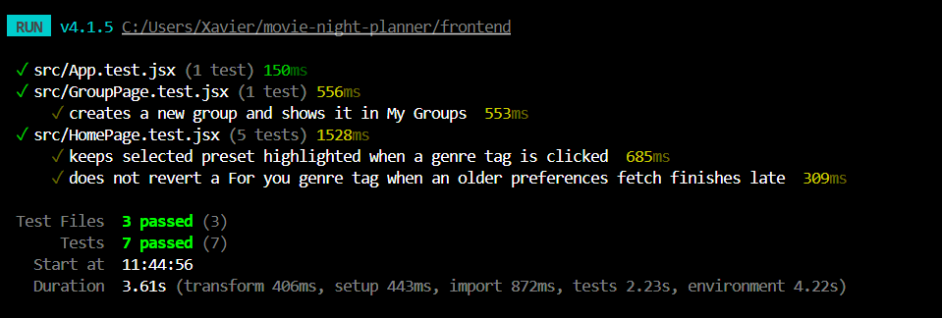
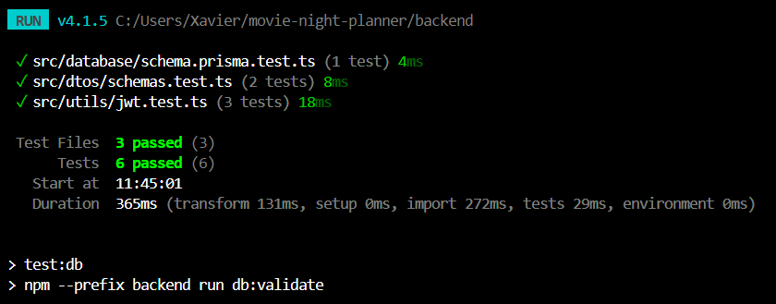
Unit Test Coverage
Framework: Vitest (both frontend and backend packages)
backend/src/utils/jwt.test.ts — sign/verify access and refresh tokens
backend/src/database/schema.prisma.test.ts — Prisma schema structure validation
frontend/src/App.test.jsx — top-level app render and route guards
frontend/src/HomePage.test.jsx — home page component rendering
frontend/src/GroupPage.test.jsx — group listing and navigation

Slide 12
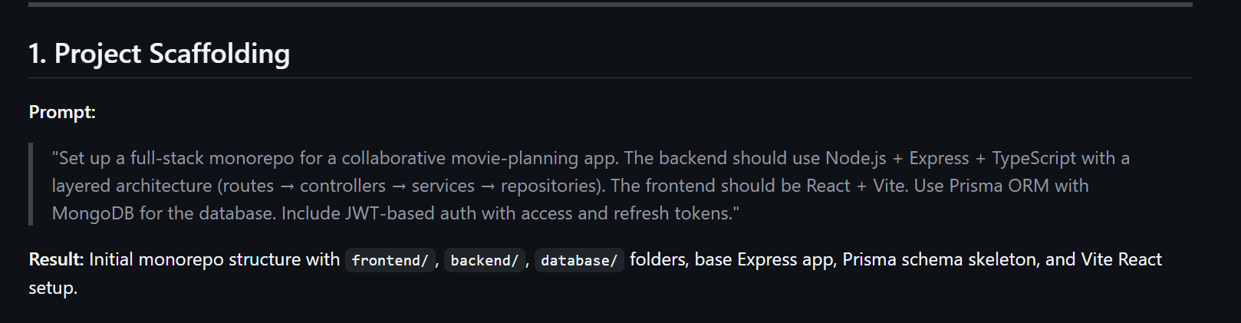
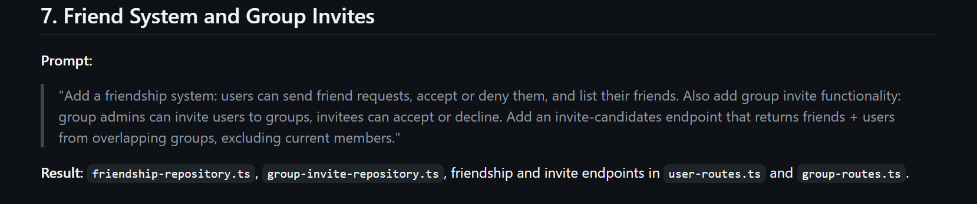
Prompts

Slide 13
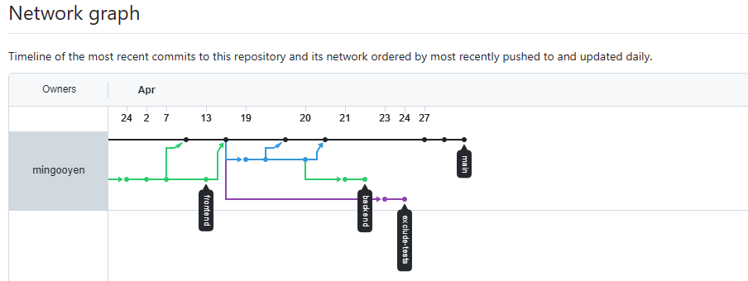
Git Repository — Branches & Commits
[ Insert GitHub Network graph screenshot here ]
Navigate to: GitHub Repo → Insights → Network
Take a screenshot and paste it onto this slide.
main — stable production branch
feature/backend — backend API development
feature/frontend — React SPA development
fix/* — bug fix branches merged into main via PR

Slide 14
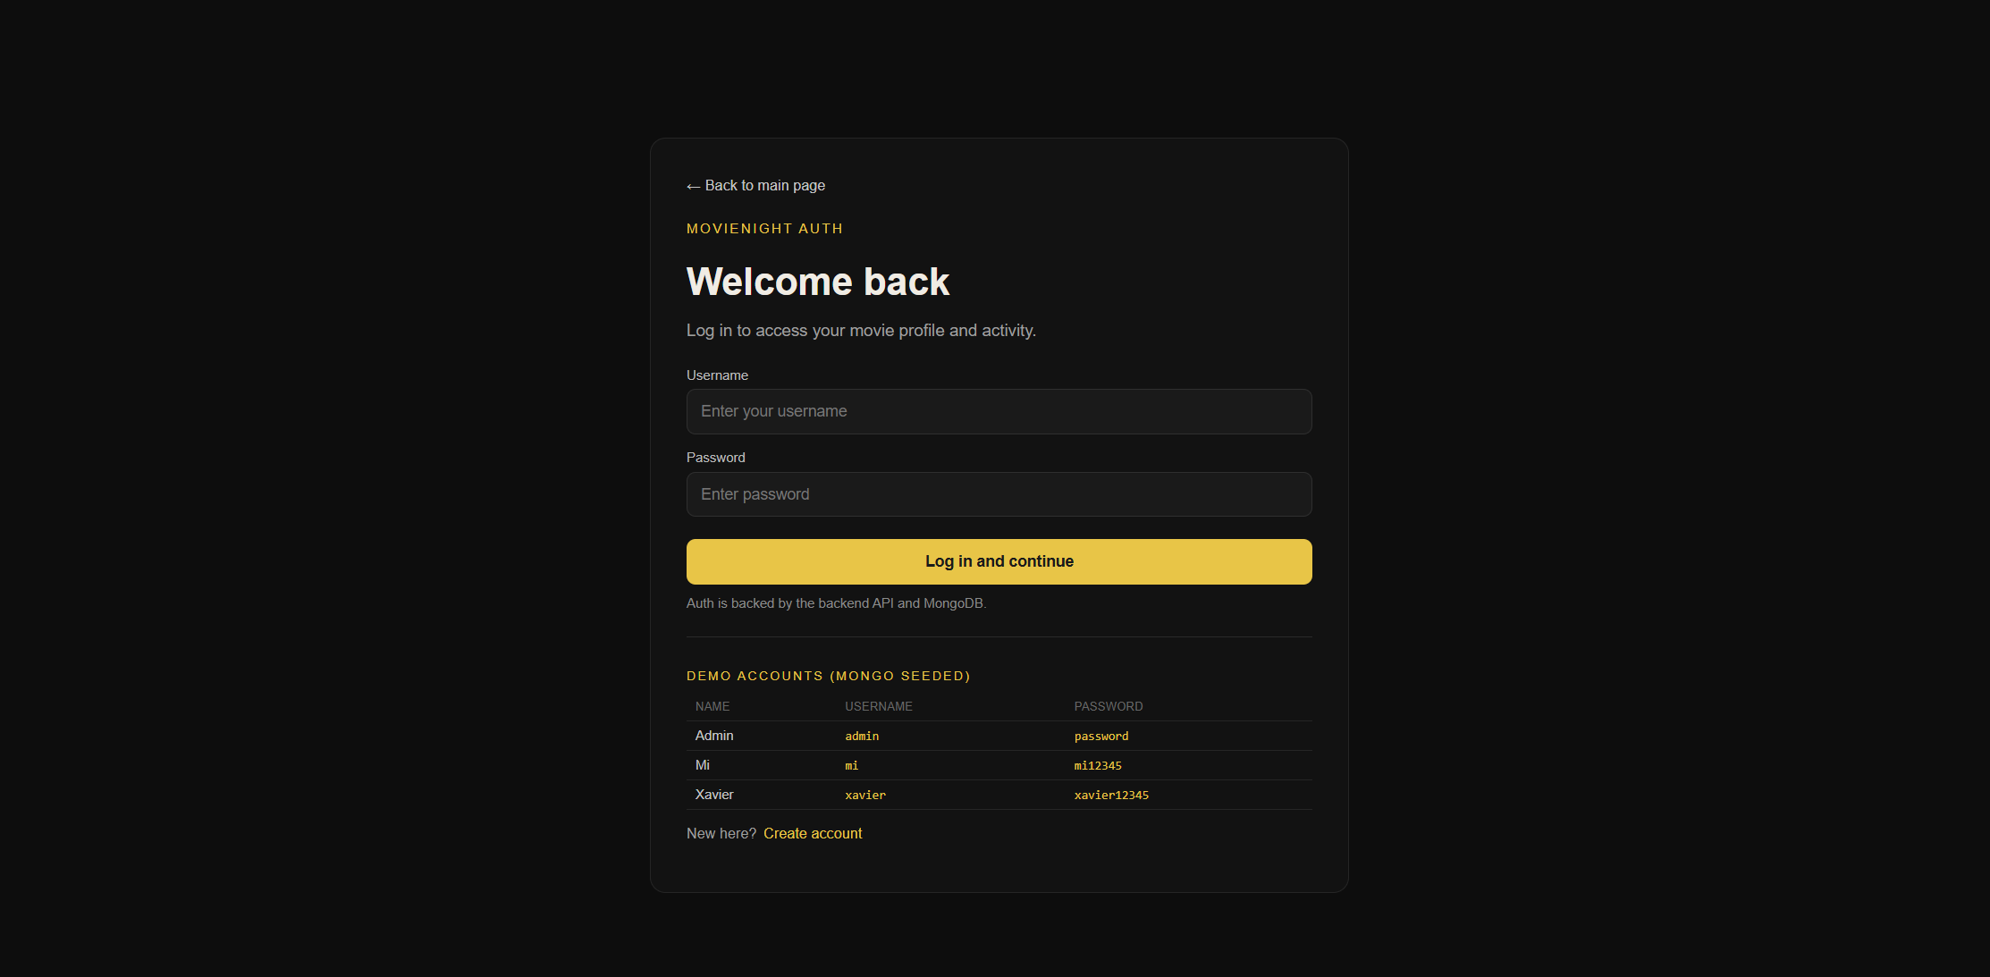
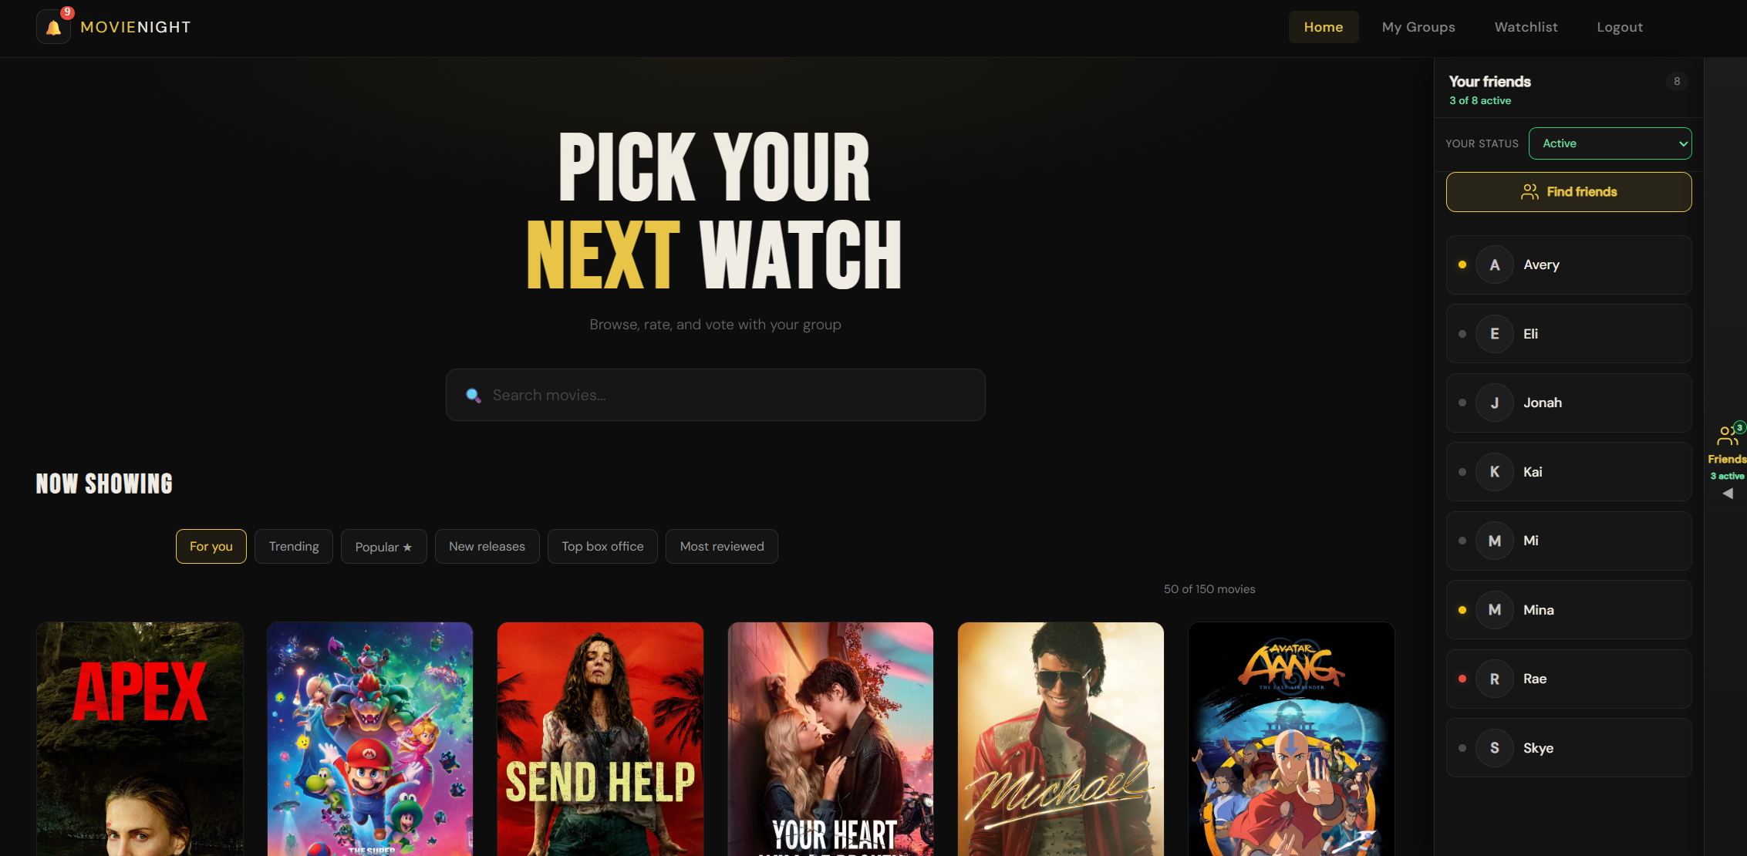
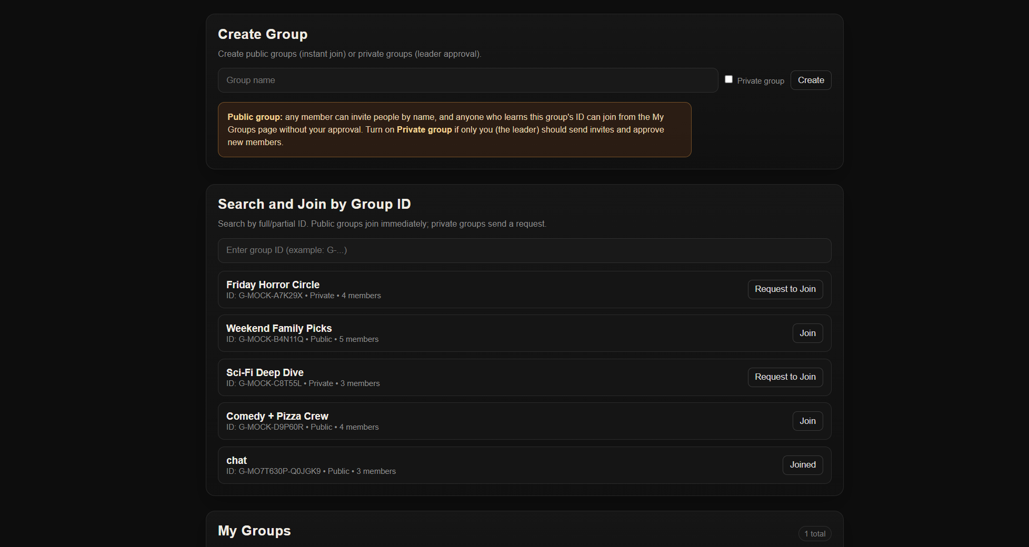
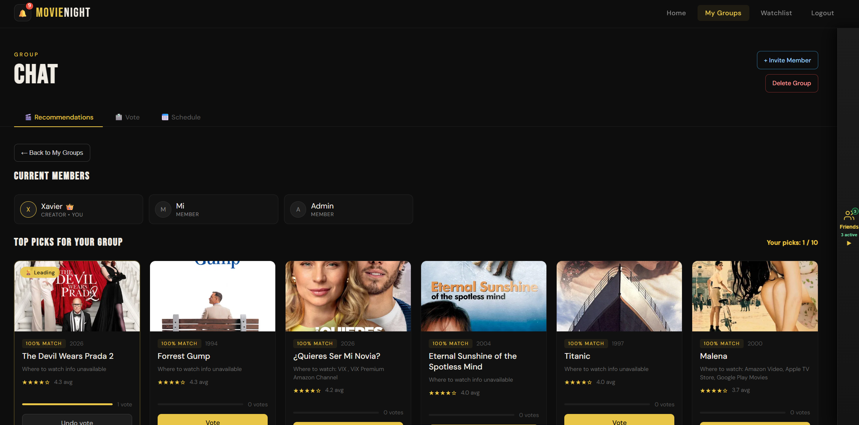
System Screenshots

Slide 15
Summary
Full-stack collaborative movie planning application
Layered architecture: routes → controllers → services → repositories
JWT dual-token auth with one-time-use refresh rotation
Real-time vote aggregation per session (admin selects winner)
AI-powered group recommendations via OpenAI (score + explanation)
Friend system with online presence indicators
10 acceptance test cases covering all core workflows
Vitest unit tests: JWT utilities, DTOs, schema, and React components

