Slide 1
FarmsPros
Mingqiang Han– PhD. Agricultural Engineering
Albert Benson – MS. Agricultural Engineering

Slide 2
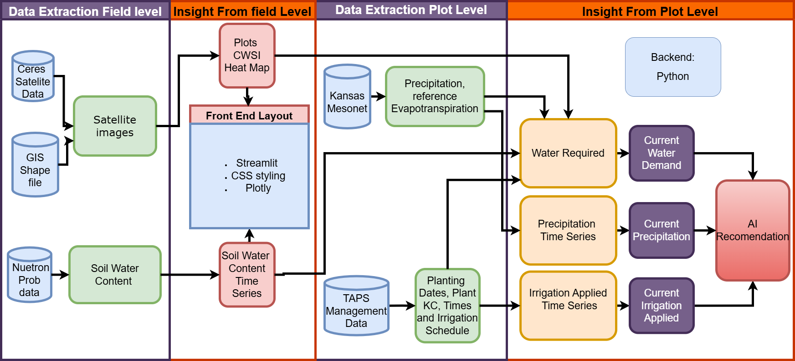
Interactive Dashboard

