Slide 1
citiBikeTableau
File created on: 7/6/2019 12:22:01 PM

Slide 2
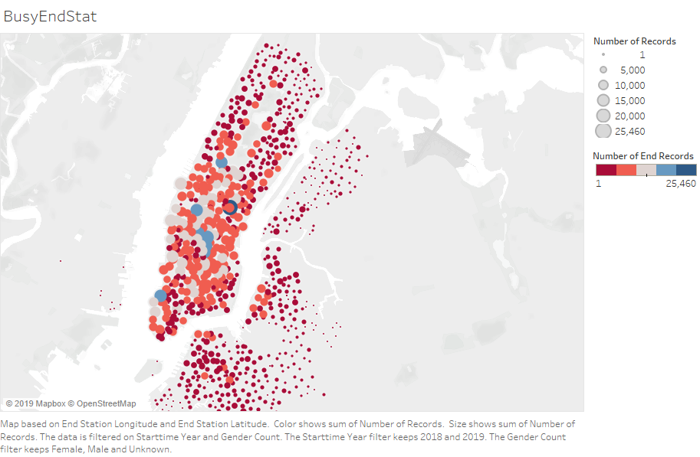

Slide 3
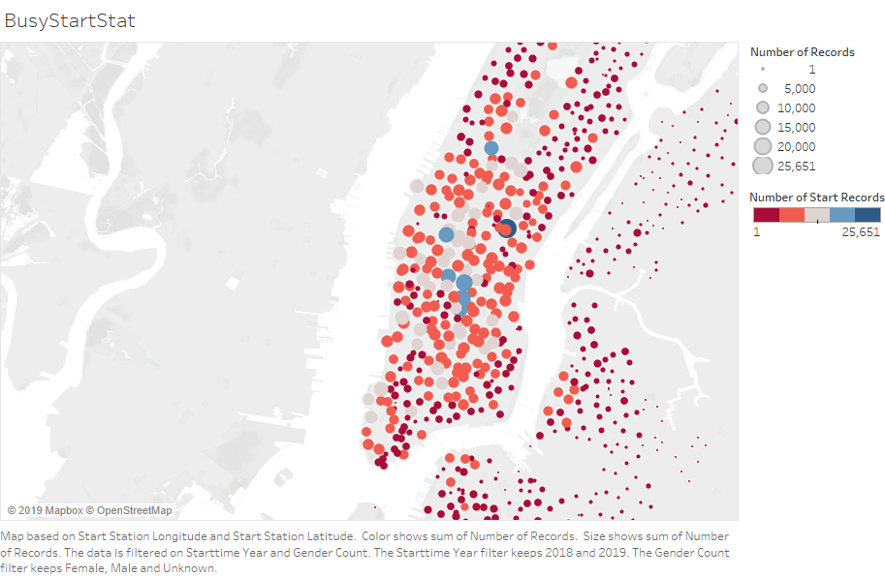

Slide 4


Slide 5
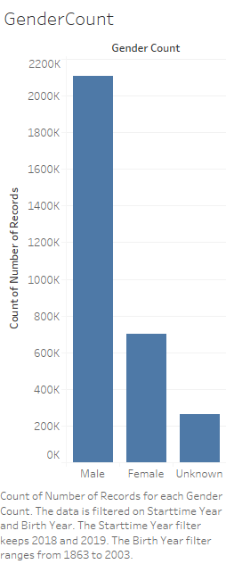

Slide 6
