Slide 1
Keywords
Search-based vs Deep-learning based
Explicit Feature Interactions vs Implicit Feature Interactions
Categorical Features vs Numerical Features
Feature crossing restricted to categorical features
Task restricted to binary classification → easy extension
Operator: Cross Product

Slide 2
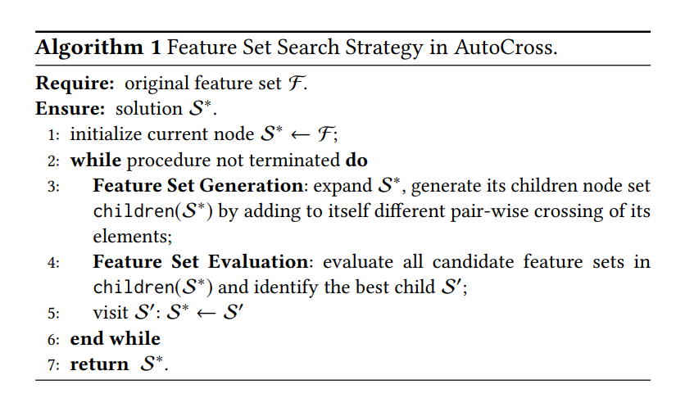
Workflow
1. Preprocessing
Determine hyper-parameters
Fill missing values
Discretization numerical values
-> multi-granularity discretization
2. Feature-set generation
-> Tree search space: each node is a feature set
-> beam search
3. Feature-set evaluation
-> approximation learning model: field-wise logistic regression
-> optimizer: successive mini-batch gradient descent
4. Termination condition meet？ No -> repeat 2&3
Runtime
Performance compared with parent node
Max feature number

Slide 3
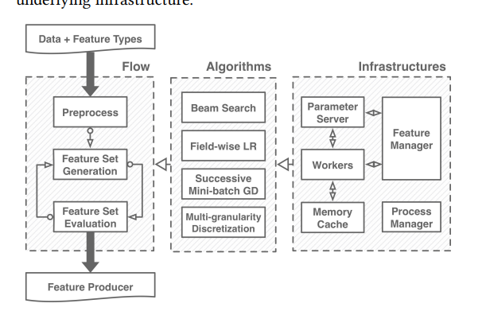
Algorithms

Slide 4
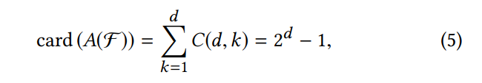
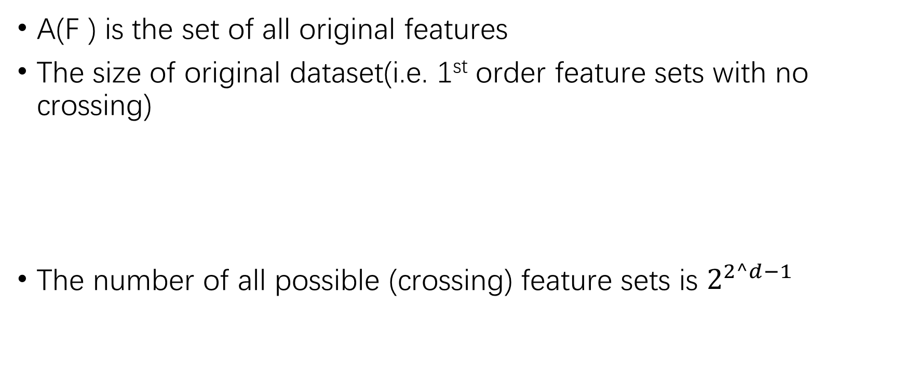
Search Space
A(F ) is the set of all original features
The size of original dataset(i.e. 1st order feature sets with no crossing)
The number of all possible (crossing) feature sets is $2^{2^d−1}$

Slide 5
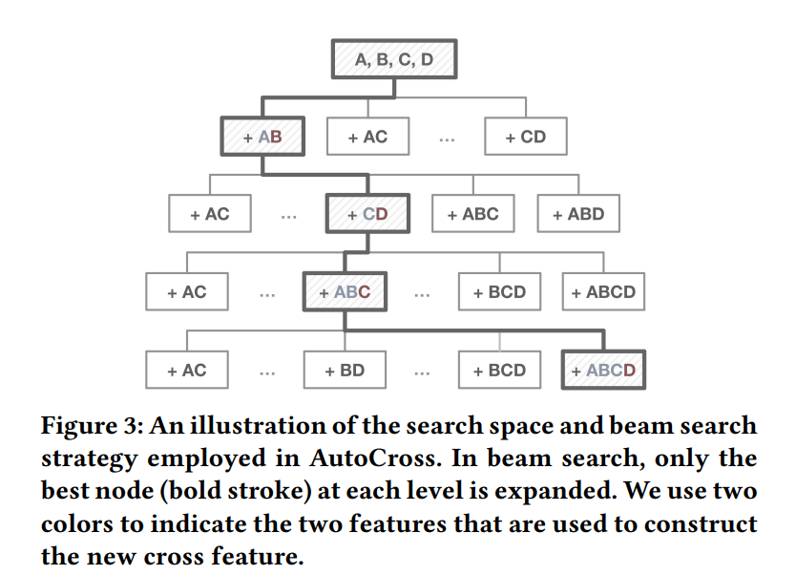

Feature set generation
For a node (a feature set), its each child is constructed by adding to itself one pair-wise crossing of its own elements.
The pair-wise interactions between cross features (or a cross feature and an original feature) will lead to high-order feature crossing.
The new space T considers all possible features in A(F ), but excludes part of its subsets.
However, the size of T is O (d 2 /2) k where k is the maximum number of generated cross features. It grows exponentially with k.
Figure 3 highlights a search path that begins from the original feature set {A, B, C, D} and ends at {A, B, C, D, AB, CD, ABC, ABCD},

Slide 6
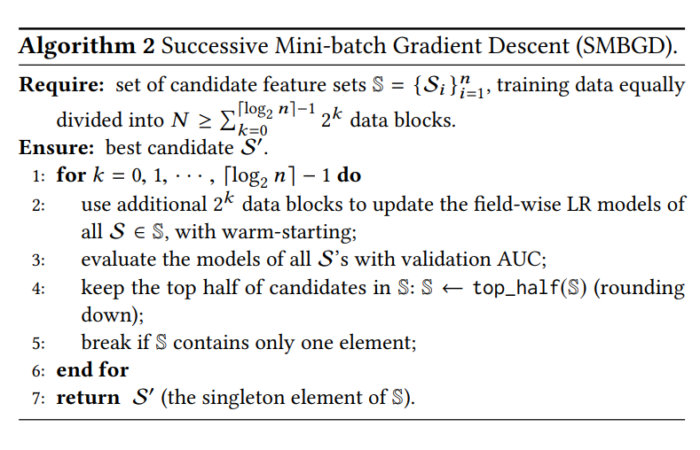
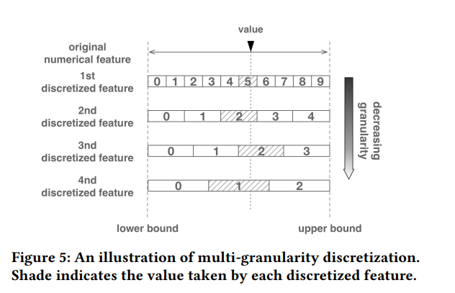

Slide 7
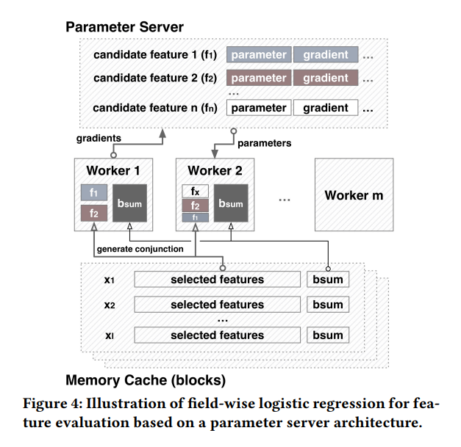
Infrastructures
Parameter Server (PS) Architectures
Feature Manager
Process Manager
Workers
Hashing tricks for storing features

Slide 8
SAFE
A more general operator set that can be extended
Unary
discretization, normalization
Binary
Four basic arithmetic operations: +, −, ×, ÷.
Logical operators: conjunction (∧), disjunction (∨), alternative denial (↑), joint denial (↓), material conditional (→), converse implication (←), biconditional (↔), exclusive or (=), etc.
GroupByThenMax, GroupByThenMin, GroupByThenAvg, GroupByThenStdev and GroupByThenCount.
Ridge regression and kernel ridge regression in [24] can also be considered as binary operators.
Ternary: conditional operator a?b:c
Domain Specific

Slide 9
Workflow
1. Preprocessing
-> View discretization as an operator in the next step
2. Feature-set generation
-> fit a base xgb tree
-> first filtering of base features: tree-path based feature combination generation
-> second filtering of base features :
- Tree split points information gain ratio filter for each feature combination
-> applying operators to generate new feature sets
3. Feature-set evaluation
-> iv
-> Pearson correlation
-> xgb average split gain
4. Termination condition meet？ No -> repeat 2&3
Runtime
Performance compared with parent node
Max iteration number

Slide 10
References
https://segmentfault.com/a/1190000021328618?utm_source=sf-similar-article

