Slide 1
Chapter 2: Intro to Relational Model

Slide 2
Outline
Structure of Relational Databases
Database Schema
Keys
Schema Diagrams
Relational Query Languages
The Relational Algebra
Notes:
1

Slide 3
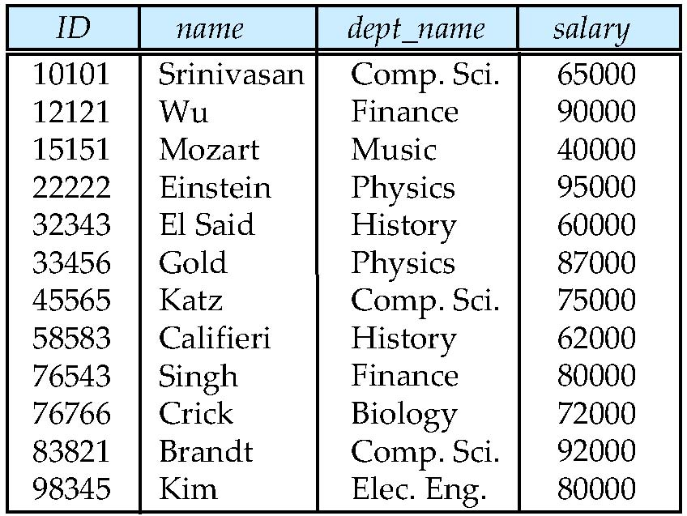
Example of a Instructor Relation
attributes
(or columns)
tuples
(or rows)

Slide 4
Attribute
The set of allowed values for each attribute is called the domain of the attribute
Attribute values are (normally) required to be atomic; that is, indivisible
The special value null is a member of every domain. Indicated that the value is “unknown”
The null value causes complications in the definition of many operations

Slide 5
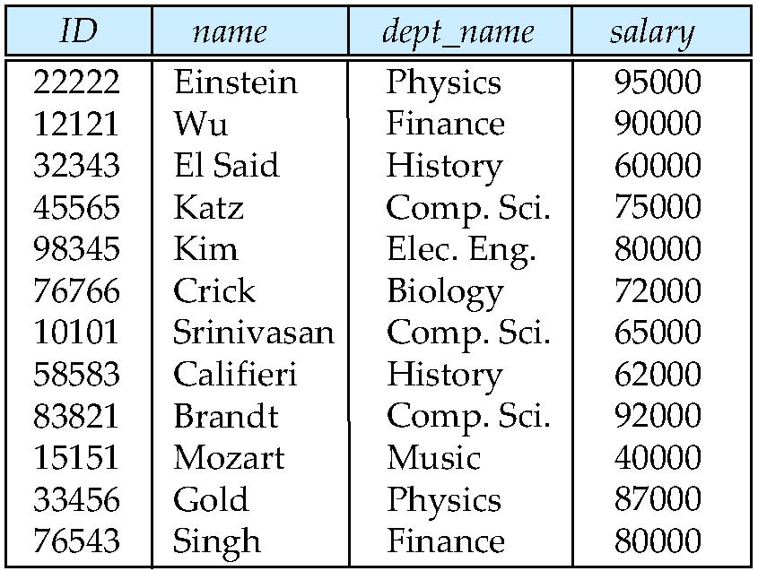
Relations are Unordered
Order of tuples is irrelevant (tuples may be stored in an arbitrary order)
Example: instructor relation with unordered tuples

Slide 6
Database Schema
Database schema -- is the logical structure of the database.
Database instance -- is a snapshot of the data in the database at a given instant in time.
Example:
schema: instructor (ID, name, dept_name, salary)
Instance:

Slide 7
Keys
Let K ⊆ R
K is a superkey of R if values for K are sufficient to identify a unique tuple of each possible relation r(R)
Example: {ID} and {ID,name} are both superkeys of instructor.
Superkey K is a candidate key if K is minimal Example: {ID} is a candidate key for Instructor
One of the candidate keys is selected to be the primary key.
which one?
Foreign key constraint: Value in one relation must appear in another
Referencing relation
Referenced relation
Example: dept_name in instructor is a foreign key from instructor referencing department

Slide 8
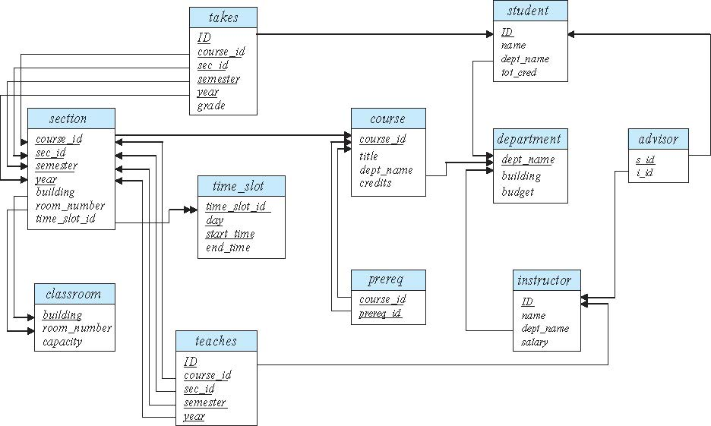
Schema Diagram for University Database

Slide 9
Relational Query Languages
Procedural versus non-procedural, or declarative
“Pure” languages:
Relational algebra
Tuple relational calculus
Domain relational calculus
The above 3 pure languages are equivalent in computing power
We will concentrate in this chapter on relational algebra
Not turning-machine equivalent
Consists of 6 basic operations

Slide 10
Relational Algebra
A procedural language consisting of a set of operations that take one or two relations as input and produce a new relation as their result.
Six basic operators
select: σ
project: ∏
union: ∪
set difference: –
Cartesian product: x
rename: ρ

Slide 11
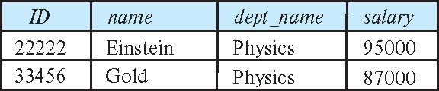
Select Operation
The select operation selects tuples that satisfy a given predicate.
Notation: σ _{p} (r)
p is called the selection predicate
Example: select those tuples of the instructor relation where the instructor is in the “Physics” department.
Query
σ _{dept_name=“Physics”} (instructor)
Result

