Slide 1
Chapter 2: Intro to Relational Model

Slide 2
Outline
Structure of Relational Databases
Database Schema
Keys
Schema Diagrams
Relational Query Languages
The Relational Algebra
Notes:
1

Slide 3
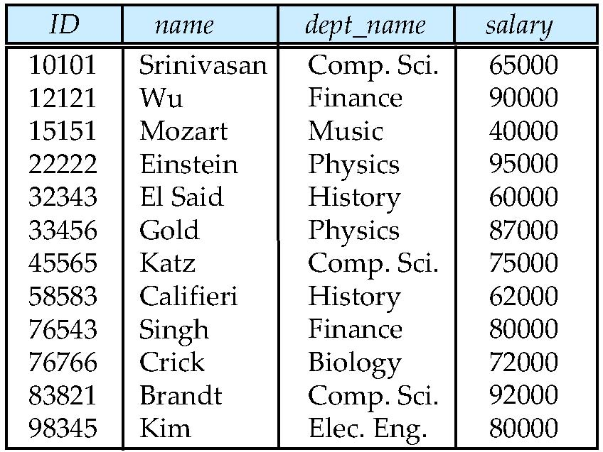
Example of a Instructor Relation
attributes
(or columns)
tuples
(or rows)

Slide 4
Attribute
The set of allowed values for each attribute is called the domain of the attribute
Attribute values are (normally) required to be atomic; that is, indivisible
The special value null is a member of every domain. Indicated that the value is “unknown”
The null value causes complications in the definition of many operations

Slide 5
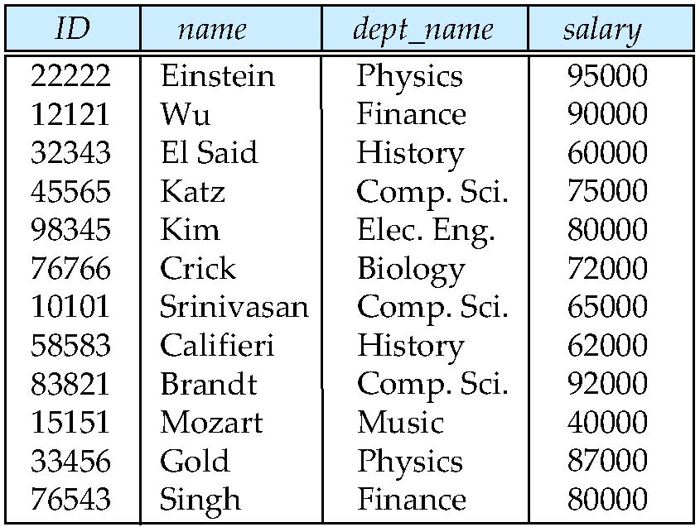
Relations are Unordered
Order of tuples is irrelevant (tuples may be stored in an arbitrary order)
Example: instructor relation with unordered tuples

Slide 6
Database Schema
Database schema -- is the logical structure of the database.
Database instance -- is a snapshot of the data in the database at a given instant in time.
Example:
schema: instructor (ID, name, dept_name, salary)
Instance:

Slide 7
Keys
Let K ⊆ R
K is a superkey of R if values for K are sufficient to identify a unique tuple of each possible relation r(R)
Example: {ID} and {ID,name} are both superkeys of instructor.
Superkey K is a candidate key if K is minimal Example: {ID} is a candidate key for Instructor
One of the candidate keys is selected to be the primary key.
which one?
Foreign key constraint: Value in one relation must appear in another
Referencing relation
Referenced relation
Example: dept_name in instructor is a foreign key from instructor referencing department

Slide 8
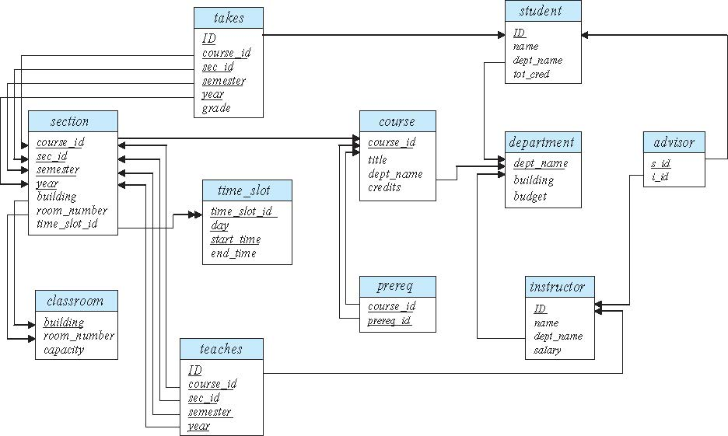
Schema Diagram for University Database

Slide 9
Relational Query Languages
Procedural versus non-procedural, or declarative
“Pure” languages:
Relational algebra
Tuple relational calculus
Domain relational calculus
The above 3 pure languages are equivalent in computing power
We will concentrate in this chapter on relational algebra
Not turning-machine equivalent
Consists of 6 basic operations

Slide 10
Relational Algebra
A procedural language consisting of a set of operations that take one or two relations as input and produce a new relation as their result.
Six basic operators
select: σ
project: ∏
union: ∪
set difference: –
Cartesian product: x
rename: ρ

Slide 11
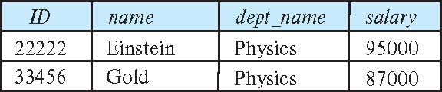
Select Operation
The select operation selects tuples that satisfy a given predicate.
Notation: σ _{p} (r)
p is called the selection predicate
Example: select those tuples of the instructor relation where the instructor is in the “Physics” department.
Query
σ _{dept_name=“Physics”} (instructor)
Result

Slide 12
Select Operation (Cont.)
We allow comparisons using
=, ≠, >, ≥. <. ≤
in the selection predicate.
We can combine several predicates into a larger predicate by using the connectives:
∧ (and), ∨ (or), ¬ (not)
Example: Find the instructors in Physics with a salary greater $90,000, we write:
σ _{dept_name=“Physics”} ∧ _{salary} > 90,000 (instructor)
Then select predicate may include comparisons between two attributes.
Example, find all departments whose name is the same as their building name:
σ _{dept_name=building} (department)

Slide 13
Project Operation
A unary operation that returns its argument relation, with certain attributes left out.
Notation:
∏ _{A1,A2,A3 ….Ak} (r)
where A₁, A₂ are attribute names and r is a relation name.
The result is defined as the relation of k columns obtained by erasing the columns that are not listed
Duplicate rows removed from result, since relations are sets

Slide 14
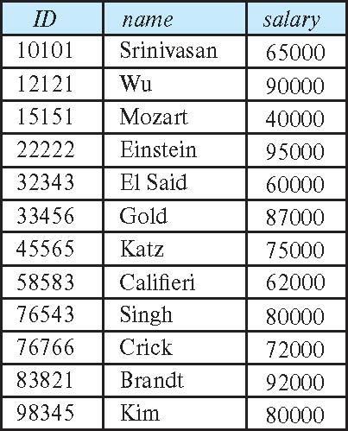
Project Operation (Cont.)
Example: eliminate the dept_name attribute of instructor
Query: ∏_{ID, name, salary} (instructor)
Result:

Slide 15
Composition of Relational Operations
The result of a relational-algebra operation is relation and therefore of relational-algebra operations can be composed together into a relational-algebra expression.
Consider the query -- Find the names of all instructors in the Physics department.
∏_{name}(σ _{dept_name} _{=“Physics”} (instructor))
Instead of giving the name of a relation as the argument of the projection operation, we give an expression that evaluates to a relation.

