Slide 1
Wear R You
Overview
Tommie N. Carter, Jr./Srikanth Bandaru

Slide 2

Phone App
Connects people to destinations
Leverages cloud storage to share location data (with permissions) ! Alternative: address entered locally
When activated allows people to connect using Google Maps Directions API

Slide 3
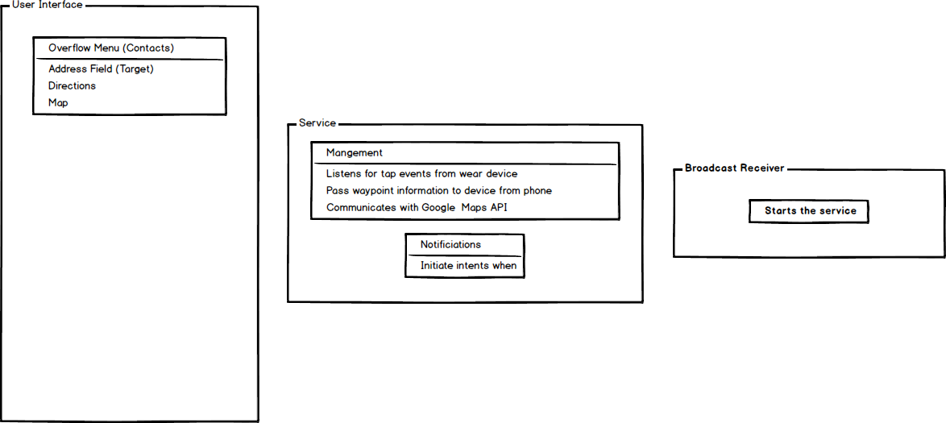
Architecture

Slide 4
Service
Coordinates the exchange of location data
Manages Notifications to/from Wear device
Forwards user messages to chat app on phone

Slide 5
Notifications
Activate on “near” waypoints
Engage a short vibration on wear device
Passes the information used to indicate directional travel

Slide 6
Broadcast Receiver
Initialize the service if it has been stopped

Slide 7
Interactions
People feel the device vibrate
Tap once to see the direction
Double tap shows short directional message for nearest waypoint (“Turn right at the 2nd cross street onto the Avenue of the Americas”)
Swipe once (dismiss the view)

Slide 8

Vibration

Slide 9
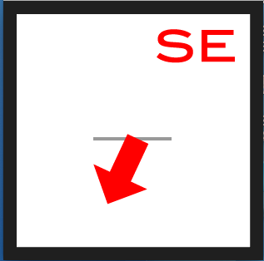
Single Tap
(Shows Direction)

Slide 10
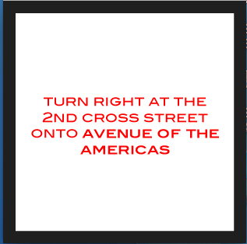
Double Tap
(Shows Waypoint Info)

Slide 11
Contact
Ming Technology LLC
http://www.tommiecarter.com
http://www.mingtech.co
tcarter@mingtech.co
tcarternyc@gmail.com
646-937-8632

Slide 12
Contact
Srikanth Bandaru
Computer Science Major
Pace University
551-697-9379
sb82603n@pace.edu

Slide 13
Questions/Discussion
Thanks for your time

