Slide 1
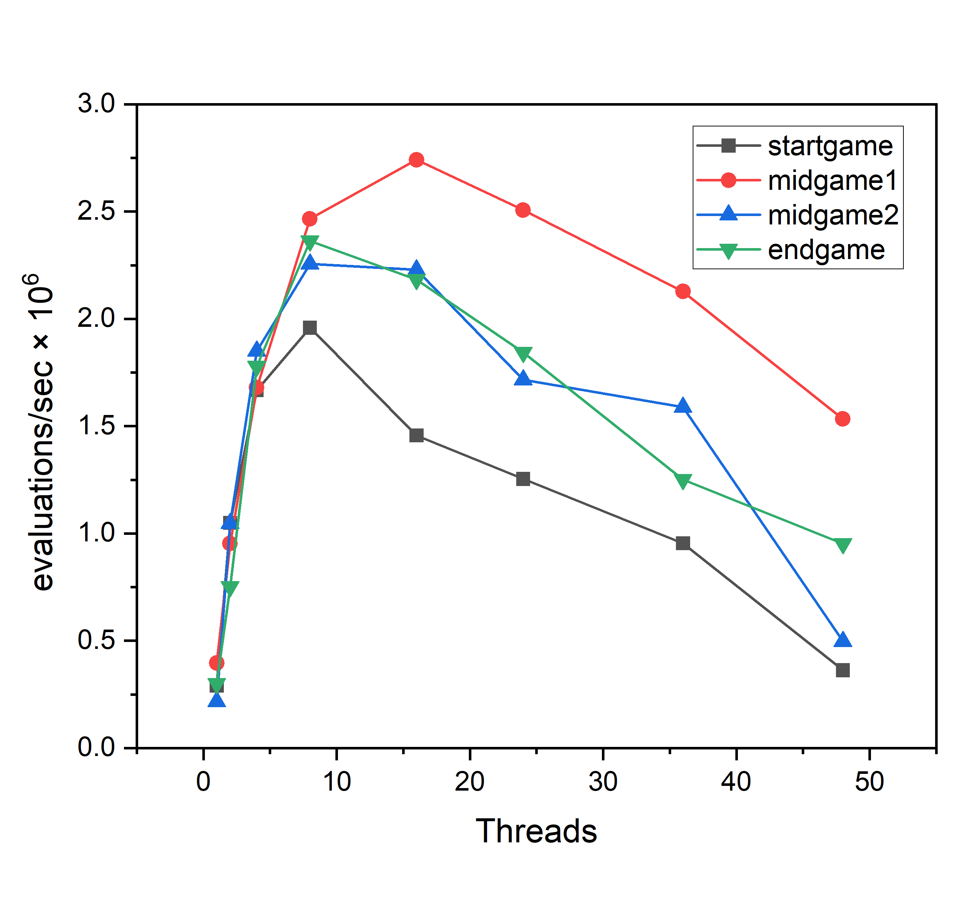
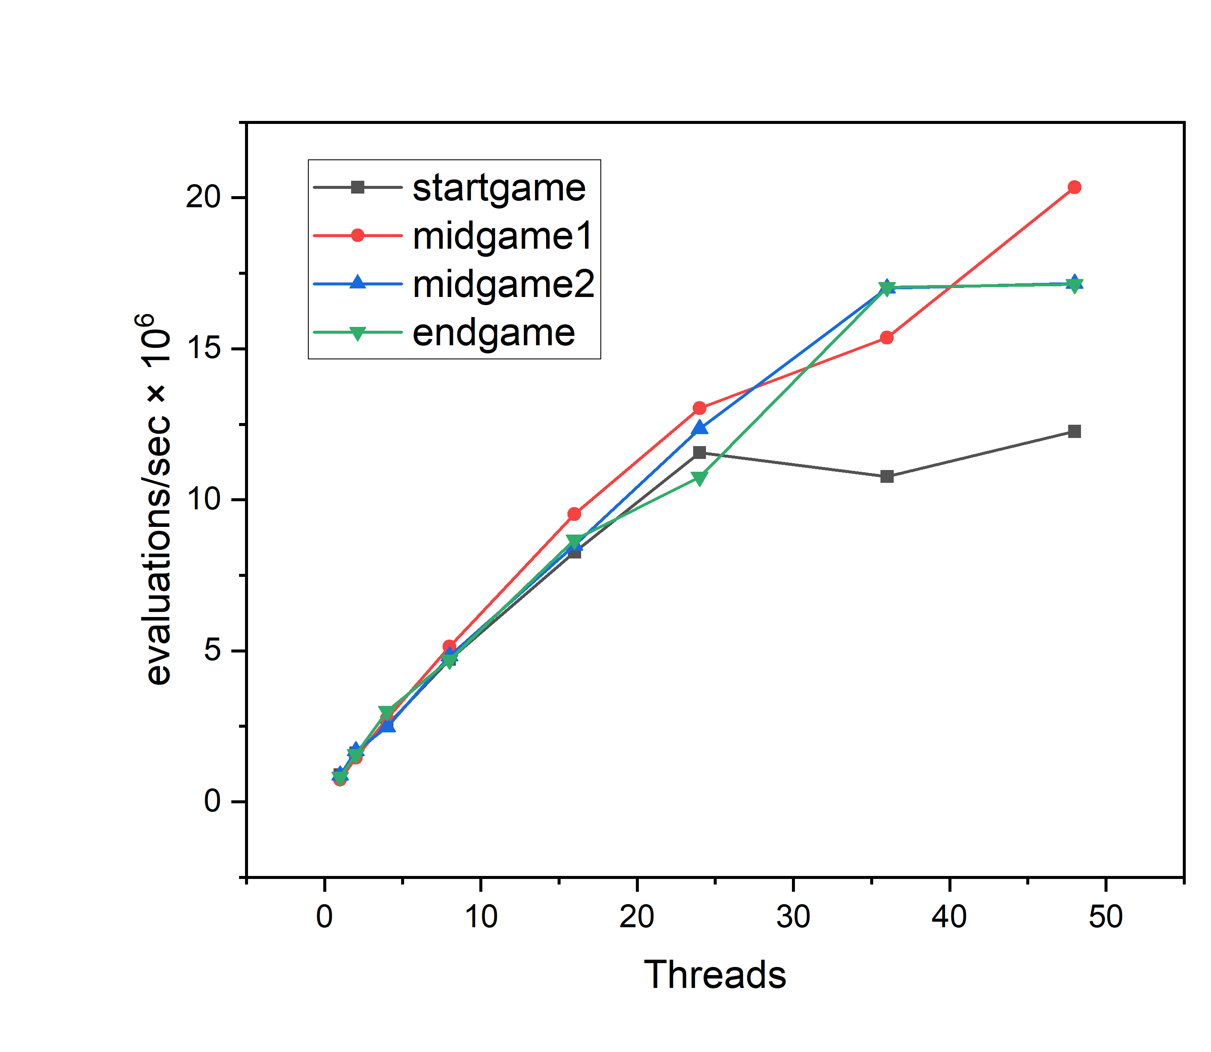
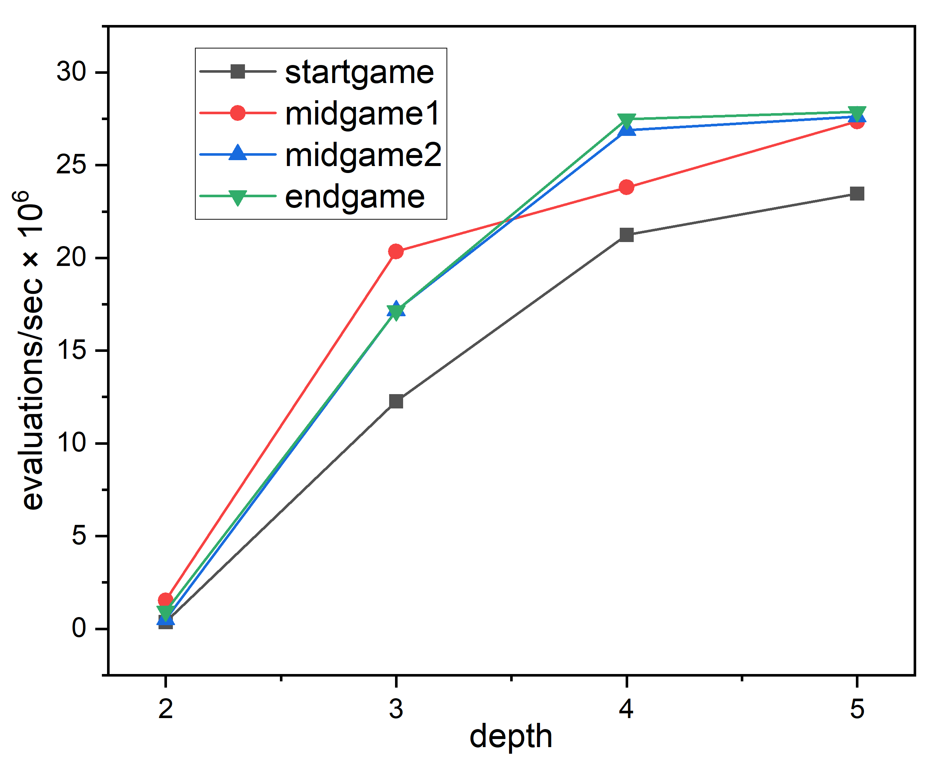
Group 7 Results
Evaluations / second in four positions when searching up to depth 2
Evaluations / second in four positions when searching up to depth 3
Evaluations / second in four positions when using 48 threads

