Slide 1
YOLOv3: An Incremental Improvement
Joseph Redmon, Ali Farhadi
[Submitted on 8 Apr 2018]
https://arxiv.org/abs/1804.02767
Present by: Jeong Mingyun
Notes:
세미나- 제목: 논문제목, 아래쪽 년도? 어디논문? 저자? 3개정보 추가

Slide 2
Abstract

Slide 3

Introduction

Slide 4
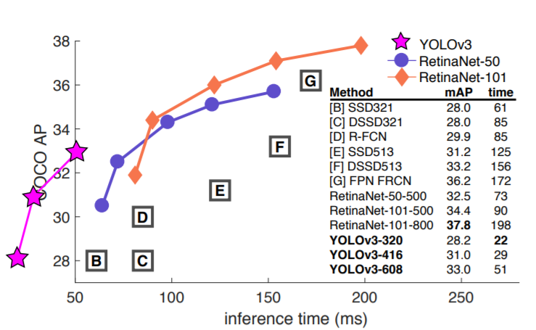
The deal

Slide 5
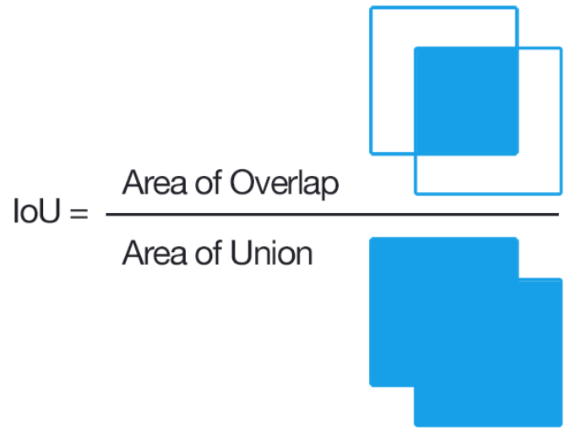
The deal

Slide 6
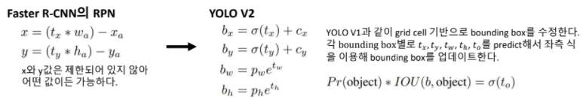
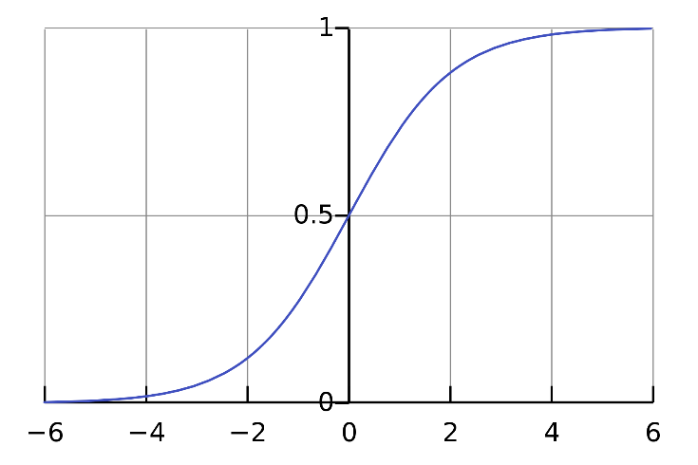
Bounding Box Prediction

Slide 7
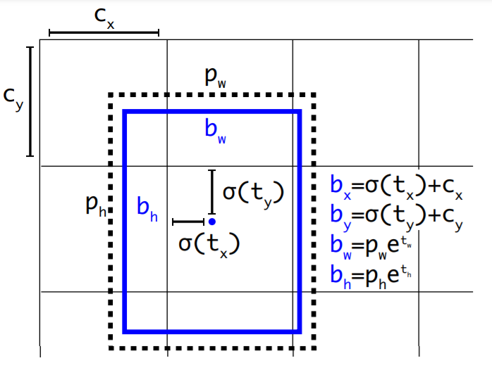
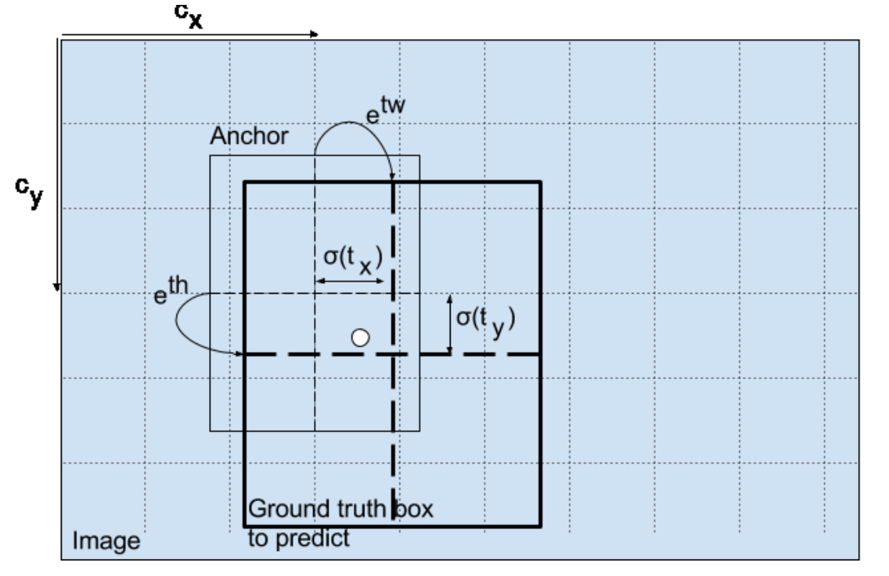
Bounding Box Prediction

Slide 8


Class prediction
Multi-label classfication
Man
Person

Slide 9
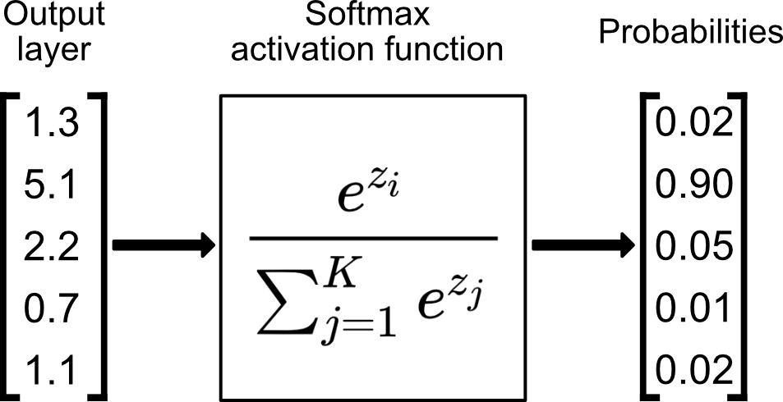
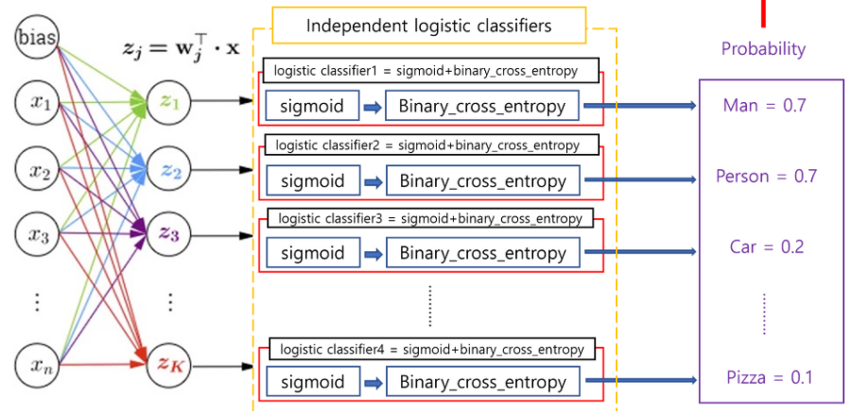
Class prediction
Multilabel classfication

Slide 10
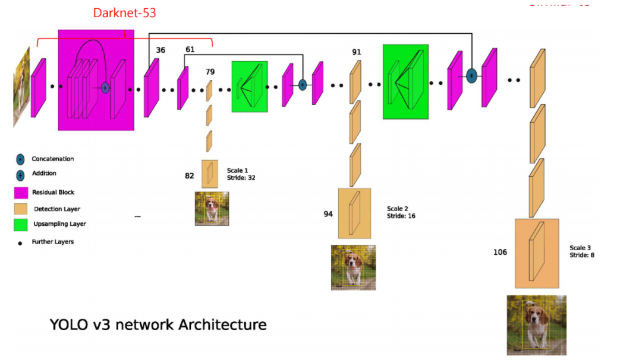
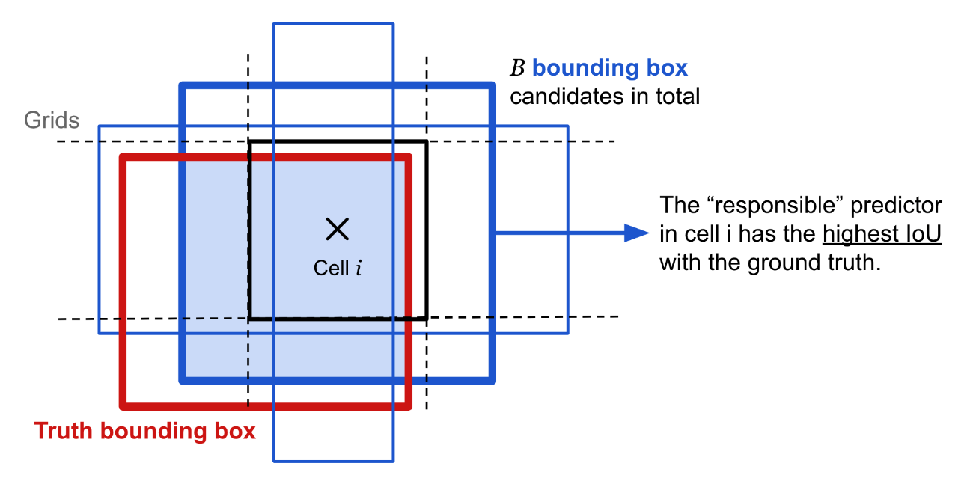
Predictions Across Scales

Slide 11
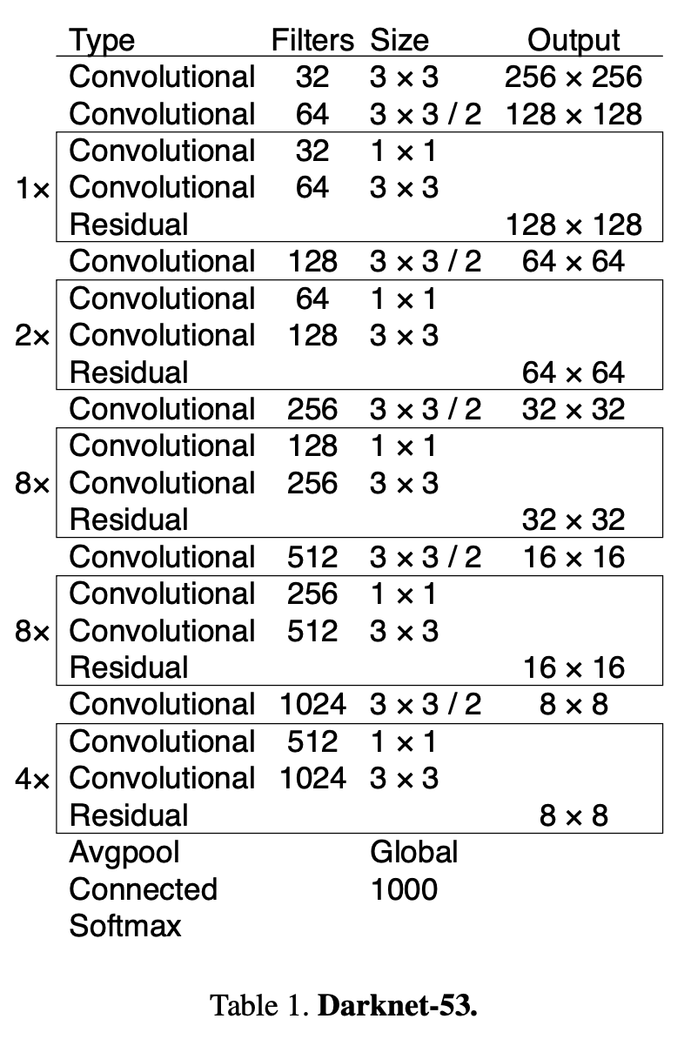
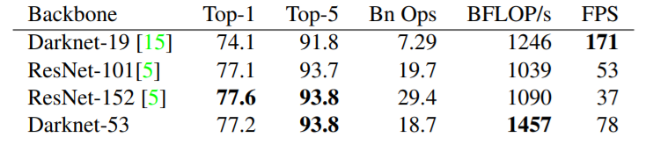
Feature Extractor

Slide 12


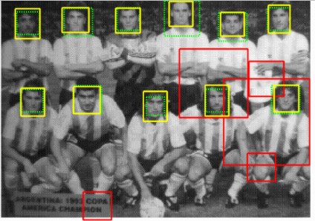
Training

Slide 13
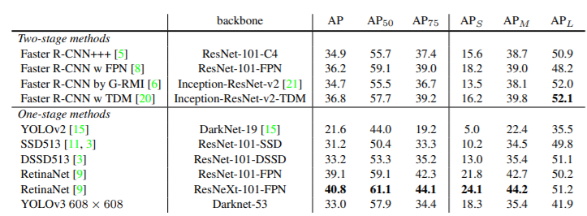
Conclusion

Slide 14
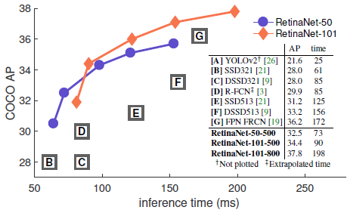
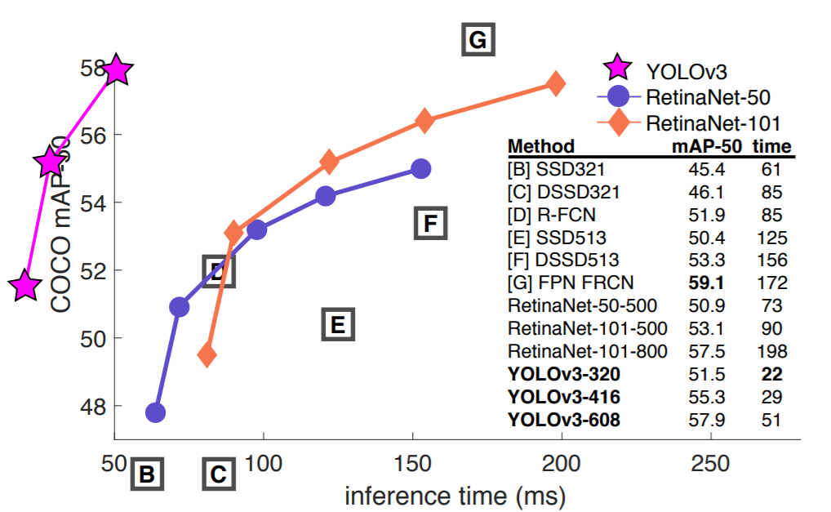
Conclusion

Slide 15
End.
Yolov3: An incremental improvement
[Submitted on 8 Apr 2018]
https://arxiv.org/abs/1804.02767
Present by: Jeong Mingyun
Notes:
세미나- 제목: 논문제목, 아래쪽 년도? 어디논문? 저자? 3개정보 추가

