Slide 1




Knowledge Graph based Explainable Question
Retrieval for Programming Tasks
Mingwei Liu, Simin Yu, Xin Peng, Xueying Du, Tianyong Yang, Huanjun Xu, and Gaoyang Zhang
WeChat
Presenter: Mingwei Liu
https://mingwei-liu.github.io/
2023.10.1
Twitter: @mliu918351
Notes:
Hello, everyone! I'm Mingwei Liu, a postdoctoral research fellow at Fudan University. Today, I’m glad to present our latest work, titled "Knowledge Graph based Explainable Question
Retrieval for Programming Tasks
Research Track, Industry Track Full Paper, Journal First Track: 16 minutes (12 min presentation, 3 min Q&A, 1 min laptop change)

Slide 2
CONTENTS
01
02
03
04
Background
Approach
Evaluation
Conclusion
Notes:
I will introduce in the order of background, approach, evaluation and conclusion.

Slide 3
Part 01
Background

Slide 4


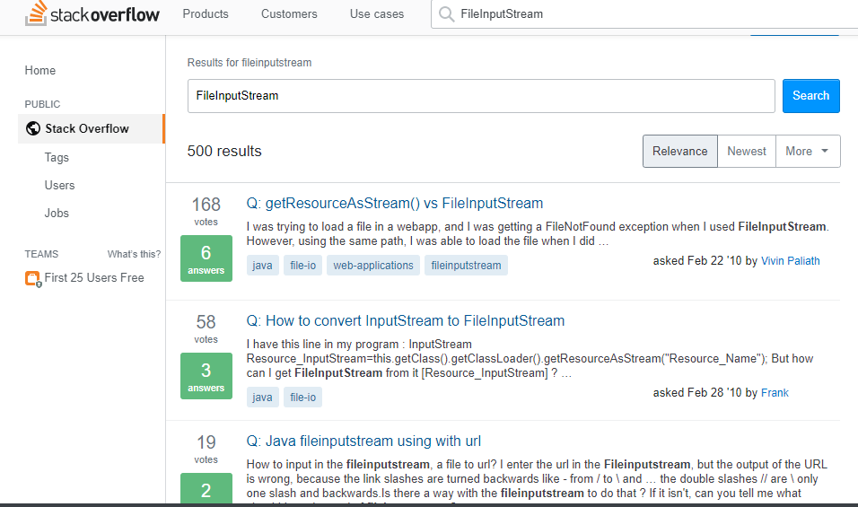
Stack Overflow
How to fix FilenNotFoundException?
How to split a string?
What is FileInputStream?
Using Jackson or Fastjson?
19 million questions
29 million answers
How to install Android SDK?
How to use ArrayList?
Due to the extensive question pool and the gap between their search queries and question titles, developers often struggle to locate relevant questions and answers on Stack Overflow.
When facing software programming problems such as implementing specific functionalities or handling errors in code developers often turn to Stack Overflow for help [1].
[1] C. Treude, O. Barzilay, and M. D. Storey, “How do programmers ask and answer questions on the web?” in 33rd International Conference on Software Engineering, ICSE 2011, May 21-28, 2011, Waikiki, Honolulu, HI, USA. ACM, 2011, pp. 804–807.
Notes:
During software development, developers often encounter technical challenges like implementing specific features or resolving code errors, such as splitting a string or fixing a FileNotFoundException. In these situations, developers often turn to Stack Overflow for assistance. Stack Overflow has become increasingly vital in the software development community, with over 19 million questions and 29 million answers available. Before posting new questions on Stack Overflow, developers typically attempt to find existing questions that match their needs using the Stack Overflow search feature or search engines like Google. However, Due to the extensive question pool and the gap between their search queries and question titles, developers often struggle to locate relevant questions and answers on Stack Overflow.

Slide 5
Existing Approach - Traditional IR Techniques
These approaches fail to address the problem of the lexical gap, i.e., similar or relevant meaning expressed in different words, e.g., email vs. mail/message
Traditional IR Techniques efficiently retrieve relevant questions that share common words with the query.
Query
SO Question
How do I send an SMTP Message from Java?
How can I send an email by Java application using Gmail, Yahoo, or Hotmail?
Lexical Gap
Traditional IR Techniques:
TF-IDF, BM25
Notes:
To address this issue, various methods have been proposed for recommending relevant Stack Overflow (SO) questions based on user queries. These methods leverage information retrieval and deep learning techniques. For instance, when a user enters a query like "How do I send an SMTP Message from Java," the goal is to find a matching SO question title, such as "How can I send email by Java application using Gmail, Yahoo, or Hotmail?" Commonly used techniques include traditional information retrieval methods like TF-IDF and BM25. They can efficiently retrieve relevant questions that share common words with the query. However, these methods fail to address the problem of the lexical gap, that is similar or relevant meaning expressed in different words, such as email vs. mail/message.

Slide 6
Existing Approach - Word Embedding Techniques
Word embedding techniques capture the contexts of words in documents and thus can address the lexical gap between SO questions and queries.
Words with similar meanings often share similar word embeddings.
This enables embedding techniques to generate word and sentence vectors, aiding in retrieving relevant questions based on their similarity to the query.
However, they cannot capture the semantic differences of different sentence patterns, as they treat a sentence as a bag of words.
Query
SO Question
How do I send an SMTP Message from Java?
How can I send an email by Java application using Gmail, Yahoo, or Hotmail?
Sentence Pattern Gap
Word Embedding Techniques :
Word2Vec, Glove
Notes:
Recently, some researches use word embedding techniques such as Word2Vec and Glove to solve this problem. Word embedding techniques capture the contexts of words in documents. And words with similar meanings often share similar word embeddings. This enables embedding techniques to generate word and sentence vectors, aiding in retrieving relevant questions based on their similarity to the query. It can address the lexical gap between SO questions and queries. However, they cannot capture the semantic differences of different sentence patterns, as they treat a sentence as a bag of words.

Slide 7
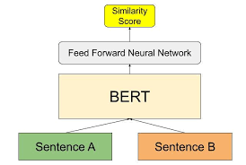
Existing Approach - Contextual Word Embedding
However, in some cases, there is a knowledge gap between the questions and the query which needs to be bridged by relevant concepts and relations. Moreover, the developers may require explanations about the relevance of the returned SO questions to choose the desired ones.
Contextual word embeddings can be employed to represent both the query and questions within the same vector space, where semantically similar queries and questions tend to have similar vector representations.
Contextual word embedding representations like BERT offer the advantage of considering both word semantics and syntax by dynamically capturing contextual information within sentences.
Query
SO Question
How do I send an SMTP Message from Java?
How can I send an email by Java application using Gmail, Yahoo, or Hotmail?
Knowledge Gap
Contextual
Word Embedding:
BERT
Notes:
This shortcoming can be alleviated by using contextual word embedding models such as BERT. They offer the advantage of considering both word semantics and syntax by dynamically capturing contextual information within sentences. They can be used to represent both the query and questions within the same vector space, where semantically similar queries and questions tend to have similar vector representations. However, Sometimes, there's a knowledge gap between the questions and the query that requires relevant concepts and relations to bridge it. Moreover, the developers may require explanations about the relevance of the returned SO questions to choose the desired ones.

Slide 8
Knowledge Gap
Q1: How do I send an SMTP Message from Java?
SMTP
alias
send
Java
Simple Mail Transfer Protocol
part of
email
use
email system
programming language
instance of
Yahoo Mail
instance of
instance of
owned by
Gmail
Hotmail
Yahoo
Q2: How can I send an email by Java application using GMail, Yahoo, or Hotmail?
Notes:
This slide highlights a knowledge gap between query Q1 and question Q2, both related to sending emails in Java. They employ different terms, like 'SMTP message' and 'email,' along with specific email providers such as 'Yahoo,' 'Hotmail,' and 'Gmail.' To bridge this gap, background knowledge about the relationships between these concepts is essential, which can be domain-specific and challenging for word embedding models like Word2Vec or BERT to capture. Moreover, the user often requires explicit explanations about the relations to understand, for example how SMTP works and what alternative protocols can be used for sending an email.

Slide 9
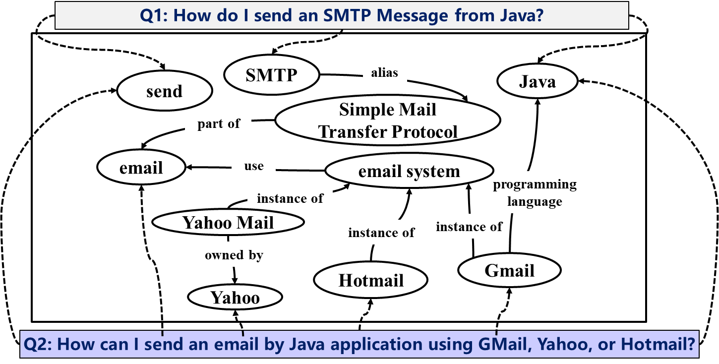
Idea
To bridge the knowledge gap, we can construct a software development related concept knowledge graph and combine it with the BERT-based sentence embedding model.
Query
SO Question
How do I send an SMTP Message from Java?
How can I send an email by Java application using Gmail, Yahoo, or Hotmail?
KGXQR: BERT+KG
Notes:
To bridge the knowledge gap, we can construct a software development related concept knowledge graph and combine it with the BERT-based sentence embedding model, that is BERT+KG. As a result, we propose KGXQR, a knowledge graph based question retrieval approach for software programming tasks.

Slide 10
Part 02
Approach

Slide 11
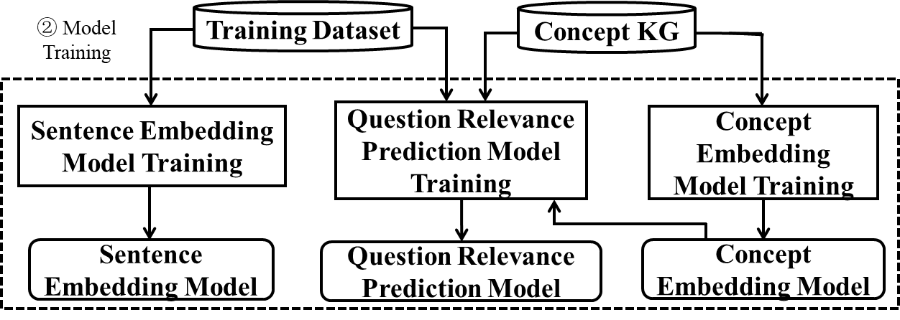
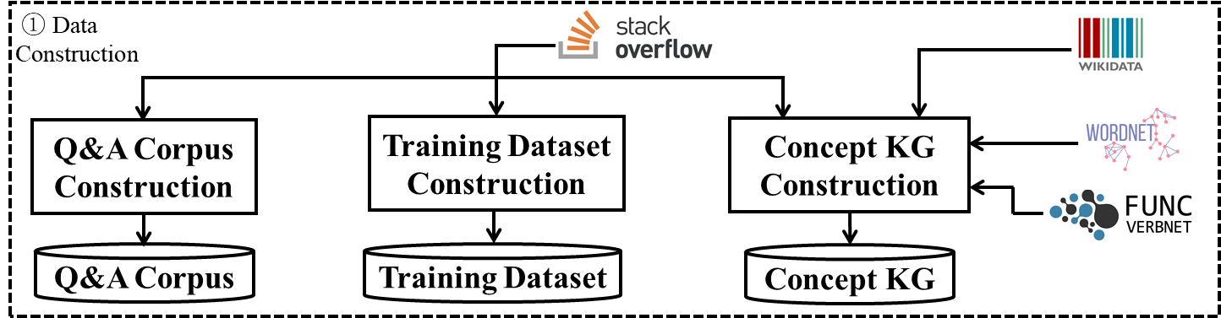
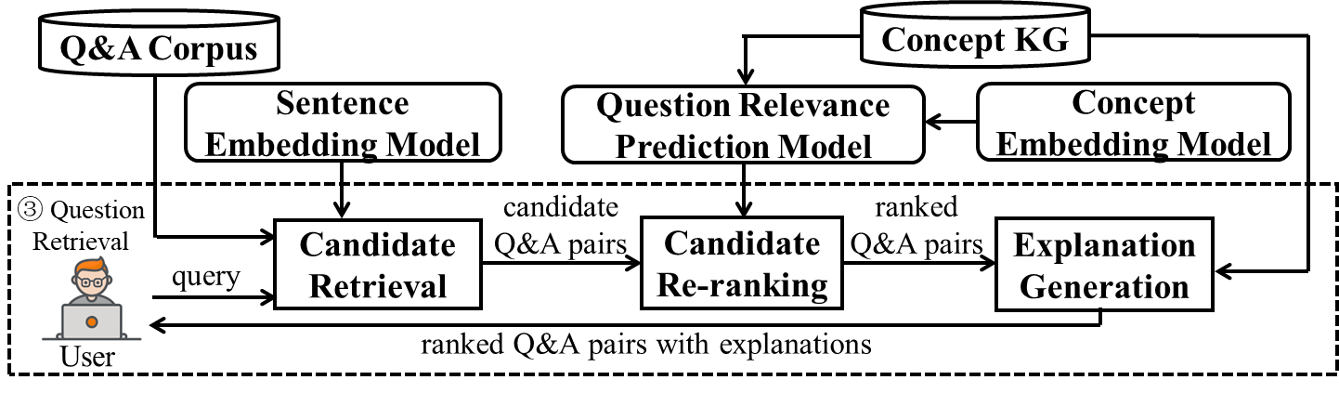
KGXQR: Overview
A
Data Construction.
In this phase, KGXQR constructs a corpus of SO questions and answers, a training dataset, and a knowledge graph.
B
Model Training.
In this phase, KGXQR trains a BERT-based sentence embedding model, a graph-based concept embedding model, and a question relevance prediction model.
C
Question Retrieval.
In this phase, KGXQR returns a ranked list of Q&A pairs along with explanations for their relevance to the user query.
Notes:
Our approach includes three phases. The first phase is the data construction. In this phase, we construct a corpus of SO questions and answers (Q&A corpus), a training dataset, and a knowledge graph. The second phase is model training. In this phase, we train a BERT-based sentence embedding model, a graph-based concept embedding model, and a question relevance prediction model. The sentence embedding can map sentences into a high-dimensional dense vector space where relevant sentences are close. The concept embedding model is trained based on the knowledge graph, which can map the concepts and relations of the knowledge graph to high-dimensional dense vectors which encode the structure information of the knowledge graph. The question relevance prediction model is trained to predict the relevance of two questions based on the training dataset, which combines sentence representation of BERT-based sentence embedding and graph-based concept embedding. The question retrieval phase is the last phase, which is online. In this phase, the approach returns a ranked list of Q&A pairs along with explanations for their relevance to the user query. It first uses BERT-based sentence embeddings to select candidate Q&A pairs based on similarity to the query. Next, the question relevance prediction model is used to re-rank the candidate pairs based on their predicted relevance. Finally, an explanation is generated for each returned Q&A pair based on the association paths between the concepts in the query and the SO question.

Slide 12
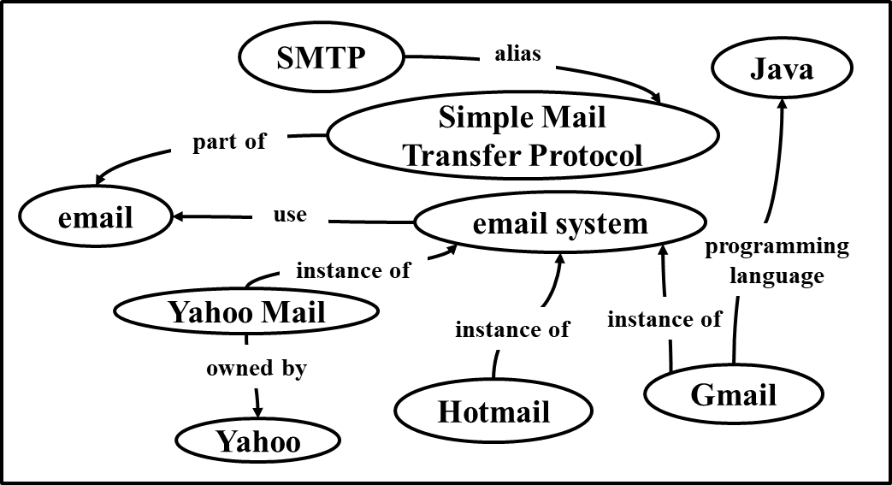
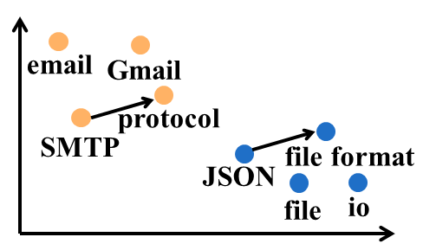
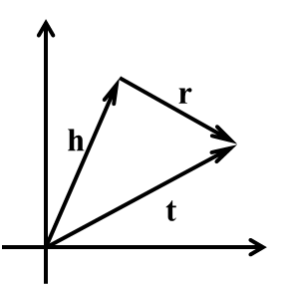
Concept Embedding Model
2 million concepts
4 million relations
Knowledge Extraction from SO Tags and Discussions
Knowledge Extraction from General Knowledge Graph
Knowledge Extraction from Lexical Database
Concept Knowledge Graph
Concept Embedding Model Training (TransE)
Concept Embedding Model
Notes:
The three models we train is the keys of our approach, we introduce them in more details. First is the concept embedding model. We first build a concept knowledge graph by extracting entities and relations from SO tags and Discussion, general knowledge graph like wikidata, lexical databases like wordNet. The concept embedding model is trained based on the knowledge graph. The model can map the concepts and relations of the knowledge graph to high-dimensional dense vectors. In our implementation, we use TransE model, its training goal is when given a relation tuples with head entity, relation, tail entity, the embedding of head entity plus relation, is close to the embedding of the tail entity. After training, we could obtain a concept embedding model, where relevant concepts in the KG have similar embeddings, for example SMTP and protocol.

Slide 13
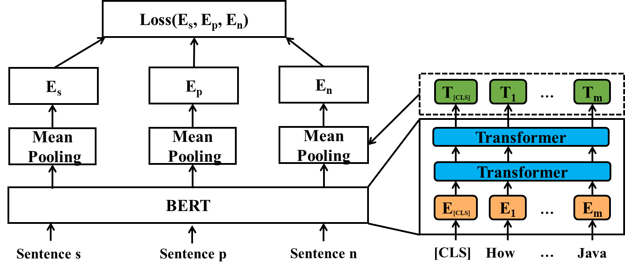
Sentence Embedding Model
Notes:
The sentence embedding model is trained by fine-tuning the pre-trained BERT model using contrastive learning based on the training dataset consisting of pairs of relevant/irrelevant questions . The objective is to make the sentence vectors of relevant questions as close as possible and the those of irrelevant questions as far as possible As a result, the model can map sentences into a high-dimensional dense vector space where relevant sentences are close.

Slide 14
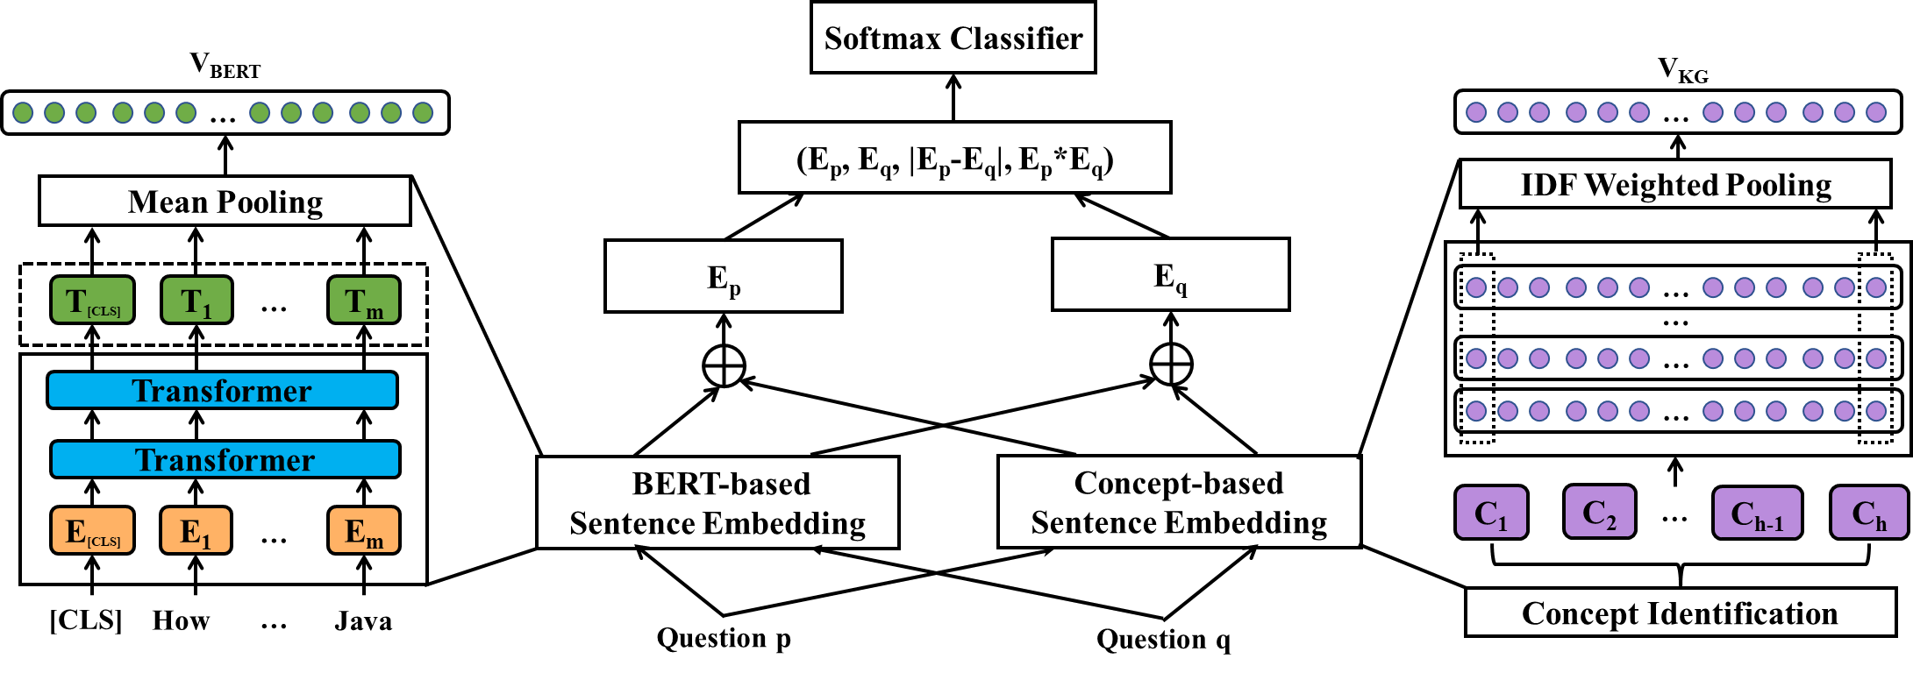
Question Relevance Prediction Model
Notes:
This silde shows the architecture of the question relevance prediction model, which takes two questions ( p and q) as input and outputs a prediction of their relevance score between 0 and 1. The model first produces a joint vector representation for the two questions and then classifies the two questions into relevant or not using a Softmax classifier. To obtain the joint vector representation, the model first generates vector representations for the two questions using BERT-based sentence embedding and concept-based sentence embedding respectively, and then concatenate their vector representations. The detailed are included in our paper.

Slide 15
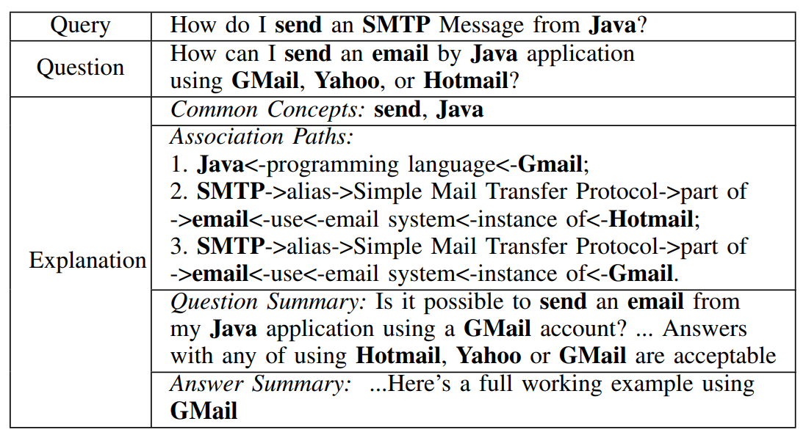
Explanation Generation
Notes:
For each returned question, we generate explanations for its relevance to the query as shown in Table. The explanations are generated based on the concept knowledge graph and describe how the query and question are relevant conceptually. The explanations include four parts., Common Concepts Association Paths, Question Summary, and answer summary.

Slide 16
Part 03
Evaluation

Slide 17
Research Questions
KG Intrinsic Quality:
What is the intrinsic quality of the concept knowledge graph constructed for KGXQR?
RQ1
Effectiveness:
How well does KGXQR perform in relevant question retrieval compared with the baselines?
RQ2
Explainability:
Are the explanations provided by KGXQR helpful for the user in relevant question retrieval?
RQ3
Notes:
Our evaluation focuses on three Research questions, which are related to KG Intrinsic Quality, the effectivenees of our approach, the usefulness of the generated explanations.

Slide 18
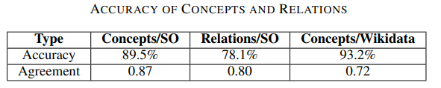
RQ1 KG Intrinsic Quality
We evaluate the intrinsic quality of the concept knowledge graph by assessing the correctness of the concepts and relations in the knowledge graph.
The concept knowledge graph is of high quality, which is indicated by the accuracy of 91.4% for the sampled concepts and 78.1% for the sampled relations.
Notes:
We evaluate the intrinsic quality of the concept knowledge graph by assessing the correctness of the concepts and relations in the knowledge graph. The results show that concept knowledge graph is of high quality.

Slide 19
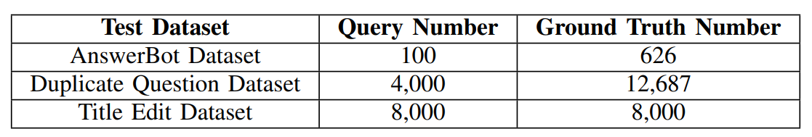
RQ2 Benchmark
AnswerBot Dataset: We used the AnswerBot replication package which provides a dataset of 100 Java-related queries and their relevant SO questions as ground truth.
Title Edit Dataset. We randomly select 2,000 questions with title edits for four programming languages (Java, Python, JavaScript, and C#) from the Stack Overflow data dump. Each question's historical title serves as the query, with its current title as the relevant question.
Duplicate Question Dataset: We randomly select 1,000 questions with duplicates for four programming languages (Java, Python, JavaScript, and C#) from the Stack Overflow data dump as queries, along with their corresponding duplicates as ground truth.
Notes:
To answer RQ2, We create a benchmark consisting of three test datasets as shown in Table III. The three datasets have different characteristics, across different programming languages.

Slide 20
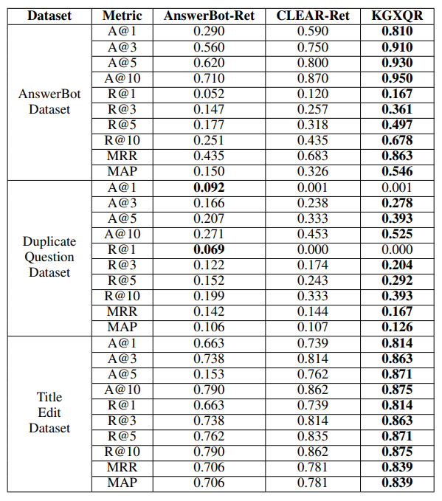
RQ2 Effectiveness
AnswerBot: It combines the Word2Vec model and IDF metric to measure the relevance between the input query and the questions in the corpus.
CLEAR-Ret: It relies on a BERT-based question retrieval module to retrieve relevant SO questions for a given query.
The evaluation results demonstrate that KGXQR is effective in related question retrieval, as it outperforms the baselines on various evaluation metrics across all three datasets.
Notes:
In RQ2, we compare our approach with baselines from previous work, AnswerBot and Clear. Representing WORD2VEC-BASED APPROACH AND BERT-based approach. The results shows that our approach is effective in related question retrieval, as it outperforms the baselines on various evaluation metrics across all three datasets.

Slide 21
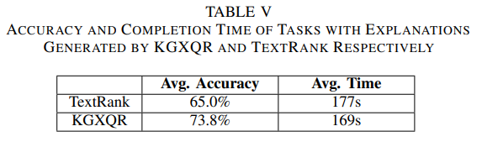
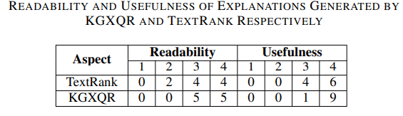
RQ3 Explainability
We evaluate KGXQR explanations by comparing user performance in selecting relevant programming task questions with KGXQR-generated explanations and a baseline, TextRank.
KGXQR explanations boosted accuracy by 13.5% and cut the time to find relevant questions by 20.7% compared to the baseline. Participants found the explanations readable and helpful.
Notes:
To evaluate the usefulness of the explanations provided by our approach, we compare the performance of users in selecting relevant questions for specific programming tasks with the explanations generated by KGXQR and a baseline method respectively. We use TextRank [61], a general-purpose method for automatic text summarization as the baseline. The result shown that our approach ‘s explanations can improve the accuracy and reduce the completion time compared to the baseline. Further, participants found the explanations readable and helpful.

Slide 22
Part 04
Conclusion

Slide 23


Summary
Mingwei Liu
https://mingwei-liu.github.io/
On the Market!
Concept Knowledge Graph
We construct a concept knowledge graph for software development with 2,291,354 concepts and 4,220,946 relations.
Novel Question Retrieval Approach
We propose KGXQR, a knowledge graph based explainable question retrieval approach for software development that uses a retrieval and re-rerank pipeline.
WeChat
Benchmark
We create a training dataset and a benchmark consisting three test datasets for relevant question retrieval.
https://kgxqr.github.io
Twitter: @mliu918351
Notes:
The slide show some key summaries of our paper, more details could be found in our paper. We also release the relevant dataset.

Slide 24
WeChat
Thanks
Knowledge Graph based Explainable Question
Retrieval for Programming Tasks
Presenter: Mingwei Liu
https://mingwei-liu.github.io/
2023.9.25
Twitter: @mliu918351
Notes:
That’s all. Thank you for your listening.

