Slide 1


CodeGen4Libs: A Two-Stage Approach for
Library-Oriented Code Generation
Mingwei Liu, Tianyong Yang, Yiling Lou, Xueying Du,
Ying Wang, and Xin Peng
Presenter: Mingwei Liu
https://mingwei-liu.github.io/
2023.9.12
Notes:
Hello, everyone! I'm Mingwei Liu, a postdoctoral research fellow at Fudan University. I'm delighted to present our latest work, titled "CodeGen4Libs: A Two-Stage Approach for Library-Oriented Code Generation."

Slide 2
CONTENTS
01
02
03
04
Background
Approach
Evaluation
Conclusion
Notes:
I will introduce in the order of background, approach, evaluation and conclusion.

Slide 3
Part 01
Background

Slide 4



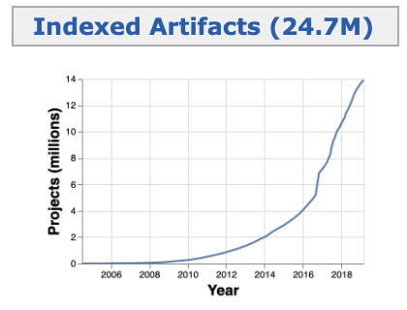
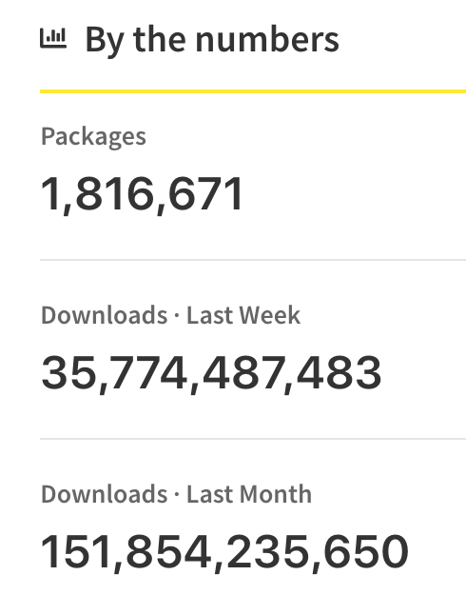
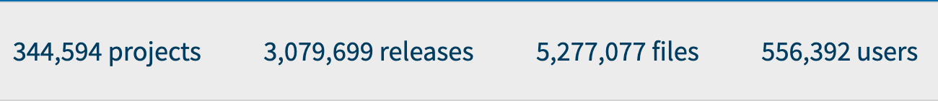
Background
93.3% of studied projects use third-party libraries, at an average of 28 third-party libraries per project [1]
Third-party library software community
Third-party libraries are important components of modern software systems
[1] F. Thung, D. Lo, and J. Lawall, “Automated library recommendation,” in Reverse Engineering (WCRE), 2013 20th Working Conference on. IEEE, 2013, pp. 182–191.
Notes:
As shown in the slide, the number of third-party libraries has grown rapidly across different programming languages. Today, they have become integral components of software systems. Research on GitHub projects shows that more than 90% of these projects use third-party libraries, with an average of 28 libraries per project. This indicates the significance of third-party libraries in modern software systems.

Slide 5


Background
Convert JSON to a HashMap
Gson
org.json
import com.google.gson.Gson;
import com.google.gson.reflect.TypeToken;
public static HashMap<String, String> jsonToHashMap(String json) {
Gson gson = new Gson();
Type type = new TypeToken<HashMap<String, String>>(){}.getType();
HashMap HashMap<String, String> hashMap = gson.fromJson(json, type);
return hashMap; }
FastJSON
import com.alibaba.fastjson.JSON;
import com.alibaba.fastjson.JSONObject;
public static Map<String, String> jsonToHashMap(String json) {
JSONObject jsonObject =JSON.parseObject(json);
Map<String, String> hashMap = new HashMap<>(jsonObject);
return hashMap; }
Jackson
DSL-json
Genson
jsoniter
Jsonb
JSON-B
Gson
FastJSON
The same functionality implemented using different libraries are quite different.
Our survey shows that developers often want to use specific third-party libraries to accomplish development tasks due to organizational strategies or personal preferences.
Notes:
In this scenario, there are many libraries offering similar functionality, such as JSON handling. For instance, there are over a dozen Java libraries that provide comparable features. Even for the same task, like converting JSON to a HashMap, developers can choose from entirely different libraries, leading to quite different implementations. This also bring challenges for developers when writing programs using specified libraries, Stack Overflow has many such kind of questions. In practice, the selection of a library is not arbitrary. Our survey indicates that developers often choose specific libraries to complete development tasks based on organizational strategies or personal preferences. For example, they may prefer using a library already employed in their projects or one with which they are more familiar. This demonstrates that exploring library-oriented code generation may be worthwhile.

Slide 6
Background
NL->Code
NL
public static HashMap<String, String> jsonToHashMap(String json) {
Gson gson = new Gson();
Type type = new TypeToken<HashMap<String, String>>(){}.getType();
HashMap HashMap<String, String> hashMap = gson.fromJson(json, type);
return hashMap; }
Convert JSON to a HashMap
Code Generation Model
CodeT5, CodeGPT, PLBART…
Using Popular Library Gson
Code
NL
NL+Libs->Code
Convert JSON to a HashMap
Code Generation Model
public static Map<String, String> jsonToHashMap(String json) {
JSONObject jsonObject =JSON.parseObject(json);
Map<String, String> hashMap = new HashMap<>(jsonObject);
return hashMap; }
com.alibaba.fastjson
Libs
Code
Using Preferred Library fastjson
Library-Oriented Code Generation
Notes:
To help developers coding more efficiently, code generation models have been introduced. These models are typically based on pre-trained language models and fine-tuned on specific datasets. They focus on generating code at the method level based on natural language descriptions. That is, NL to Code. However, they often overlook the preference for specific libraries. The code they generate may directly rely on the most popular libraries due to the distribution in the training data. Therefore, we propose the Library-Oriented Code Generation Task in the paper, denoted as NL+Libs->Code. In this task, the model takes both natural language descriptions and one or more specified libraries as input and generates code that completes the task using the provided libraries.

Slide 7
Part 02
Approach

Slide 8
Idea
When faced with a task that requires a specific third-party library, developers typically begin by identifying the necessary APIs and then proceed to write code based on them. Import statements can bridge the gap because they are related to both Libs and the classes used in the code.
NL
Code
Convert JSON to a HashMap
public static Map<String, String> jsonToHashMap(String json) {
JSONObject jsonObject =JSON.parseObject(json);
Map<String, String> hashMap = new HashMap<>(jsonObject);
return hashMap; }
Gap
com.alibaba.fastjson
Libs
import com.alibaba.fastjson.JSON;
import com.alibaba.fastjson.JSONObject;
Class Import Statements
Notes:
In fact, we have found that although existing models can be fine-tuned to accept input in the form of natural language (NL) and libraries (Libs) to generate code, the results are not satisfactory. We have analyzed the reasons, and the main issue is the significant gap between Libs and the generated code. It is challenging to make the generated code specific to the provided libraries. Based on our observations, we have found that using Class Import Statements can help bridge this gap. This is because when developers are faced with a task that requires a library, they typically start by identifying the necessary APIs and then proceed to write code based on them. Import statements can bridge the gap because they are related to both libraries (Libs) and the classes used in the code, providing more context when generating the code.
实际上，我们发现虽然可以使用现有的模型进行微调之后，接受输入NL和Libs作为输入生成代码。但是效果并不好，我们分析了原因，主要是Libs和代码之间的gap比较大，生成的代码很难特定到要使用的三方库。基于我们的观察，我们发现，可以使用Class Import Statement来帮助跨越这个gap. Because when faced with a task that requires a specific third-party library, developers typically begin by identifying the necessary APIs and then proceed to write code based on them. Import statements can bridge the gap because they are related to both Libs and the classes used in the code.

Slide 9
CodeGen4Libs Overview
Imports Generation
More Context
NL+Libs->Imports
Generates API class-level import statements (Imports) from NL and Libs
Code Generation
NL+Libs+Imports->Code
Generates Code from NL, Libs,
and Imports
We propose CodeGen4Libs, which incorporates two stages (i.e., imports generation and code generation), to enable more accurate library-oriented code generation.
Notes:
Based on this idea, We propose CodeGen4Libs, which includes two stages (i.e., imports generation and code generation). Imports generation is to Generate API class-level import statements (Imports) from NL and Libs. While Code Generation is to generate Code from NL, Libs, and Imports generated.
We split the task into two subtasks. So two different models to be trained to handle imports generation and code generation. The imports generated in the first step could provide more context for the code generation more and help the model to generate code more target at the provided libraries.

Slide 10
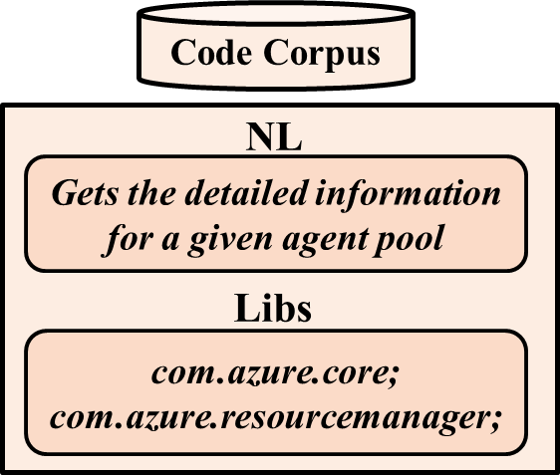
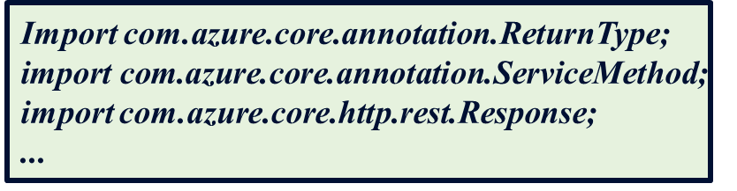
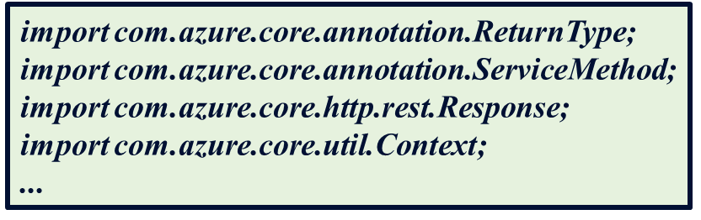
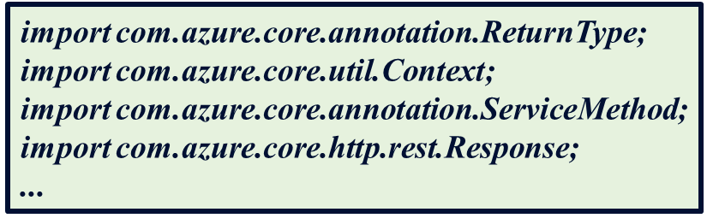
Imports Generation
Retrieved Similar Imports
BM25-based
Import
Retriever
CodeT5-based
<NL, Libs, Imports>
Import
Generator
Generated Imports
Raw Generated Imports
Import
Cleaner
Notes:
We train an imports generation model to complete the import generation task. To improve the model performance, we use the retrieval-argumentation technology. First, based on the NL and Libs, we use a import retriever to retrieve similar imports from the code corpus based on BM25. The retrieved imports is corresponding to a code with similar NL to the input. Then we combined they together as the input of import generator to generate the raw generated imports. The Import generator is trained based on CodeT5 in our implementations. After that we clean raw generated imports based on some rules, for example, remove incomplete or duplicate ones..

Slide 11
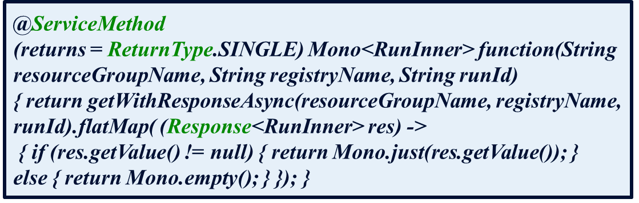
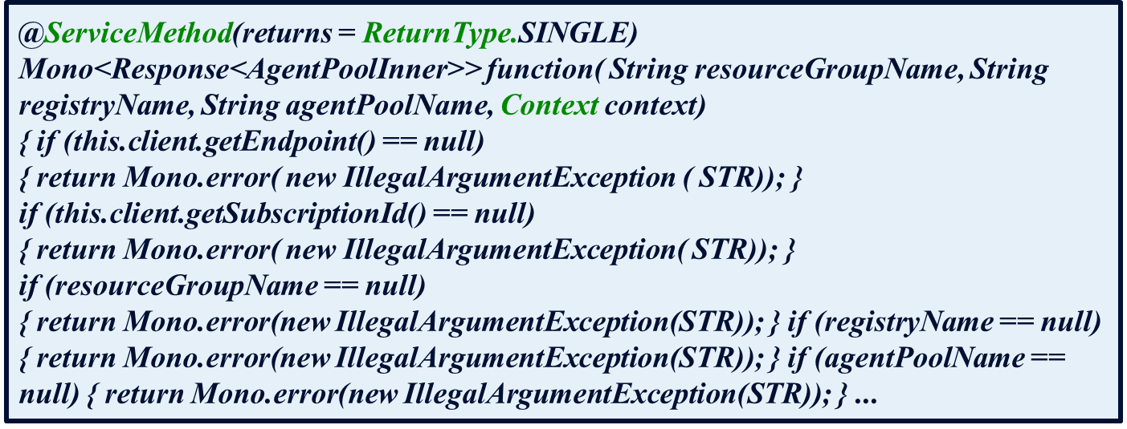
Code Generation
Retrieved Similar Code
BM25-based
Code
Retriever
CodeT5-based
Code
Generator
<NL, Libs, Imports(Gen), Code(Ret)>
Generated Code
Generated Imports
Notes:
Code generation is similar, we also use the retrieval-argumentation technology to improve the model performance. First, based on the NL and Libs, we use a similar code retriever to retrieved code with the similar NL from the code corpus. Then we combined NL, LIBS, generated imports, similar code together as the input of code generator to generate the final code.

Slide 12
Benchmark
Dataset | Size | NL/Token | Code/Token | Imports | Libs
Train | 391,811 | 19.0 | 87.2 | 2.8 | 1.7
Validation | 5,967 | 18.3 | 72.9 | 2.1 | 1.3
Test | 6,002 | 18.4 | 77.3 | 2.4 | 1.5
We create a benchmark for library-oriented code generation from GitHub project, which includes 403,780 code snippet tuples (<NL,Libs,Imports,Code>) for 500 libraries.
To build the import retriever and code retriever, we use Elasticsearch and built an index on the NL of the code corpus, which contains 1,215,900 code snippet tuple.
Notes:
To train and evaluate the models, we create a benchmark for library-oriented code generation from GitHub projects, which includes about four hundred thousand code snippet tuples (<NL,Libs,Imports,Code>) for 500 libraries. To build the import retriever and code retriever, we use Elasticsearch and built an index on the NL of the code corpus, which contains more than one million code snippet tuple.

Slide 13
Part 03
Evaluation

Slide 14
Research Questions
Effectiveness of Library-oriented Imports Generation:
How effective is CodeGen4Libs in generating high-quality library-oriented import?
RQ1
Effectiveness of Library-oriented Code Generation:
How effective is CodeGen4Libs in generating high-quality library-oriented code?
RQ2
Imports Generation Quality Impact:
To what extent does the quality of import generation affect the quality of code generation results?
RQ3
Notes:
Our evaluation focuses on three Research questions, which are related to the effectivenees of imports generation, code generation and the impact of the imports generation quality.

Slide 15
RQ1 Baselines
Import(Ret)
Import(Gen)∪Imports(Ret)
Retrieve the most relevant imports for a given NL and Libs using BM25
Union of the import statements obtained by the two methods
01
04
03
02
Import(Gen)∩Imports(Ret)
Import(Gen)-NL+Libs
Intersection of the import statements generated by the two methods as the final import generation results, which can reduce the noise in the import generation result
A new import generation model using the same dataset and hyperparameters, but with only NL and Libs as input.
Notes:
To answer RQ1, we select fou baselines, including retrieval-based one, generation based one, and the combinations of them. Union and intersection

Slide 16
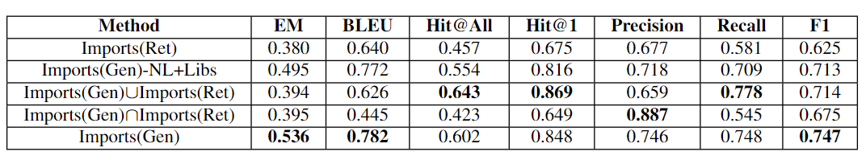
RQ1 Results
01
Generation-based methods outperform the retrieval-based method, Imports(Ret), across all metrics.
02
Retrieved similar imports improve the imports generation model significantly.
03
Import(Gen)∪Imports(Ret)：best coverage and lowest precision.
Import(Gen)∩Imports(Ret): best precision and lowest coverage.
04
Imports(Gen) achieves a good balance between coverage and precision,
with the highest F1, EM and BLEU scores.
Notes:
The table shows the evaluation results of different imports generation methods on benchmark.

Slide 17
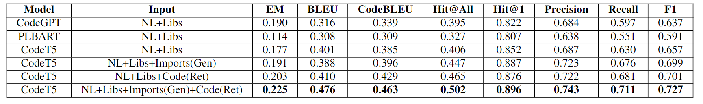
RQ2 Results
We compare the performance of CodeGen4Libs
with different models and input variations on the benchmark
01
Our approach, CodeT5 with NL+Libs+Import(Gen)+Code(Ret) input,
achieved the best performance in all evaluation metrics
Both generated import statements and retrieved code snippets
can improve the code generation performance,
but combining them leads to even better results
02
Notes:
For RQ2. We compare the performance of CodeGen4Libs with different models and input variations on the benchmark. The table shows that results.
First, as shown in the table, our approach using generated imports and retrieved similar code achieved the best performance in all evaluation metrics.
Second, the two variants of CodeGen4Libs also achieve good results, but are outperformed by our final approach. This suggests that both generated import statements and retrieved code snippets can improve the code generation performance, but combining them leads to even better results

Slide 18
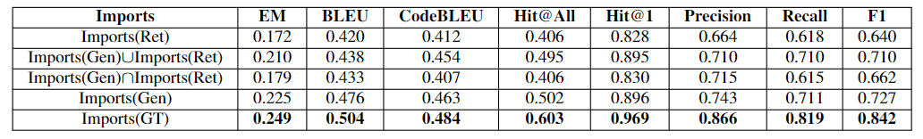
RQ3 Results
We compare the performance of CodeGen4Libs
using different imports as inputs on test dataset of the benchmark
Using Imports(GT) as input achieved the best performance across all
Metrics, followed by Imports(Gen).
01
02
There still some gaps between using ground truth imports and generated imports.
03
Improve the imports generation performance can improve the performance of code generation models further.
Notes:
For RQ3, We compare the performance of CodeGen4Libs using different imports as inputs on test dataset of the benchmark.
The results are shown in the table. First, we can see that Using ground truth Imports as input achieved the best performance across all
Metrics, followed by using generated Imports. There still some gaps between using ground truth imports and generated imports. The results show that using high-quality imports as input for code generation models is important. We believe that if we can improve the imports generation performance, we can further improve the performance of code generation models.

Slide 19
Part 04
Conclusion

Slide 20


Summary
Mingwei Liu
https://mingwei-liu.github.io/
On the Market!
Survey
We conducted a survey involving 66 participants to motivate the library-oriented code generation problem
Novel Approach
A novel approach CodeGen4Libs which incorporates two stages (i.e., import generation and code generation) to enable more accurate library-oriented code generation
Benchmark
A new dataset which is specifically constructed for the library-oriented code generation task.
https://github.com/FudanSELab/codegen4libs
Notes:
The slide show some key summaries of our paper, more details could be found in our paper. We also release the relevant dataset and models. We are still working on this direction and welcome collaboration and discussions with all interested parties. By the way, I am looking for the both academic and industry jobs. Any help are welcome.

Slide 21

Thanks
CodeGen4Libs: A Two-Stage Approach for
Library-Oriented Code Generation
Presenter: Mingwei Liu
https://mingwei-liu.github.io/
2023.9.12
Notes:
That’s all. Thank you for your listening.

