Slide 1
Installation of eclipse to run the java program

Slide 2
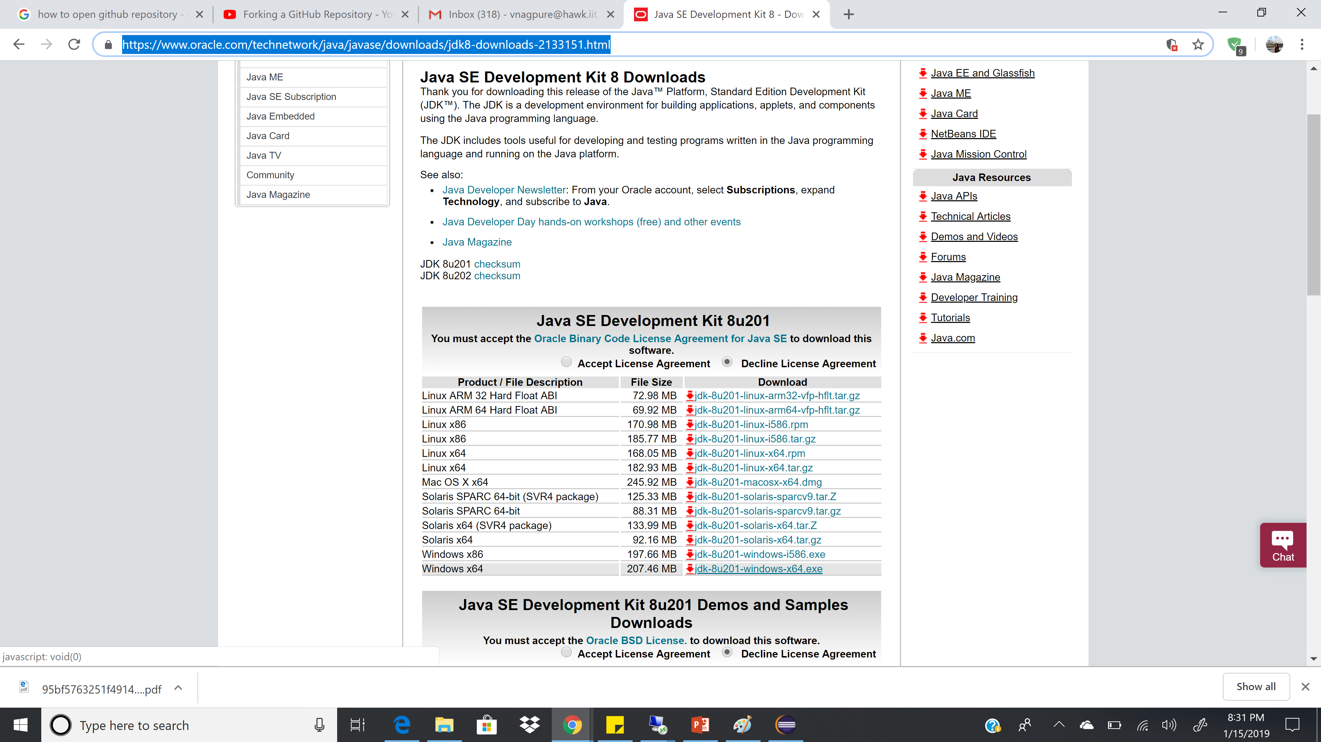
Download and install Java
https://www.oracle.com/technetwork/java/javase/downloads/jdk8-downloads-2133151.html

Slide 3
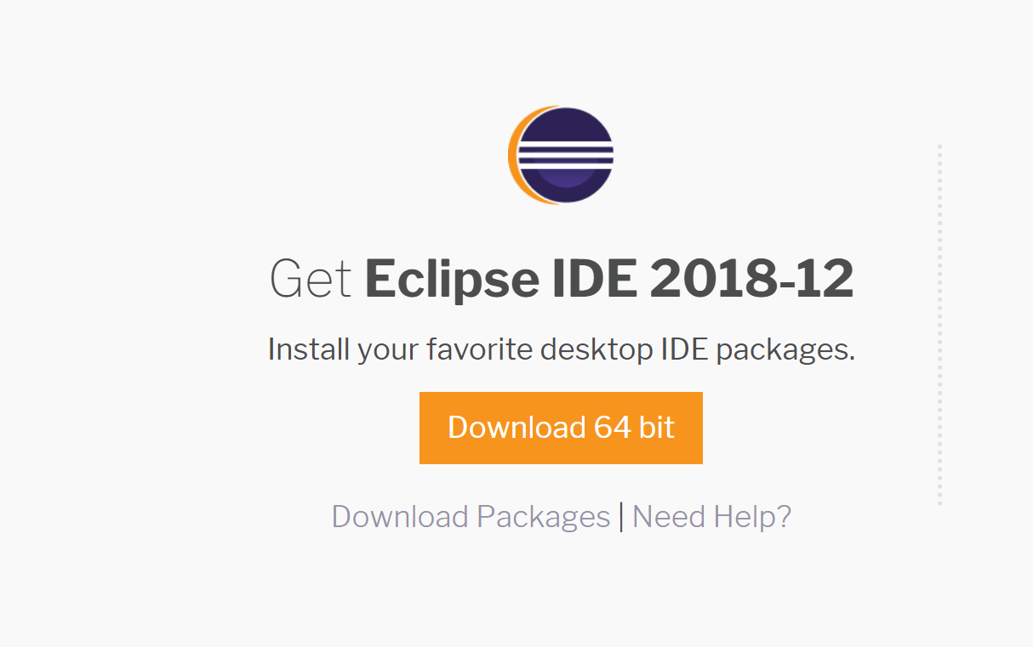
https://www.eclipse.org/downloads/

Slide 4
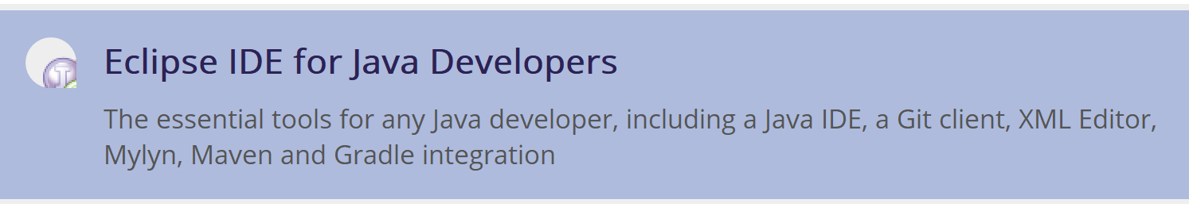
Select above option

Slide 5
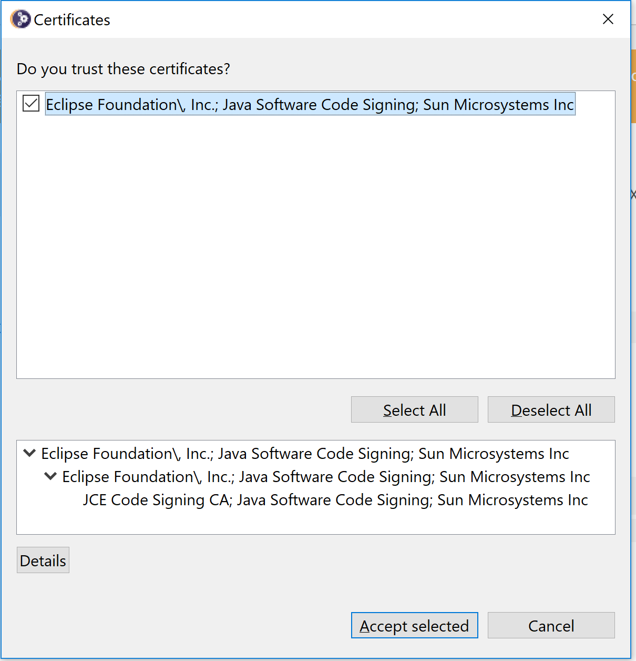

Slide 6
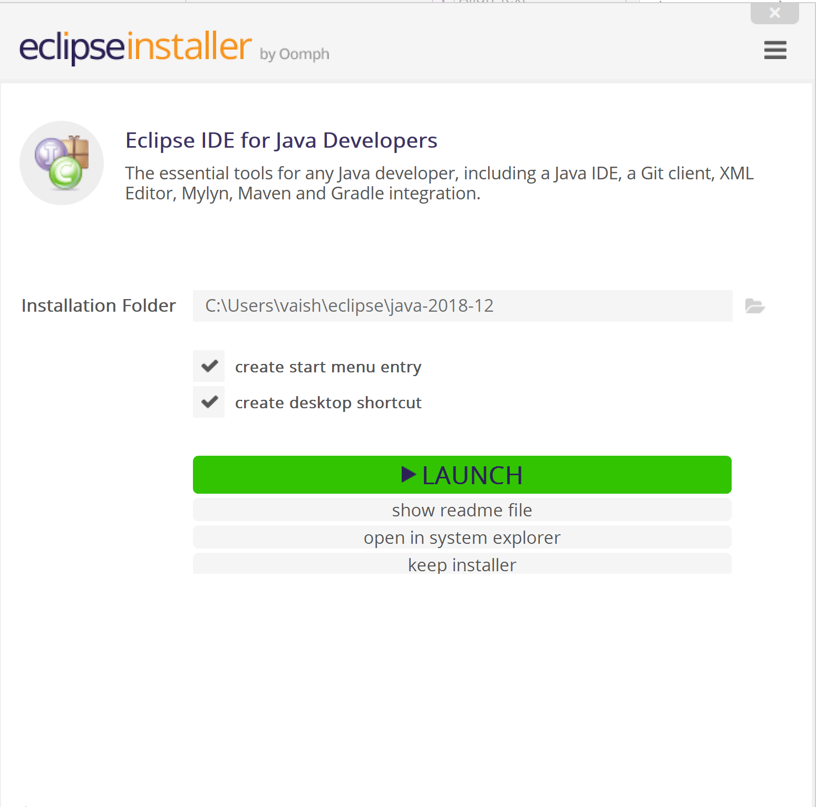

Slide 7
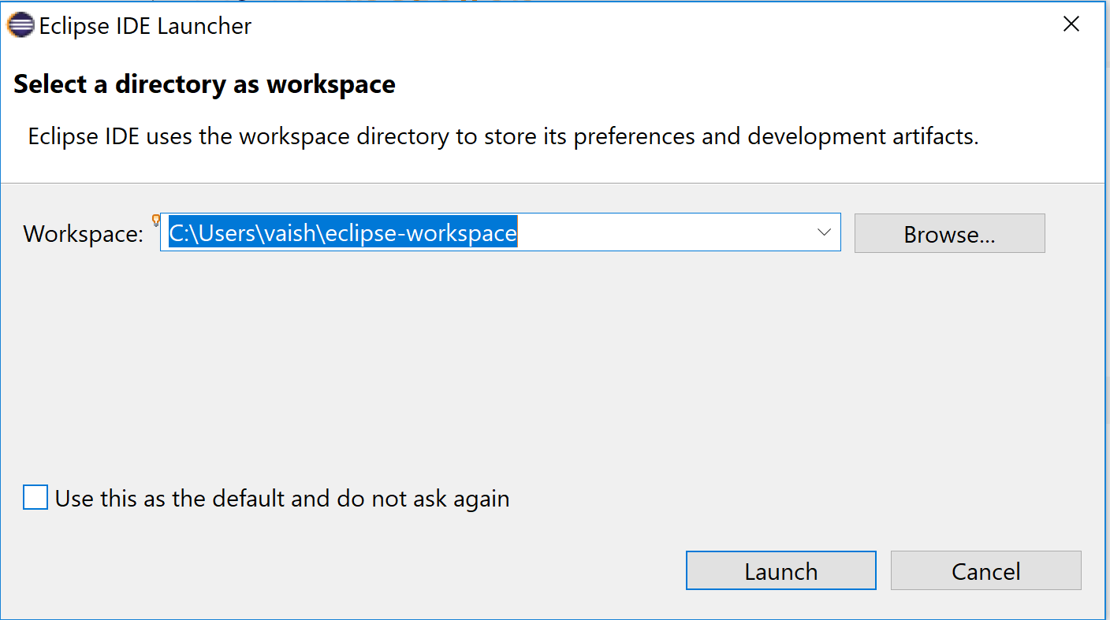

Slide 8
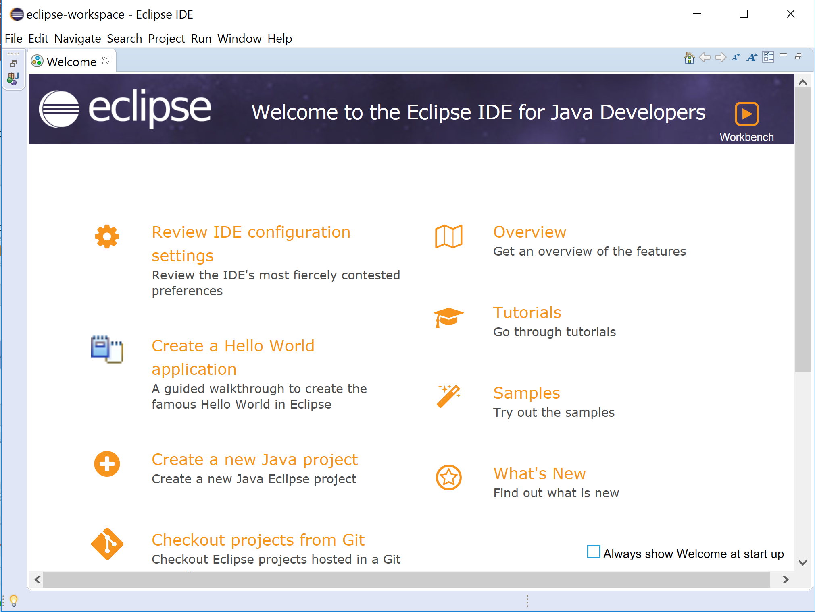
Close Welcome tab

Slide 9
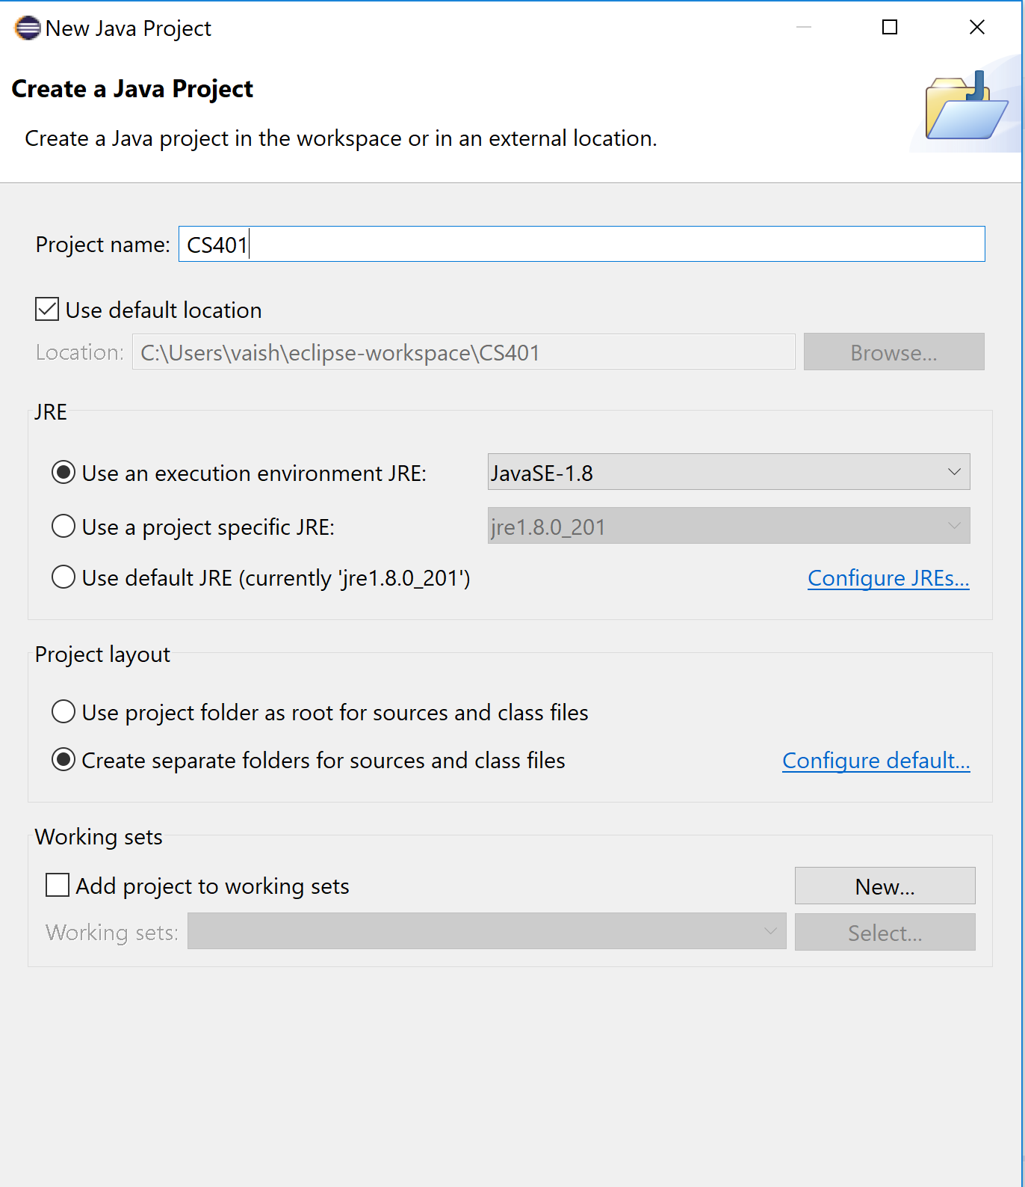

Slide 10
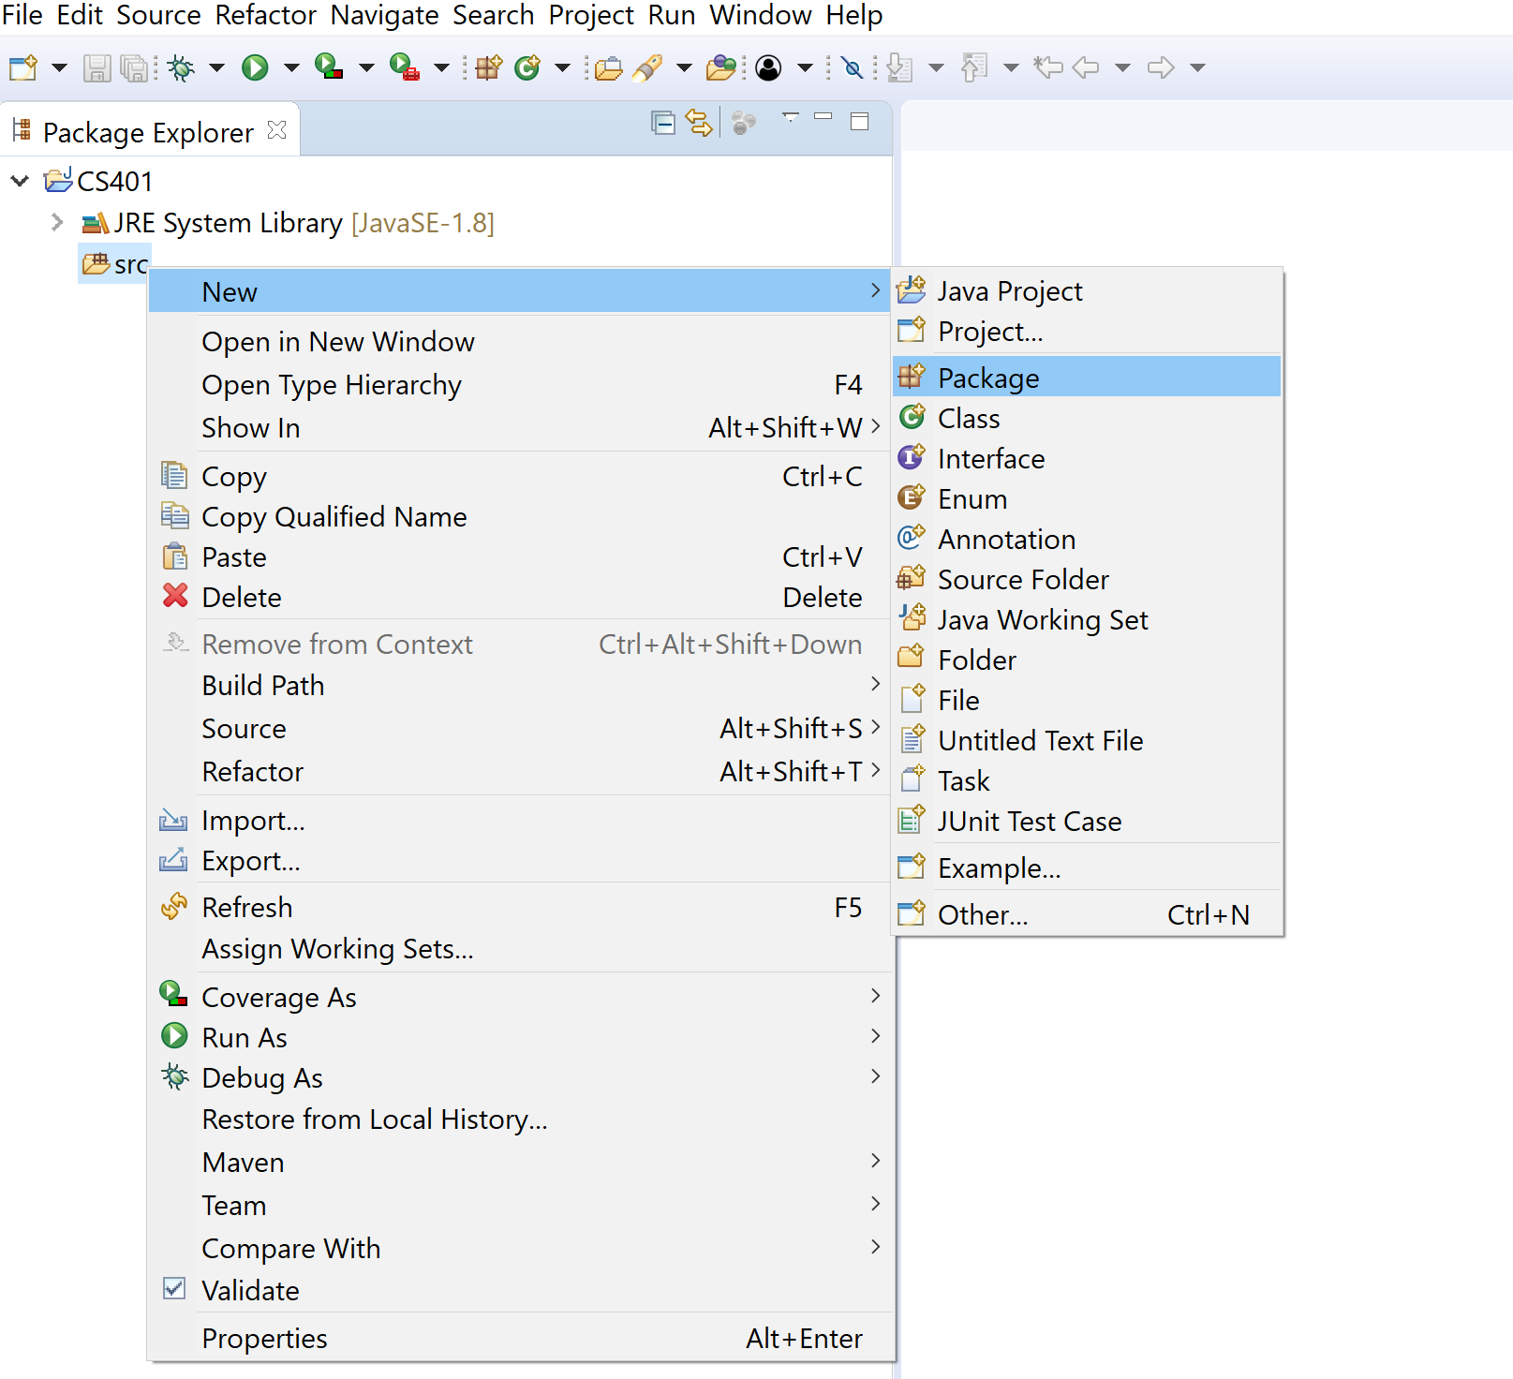
Create new package

Slide 11
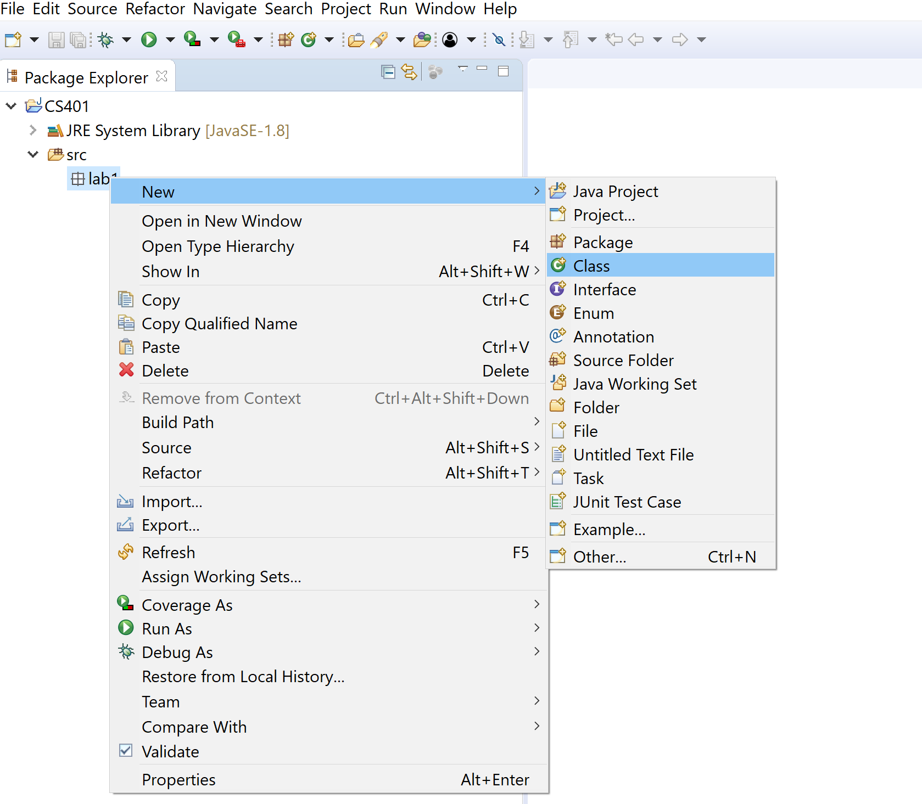
Create class file which is “.java” (executable) file

Slide 12
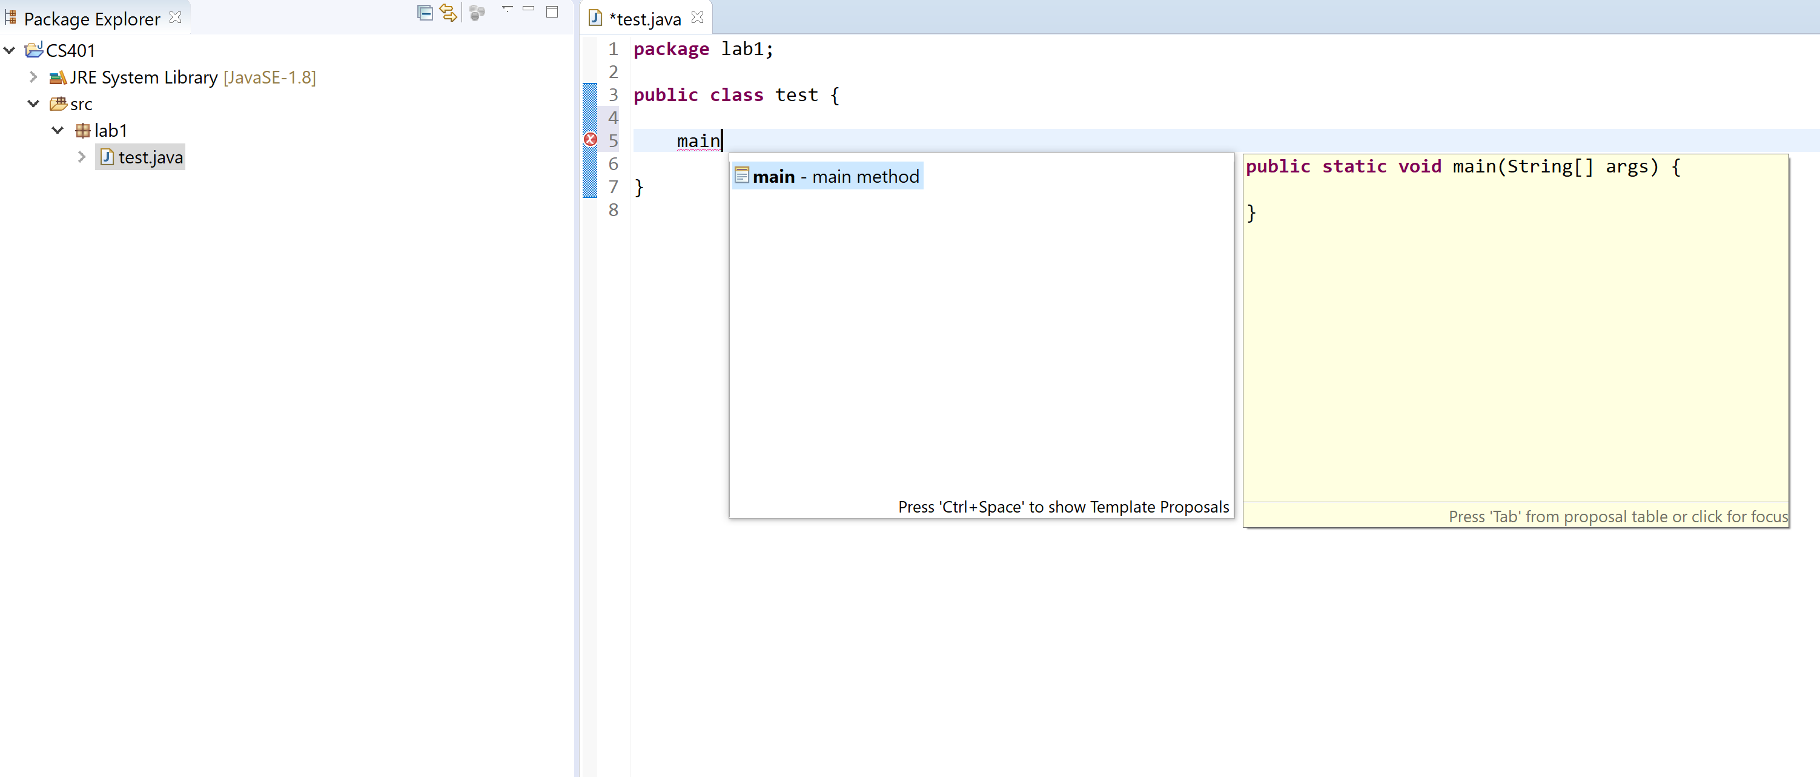
Type commands of your program under main

Slide 13
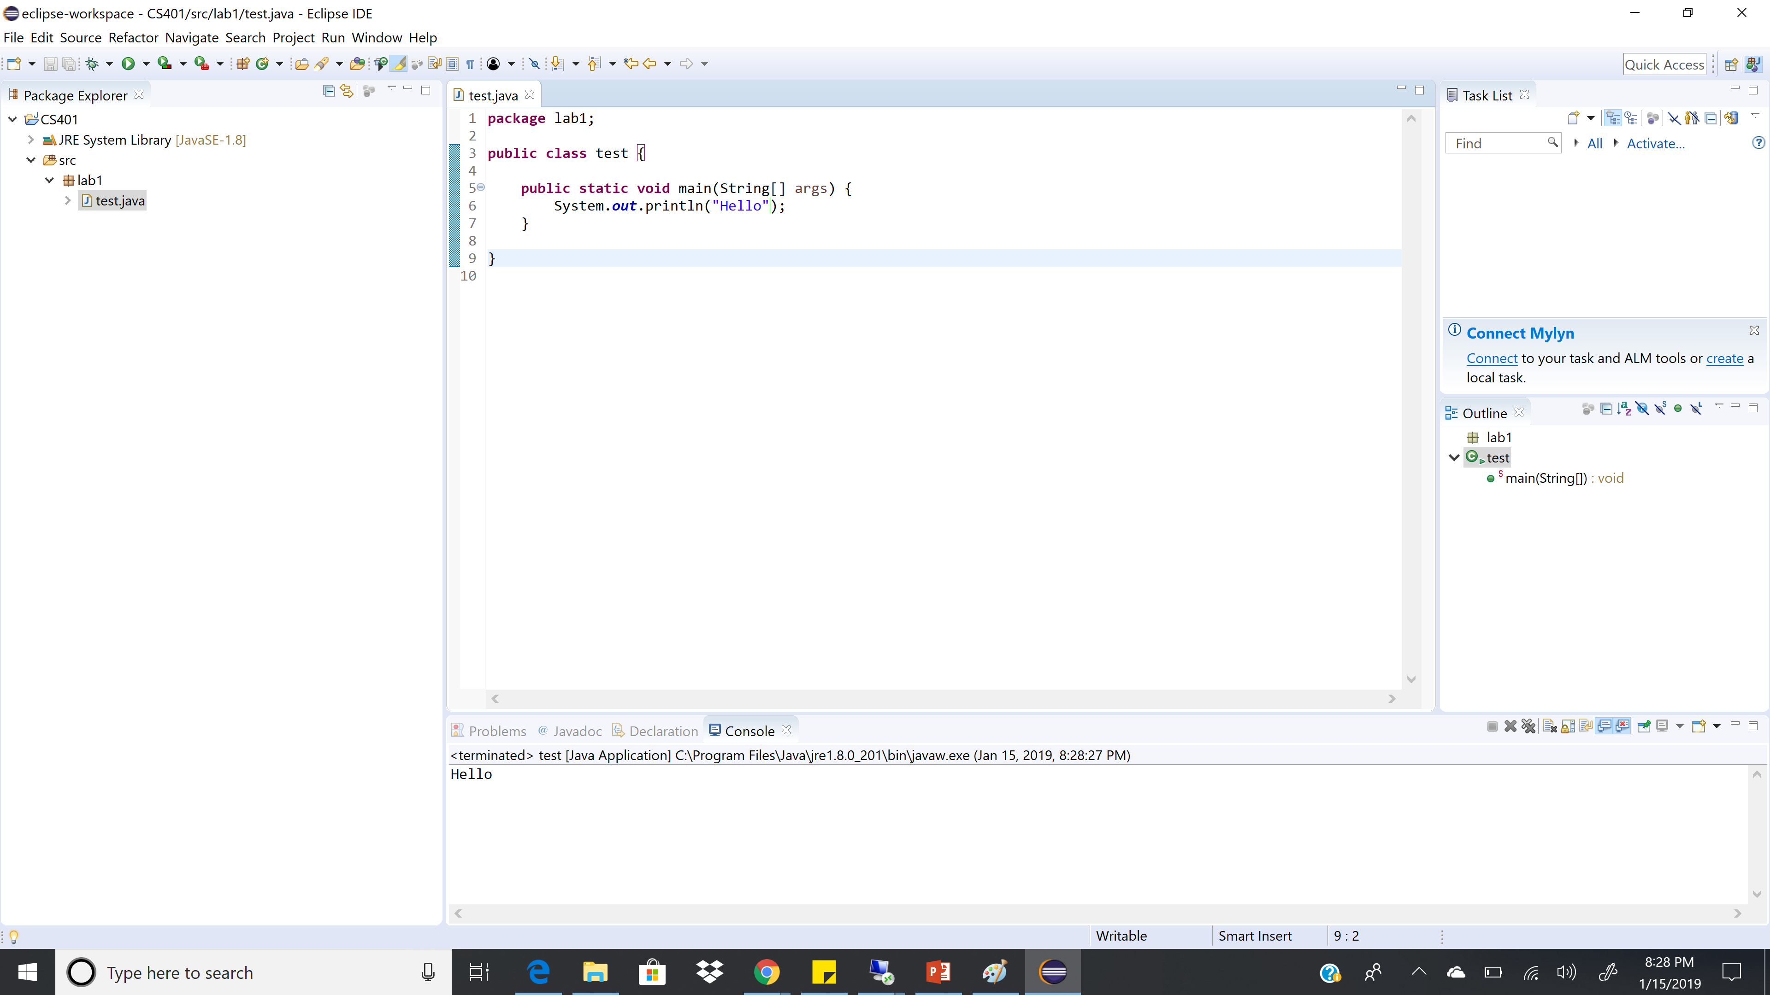
Run the program

