Slide 1

NASA SPACE APPS 2021
WARNING: THINGS ARE HEATING UP !
Team: TwoDegreeCelcius

Slide 2
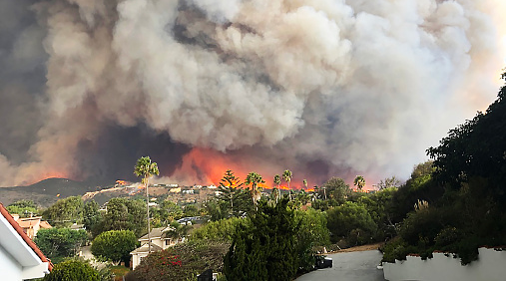
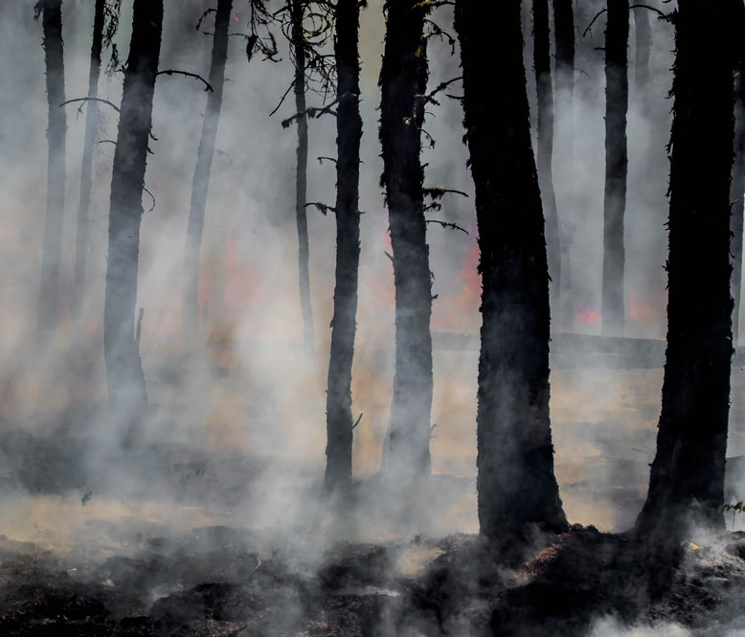
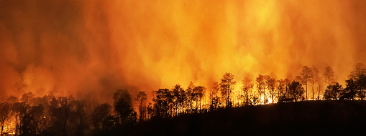
What inspired your team to choose this challenge?

Slide 3
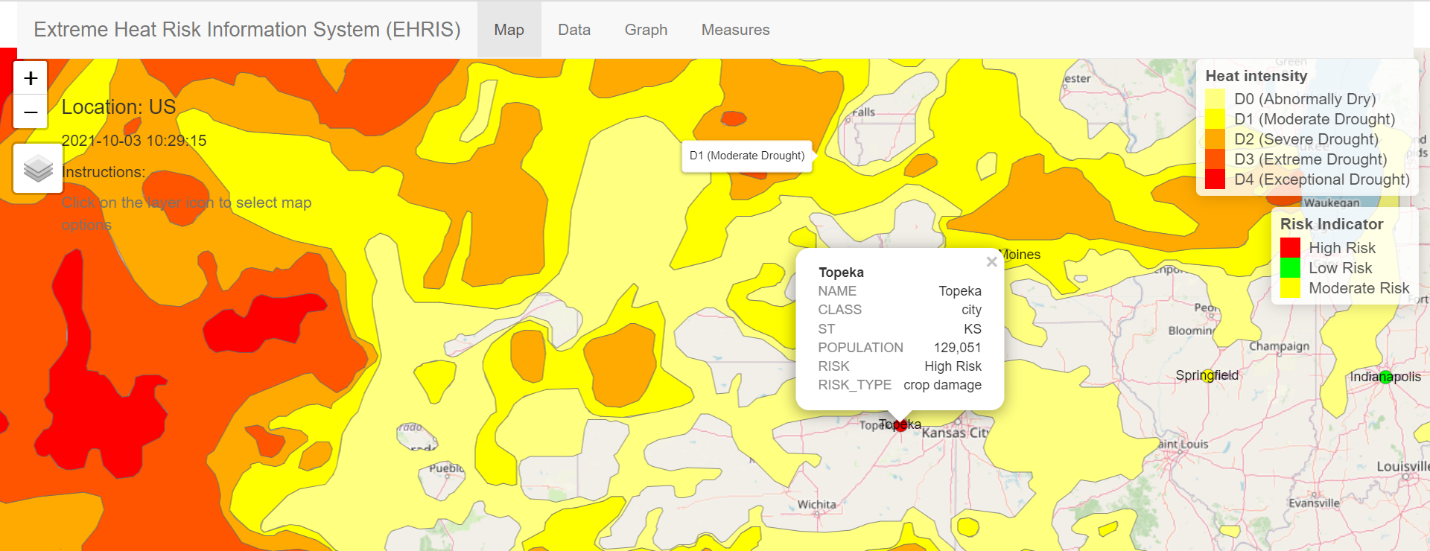
What problem does it solve? What do people gain? Where is the opportunity?

Slide 4
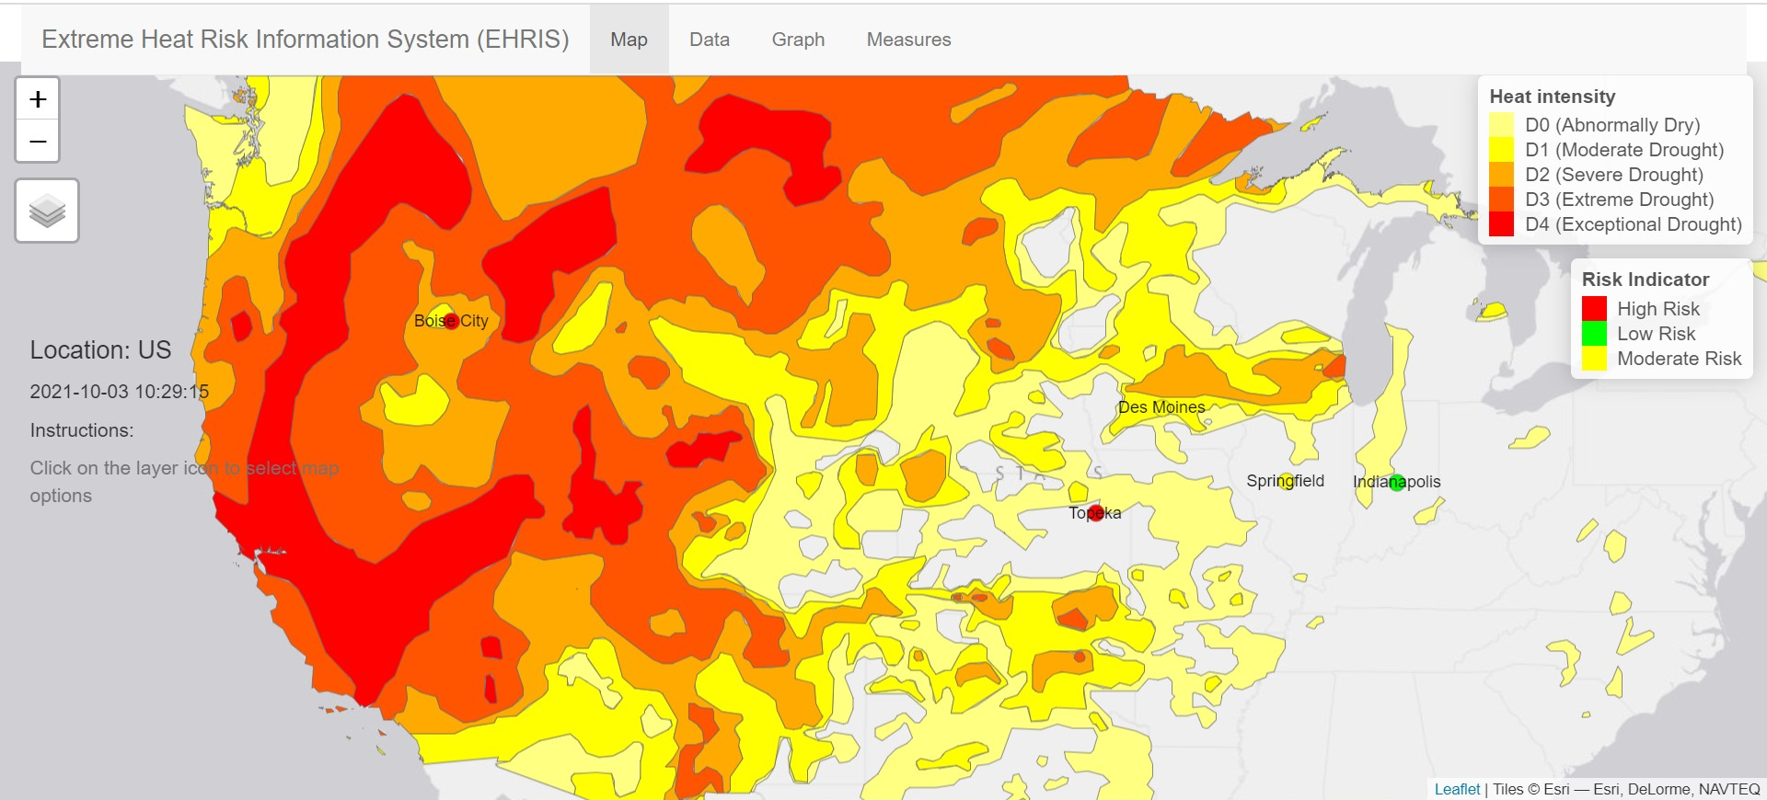
Display images or a prototype (optional screen share)

Slide 5
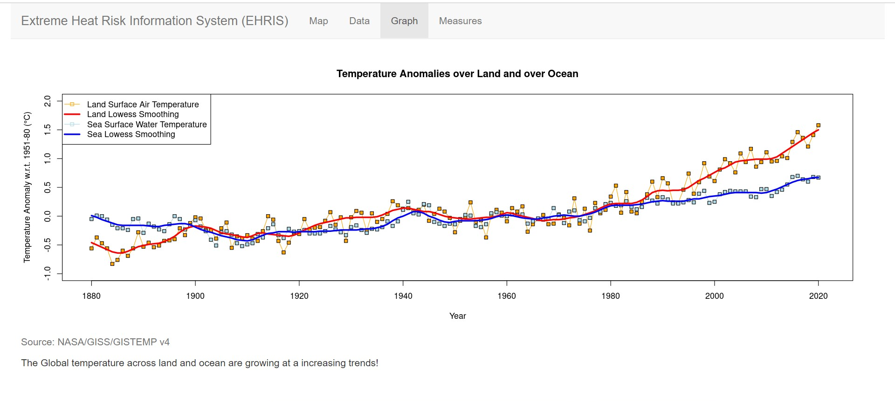
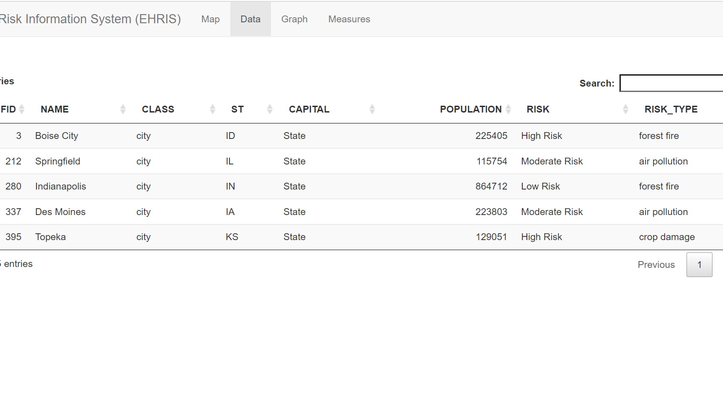
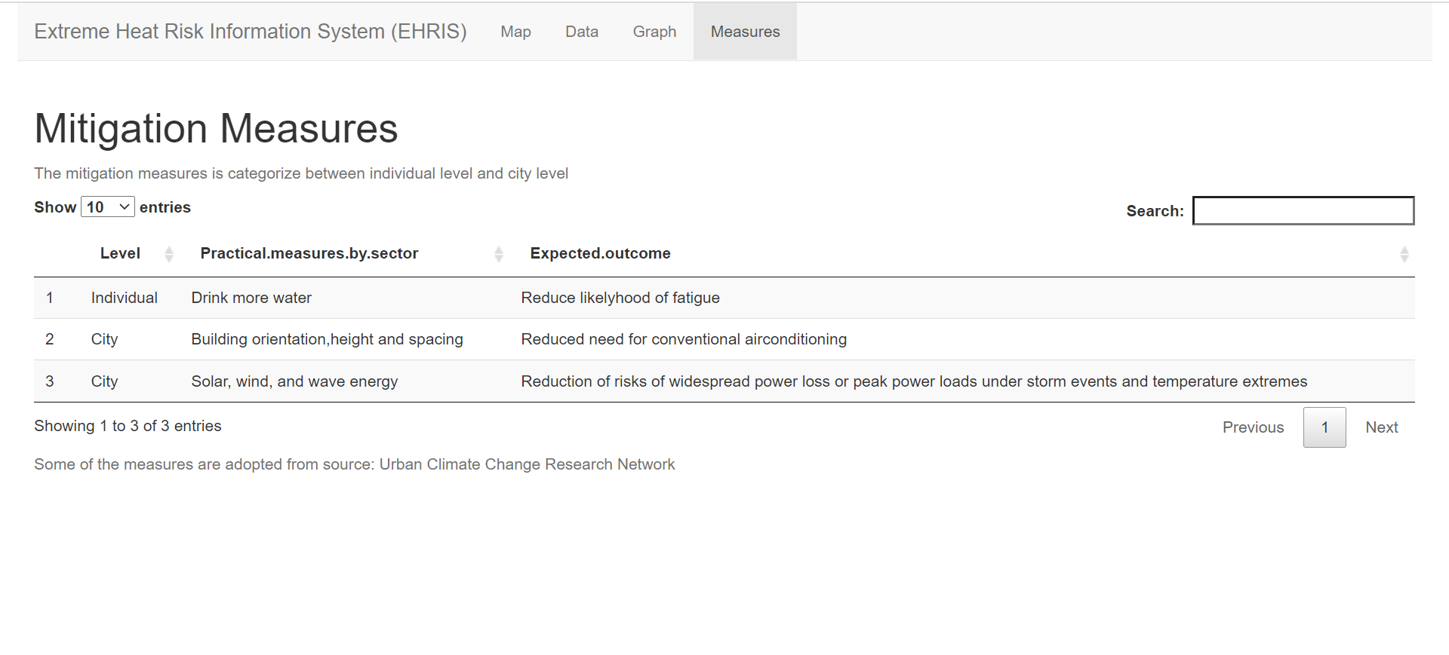

Slide 6
What will your idea change?

Slide 7
Thank you

