Slide 1







Single-variate Linear Regression
21010469 김민경

Slide 2

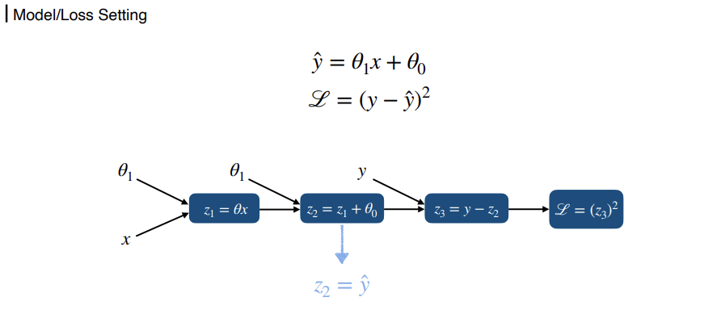
For One Sample: Theory
02

Slide 3
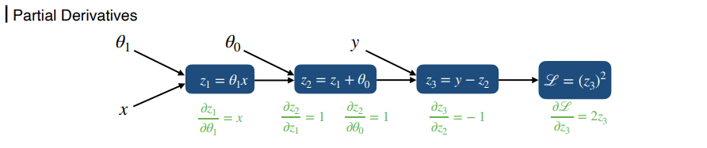
For One Sample: Theory
03

Slide 4
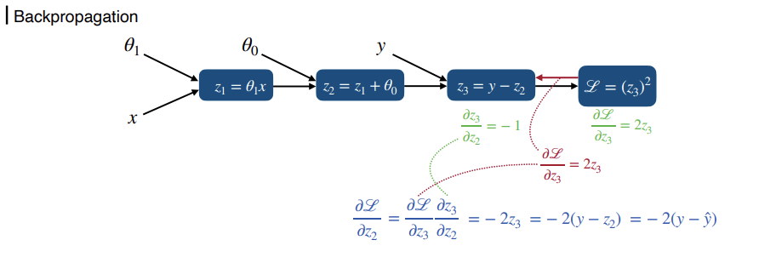
For One Sample: Theory
04

Slide 5
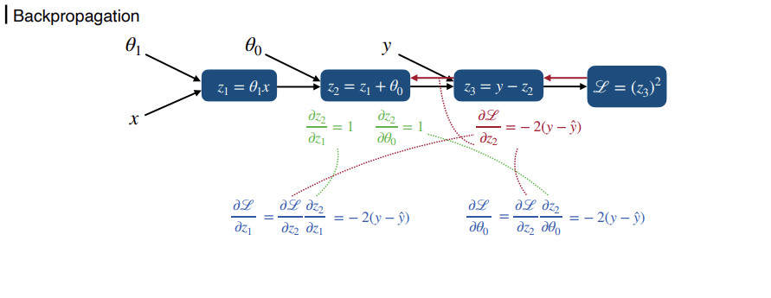
For One Sample: Theory
05

Slide 6
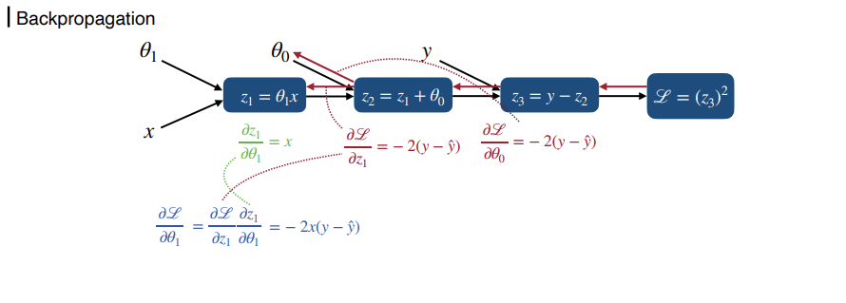
For One Sample: Theory
06

Slide 7
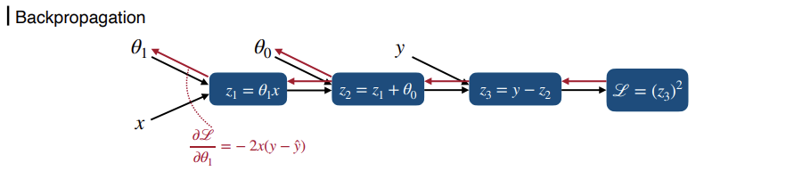
For One Sample: Theory
07

Slide 8
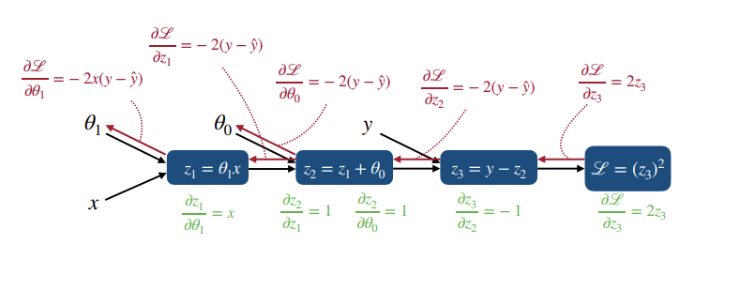
For One Sample: Theory
08

Slide 9
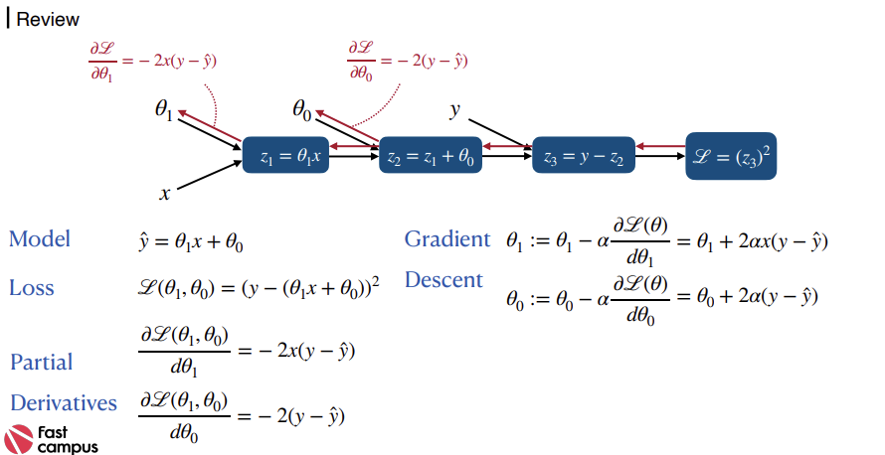

For One Sample: Theory
09

Slide 10
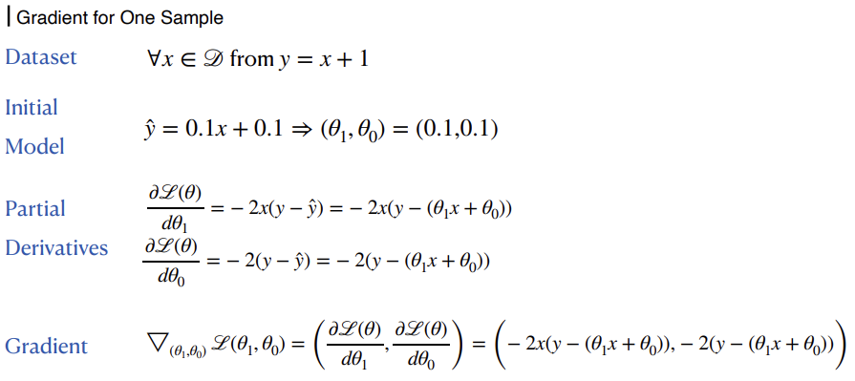
For One Sample: Theory
10

Slide 11
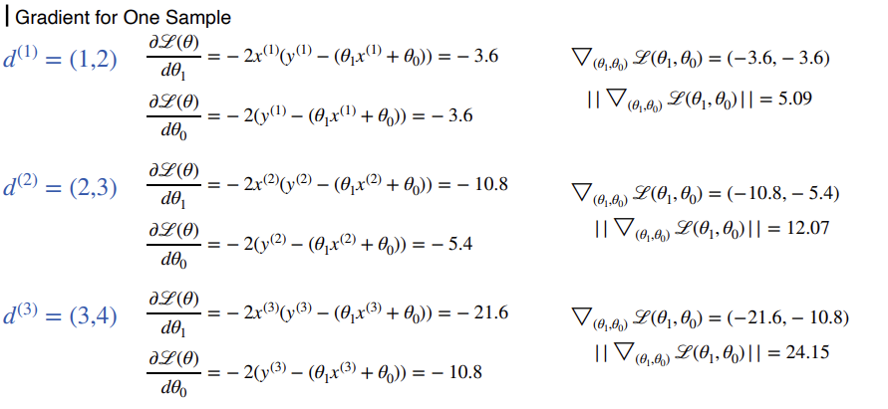
For One Sample: Theory
11

Slide 12
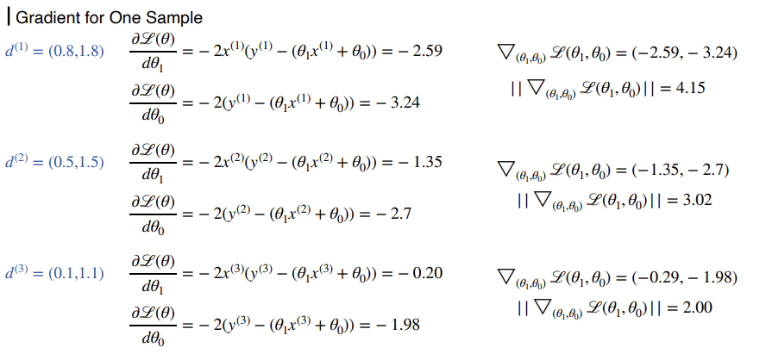
For One Sample: Theory
12

Slide 13

For One Sample: Theory
13

Slide 14
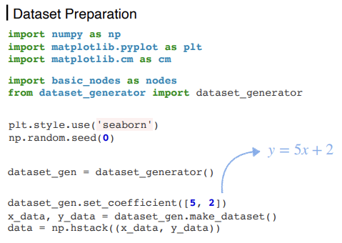
For One Sample: Implementation
14

Slide 15
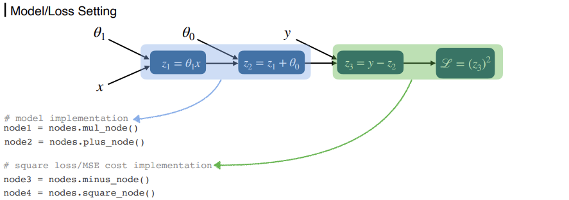
For One Sample: Implementation
15

Slide 16
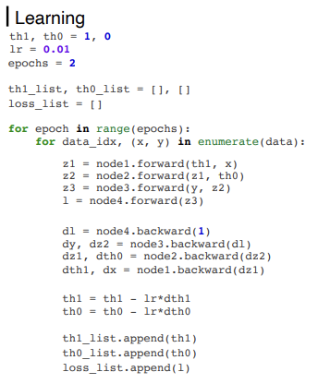
For One Sample: Implementation
16

Slide 17
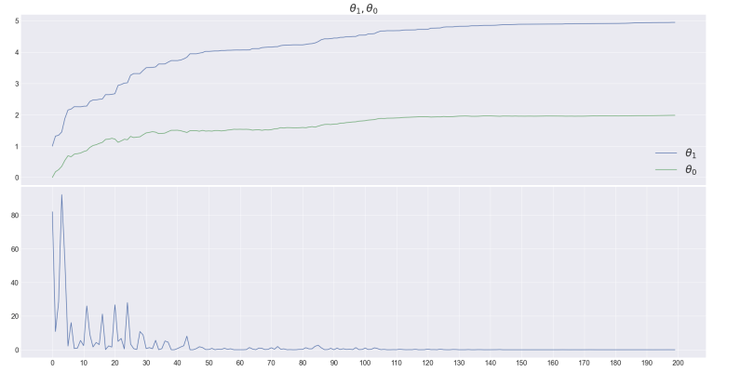
For One Sample: Implementation
17

Slide 18
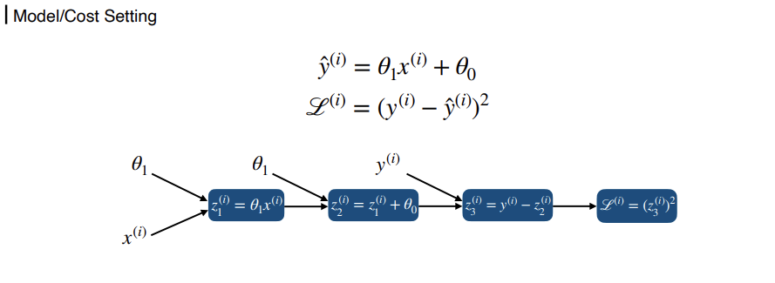
For Several Samples: Theory
18

Slide 19
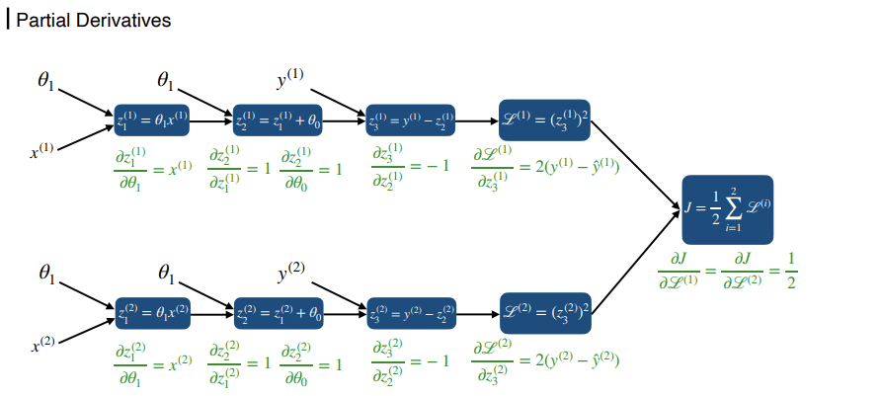
For Several Samples: Theory
19

Slide 20
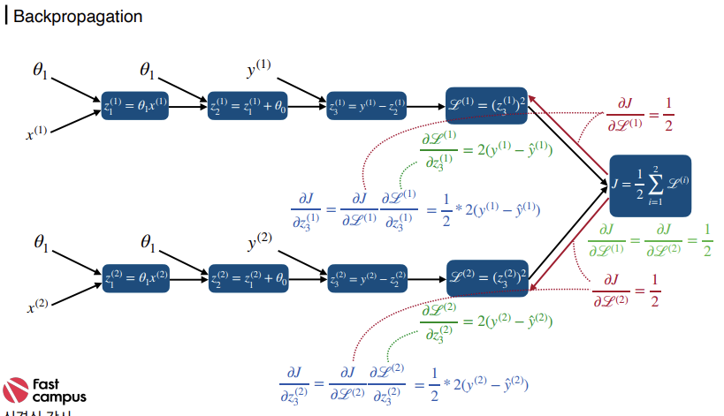

For Several Samples: Theory
20

Slide 21
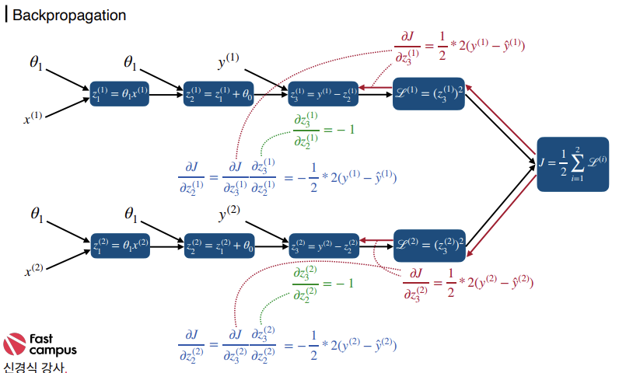
For Several Samples: Theory
21

Slide 22
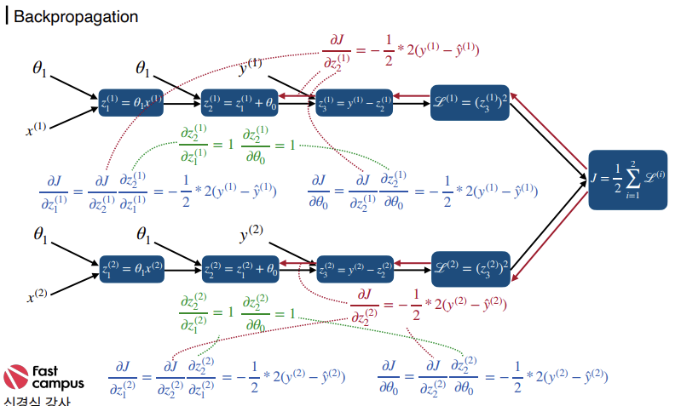
For Several Samples: Theory
22

Slide 23
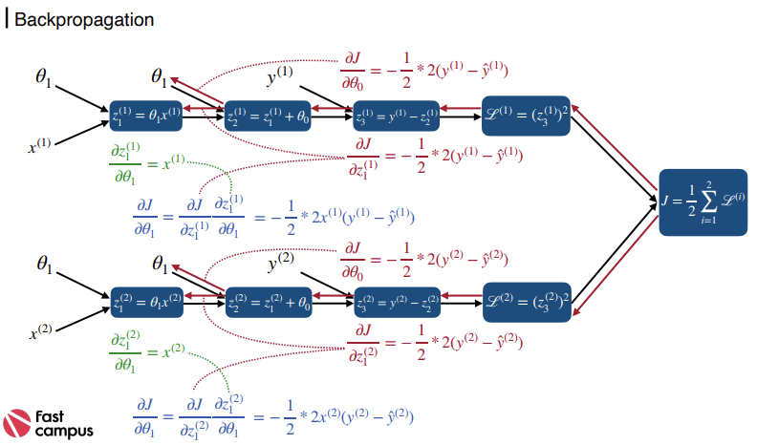
For Several Samples: Theory
23

Slide 24
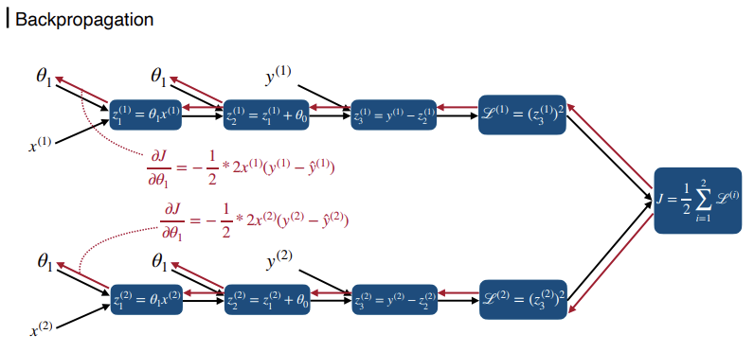
For Several Samples: Theory
24

Slide 25
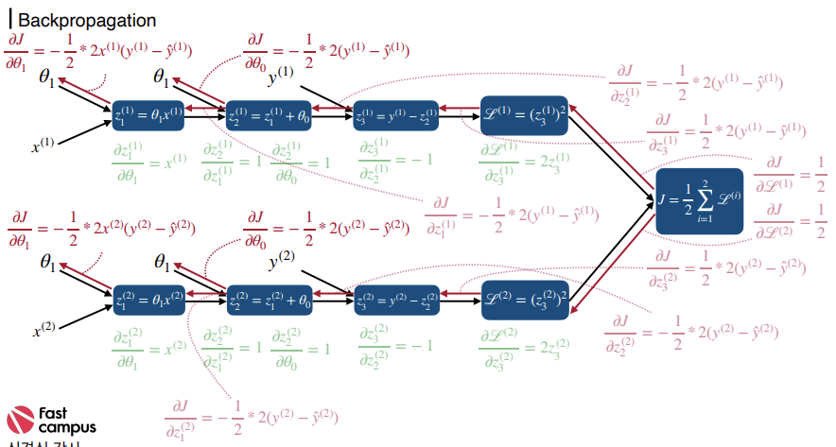
For Several Samples: Theory
25

Slide 26
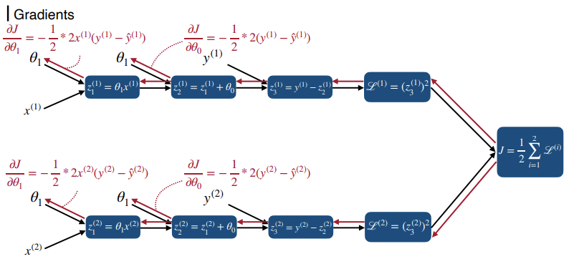
For Several Samples: Theory
26

Slide 27
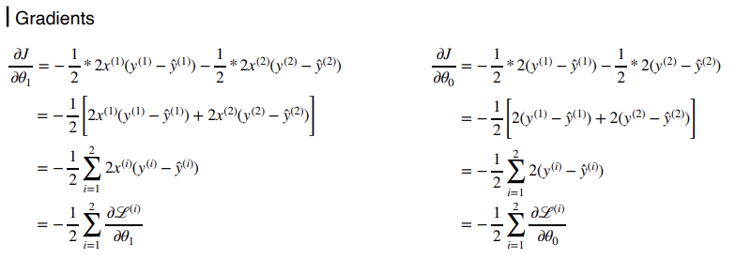
For Several Samples: Theory
27

Slide 28
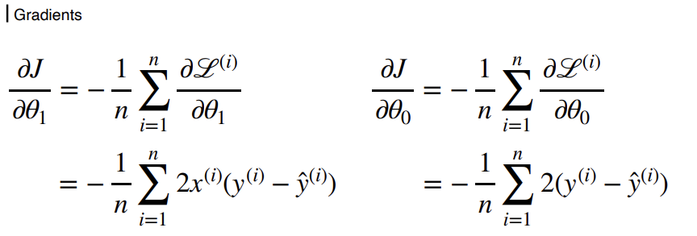
For Several Samples: Theory
28

Slide 29
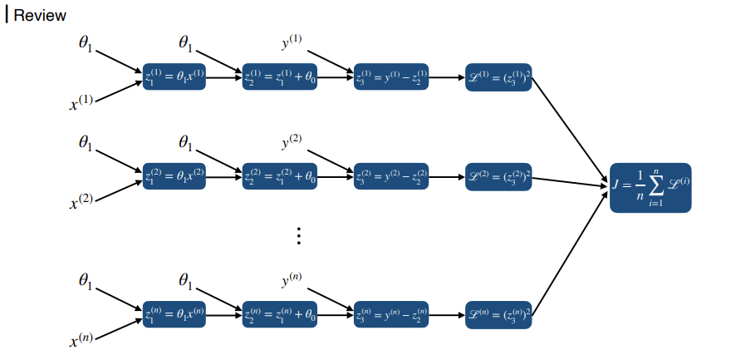
For Several Samples: Theory
29

Slide 30
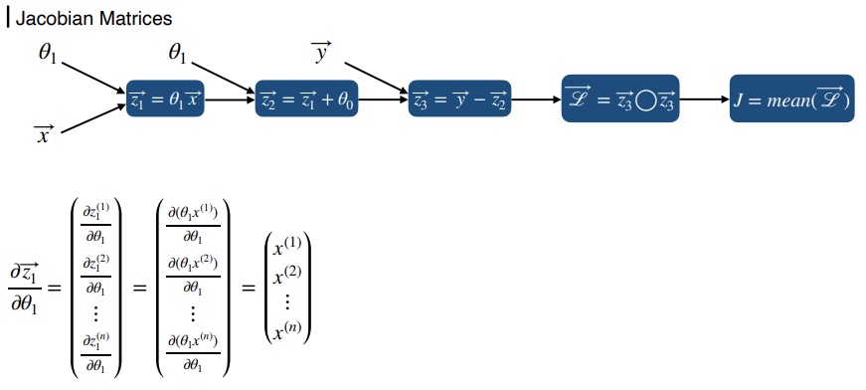
For Several Samples: Theory
30

Slide 31
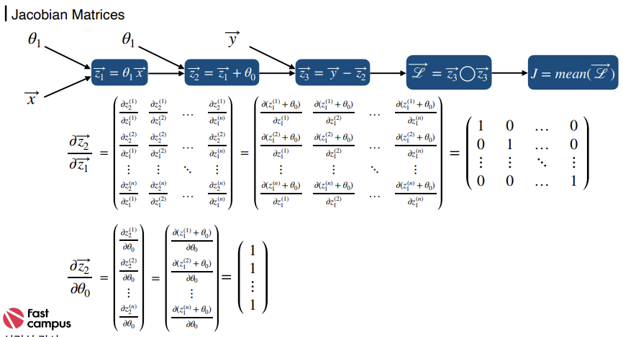

For Several Samples: Theory
31

Slide 32
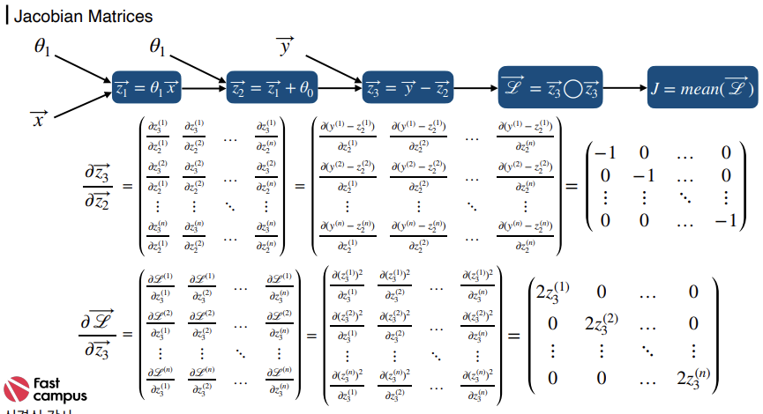
For Several Samples: Theory
32

Slide 33
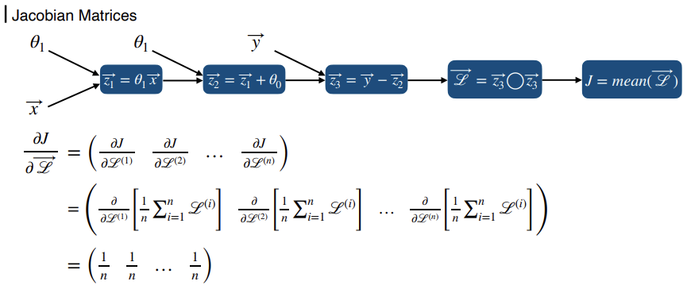
For Several Samples: Theory
33

Slide 34
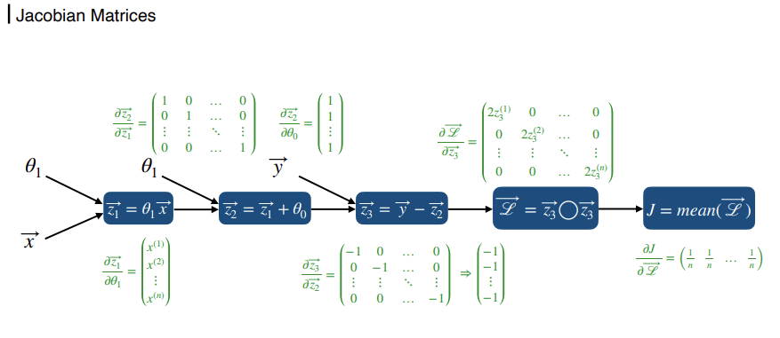
For Several Samples: Theory
34

Slide 35
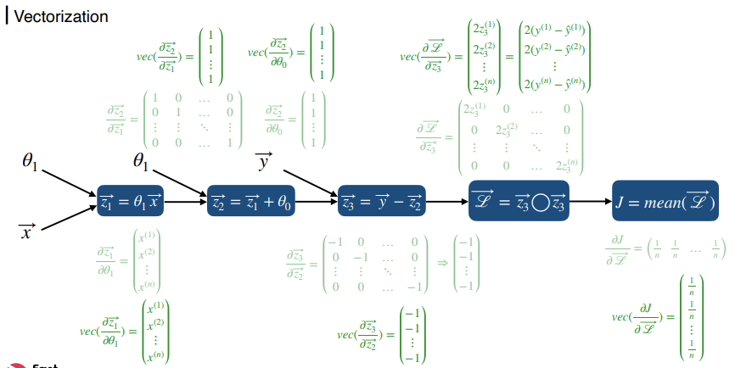
For Several Samples: Theory
35

Slide 36
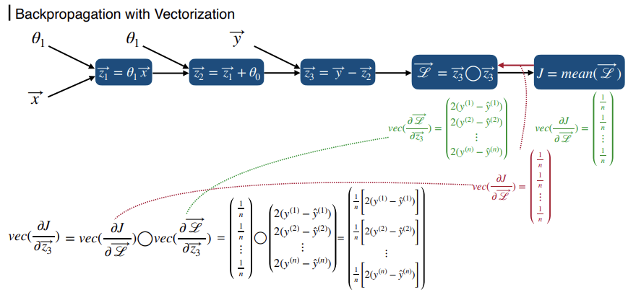
For Several Samples: Theory
36

Slide 37
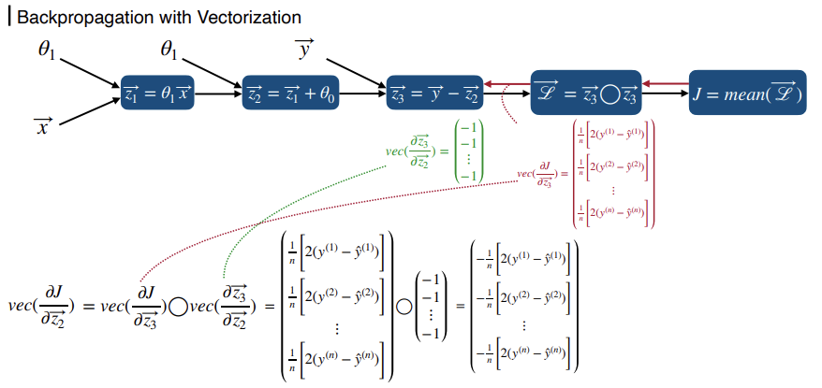
For Several Samples: Theory
37

Slide 38
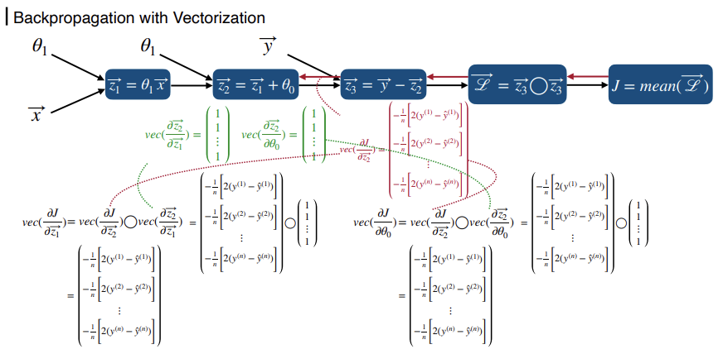
For Several Samples: Theory
38

Slide 39
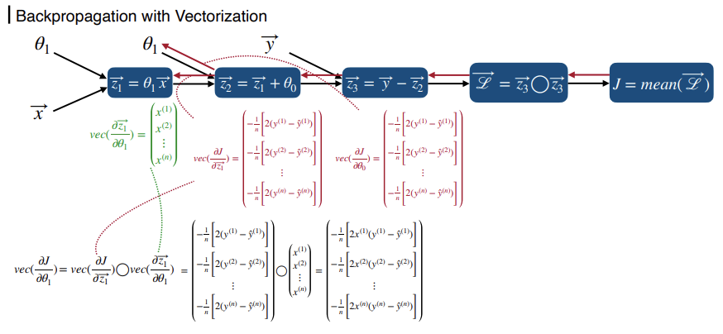
For Several Samples: Theory
39

Slide 40
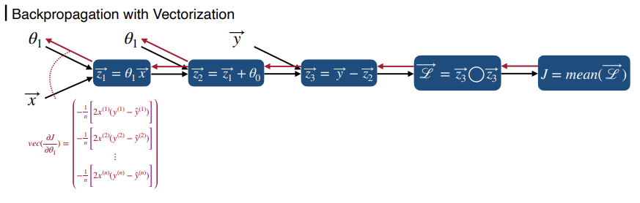
For Several Samples: Theory
40

Slide 41
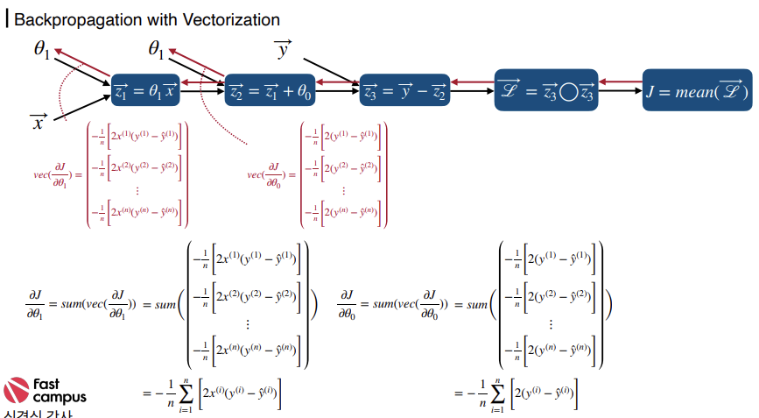

For Several Samples: Theory
41

Slide 42
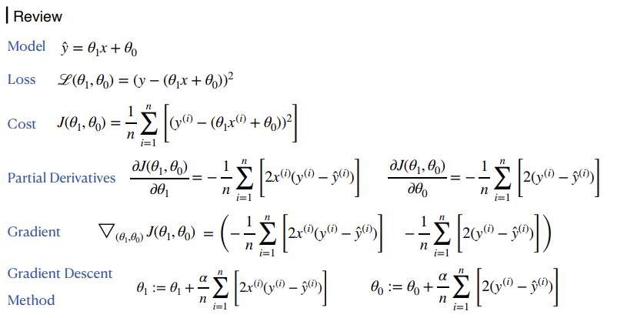
For Several Samples: Theory
42

Slide 43



THANKS FOR WATCHING

