Slide 1







Fuzzy Support Vector Machines
Abstract
INTRODUCTION
SVMs
FSVMs
EXPERIMENTS
CONCLUSION

Slide 2

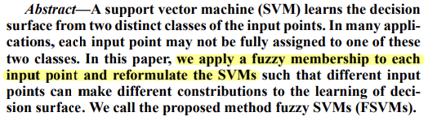
Abstract
02

Slide 3
Introduction
• SVM has been shown to provide higher performance than traditional learning machines
and has been introduced as powerful tools for solving classification problems.
• However, some input points may not be exactly assigned to one of these two classes.
Some data points corrupted by noises are less meaningful and the machine should better
to discard them.
• In this paper, we apply a fuzzy membership to each input point of SVM
and reformulate SVM into fuzzy SVM (FSVM) such that different input points can make
different constribution to the learning of decision surface.
03

Slide 4
SVMs
• In this section we briefly review the basis of the theory of SVM in classification problems.
• Suppose we are given a set $S$ of labeled training points
04

Slide 5
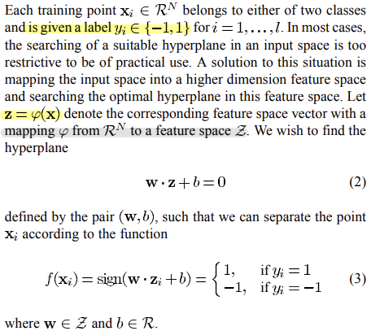
SVMs
05

Slide 6
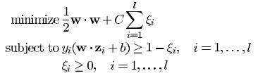
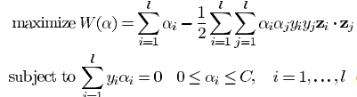
SVMs
• The optimal hyperplane problem is then regarded as the solution to the problem.
• Searching the optimal hyperplane in (6) is a quadratic programming problem
,which can be solved by constructing a Lagrangian and transformed into the dual.
06

Slide 7
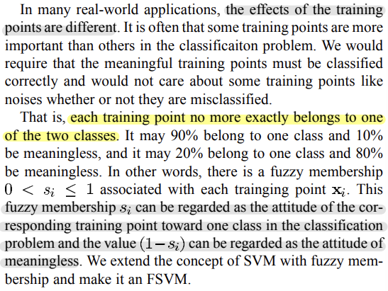
FSVMs
07

Slide 8
Reformulate SVM
• Suppose we are given a set S of labeled training points with associated fuzzy membership.
08

Slide 9
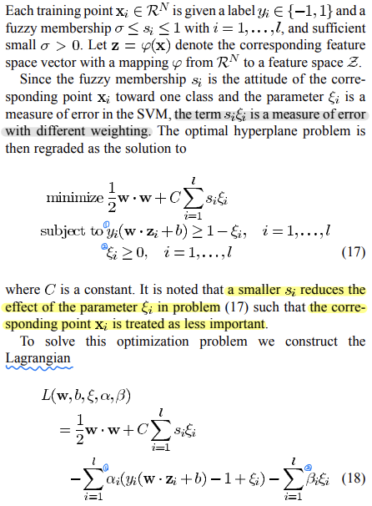
FSVMs
09

Slide 10
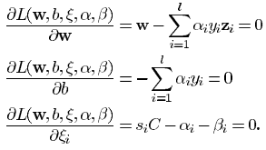
FSVMs
10

Slide 11
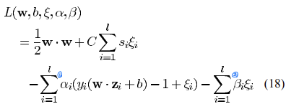
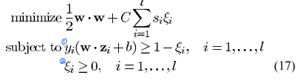
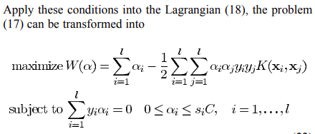
FSVMs
11

Slide 12

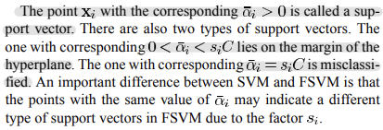
FSVMs
• The Kuhn-Tucker conditions are defined as
• KKT 조건에서 ${\overline{α}}_{i}>0$ 이면, $y_{i}\left(\overline{w}∙z_{i}+\overline{b}\right)−1+\overline{ε_{i}}=0$ 이다.
즉, $y_{i}\left(\overline{w}∙z_{i}+\overline{b}\right)=1−\overline{ε_{i}}$ 이므로 margin 끝에 점이 위치한다.
12

Slide 13

Dependence on the Fuzzy Membership
• The only free parameter C in SVM controls the tradeoff between the maximization of
margin and the amount of misclassifications.
• A larger C makes the training of SVM less misclassifications and narrower margin.
The decrease of C makes SVM ignore more training points and get wider margin.
13

Slide 14
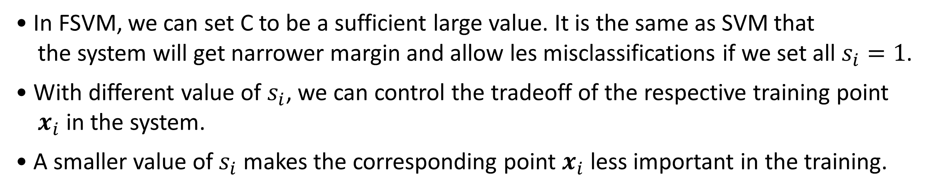
Dependence on the Fuzzy Membership
• In FSVM, we can set C to be a sufficient large value. It is the same as SVM that
the system will get narrower margin and allow les misclassifications if we set all $s_{i}=1$.
• With different value of $s_{i}$, we can control the tradeoff of the respective training point
$x_{i}$ in the system.
• A smaller value of $s_{i}$ makes the corresponding point $x_{i}$ less important in the training.
14

Slide 15
Experiments (Two Classes With Different Weighting)
• If the machine says 1, it means that the point belongs to this class with very high accuracy,
but if the machine says -1, it may belong to this class with lower accuracy or really
belongs to another class.
• For this purpose, we can select the fuzzy membership as a function of respective class.
15

Slide 16

Experiments (Two Classes With Different Weighting)
• Suppose we are given as sequence of training points.
• Let fuzzy membership $s_{i}$ be a function of class $y_{i}$
16

Slide 17

Experiments (Two Classes With Different Weighting)
• Fig.3 shows the result of the SVM and Fig.4 shows the result of FSVM by setting.
17

Slide 18
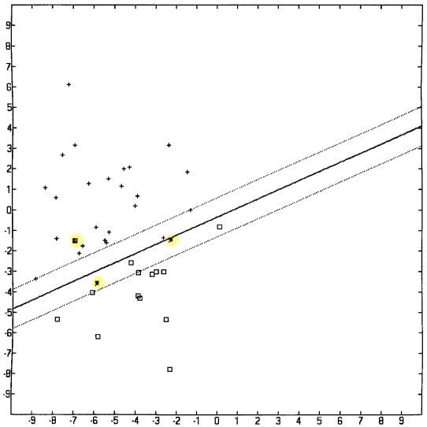
Experiments (Two Classes With Different Weighting)
• The point with $y_{i}=1$ is indicated as cross, and the point ($y_{i}=−1$) is indicated as square.
• In Fig. 3, the SVM finds the optimal hyperplane with errors appearing in each class.
18

Slide 19
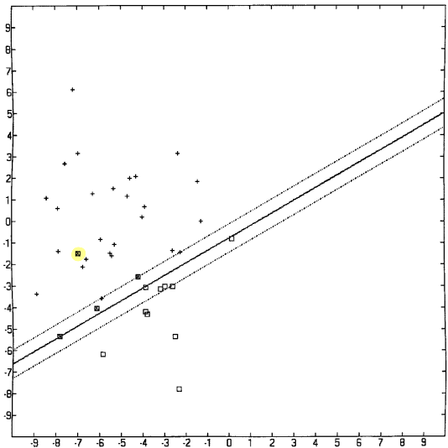
Experiments (Two Classes With Different Weighting)
• In Fig. 4, we apply different fuzzy memberships to different classes,
the FSVM finds the optimal hyperplane with errors appearing only in one class.
• We can easily check that the FSVM classify the class of cross with high accuracy and
the class of square with low accuracy, while SVM does not.
19

Slide 20
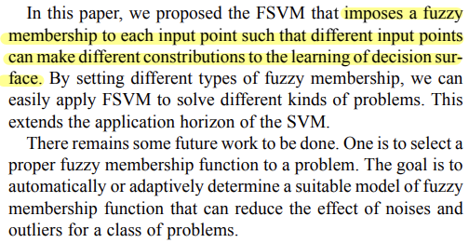
Conclusion
20

Slide 21




