Slide 1







A New Fuzzy Support Vector Machine
to Evaluate Credit Risk
Abstract
Introduction
SVM and Fuzzy SVM
New Fuzzy SVM
Empirical Analysis
Summary and Conclusion

Slide 2

Abstract
• Due to recent financial crises and regulatory concerns, financial intermediaries’ credit risk
assessment is an area of renewed interest.
• In this paper, we propose a new fuzzy SVM to discriminate good creditors from bad ones.
Because in credit scoring areas we usually cannot label one customer as absolutely bad
who will default certainly, our new fuzzy SVM treats every sample as both positive and
negative classes, but with different memberships.
• By this way, we expect the new fuzzy support vector machine to have more generalization
ability, while preserving the merit of insensitive to outliers.
02

Slide 3
Introduction
• Today, one of the most significant threats for many businesses, is counterparts’ credit risk.
Due to recent financial crises and regulatory concerns credit risk assessment is an area
that has seen a resurgence of interest.
• Especially for credit-granting institutions, the ability to discriminate faithful customers
from bad ones is crucial. In order to enable the interested parties to take either
preventive or corrective action, the need for efficient and reliable models that predict
defaults accurately is imperative.
• Accurate classifiers should be found in order to categorize new applicants or existing
customers as good or bad.
03

Slide 4
Introduction
• SVM is useful for credit scoring. One of the main drawbacks in the application of standard
SVM is their sensitive to outliers or noises in the training sample due to overfitting. Fuzzy
support vector machine is proposed to deal with the problem.
• Experimental results show that the proposed fuzzy SVM can actually reduce the effect of
outliers and yield higher classification rate than traditional SVMs do.
• This paper provides a new fuzzy SVM to evaluate the credit risk. Unlike the fuzzy SVM, we
treat each data as both of positive and negative classes, but assigned with different
memberships.
04

Slide 5
Introduction
• If one data is detected as outlier, which means that it is very likely to fall in this class,
but it falls in the contrary class actually. We treat it as a member of this class with large
membership, at the same time treat it as a member of the contrary class with small
membership.
• The economic meaning of the new fuzzy SVM is that the most reliable customer also may
default his or her debt and vice versa.
05

Slide 6
SVM and Fuzzy SVM
• This section provides a simple introduction about standard SVM and fuzzy SVM
06

Slide 7
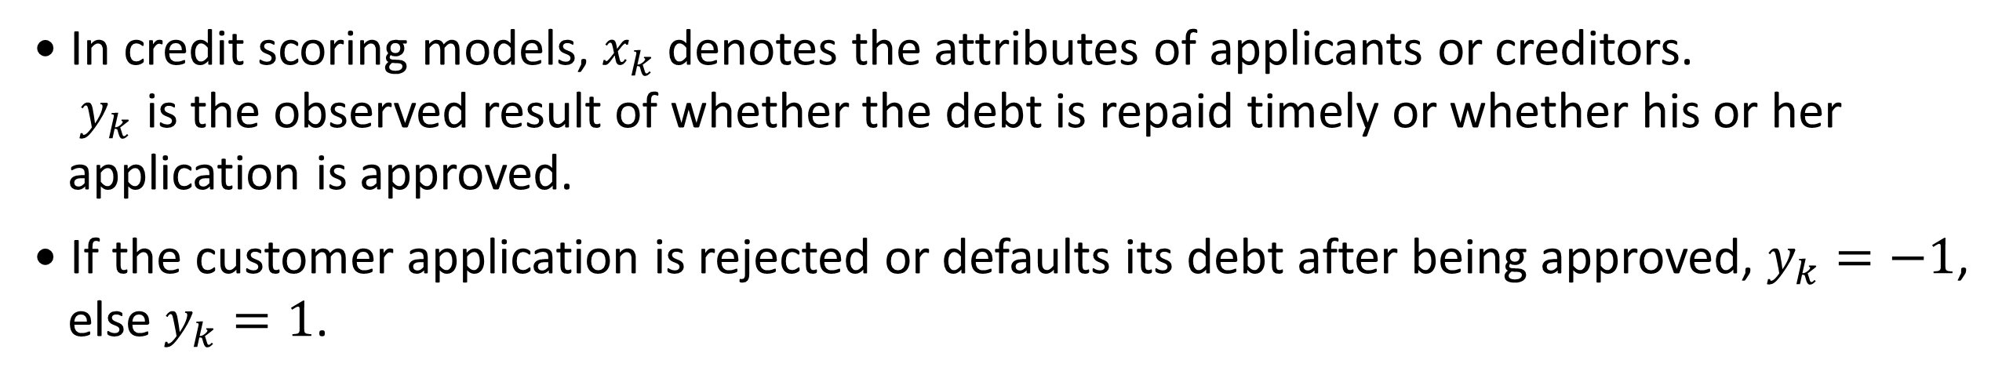
A. SVM
• Considering a training sample.
$$\left\{x_{k}, y_{k}\right\}, k=1, …, N$$
• In credit scoring models, $x_{k}$ denotes the attributes of applicants or creditors.
$y_{k}$ is the observed result of whether the debt is repaid timely or whether his or her
application is approved.
• If the customer application is rejected or defaults its debt after being approved, $y_{k}=−1$,
else $y_{k}=1$.
07

Slide 8

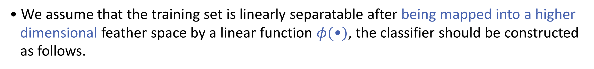
A. SVM
• We assume that the training set is linearly separatable after being mapped into a higher
dimensional feather space by a linear function $φ(\text{•})$, the classifier should be constructed
as follows.
08

Slide 9


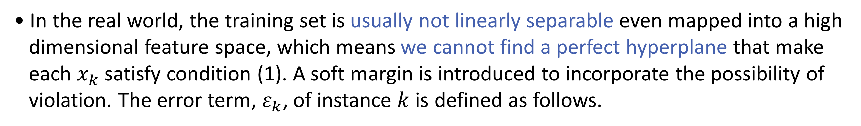
A. SVM
• In the real world, the training set is usually not linearly separable even mapped into a high
dimensional feature space, which means we cannot find a perfect hyperplane that make
each $x_{k}$ satisfy condition (1). A soft margin is introduced to incorporate the possibility of
violation. The error term, $ε_{k}$, of instance $k$ is defined as follows.
09

Slide 10
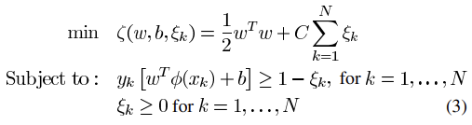
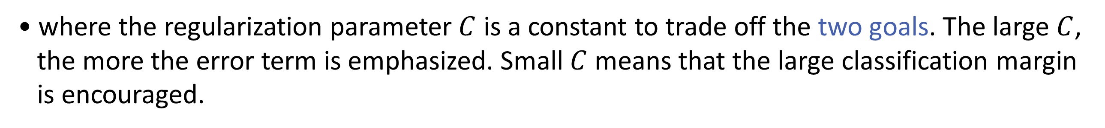
A. SVM
• It is expected that the training should maximize the classification margin and minimize the
sum of error terms at the same time. When the training set is not nonlinear separable in
the feature space, the two goals usually cannot be achieved at the same time.
• We formulate the two group classification problems as the following optimization problem.
• where the regularization parameter $C$ is a constant to trade off the two goals. The large $C$,
the more the error term is emphasized. Small $C$ means that the large classification margin
is encouraged.
10

Slide 11
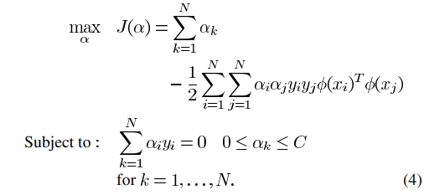

A. SVM
• By introducing Lagrange multiples $α_{i}$ and $β_{i}$ for the constraints in the (3), the problem can be transformed into its dual form.
• From the conditions of optimality, it follows.
11

Slide 12
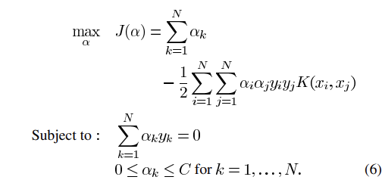

A. SVM
• Substituting ${φ(x_{i})}^{T}φ(x_{j})$ with kernel function $K(x_{i},x_{j})$.
• After solving (6) and subsitituting $w=\sum_{k=1}^{N}{α_{k}y_{k}φ(x_{k})}$ into the original classification problem, we obtain the following the classifiers.
12

Slide 13
B. Fuzzy SVM
• Due to over fitting, in SVM and least-squares SVM, the training process is very sensitive to
those outliers in the training dataset which are far away from their own class.
• In order to decrease the effect of those outliers or noises, we assign each data point in the training dataset with a membership and sum the deviations weighted by their memberships.
• This kind of SVM fuzzifies the penalty term in order to reduce the sensitivity of less
important data points.
13

Slide 14
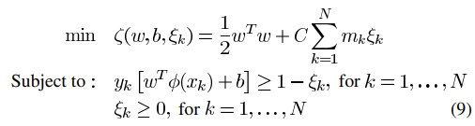
B. Fuzzy SVM
• The classification problem is modeled as follows.
where $m_{k}$ is the membership.
• An important step in implementing fuzzy SVM is the determination of memberships.
14

Slide 15
New Fuzzy SVM
• The main idea of fuzzy SVM is that if the input is detected as an outlier,
we decrease one input’s membership, so decrease its contribution to total error term.
• Our new fuzzy SVM follows in the same idea. But different from fuzzy SVM, the new FSVM
also treat each input as an input of the opposite class with membership.
• In such way we expect the new fuzzy machine to make full use the data and achieve better
generalization ability.
15

Slide 16
New Fuzzy SVM
• Because in the new fuzzy SVM one data contributes two errors to the total error term
in the objective function, while in previous proposed SVM one data contribute just
one error, we call the fuzzy SVM as unilateral-weighted fuzzy SVM (U-FSVM), our new
FSVM as Bilateral-weighted fuzzy SVM (B-FSVM) in this paper.
• We first explain why we apply fuzzy theory to bilaterally weight fitting error in the model.
Then we show how to solve the training problem by transforming it into quadratic
programming problem. How to generate memberships will be analyzed in the end.
16

Slide 17
A. Bilateral-Weighting Errors
• In credit risk analysis, we cannot say one customer is absolutely good and he will not
default his debt at any event, or vice versa.
• Based on this idea, we treat every data point in the training dataset as both positive and
negative class but with different memberships. Memberships are assigned to both classes
for every data point.
17

Slide 18
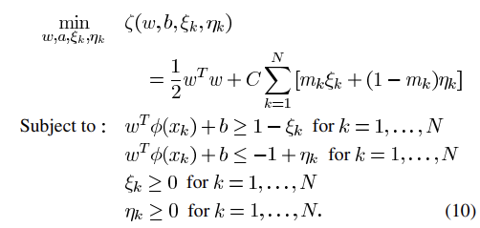
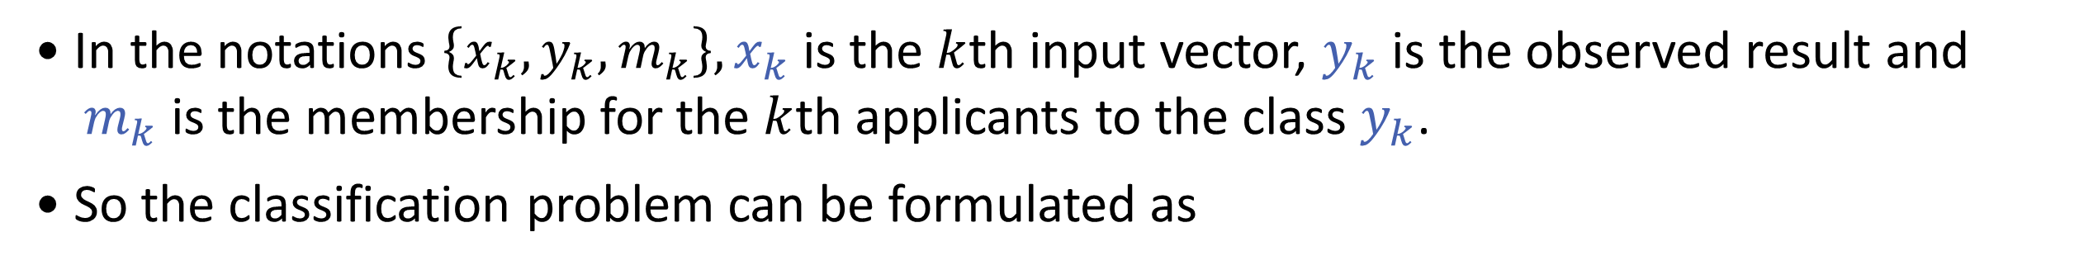
A. Bilateral-Weighting Errors
• In the notations $\left\{x_{k},y_{k},m_{k}\right\},x_{k}$ is the $k$th input vector, $y_{k}$ is the observed result and
$m_{k}$ is the membership for the $k$th applicants to the class $y_{k}$.
• So the classification problem can be formulated as
18

Slide 19
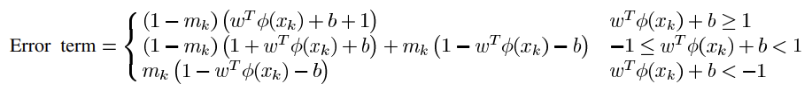
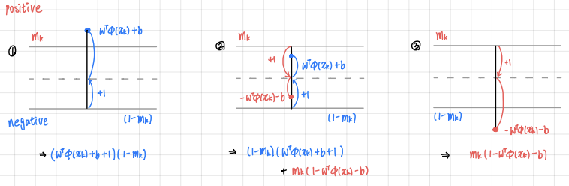
A. Bilateral-Weighting Errors
• In the bilateral-weighted FSVM the error term of an input originally labeled as positive.
19

Slide 20
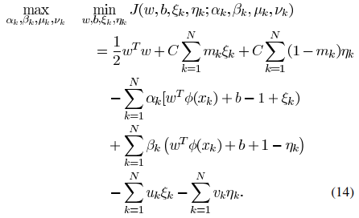
B. Formulation
• Letting the corresponding Lagrange multipliers to the conditions be $α_{k},β_{k},μ_{k}$ and $ν_{k}$.
We construct the Lagrangian function of the previous model.
20

Slide 21
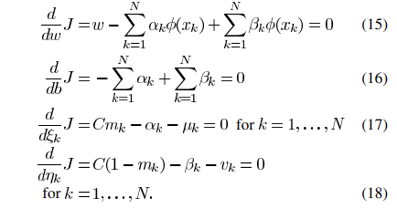
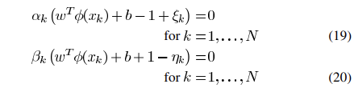
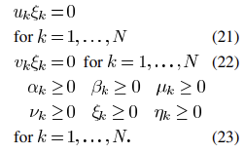
B. Formulation
• Differentiating this with $w, b,ε_{k}$ and $η_{k}$.
• From the Kuhn-Tucker Theorem, the following conditions are also satisfied.
21

Slide 22
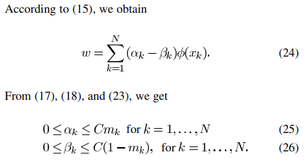
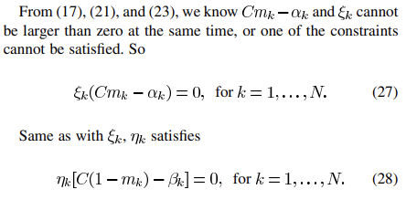










B. Formulation
22

Slide 23
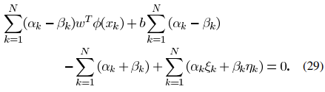
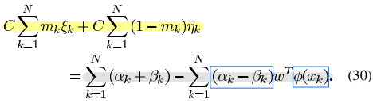
B. Formulation
• Taking the difference between the sum of (19) and (20) from $k=1$ to $N$, we obtain
• Incorporating (16), (27) and (28)
23

Slide 24
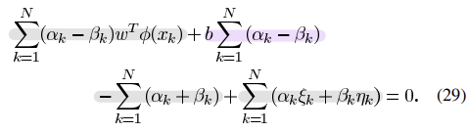


B. Formulation
24

Slide 25
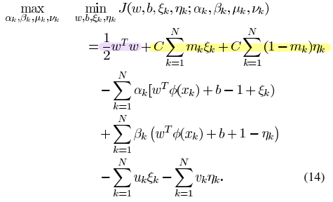
B. Formulation
25

Slide 26
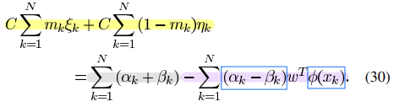
B. Formulation
26

Slide 27
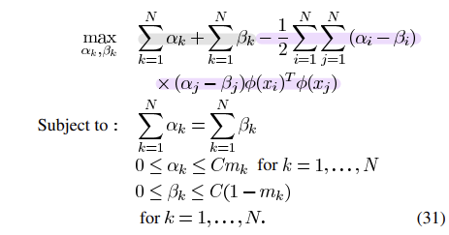
B. Formulation
27

Slide 28
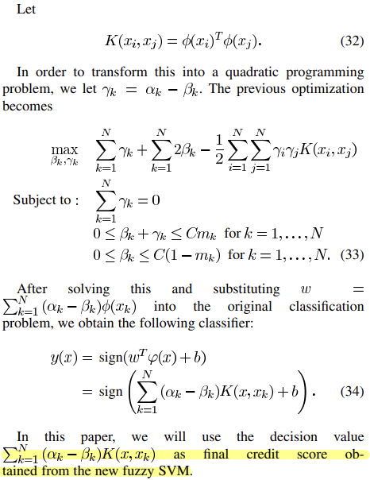
B. Formulation
28

Slide 29




