Slide 1







Multi-variate Linear Regression
21010469 김민경

Slide 2

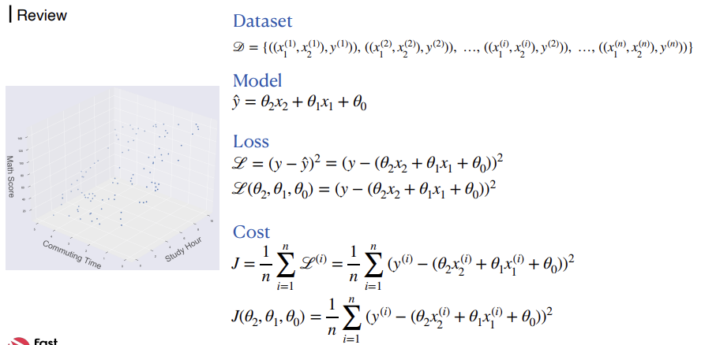

For One Sample: Implementation
02

Slide 3
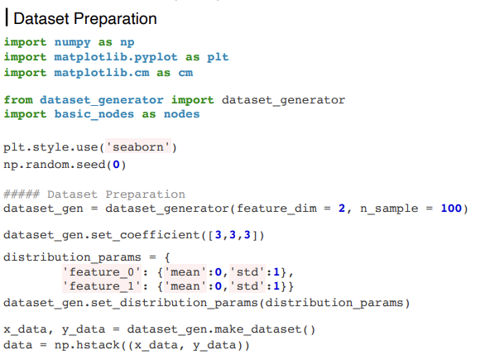
For One Sample: Implementation
03

Slide 4
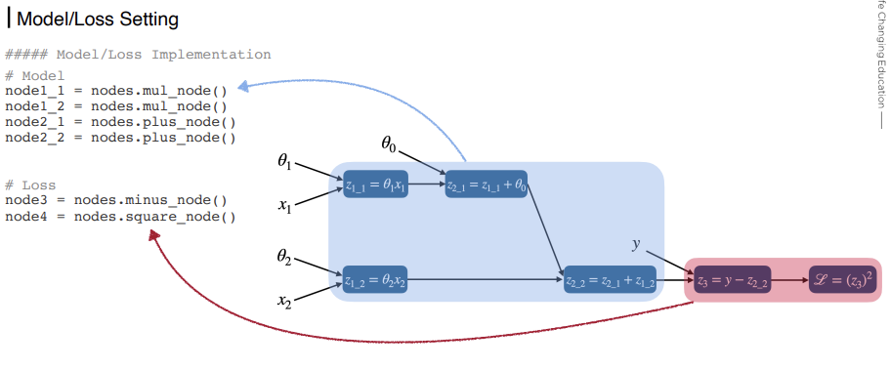
For One Sample: Implementation
04

Slide 5
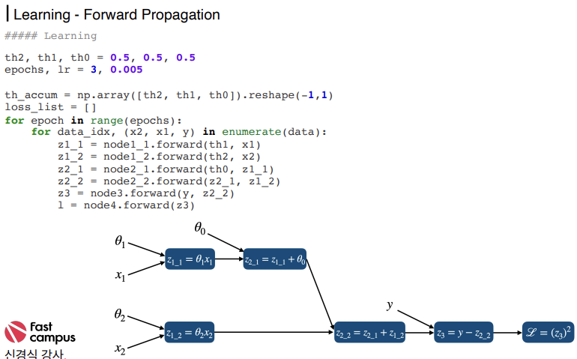
For One Sample: Implementation
05

Slide 6
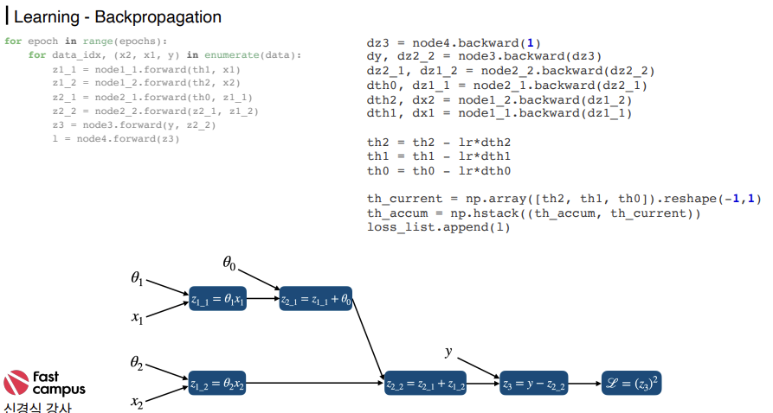
For One Sample: Implementation
06

Slide 7
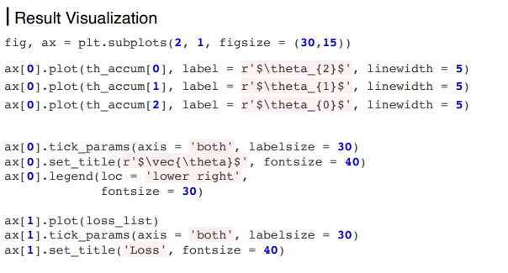
For One Sample: Implementation
07

Slide 8
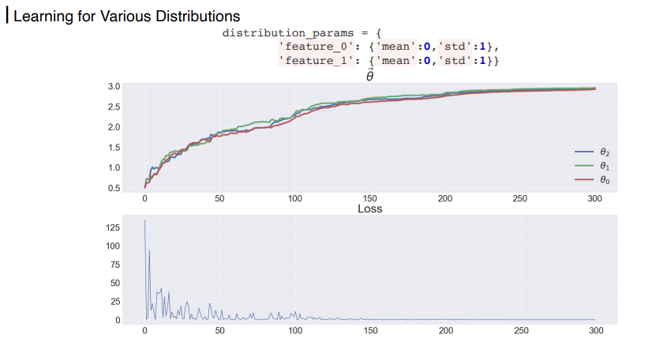
For One Sample: Implementation
08

Slide 9
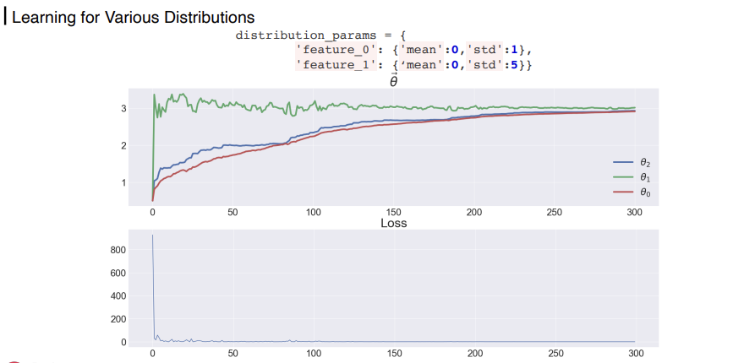
For One Sample: Implementation
09

Slide 10
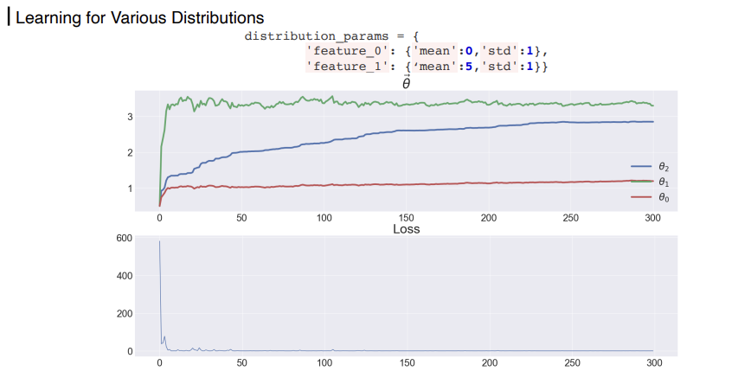
For One Sample: Implementation
10

Slide 11
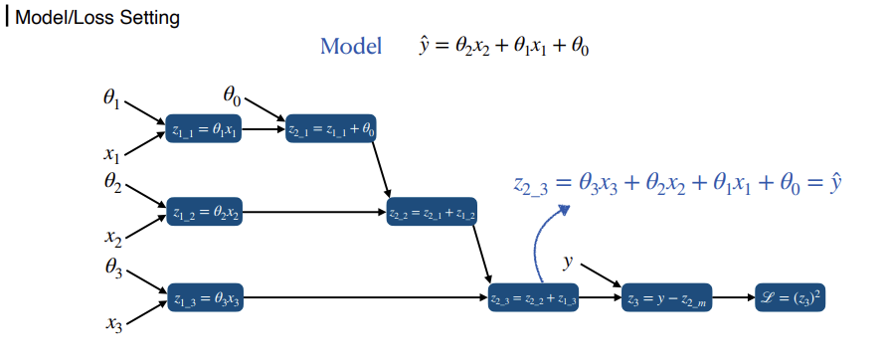
Implementation for n Features
11

Slide 12
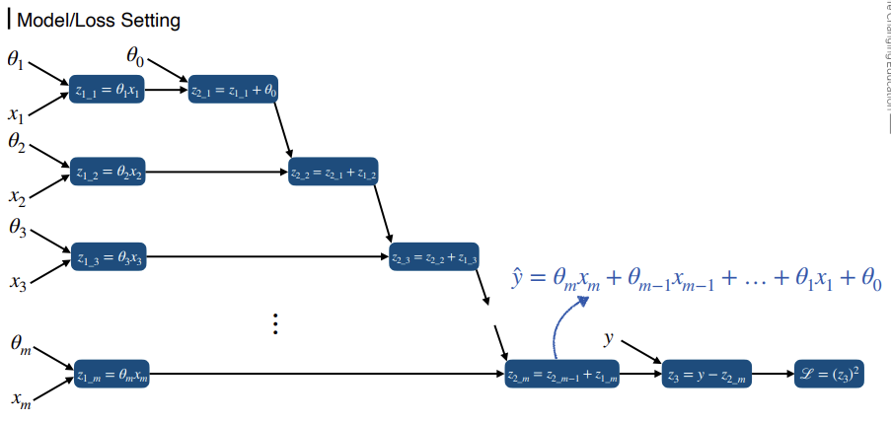

Implementation for n Features
12

Slide 13
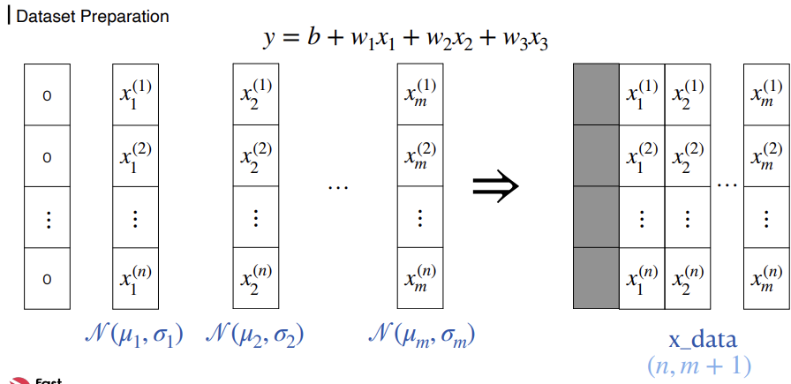
Implementation for n Features
13

Slide 14
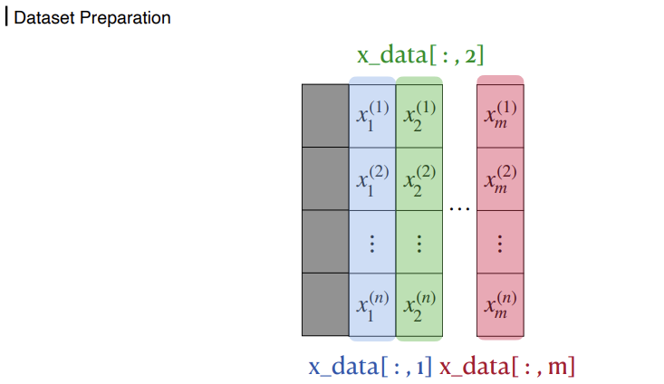
Implementation for n Features
14

Slide 15
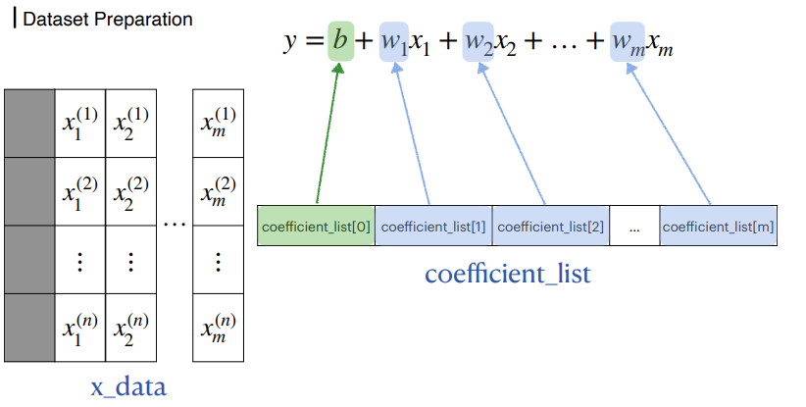
Implementation for n Features
15

Slide 16
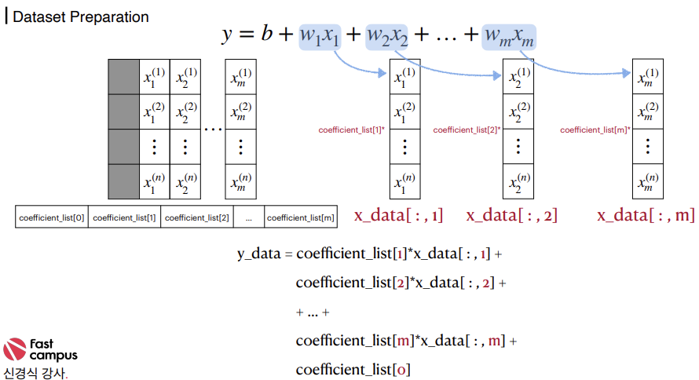
Implementation for n Features
16

Slide 17
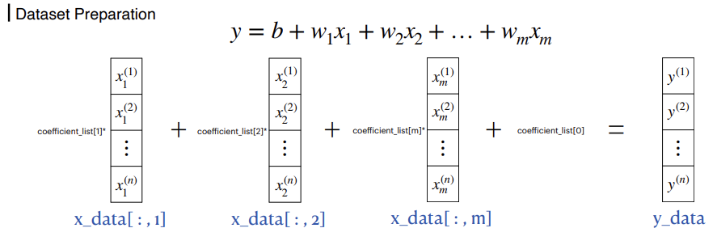
Implementation for n Features
17

Slide 18
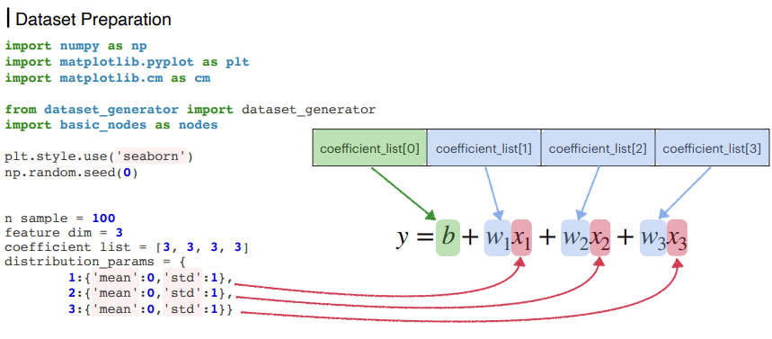
Implementation for n Features
18

Slide 19
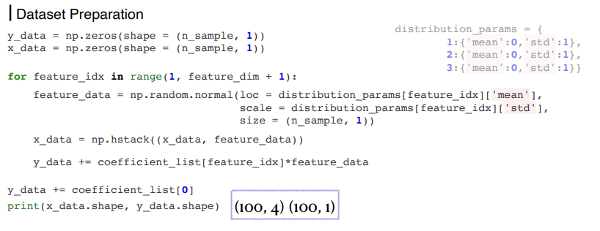
Implementation for n Features
19

Slide 20
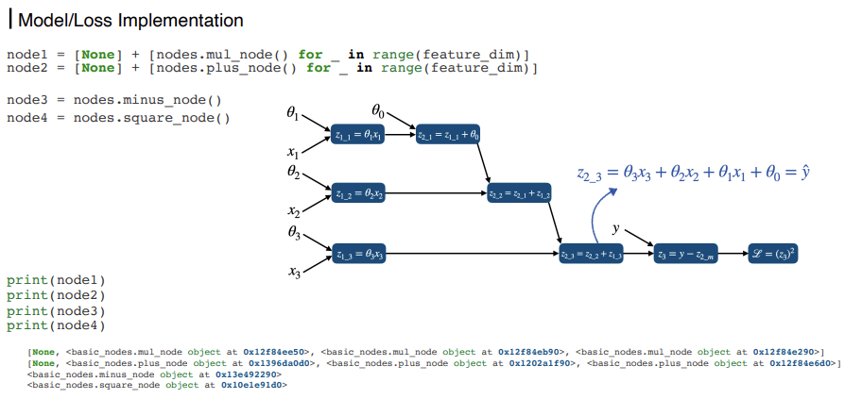
Implementation for n Features
20

Slide 21
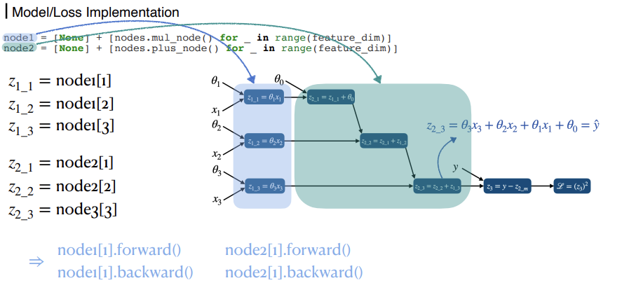
Implementation for n Features
21

Slide 22
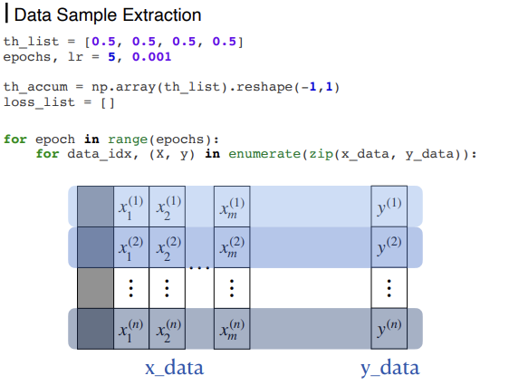
Implementation for n Features
22

Slide 23
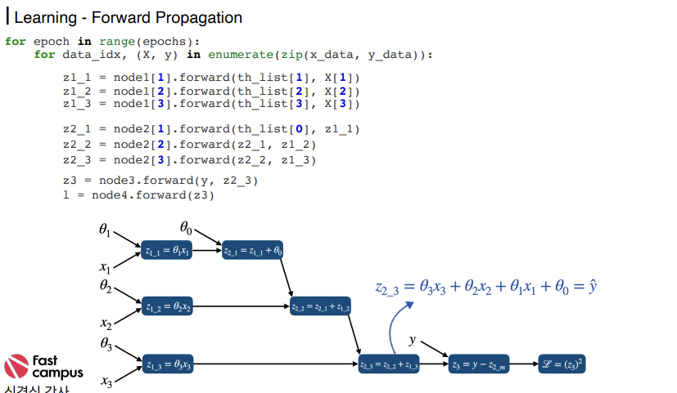

Implementation for n Features
23

Slide 24
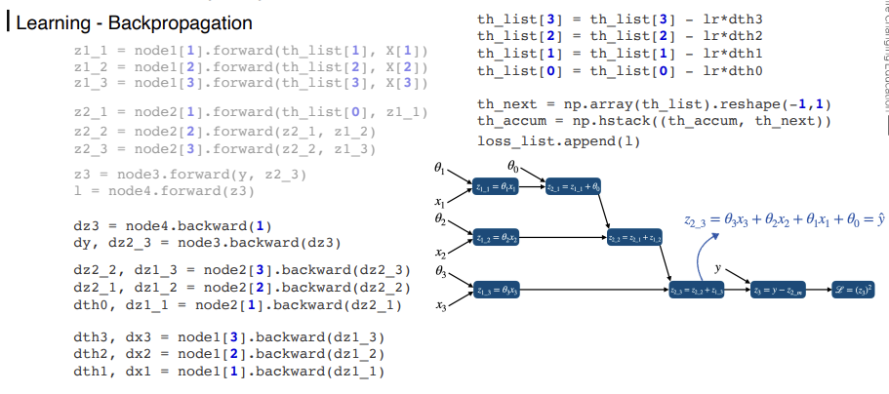
Implementation for n Features
24

Slide 25
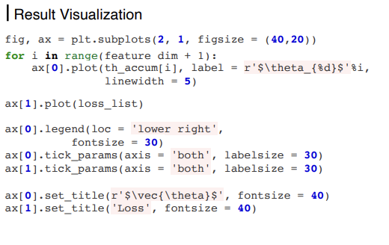
Implementation for n Features
25

Slide 26
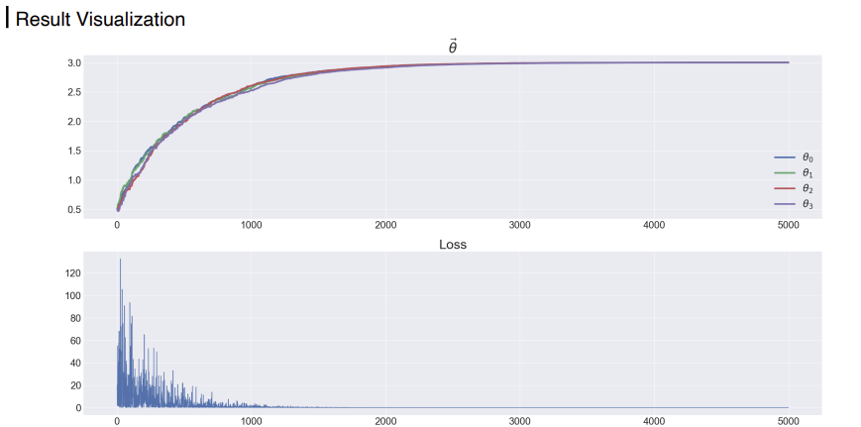
Implementation for n Features
26

Slide 27
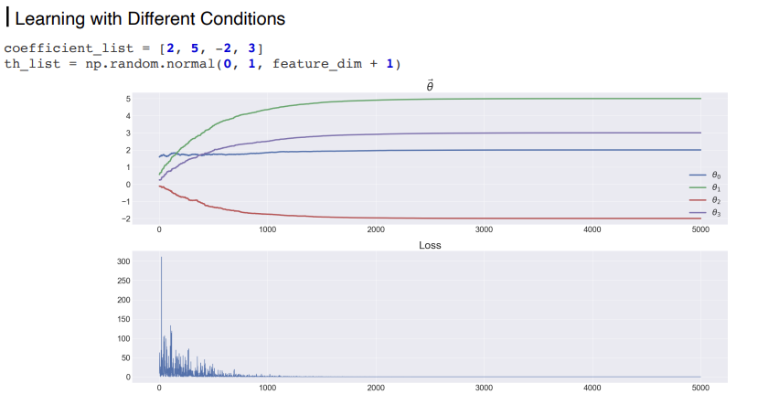
Implementation for n Features
27

Slide 28
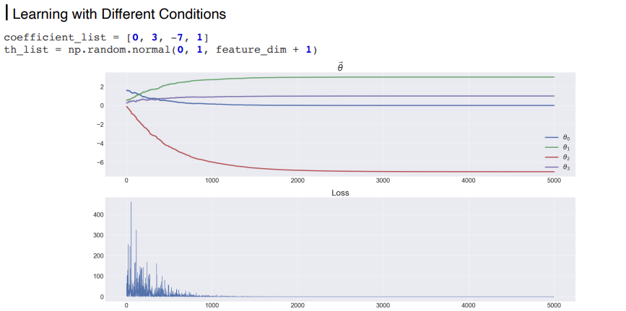
Implementation for n Features
28

Slide 29



THANKS FOR WATCHING

