Slide 1







Multi-variate Linear Regression
21010469 김민경

Slide 2

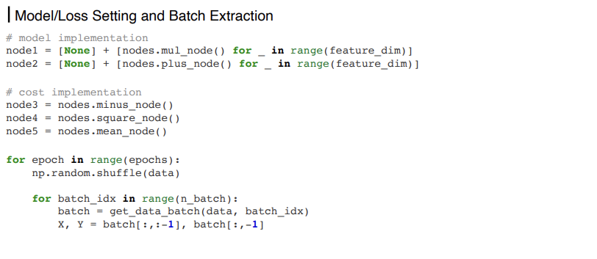
Implementation for n Features
02

Slide 3
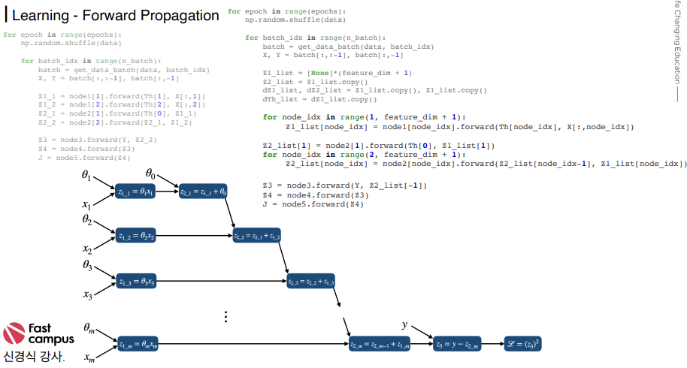

Implementation for n Features
03

Slide 4
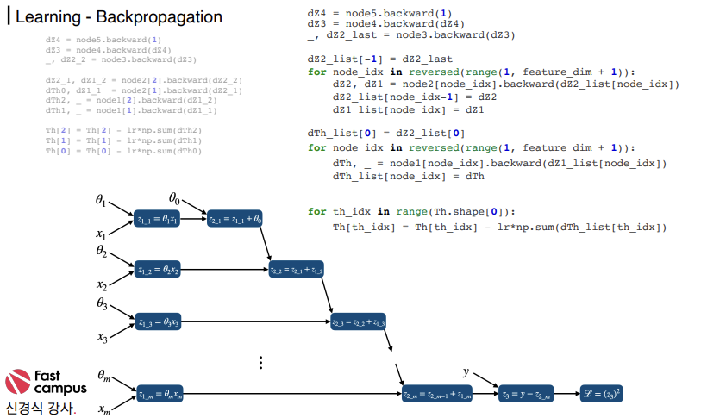
Implementation for n Features
04

Slide 5
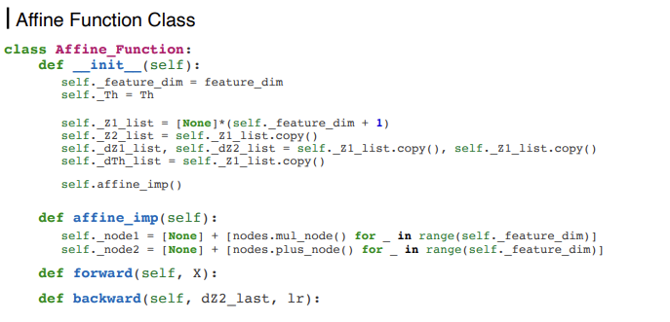
Implementation for n Features
05

Slide 6
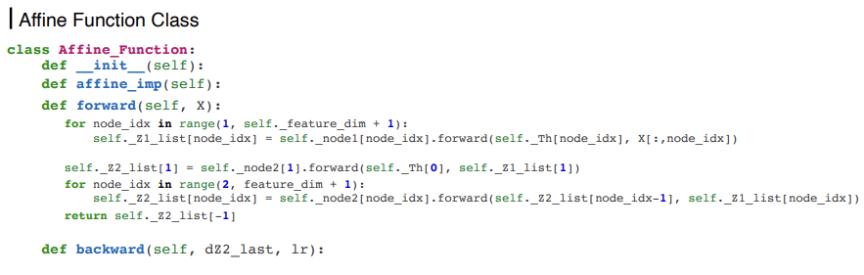
Implementation for n Features
06

Slide 7
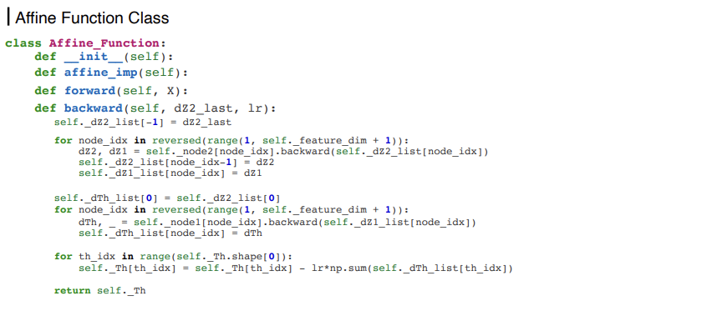
Implementation for n Features
07

Slide 8
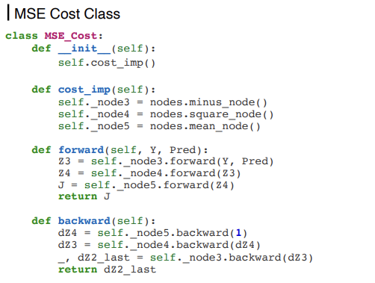
Implementation for n Features
08

Slide 9
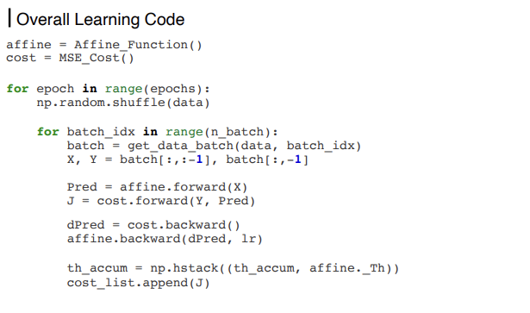
Implementation for n Features
09

Slide 10
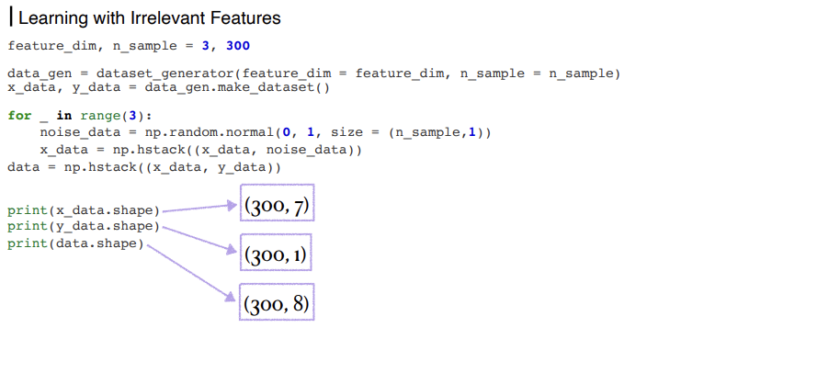
Implementation for n Features
10

Slide 11
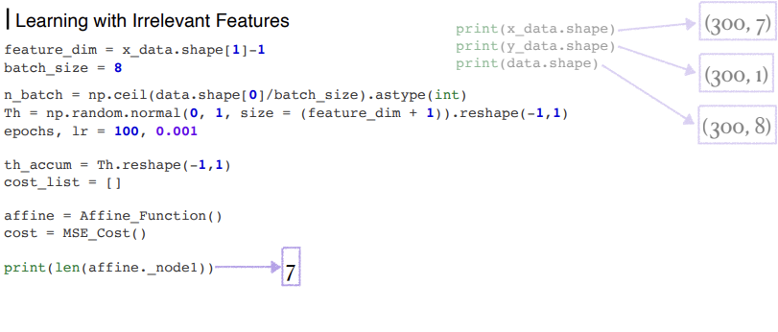
Implementation for n Features
11

Slide 12
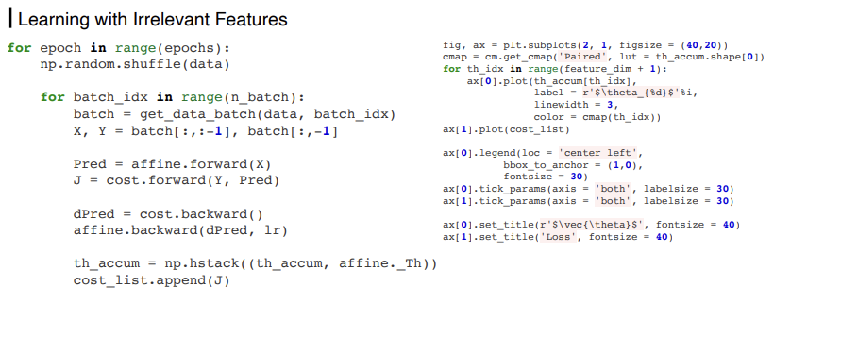
Implementation for n Features
12

Slide 13
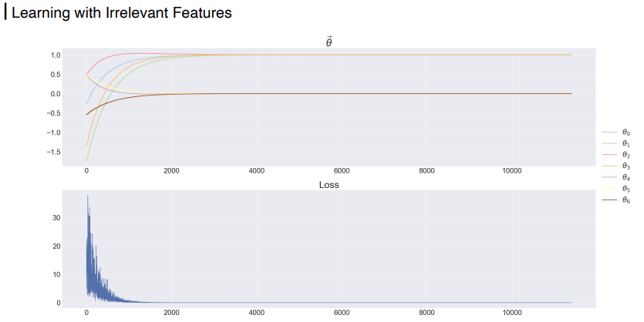
Implementation for n Features
13

Slide 14
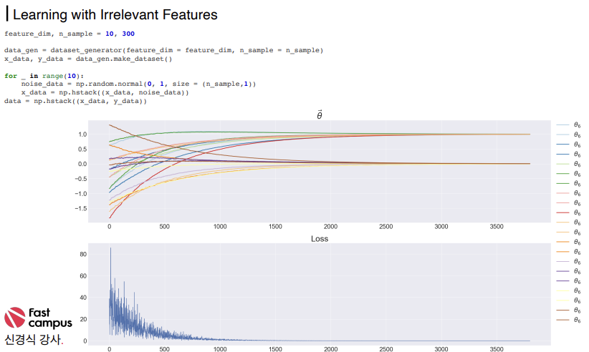
Implementation for n Features
14

Slide 15
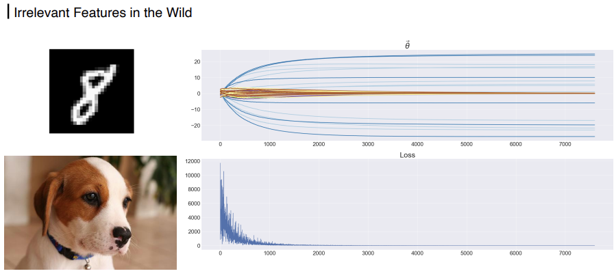
Implementation for n Features
15

Slide 16
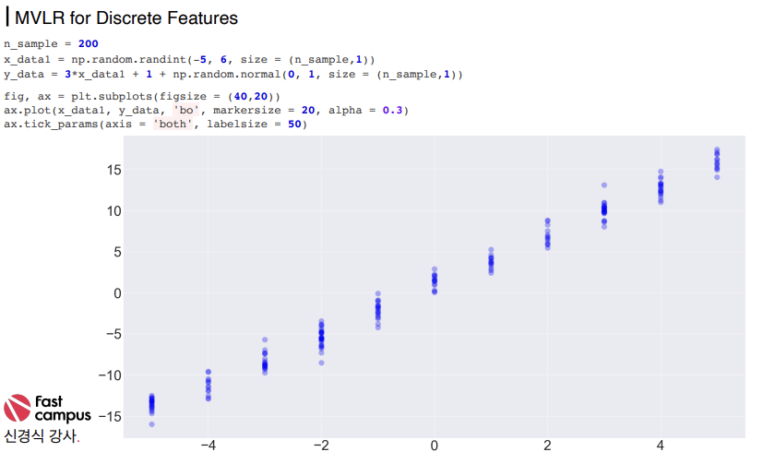
Implementation for n Features
16

Slide 17
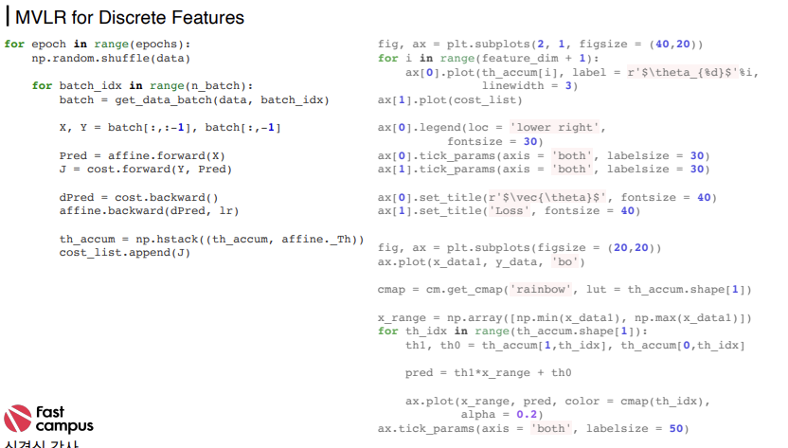
Implementation for n Features
17

Slide 18
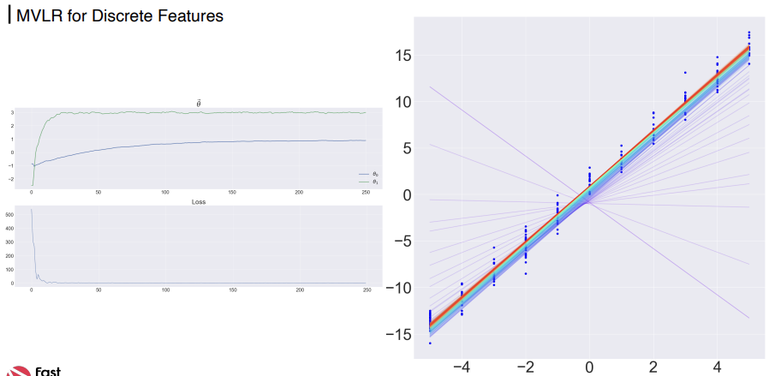
Implementation for n Features
18

Slide 19



THANKS FOR WATCHING

