Slide 1
Uploading Datasets
Daniel Chen

Slide 2
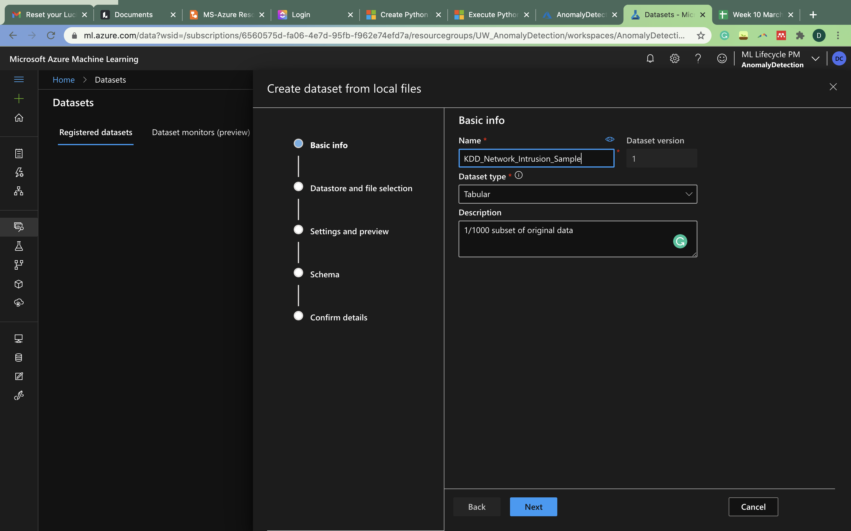

Slide 3
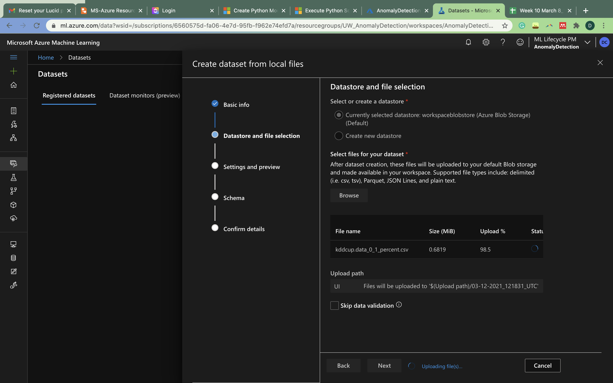

Slide 4
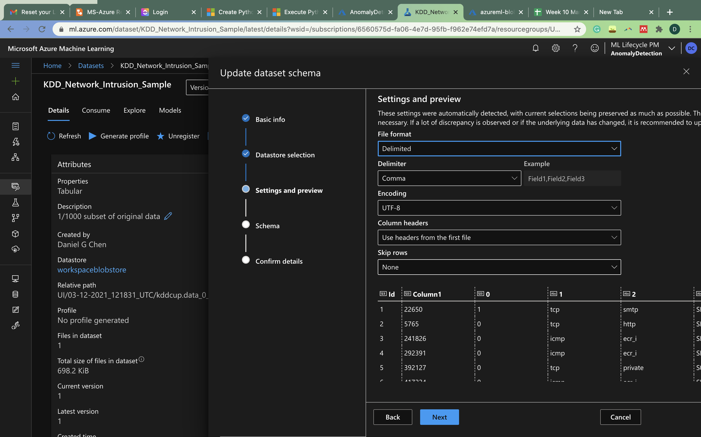

Slide 5
