Slide 1
Quantification of Formate by HPLC
Learning objectives
Outline
Understand how chromatography separates compounds and how an HPLC is built
Read chromatogram terms and units: t₀, void volume, FT, column volume
Back-calculate formate concentrations and judge reliability with %CV and %RE
# | Topic
2 | Principles of chromatography
3 | HPLC in brief
4 | Reading a chromatogram
5 | Units and the void volume
6 | Flow-through (FT)
7 | Parameters that shape a chromatogram
8 | Quantification: external calibration
9 | Procedure (summary)
10 | %RE, %CV and acceptance limits
App. | Evidence for %RE and %CV, references
Analyte
Formate, a metabolite in aerobic and micro-aerobic E. coli cultures [3, p.10]
Notation
'CV' means both column volume and coefficient of variation. Here column volume is written out and the coefficient of variation is written %CV. FT = flow-through.

Slide 2
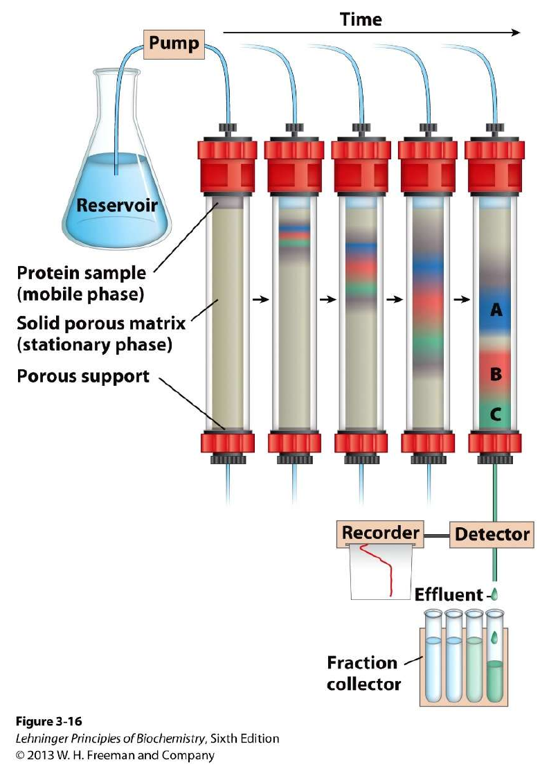
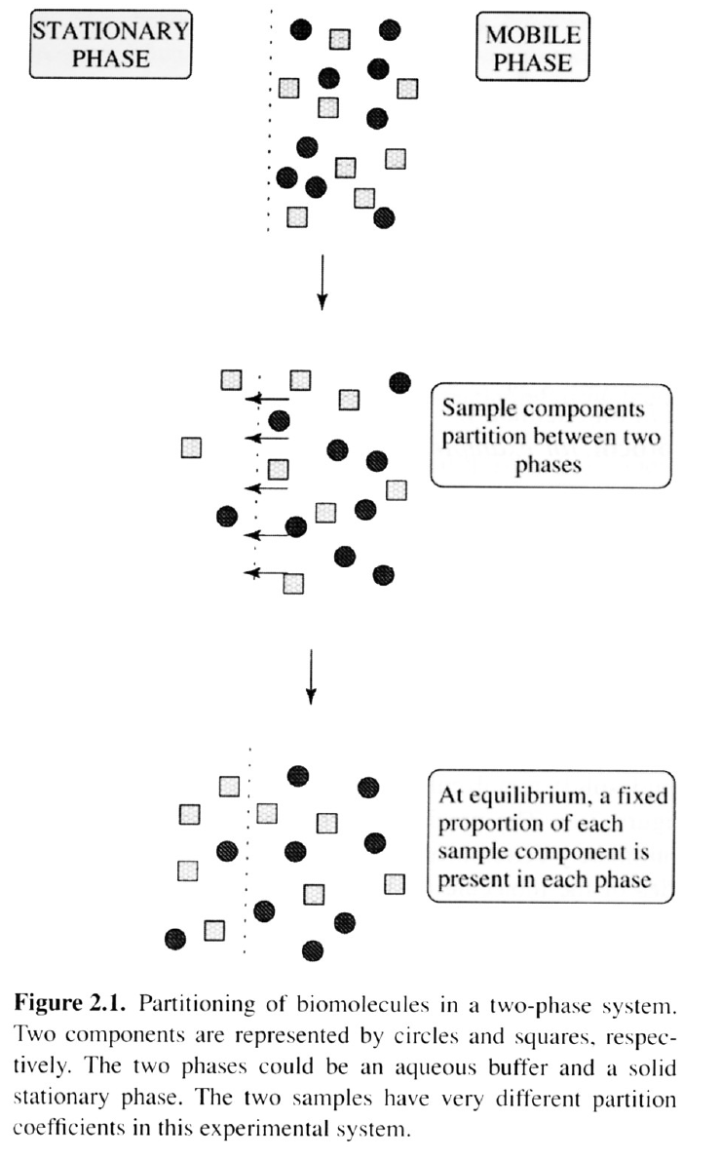
Principles of Chromatography
Compounds separate because each spends a different share of time in the stationary phase (fixed solid or liquid) and the mobile phase (flowing liquid) [1, p.12]
Partition coefficient K = C_{s}/C_{m}: the larger K, the longer a compound is retained [1, p.13–14]
K depends on temperature, pH and solvent polarity, which are tuned to optimize separation [1, p.15]
Modes: charge (ion exchange), size (size exclusion), hydrophobicity (reversed phase), specific binding (affinity) [1, p.16–25]
Formats: open column, FPLC, HPLC carry out the same modes [1, p.10–11]
Protein purification is preparative; today's HPLC quantification is analytical [1, p.16, 22]
Fig. 1. Column chromatography. Source: [2], Fig. 3-16 (© 2013 W. H. Freeman); reproduced in [1, p.12]
Fig. 2. Partitioning between two phases. Source: [1, p.14], Figure 2.1 (book not named)

Slide 3
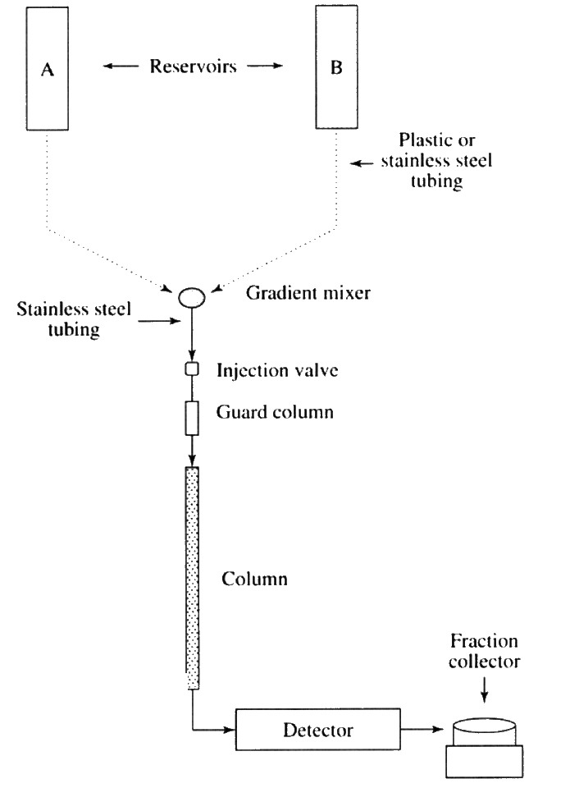
HPLC in Brief
The mobile phase is pumped at high pressure through a column packed with small particles, giving high resolution [1, p.29; 3, p.3]
Reservoir → (degassing) → pump → injector → guard and analytical column → detector (Fig. 3) [1, p.29]
Detectors: UV, fluorescence, refractive index (RI) [1, p.29]. RI is universal but less sensitive and temperature-sensitive [5]
Mode | Stationary / mobile phase · notes
Normal phase | Polar / non-polar. Less polar mobile phase → less retention [3, p.4]
Reversed phase | Hydrophobic / water + organic solvent. Polar analytes elute first [3, p.5]
Ion exchange | Charge differences [3, p.3]
Size exclusion | Molecular size differences [3, p.3]
Column and mobile phase in this lab
[to be filled in] — check the mode in the table once the column is fixed
Fig. 3. A typical HPLC system. Source: [1, p.29], Figure 2.20 (book not named)

Slide 4
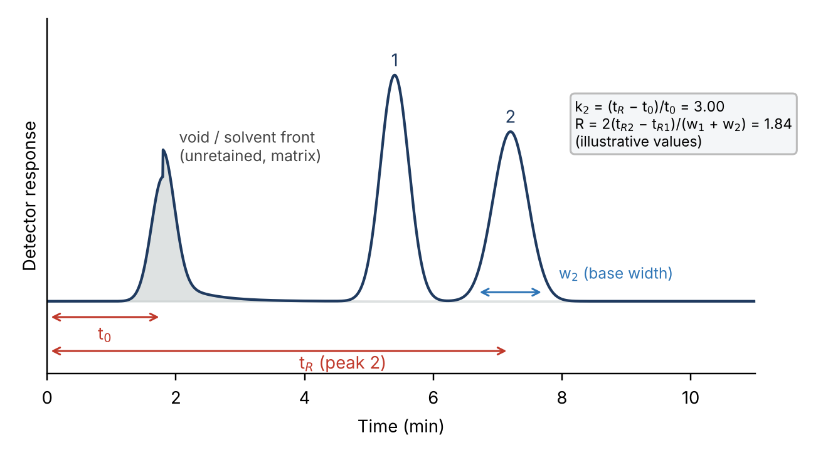
Reading a Chromatogram
Term | Equation · meaning | Source
t_{R}, t₀ | Retention time / time of an unretained compound | [3, p.6]
k | k = (t_{R} − t₀)/t₀ | [3, p.6]
α | α = k₂/k₁ | [3, p.6]
R | 2(t_{R2} − t_{R1})/(w₁ + w₂); 1.5 = baseline, 2 preferred | [3, p.7]
N | 5.54 (t_{R}/w_{1/2})² | [13]
Purnell | R = (√N/4)·((α−1)/α)·(k/(1+k)) | [6]
van Deemter | H = A + B/u + C·u (optimum flow) | [7]
Tailing T | W_{0.05}/2f (at 5% height) | [12]
Fig. 4. Elements of a chromatogram (schematic, illustrative values). Definitions from [3, p.6–7]
Reading order
① Compare with a blank to spot void peaks → ② match t_{R} with the standard → ③ quantify by area. Doubling R needs 4× N, so adjust α first [13]

Slide 5
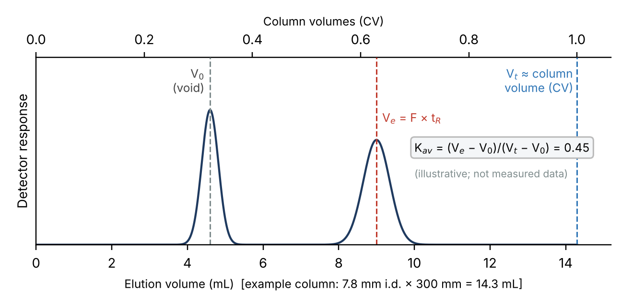
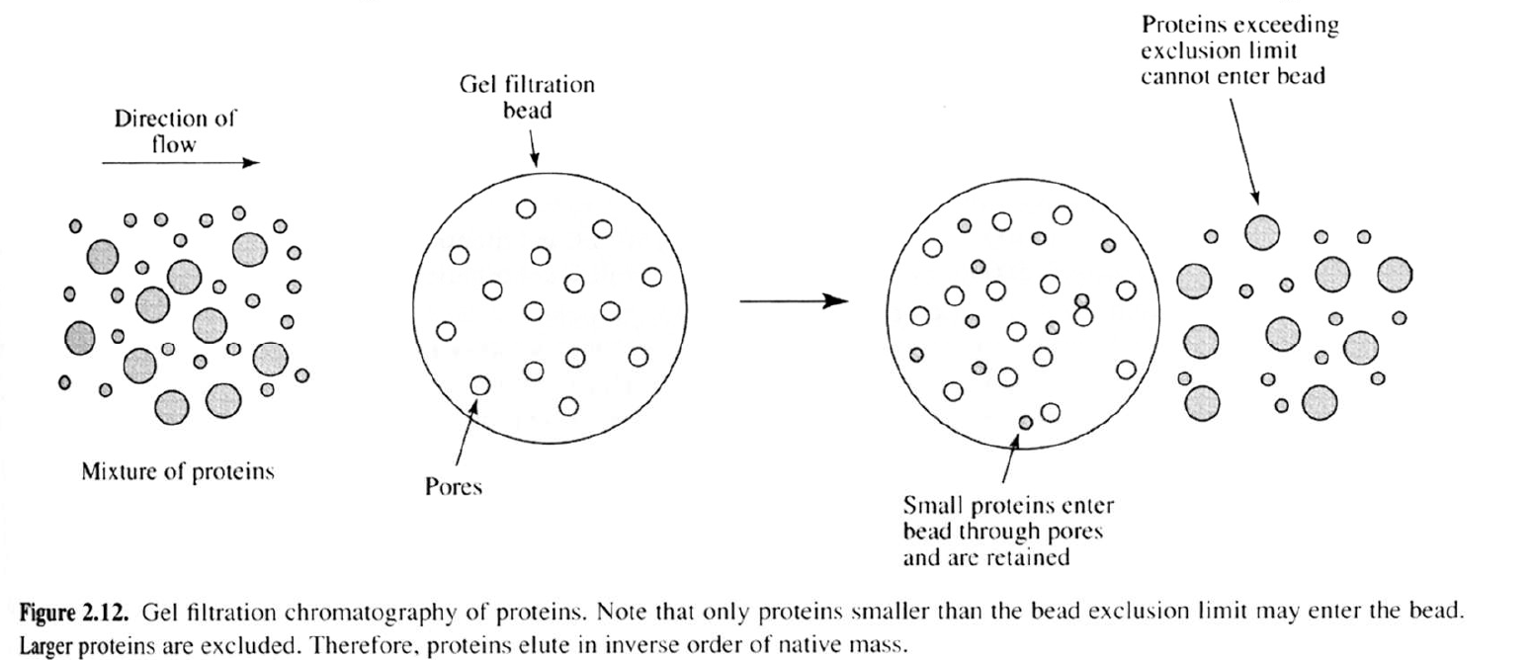
Units and the Void Volume
Column volume = packed bed volume = πr²L (same as bed volume) [9]
V_{e} = F × t_{R}, V₀ = F × t₀, V_{t} ≈ column volume
E.g. 7.8 mm × 300 mm → about 14.3 mL; at 0.6 mL/min about 24 min per column volume (example)
Size exclusion separates between V₀ and V_{t}: K_{av} = (V_{e} − V₀)/(V_{t} − V₀) [9]
Void volume: cautions
Large peaks near the void (medium salts, matrix) are not the analyte
t₀ can include tubing volume (extra-column volume) [5]
Keep k large enough that the first peak clears the void [5]
t₀ changes with flow, V₀ does not → compare by volume
Fig. 5. V₀, V_{e} and V_{t} on a volume axis (schematic, illustrative values) [9]
Fig. 6. Gel filtration: molecules above the exclusion limit elute in the void. Source: [1, p.18], Figure 2.12

Slide 6
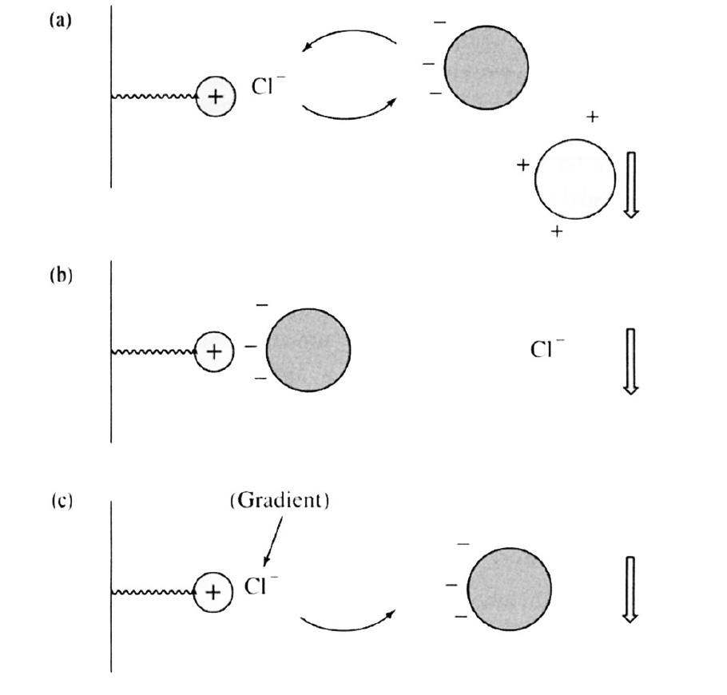
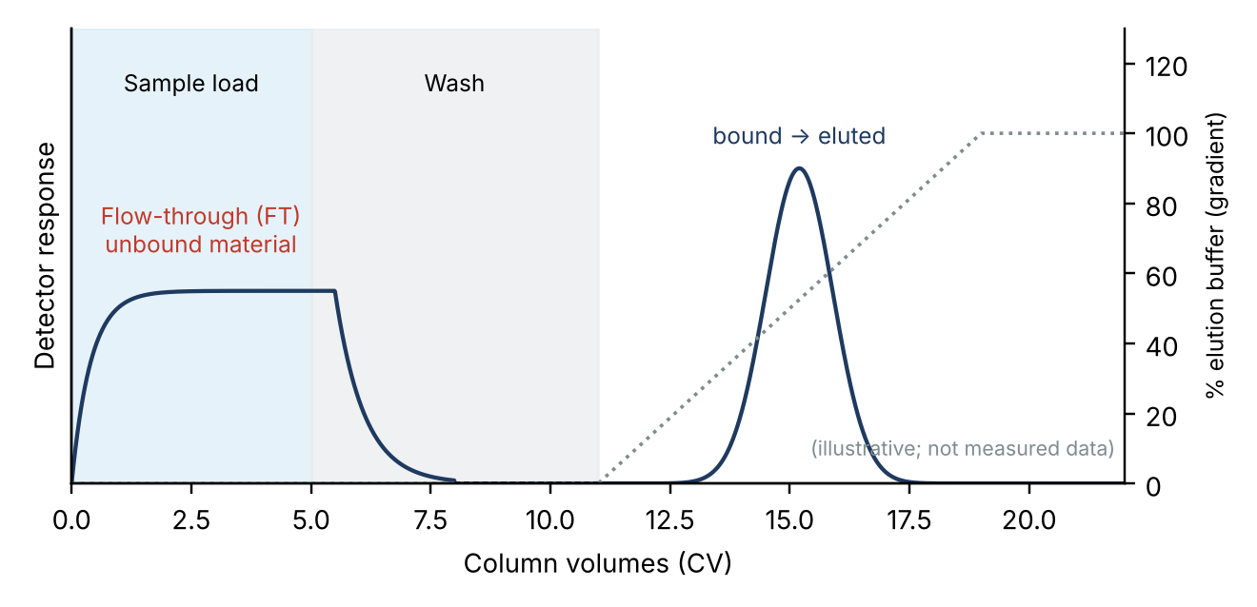
Flow-Through (FT)
FT: in bind–elute modes (ion exchange, affinity), the fraction that passes through unbound during loading. Molecules with the same charge as the resin go straight through [1, p.21]
FT: cautions
Keep the FT: target found there means failed binding or overload
Match pH and ionic strength of the load to the equilibration buffer (desalt first) [1, p.21]
Wash until the baseline returns, then elute
Net charge changes with pH [1, p.21]
Fig. 7. Ion exchange: positively charged proteins pass straight through. Source: [1, p.21], Figure 2.11
Relevance to this lab
If formate is separated isocratically by retention differences, there is no FT; the matching idea is the void peak (slide 5). (Confirm once the column is fixed.)
Fig. 8. FT peak during loading and gradient elution (schematic, illustrative values)

Slide 7
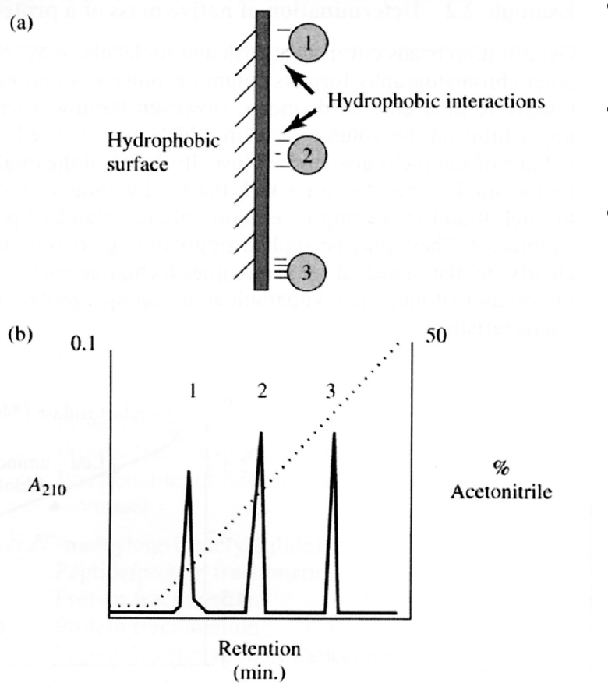
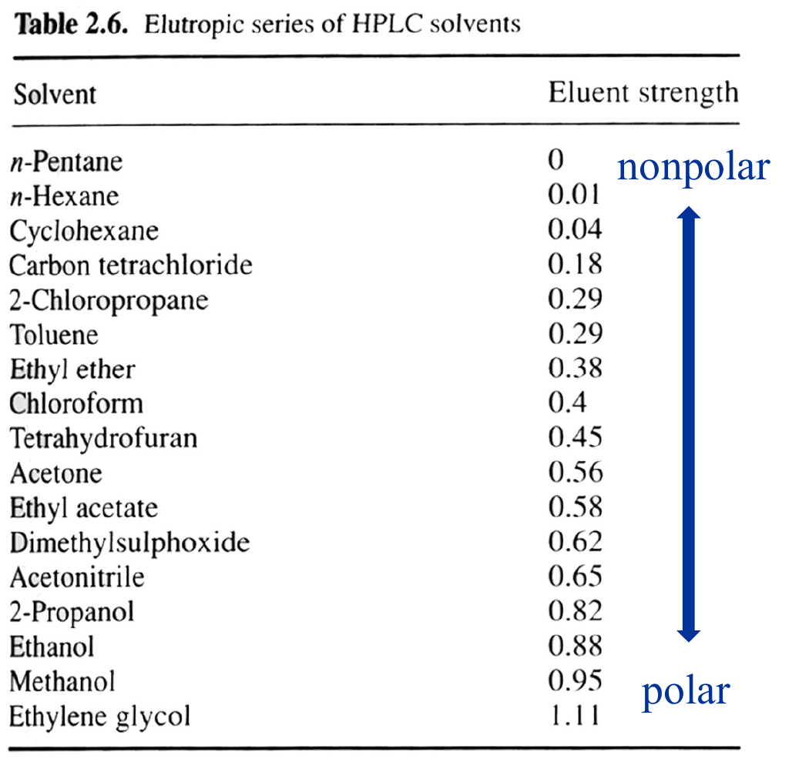
Parameters That Shape a Chromatogram
Parameter | Retention t_{R} | Width · separation | Watch out
Flow rate F | F↑ → t_{R}↓, pressure↑ | Optimum flow exists [7] | Same flow for standards and samples
Column temp. | Usually T↑ → t_{R}↓ [1, p.15] | Viscosity↓ → narrower peaks | Stay within limits; stable T for RI
Eluent strength | RP: organic↑ → t_{R}↓ [1, p.22] | Changes k and α | One bottle per sequence
pH · ionic strength | Ionization of weak acids/bases | Changes α | Prepare pH carefully
Length L · particle d_{p} | L↑ → t_{R}↑ | N ∝ L/d_{p} [3, p.8] | Pressure ∝ L/d_{p}²
Stationary phase | Sets the interaction | Large change in α | Choice of mode [3, p.3–5]
Injection · solvent | Shifts when overloaded | Broader peaks | Sample solvent close to eluent
Detector settings | Little effect | Shape, sensitivity | RI: T and flow sensitive [5]
Fig. 9. Reversed phase: more acetonitrile elutes compounds in order of hydrophobicity. [1, p.22], Fig. 2.13
Fig. 10. Eluent strength of HPLC solvents. [1, p.30], Table 2.6
Key point
Conditions change retention → run standards and samples under identical conditions

Slide 8
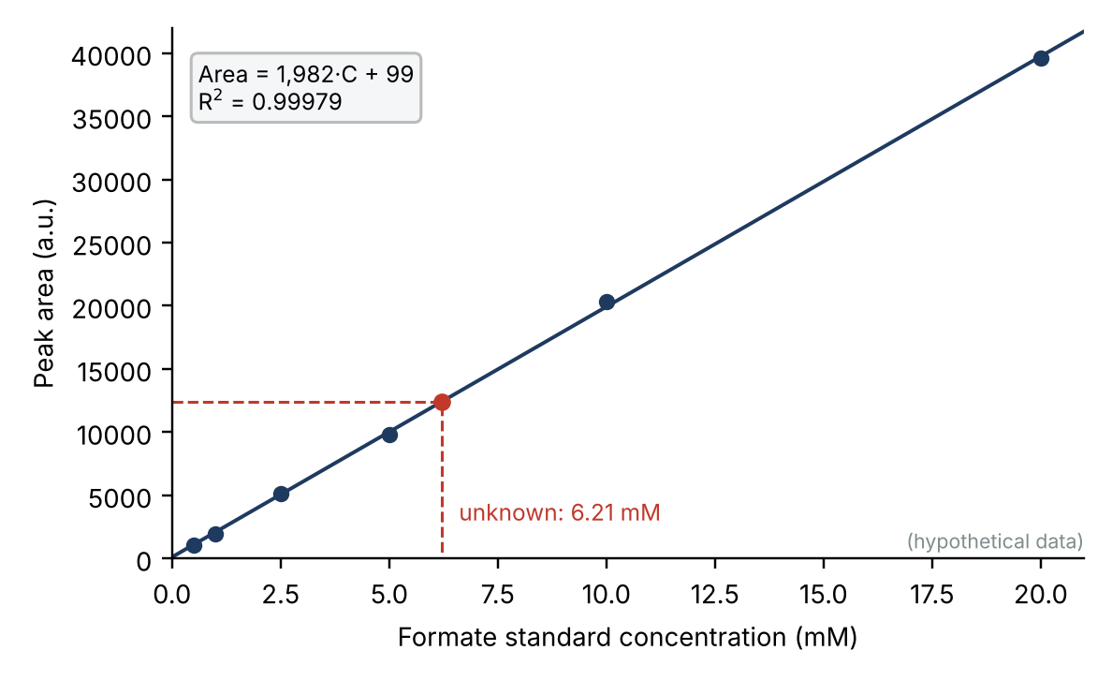
Quantification: External Calibration
Area ∝ concentration → build a calibration curve from standards and read samples from it (absolute calibration) [4]
Standards: 100 mM stock → 2-fold serial dilution, 5 levels (100–6.25 mM) → filter → vial insert [4]
Formate: sodium formate 68.01 g/mol → 100 mM in 100 mL = 0.680 g
Samples: 100 µL broth diluted 10× → centrifuge → filter → −20 °C [3, p.10]
C_{broth} = (A − b)/a × 10. E.g. A = 12,400 → 6.21 mM → 62.1 mM (hypothetical)
Cautions
Never extrapolate; dilute and re-run out-of-range samples [14, p.5, p.8]
Do not judge by R² alone; check back-calculated %RE [14, p.6]
Remember the dilution factor of 10
The handout range may sit above formate levels [to be checked]
Fig. 11. Calibration and back-calculation (6 hypothetical levels). Area = 1982·C + 99, R² = 0.99979

Slide 9
Procedure (Summary) and Conditions
# | Step | Check
1 | Prepare formate standards: stock → serial dilution, 5–6 levels | Low levels covered; QCs from a separate stock [14, p.2]
2 | Filter samples: syringe filter → vial insert → vial | Pore size and material [fill in]
3 | Prepare the load: blank → control → standards (low→high) → samples → QC | Avoid carry-over; same solvent
4 | Compare peaks with controls: void/system peaks, t_{R} vs standard | No interference; R ≥ 1.5
5 | Compare areas with identical integration | Stable baseline; tailing
6 | Calibrate and back-calculate: y = ax + b → conc. × dilution | In range; no extrapolation
7 | Compute %CV and %RE | CV on back-calculated conc. [14, p.6]
8 | Judge against limits | Limits [ ± __ %, ≤ __ % ]
Conditions (to be filled in)
Item | Value
Column | [ ]
Mobile phase | [ ]
Flow rate | [ ]
Column temp. | [ ]
Detector | [ ]
Injection volume | [ ]
Run time | [ ]
Formate t_{R} | [ from standard ]

Slide 10
%RE, %CV and Acceptance Limits
%RE = (mean measured − nominal)/nominal × 100 [14, p.6, p.9] %CV = SD/mean × 100 on back-calculated concentrations [14, p.6]
Back-calculated standards (hypothetical)
Nominal (mM) | Area | Back-calc. (mM) | %RE
0.5 | 1,080 | 0.495 | −0.99 %
1 | 1,960 | 0.939 | −6.10 %
2.5 | 5,160 | 2.553 | +2.13 %
5 | 9,800 | 4.894 | −2.12 %
10 | 20,300 | 10.191 | +1.91 %
20 | 39,600 | 19.927 | −0.36 %
Item | HPLC, common criteria [10, 11] | LBA white paper [14, Table I]
Standard RE | ±15% (LLOQ ±20%) | ±20% (LLOQ ±25%)
Standard CV | ≤15% (LLOQ ≤20%) | <20% (LLOQ 25%)
Pass rate | ≥75% of non-zero standards | ≥75%
No. of standards | ≥6 | ≥6, in duplicate
R² | — | Not set by FDA/EMA; ANVISA 0.99
QC replicates, n = 3 (hypothetical)
Level | Nominal | Mean | SD | %CV | %RE
Low | 1.5 | 1.50 | 0.033 | 2.21% | −0.07%
Mid | 7.5 | 7.55 | 0.094 | 1.24% | +0.68%
High | 15 | 15.11 | 0.160 | 1.06% | +0.75%
Caution
[14] covers ligand binding assays (p.2), so its limits are wider than for HPLC. HPLC column not checked against the originals → verify before citing. Course limits: [ ± __ %, ≤ __ % ]

Slide 11
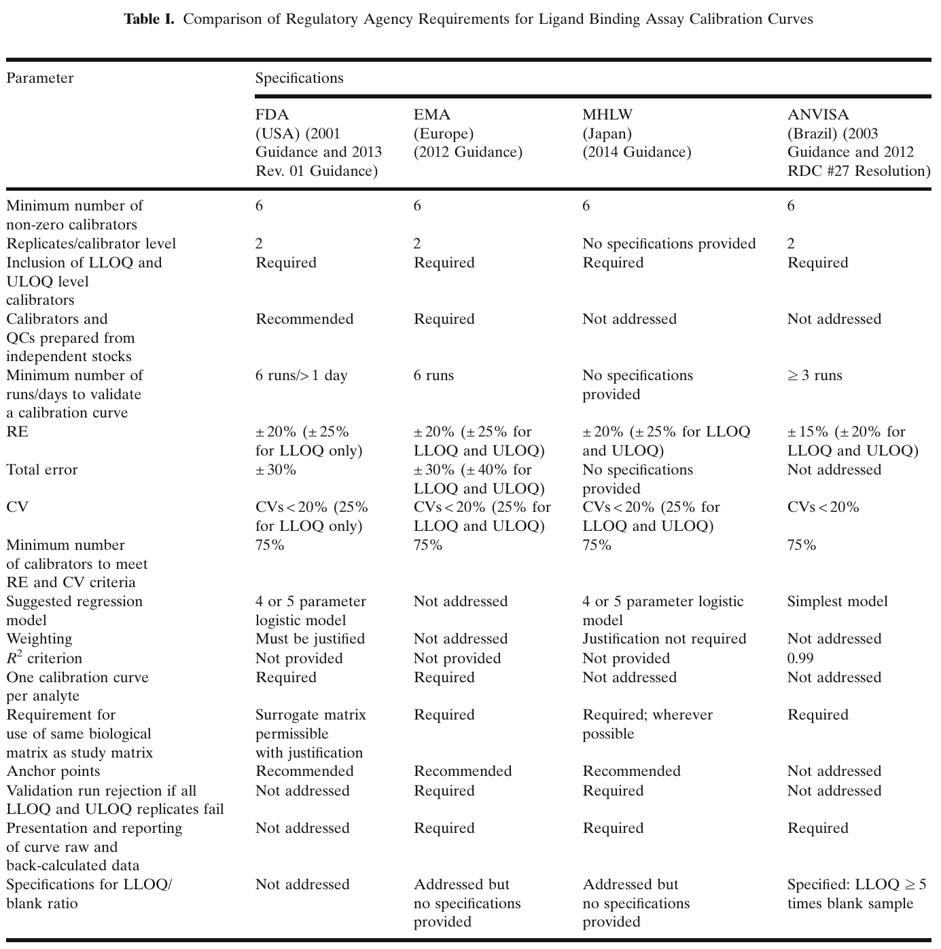
Appendix A. Evidence for %RE and %CV (Azadeh et al., 2017)
RE = (experimental − theoretical)/theoretical [14, p.6]; %Bias formula [14, p.9]
≥75% of calibrators, including LLOQ and ULOQ, must meet the RE and CV limits [14, p.6]
Report CVs of back-calculated concentrations, not instrument response [14, p.6]
At least six non-zero standards, including LLOQ and ULOQ [14, p.4]
Prepare calibrators and QCs from separate stocks [14, p.2]
R² and RMSE may not reflect the error of reported results [14, p.6]
Scope
The paper covers PK ligand binding assays (p.2) and notes that chromatographic responses are typically linear in concentration (p.2). Use its principles, not its numbers, for HPLC.
Fig. 12. Regulatory requirements for LBA calibration curves. Source: [14, p.3], Table I (CC BY 4.0)

Slide 12
Appendix B. Editing Rules and How We Apply Them
Masking calibrators [14, p.8]
Application here
Edit only for a documented, assignable cause
Mask CV failures first, then exclude one at a time by highest bias
No two consecutive calibrators; masked ≤ 25%
At least six valid points must remain
Masking LLOQ or ULOQ narrows the range to the next calibrator
Never exclude calibrators to make QCs pass
Re-run out-of-range samples after dilution [14, p.8]
Match the calibration range to expected levels [14, p.5]
EMA 2012 is cited as recommending that the zero calibrator not be used to calculate chromatographic calibration curves [14, p.15; 15]
Example: masking a 5 ng/mL calibrator (RE 56%, CV 44.2%) brought others within limits [14, p.14, Table III]

Slide 13
References (1/2)
Status: ● verified in the supplied file ◐ verified via a secondary source (search result or reference list); original not opened ○ not verified (commonly cited bibliographic data; check before citing)
No. | Reference | Used in | Status
1 | Class material: "Protein purification & Structure determination", UNIST, Fall 2026, 53 slides (ProteinEng_Protein_Purification.pdf). p. = PDF slide number. | Figs. 1–3, 5–10 | ●
2 | Nelson DL, Cox MM. Lehninger Principles of Biochemistry, 6th ed. New York: W. H. Freeman and Company; 2013. Figure 3-16. (credit printed on [1] p.12) | Fig. 1 | ●
3 | Ryu H, Bassey BF. "13th Week — Metabolite analysis: HPLC". ECHE34101/2 Engineering Biology Laboratory, BCE_UNIST. 11 slides (20221201and02_HPLC_Lecture_1.pdf). | Slides 2–4, 7–9 | ●
4 | Class handout: "Standard preparation for HPLC" (in-class material). Absolute calibration method; standard preparation. | Slides 8–9 | ●
5 | Snyder LR, Kirkland JJ, Dolan JW. Introduction to Modern Liquid Chromatography, 3rd ed. Hoboken, NJ: Wiley; 2010. | Slides 3–7 | ○
6 | Purnell H. The correlation of separating power and efficiency of gas-chromatographic columns. J Chem Soc 1960:1268–1274. doi:10.1039/JR9600001268 | Slide 4 | ◐
7 | van Deemter JJ, Zuiderweg FJ, Klinkenberg A. Longitudinal diffusion and resistance to mass transfer as causes of nonideality in chromatography. Chem Eng Sci 1956;5(6):271–289. | Slides 4, 7 | ○
8 | Ettre LS. Nomenclature for chromatography (IUPAC Recommendations 1993). Pure Appl Chem 1993;65(4):819–872. doi:10.1351/pac199365040819 | Terminology | ○
9 | GE Healthcare (now Cytiva). Size Exclusion Chromatography: Principles and Methods, 18-1022-18 (copy found: Edition AI). Definitions of V₀, V_{e}, V_{t}, column volume. | Slide 5 | ◐
10 | ICH. M10: Bioanalytical Method Validation and Study Sample Analysis. Step 4, 24 May 2022. | Slide 10 | ◐
11 | US FDA. Bioanalytical Method Validation: Guidance for Industry. May 2018. | Slide 10 | ○
12 | USP–NF General Chapter <621> Chromatography (tailing factor, system suitability). | Slide 4 | ○
13 | Analytics-Shop. "Terms and equations used in HPLC explained". https://analytics-shop.com/gb/hplc-definition-equations | Slide 4 | ◐

Slide 14
References (2/2)
No. | Reference | Used in | Status
14 | Azadeh M, Gorovits B, Kamerud J, MacMannis S, Safavi A, Sailstad J, Sondag P. Calibration curves in quantitative ligand binding assays: recommendations and best practices for preparation, design, and editing of calibration curves. AAPS J. 2017 (received 1 Aug 2017, accepted 28 Aug 2017). doi:10.1208/s12248-017-0159-4. Open Access (CC BY 4.0). p. = PDF page (1–16). | Slides 8–10, appendix, Fig. 12 | ●
15 | EMA. Guideline on bioanalytical method validation. EMEA/CHMP/EWP/192217/2009, July 21, 2011. (reference 9 of [14]) | Slide 10, appendix | ◐
16 | US FDA. Guidance for industry: bioanalytical method validation. May 2001. (reference 10 of [14]) | Slide 10 | ◐
17 | US FDA. Draft guidance for industry: bioanalytical method validation (Revised). September 2013. (reference 11 of [14]) | Slide 10 | ◐
18 | Viswanathan CT, Bansal S, Booth B, DeStefano AJ, Rose MJ, Sailstad J, et al. Quantitative bioanalytical methods validation and implementation: best practices for chromatographic and ligand binding assays. Pharm Res. 2007;24(10):1962–73. (reference 15 of [14]) | Slide 10 | ◐
Note: the original book of the "Figure 2.x" and "Table 2.x" items in [1] is not named (only the Figure 2.23 caption says "adapted from Doonan, 1996"; not used here). [15]–[18] were taken from the reference list of [14]; the originals were not opened.

Slide 15
Figure and Table Sources
No. | Content | Location | Original caption / label (as printed) | Credit
Fig. 1 | Lehninger Fig. 3-16 (column chromatography) | [1] p.12 | "Figure 3-16 Lehninger Principles of Biochemistry, Sixth Edition © 2013 W. H. Freeman and Company" | [2]
Fig. 2 | Figure 2.1 (partitioning) | [1] p.14 | "Partitioning of biomolecules in a two-phase system. Two components are represented by circles and squares, respectively. The two phases could be an aqueous buffer and a solid stationary phase. The two samples have very different partition coefficients in this experimental system." | Book not named
Fig. 3 | Figure 2.20 (HPLC system) | [1] p.29 | "Overview of typical HPLC system. Low-pressure region of the system where tubing may be plastic is denoted by dashed line. Solid lines denote stainless steel tubing required due to high pressure." | Book not named
Figs. 4, 5, 8, 11 | Own schematics (illustrative values) | — | Concepts from [3] p.6–7, [9], [1] p.21, [4] | —
Fig. 6 | Figure 2.12 (gel filtration) | [1] p.18 | "Gel filtration chromatography of proteins. Note that only proteins smaller than the bead exclusion limit may enter the bead. Larger proteins are excluded. Therefore, proteins elute in inverse order of native mass." | Book not named
Fig. 7 | Figure 2.11 (ion exchange) | [1] p.21 | "A typical ion exchange experiment. … Note that positively-charged proteins pass straight through the stationary phase and that proteins with different net charge are separated by the gradient of NaCl (Figure 2.7)." | Book not named
Fig. 9 | Figure 2.13 (reversed phase) | [1] p.22 | "Reversed phase chromatography. (a) Samples interact with nonpolar stationary phase by hydrophobic interaction and are eluted by increase in hydrophobicity of mobile phase. …" | Book not named
Fig. 10 | Table 2.6 (elutropic series) | [1] p.30 | "Table 2.6. Elutropic series of HPLC solvents" | Book not named
Fig. 12 | Table I (LBA calibration requirements) | [14] p.3 | "Table I. Comparison of Regulatory Agency Requirements for Ligand Binding Assay Calibration Curves" | [14], CC BY 4.0
Note: class-material figures were rendered at 200 dpi and cropped without altering content (overlapping slide text removed in Fig. 3). Check copyright for your distribution. Fig. 12 is reproduced under CC BY 4.0 with attribution.

