Slide 1
What is
SYN Flooding?
Respondent: 265149-周明宇
Course: Computer Networking
2026/11/07

Slide 2
01
02
What is SYN flood
TCP handshake
03
Attack process
04
Solutions
05
Present situation
06
Summary

Slide 3
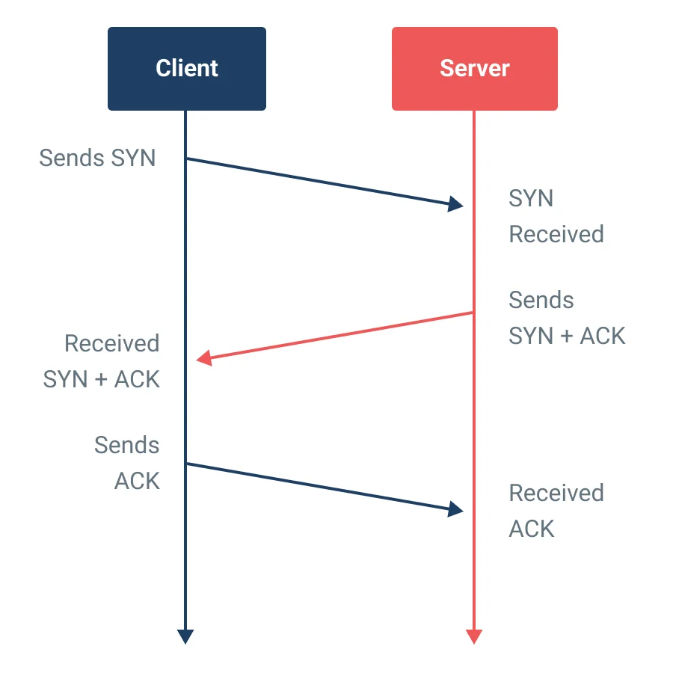
What is SYN flooding?
「
SYN Flooding
A denial-of-service attack on TCP. The attacker sends a flood of SYN packets, usually with fake source IPs, and never finishes the three-way handshake. Every half-open connection takes a slot in the server's SYN queue. Once the queue is full, real users can no longer connect.
「

Slide 4
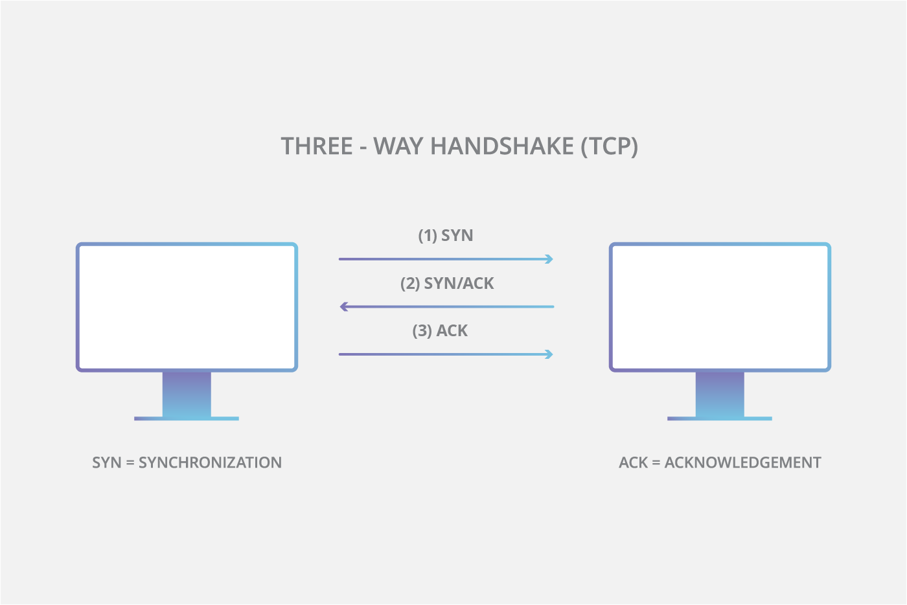
Normal handshake vs SYN flood
Step | Normal client | SYN flood attacker
1. SYN | Sends one SYN from its real IP | Floods SYNs from spoofed IPs
2. SYN-ACK | Server replies, stores half-open entry | Reply goes to a fake address
3. ACK | Client replies, connection opens | No ACK, entry waits for timeout
Server state | Entry moves to accept queue | SYN queue fills with half-open entries
Result | Service works normally | Real users are refused

Slide 5
How the attack works
Half-open state: after sending SYN-ACK, the server keeps the connection in SYN_RECV and waits for the final ACK.
Limited queue: the SYN queue (backlog) has a fixed size, for example a few hundred to a few thousand entries.
Spoofed sources: fake source IPs make the attacker hard to trace and mean the ACK never comes back.
Long timeout: Linux retransmits SYN-ACK 5 times by default, so one entry can stay for about a minute.
Distributed attack: botnets send SYNs from many real machines at once, which defeats simple per-IP blocking.

Slide 6
Possible solutions
SYN cookies: the server encodes connection info into the SYN-ACK sequence number and stores nothing until a valid ACK returns.
Tune the queue: enlarge the backlog and reduce SYN-ACK retries so half-open entries expire faster.
Firewall / SYN proxy: a firewall or load balancer completes the handshake first and passes only real clients to the server.
Ingress filtering: ISPs drop packets with forged source addresses at the network edge (BCP 38).
Cloud scrubbing: CDN and anti-DDoS providers absorb very large floods across many data centers.

Slide 7
Comparing the solutions
Solution | Where | Strength | Limit
SYN cookies | Server OS | No state for half-open | Loses some TCP options
Queue tuning | Server OS | Simple config change | Only delays exhaustion
SYN proxy | Firewall / LB | Shields all servers | Proxy can be overloaded
DDoS scrubbing | ISP / CDN | Absorbs Tbps floods | Costs money, adds detour
In practice: these methods are combined. SYN cookies protect each host, and edge or cloud defenses stop the traffic volume before it reaches the server.
Root cause: TCP gives server memory to a peer before the peer proves its address, so no single fix removes the problem.

Slide 8
Present situation
An old attack: SYN flooding became widely known in 1996; RFC 4987 (2007) documents the standard mitigations.
Still common: SYN floods remain one of the most frequent network-layer DDoS vectors in industry reports such as Cloudflare's.
Default defenses: Linux turns on SYN cookies automatically when the SYN queue overflows (tcp_syncookies = 1).
Bigger scale: botnets of IoT devices, such as Mirai, made multi-hundred-Gbps floods possible, so defense moved to the cloud.
New protocols: QUIC (HTTP/3) adds an address check with Retry tokens, using the same idea as SYN cookies.

Slide 9
Summary
What: SYN flooding fills the server's SYN queue with half-open connections.
Why: TCP reserves state before the client proves it is real.
Solutions: SYN cookies, queue tuning, SYN proxies, source filtering and cloud scrubbing.
Today: single servers are well protected, but large distributed floods still need network-level defense.

Slide 10
Thanks for your listening!
Respondent: 265149-周明宇
Course: Computer Networking
2026/11/07

