Slide 1
Differences among
HTTP/1.0, 1.1, 2.0, 3.0
Respondent: 265149-周明宇
Course: Computer Networking
2026/11/03

Slide 2
01
02
Overview of Versions
HTTP basics
03
HTTP/1.0 vs 1.1
04
HTTP/2
05
HTTP/3 & QUIC
06
Comparison

Slide 3
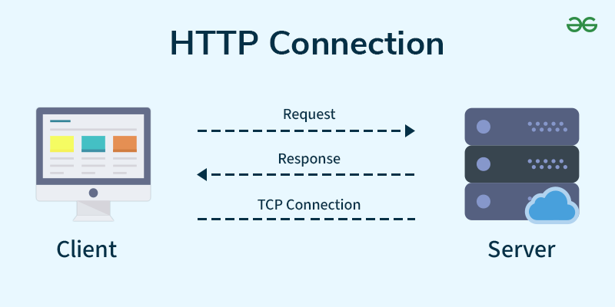
What is HTTP?
「
」
HyperText Transfer Protocol
HTTP is the Web's application-layer protocol. A client sends a request (method, URL, headers) and a server returns a response (status code, headers, body). HTTP is stateless; cookies add state on top. Methods such as GET and status codes such as 404 have barely changed since the 1990s. Each new version changes only how these messages are carried over the network.
「
」

Slide 4
Overview of Versions
Version | Year / RFC | Transport & format | Key idea
HTTP/1.0 | 1996, RFC 1945 | TCP, plain text | One request per connection
HTTP/1.1 | 1997, RFC 2068 (2616) | TCP, plain text | Persistent connections
HTTP/2 | 2015, RFC 7540 | TCP, binary frames | Multiplexed streams
HTTP/3 | 2022, RFC 9114 | QUIC over UDP | No TCP head-of-line blocking
Same semantics: every version uses the same methods, status codes and headers, so websites did not need to be rewritten to upgrade.
What changes: the connection model, the message format and finally the transport protocol itself.

Slide 5
HTTP/1.0 vs HTTP/1.1
Feature | HTTP/1.0 | HTTP/1.1
Connection | New TCP connection per object | Persistent (keep-alive) by default
Requests | One at a time | Pipelining allowed, responses in order
Host header | Not required: one site per IP | Required: many sites per IP
Caching | Expires, If-Modified-Since | Cache-Control, ETag
Transfer | Whole body, length known | Chunked transfer, range requests
Effect: HTTP/1.0 pays about 2 RTTs for every object; HTTP/1.1 pays the TCP handshake once and then reuses the connection, so pages with many images load much faster.

Slide 6
HTTP/2: same semantics, new delivery
Binary framing: messages are split into small binary frames that belong to numbered streams; they are faster and less error-prone to parse than text.
Multiplexing: many requests and responses interleave on one TCP connection, so a large file no longer blocks small ones at the HTTP level.
Header compression (HPACK): repeated headers such as cookies and user-agent are sent once and then referenced, saving bandwidth.
Priority and server push: clients can mark important resources, and servers may send files before they are requested; push saw little use and browsers have dropped it.
Limit: all streams still share one TCP connection, so one lost packet stalls every stream.

Slide 7
HTTP/3: replacing TCP with QUIC
New transport: HTTP/3 runs on QUIC, a transport protocol built on top of UDP instead of TCP.
Independent streams: QUIC recovers lost packets per stream, so a loss only delays the stream it belongs to.
Faster setup: TLS 1.3 is built into QUIC, so a new connection needs 1 RTT and a resumed one can send data at once (0-RTT).
Connection migration: a connection ID, not the IP address, identifies the connection, so it survives a switch from Wi-Fi to 4G.
Always encrypted: almost all QUIC headers are encrypted, which protects privacy and stops middleboxes from interfering.

Slide 8
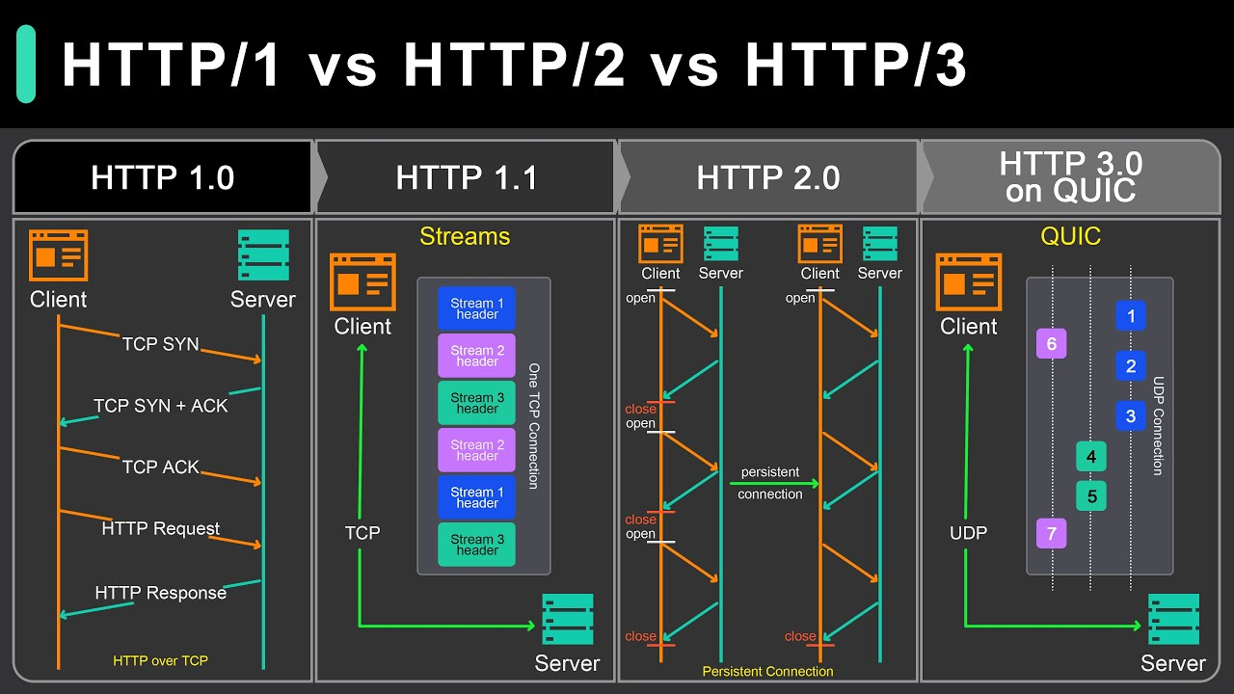
Comparison of the four versions
Version | Connection use | Head-of-line blocking | Setup RTTs | Encryption
HTTP/1.0 | One per object | Each object waits for setup | 1 per object | Optional
HTTP/1.1 | Persistent | Responses must stay in order | 1-3, once | Optional
HTTP/2 | One, multiplexed | Only at TCP level | 2-3, once | TLS in practice
HTTP/3 | One QUIC link | Removed | 1, or 0 | Always

Slide 9
Which version is used today?
Wide support: all major browsers, CDNs and large sites support HTTP/2 and HTTP/3.
Upgrade path: a browser often starts on HTTP/2, learns from the Alt-Svc header or a DNS HTTPS record that HTTP/3 is available, then switches to QUIC.
Fallback: if a firewall blocks UDP, the browser simply falls back to HTTP/2 over TCP.
HTTP/1.1 is still common: simple APIs, internal services and tools such as curl rely on it.
My view: HTTP's evolution is about latency, not new features; each version removes one more source of waiting while staying compatible.

Slide 10
Summary
HTTP/1.0: one request per TCP connection, simple but slow.
HTTP/1.1: persistent connections, Host header and better caching; still the baseline today.
HTTP/2: binary frames and multiplexing on one connection, but TCP head-of-line blocking remains.
HTTP/3: QUIC over UDP with built-in TLS 1.3, fixing TCP-level blocking and speeding up setup.
Overall: the meaning of HTTP never changed; only the way it travels did.

Slide 11
Thanks for your listening!
Respondent: 265149-周明宇
Course: Computer Networking
2026/11/03

