Slide 1

MPEG VIDEO COMPRESSION
CSC591M -- FALL 1997

Slide 2
VIDEO DATA REQUIREMENTS
30 Frames / Second *
640x480 Pixels / Frame (VGA) *
3 Bytes / Pixel =
26.4 MB/second!
Or, 92 GB For a One Hour Video!
Many Computer Components Are Too Slow/Small For This

Slide 3
MPEG VIDEO STANDARDS
MPEG-I
  Targeted for 1.2-1.5 Mb/sec
  352x240, 30 Frames / Second
  "VHS quality"

Slide 4
STANDARDS (cont.)
MPEG-II
  targetted for 4-15 Mb/sec
  Up to 1920x1152, 30 frames/sec
  interlaced video
  "TV and HDTV quality"
MPEG-IV
  Very low bandwidth: 10-64 Kb/sec
  "videoconference quality"

Slide 5
ASSESSMENT
Best Quality / Compression Combination
An International Standard
Not Too Hard to Decode
But, Encoding Requires a Lot of Computation

Slide 6
BASIC IDEA
Use Same Spatial Compression as JPEG
Add Temporal Compression (“Motion Compensation”) As Well
  improves compression ratio by 2-4X

Slide 7
MACRO BLOCKS
Macro Block = 16x16 Pixel Region
  4 8x8 blocks of Y
  1 8x8 block (subsampled) of Cb
  1 8x8 block (subsampled) of Cr
Macro Block is Basic Unit of Temporal Coding

Slide 8
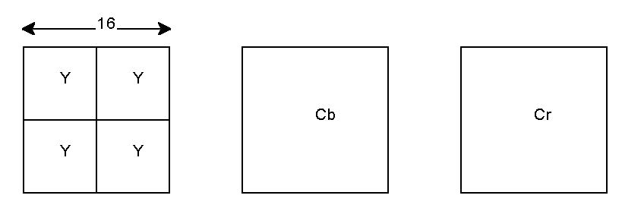
MACROBLOCKS

Slide 9
TEMPORAL ENCODING
Search Forward or Backward (or Both) in Time for a "Similar" Macro Block
Interpolated Match: Average of Forward and Backwards Block

Slide 10
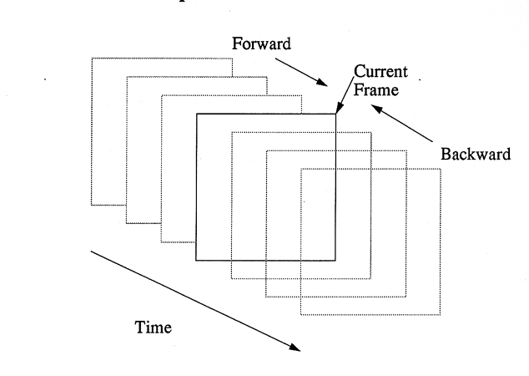

Slide 11
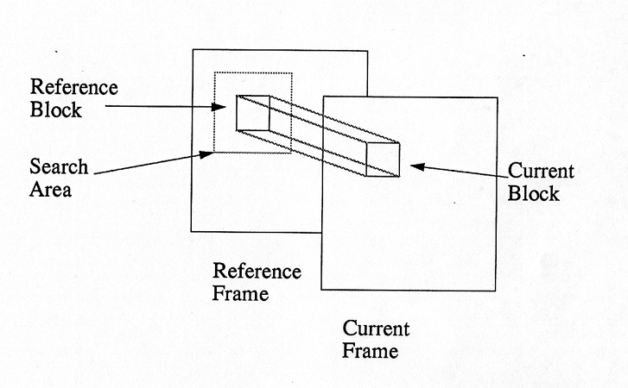
TEMPORAL ENCODING
Search a Spatial Region for a Similar Macro Block

Slide 12
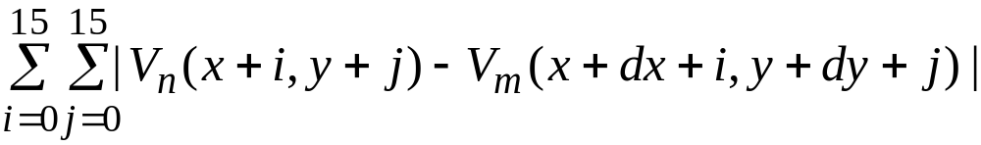
SEARCHING FOR SIMILAR MACROBLOCKS
Search Method Not Specified by Standard
Can Search on Full Pixel or Half-Pixel Boundaries
How Define "Best" Match?
  minimize absolute difference =
  where V_{n} is macroblock, V_{m} is matching macroblock

Slide 13
SIZE OF SEARCH REGION
How Big is Big Enough?
More Separation in Time --> Greater Amount of Motion

Slide 14
EXHAUSTIVE STRATEGY
Check Every Possible Match Within Some Spatial Region
Example: Offset From -15 to +15 in X and Y Directions
  961 possible matches
  7 Billion Operations/Sec

Slide 15

EXHAUSTIVE (cont.)

Slide 16
LOGARITHMIC SEARCH
Check at X, Y Offsets = 0 or +/- 2^i, Where i = 0, 1, 2, 3
  17 possible matches

Slide 17
LOGARITHMIC (cont.)

Slide 18
SHRINKING SEARCH
Search Blocks on +/- j Boundary
Move Search Center to Best Match
Decrement j and Repeat Until J = 1

Slide 19
SHRINKING (cont.)

Slide 20
HIERARCHICAL SEARCH
Filter 31x31 Search Area to 15x15 Search Area
  225 possible matches
Then Check All 4 Macro Blocks in the Best Match

Slide 21
MOTION VECTOR ENCODING
Motion Vector = X, Y Offset To Best Match
  sign is always relative to the current picture
Number of Vectors Needed
  1 for forward or backwards predictions
  2 for bi-directional (interpolated) prediction
Differentially Encoded Relative to Motion Vectors of Previous Adjacent Block
Entropy Code the Result

Slide 22
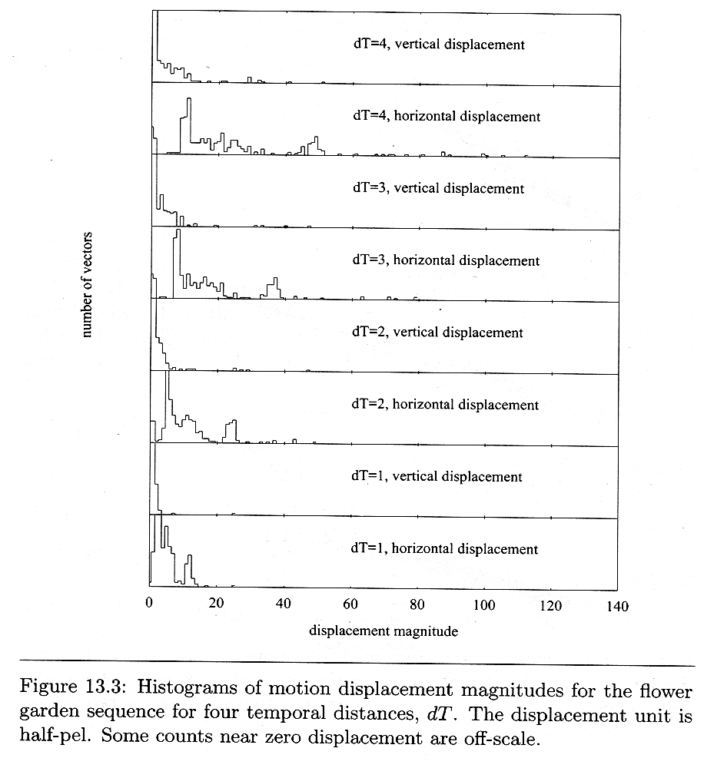

Slide 23
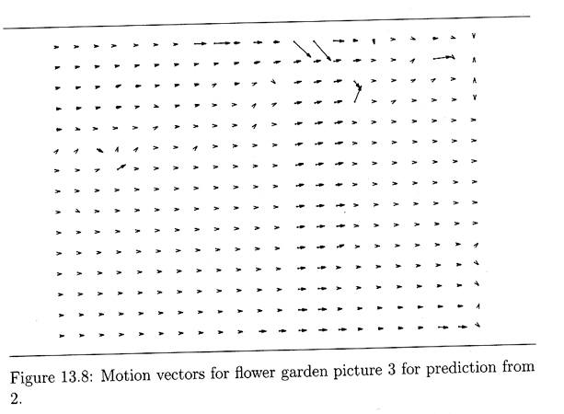

Slide 24
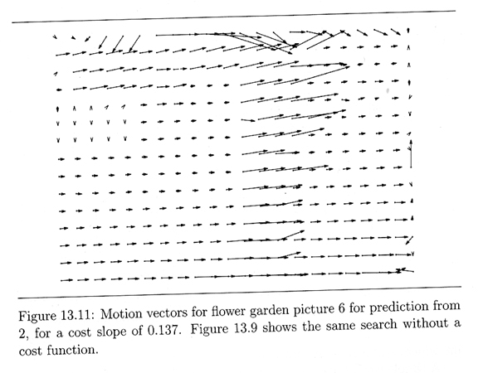

Slide 25
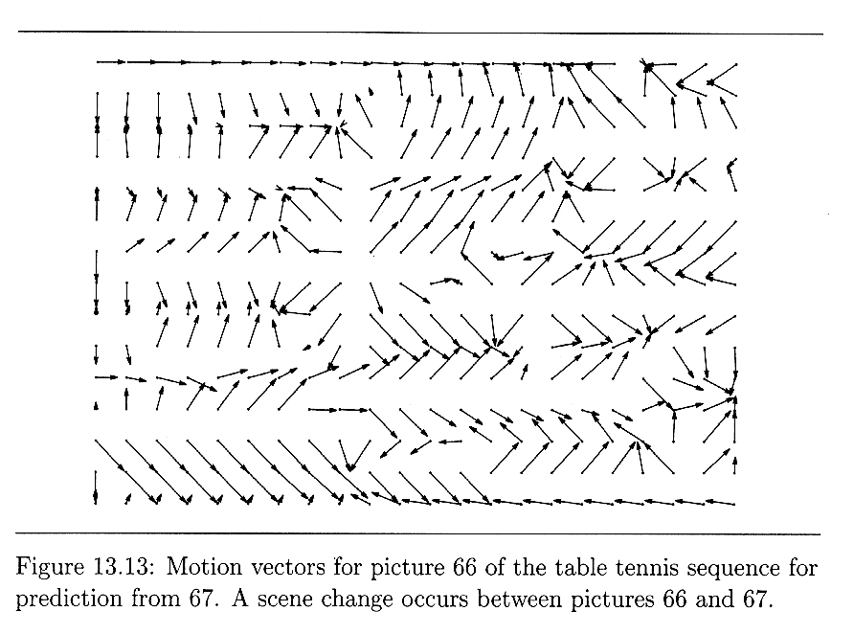
EFFECTS OF SCENE CHANGES
Temporal Compression Not Nearly As Effective

Slide 26
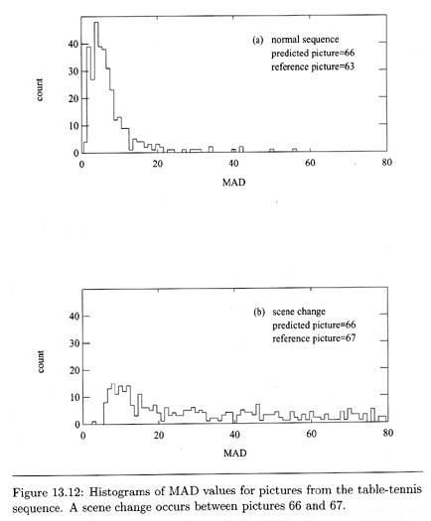

Slide 27
TEMPORAL RESULTS
If Closest Match is "Close Enough", Just Output Motion Vector
If Not Close Enough, Spatially Code (JPEG) All 6 Blocks

Slide 28
"ALMOST" CLOSE ENOUGH
Output Motion Vector
Create 6-Bit Block Code
For Each Block...
  subtract from the reference (matched) block
  spatially compress the difference block
  If result is completely zero, clear the block bit and skip the block
  Otherwise, set the block bit and output the (compressed) difference block

Slide 29
QUANTIZATION
Can Tolerate More Quantization of Difference Blocks Than I Blocks
Possible to Adapt the Quantizer Scale to Video Content
  Q factor can be part of macroblock

Slide 30
TYPES OF MACROBLOCKS
I Macro Blocks
  spatial information only
Temporal Macro Blocks
  motion vector(s)
  block code
  spatially-coded difference blocks
"Skip" Macro Block (No Change)

Slide 31
TYPES OF FRAMES
I Frames
  Spatial macro blocks only
  serves as "anchor" frame
P Frames
  Spatial, forward motion, and skip macro blocks
  can refer backwards to I and P frames
  can serve as "anchor" frame

Slide 32
FRAMES (cont.)
B Frames
  Spatial, forward/backward/interpolated motion, and skip macro blocks
  can refer backwards or forwards to I and P frames
  never used as "anchor" frame
  depends on a "future" frame which must be received and decoded first

Slide 33
GROUP OF PICTURES (GOP)
Repetitive Sequence of Frame Types
  (IB^m(PB^m)^n)^l
Examples
  I I I ....
  IPP IPP IPP...
  very common: IBBPBBPBB IBBPBBPBB IBBPBBPBB ...

Slide 34
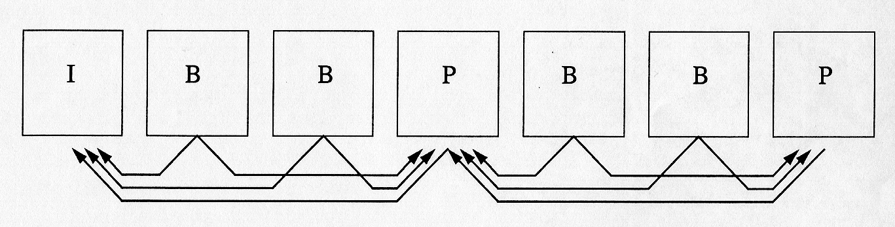
GOP SEQUENCE

Slide 35
GOP TRADEOFFS
How Much Compression Desired?
How Much Buffer Space Required
How Much Delay is Tolerable?
What Degree of Random Access
How Much Error Recovery is Needed?

Slide 36
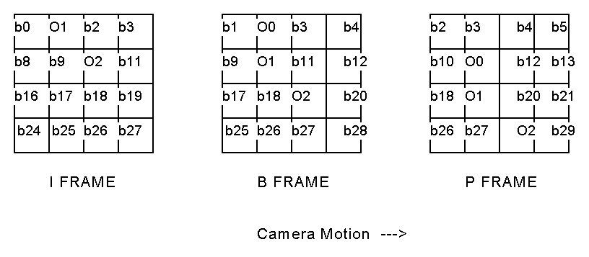
COMPRESSION EXAMPLE

Slide 37
DECOMPRESSION
Much Faster; No Searching or Matching Required
If Motion Vector Present
  use tables to undo entropy coding of motion vector
  undo differential encoding of motion vector
  read reference block(s) from buffer
If Quantizer Present
  scale quantizer matrix

Slide 38
DECOMPRESSION (cont.)
If Block Code Present
  use tables to entropy decode coefficients
  undo RLE
  undo zigzag
  undo quantization
  undo DCT
Combine Differential and Reference Blocks

Slide 39
DECOMPRESSION (cont.)
Combine 6 Blocks into a Macro Block (with unsubsampling)
Combine MacroBlocks into an Image
Convert YCbCr to RGB for Display

Slide 40
DEMONSTRATION OF MPEG COMPRESSION

Slide 41
H.261
Standard for VideoConferencing
Much Lower Bit Rates / Quality Than MPEG
Also Called px64, p = 1..30
YCbCr Color Coding
288 Lines By 352 Pixels (CIF)or 144 By 176 (QCIF)

Slide 42
H.261 (cont.)
Macro Blocks Like MPEG
Intraframe Coding Like JPEG
Interframe Coding Like P Frames From MPEG

Slide 43
OTHER
Motion JPEG (M-JPEG)
Indeo (DVI)
Cinepak
RLE
Lots of Other Proprietary Algorithms

Slide 44
SOURCES OF INFO
[Mitchell97] MPEG Video Compression Standard
[Poynton96] A Technical Introduction to Digital Video

