Slide 1
On Clusterings: Good, Bad, and Spectral
R. Kannan, S. Vempala, and A. Vetta
Presenter: Alex Cramer

Slide 2
Outline
Cluster Quality
Expansion
Conductance
Bi-criteria
Approximate-Cluster Performance
Spectral Clustering
Worst Case
Good Case
Conclusions

Slide 3
Outline
Cluster Quality
Expansion
Conductance
Bi-criteria
Approximate-Cluster Performance
Spectral Clustering
Worst Case
Good Case
Conclusions

Slide 4
Cluster Quality
Model the problem of clustering n objects as a similarity graph G, with similarity matrix A:
A is an nxn symmetric matrix
A has entries a_{ij} which denote similarity between vertices i and j in the graph
How do we measure the quality of a cluster?

Slide 5
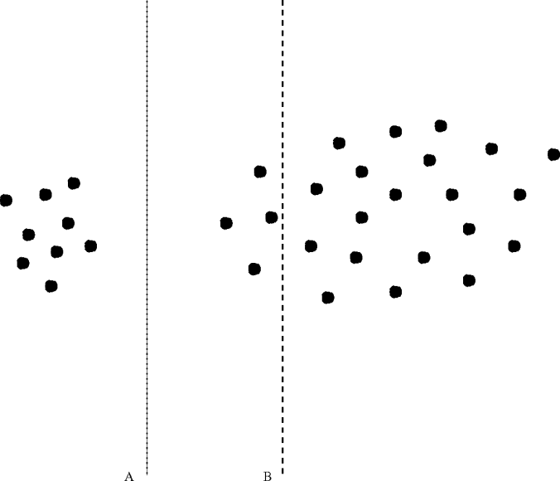
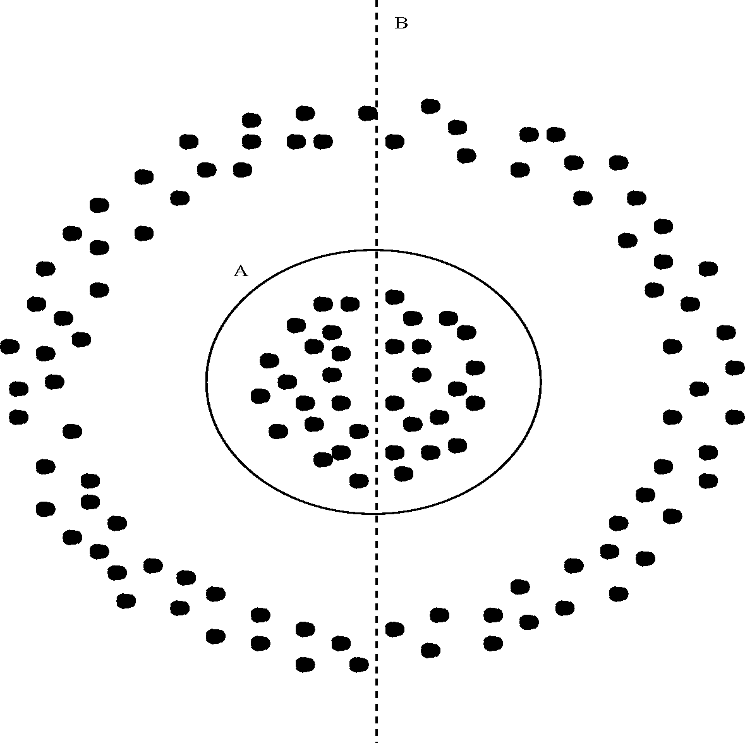
Cluster Quality
Many measures exist, but often favor simplicity over effectiveness (cut “B” in each case)
The cut “A” (dashed line) in each of these examples optimizes the quality measure derived in the paper

Slide 6
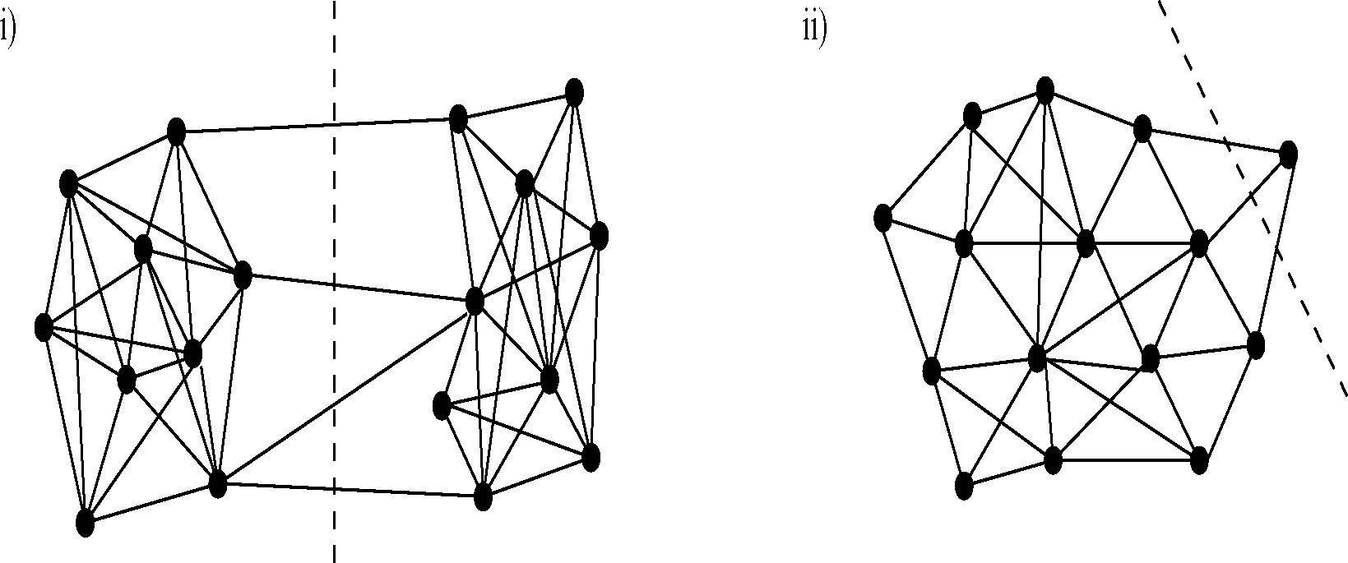
Cluster Quality
Can measure the quality of a cluster by the possible cuts on the cluster
A good cut (low cost, well clustered pieces) indicates the original cluster was of low quality

Slide 7
Cluster Quality: Expansion
Define the expansion of a cut as:
A good cut is one with low expansion:
The inter-cluster edges are small
The size of the resulting clusters is large

Slide 8
Cluster Quality: Expansion
A cut with low expansion generates high quality clusters
The expansion of a cluster is the minimum expansion of all cuts on the cluster
The expansion of a clustering is the minimum expansion of all its clusters

Slide 9
Cluster Quality: Expansion
In some cases one dissimilar point will drag down the quality of a cluster
Quality measure should lend more importance to points with more neighbors
Generalize to conductance

Slide 10
Cluster Quality: Conductance
Define the conductance of a cut S on a cluster C as:
As with expansion, the conductance of a cluster (clustering) is the minimum of the conductance of its cuts (clusters)

Slide 11
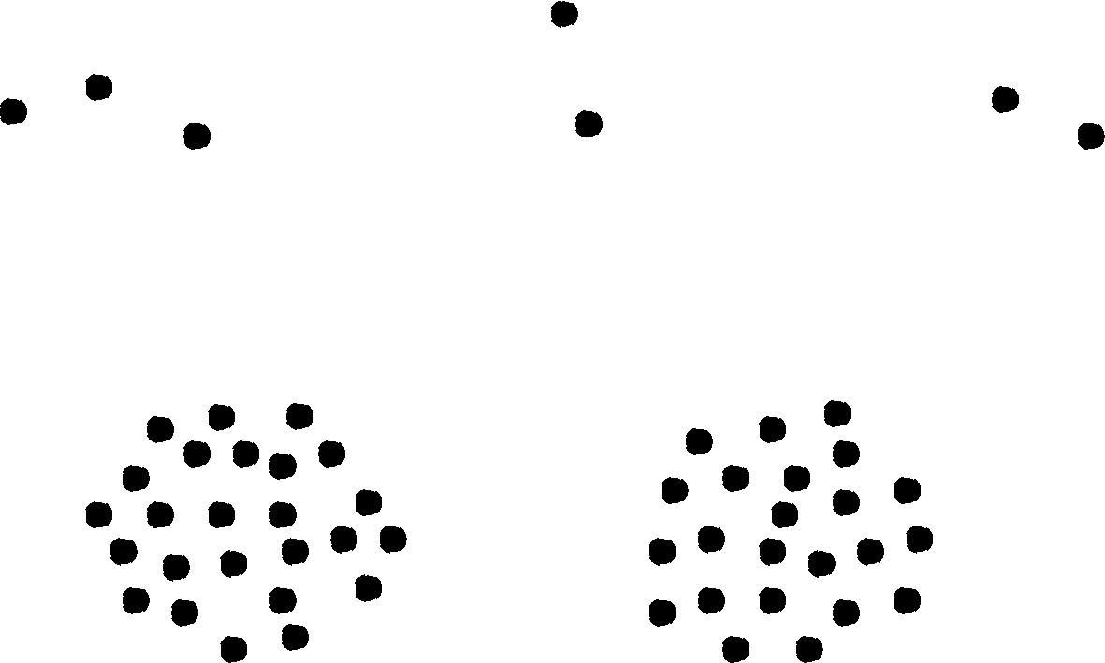
Cluster Quality: Conductance
Outliers might:
Force the resulting clusters to have low quality
Cause the algorithm to cut high quality clusters into many small clusters

Slide 12
Cluster Quality: Bi-criteria
Introduce a term ε to measure the weight of edges between clusters
So ε is the ratio of edge weight between clusters to total edge weight of the graph
These two combine to a bi-criteria for clusters
An (α,ε) clustering seeks to maximizes conductance, α and minimize ε

Slide 13
Outline
Cluster Quality
Expansion
Conductance
Bi-criteria
Approximate-Cluster Performance
Spectral Clustering
Worst Case
Good Case
Conclusions

Slide 14
Approximate-Cluster Algorithm
Finding an (α,ε) clustering is very intensive
In the case of fixed ε=0, maximizing α requires finding the conductance of a graph, which is NP-Hard
Instead, base an algorithm around some approximation of the minimum cut

Slide 15
Approximate-Cluster Algorithm
Assume there is a subroutine A for finding a close-to-minimum cut on a graph
Use A to find a low-conductance cut on G
Recurse on the pieces induced by the cut
Stop when the desired conductance is reached
If there is a minimum conductance cut of x, the approximation A will find one of conductance Kx^{v}

Slide 16
Approximate Cluster Performance
Theorem 3.1: If G has an (α,ε)-clustering, then the approximate-cluster algorithm will find a clustering of quality:

Slide 17
Approximate Cluster Performance
Notes on Theorem 3.1
Bound on conductance comes from termination condition:
Proof of the ε portion depends on the recursive nature of the algorithm

Slide 18
Outline
Cluster Quality
Expansion
Conductance
Bi-criteria
Approximate-Cluster Performance
Spectral Clustering
Worst Case
Good Case
Conclusions

Slide 19
Spectral Algorithm
Follows the approximate-cluster structure using a spectral algorithm for A
Normalize A and find its 2nd right eigenvector v
Find the cut of best conductance wrt. v
Order the rows of A based on their projection onto v:
Cut find an index j s.t. the cut S = {1,…j} minimizes the conductance
Divide V into C₁ = S, C₂ = S’
Recurse on C_{i}

Slide 20
Worst-Case Spectral Performance
Corollary 4.2: If G has an (α,ε)-clustering, then the spectral algorithm will find a clustering of quality:
This amounts to K=√2, v = ½

Slide 21
Good Cluster Performance
If there is a “good” clustering available, we can bound performance differently
Theorem 4.3: Say that A = B+E where
B is a block-diagonal with k normalized sub-blocks
The largest sub-block of B is of size O(n/k)
E introduces edges between clusters in B
λ_{k+1}(B) + ║E║≤ δ < ½
Then the spectral clustering algorithm misclassifies O(δ²n) rows

Slide 22
Outline
Cluster Quality
Expansion
Conductance
Bi-criteria
Approximate-Cluster Performance
Spectral Clustering
Worst Case
Good Case
Conclusions

Slide 23
Conclusions
Defined a fairly effective measure of cluster quality: conductance/cut-weight bi-criteria
Used this quality measure to derive worst-case performance for a general algorithm, and for a common spectral one
Not much consideration given to computation time and implementation
Implemented as the divide phase of Eigencluster

Slide 24
Questions?

Slide 25
Sources
R. Kannan, S. Vempala, and A. Vetta “On Clusterings: Good, Bad and Spectral” in Proceedings of the Symposium on Foundations of Computer Science 2000
David Cheng, Ravi Kannan, Santosh Vempala and Grant Wang. A Divide-and- Merge methodology for Clustering. ACM SIGMOD/PODS, 2005.

