Slide 1
Manifold Regularization: A Geometric Framework for Learning from Labeled and Unlabeled Examples
Authors: M. Belkin, P. Niyogi and V. Sindhwani
Journal of Machine Learning Research, 2006
Presented by: Huy Tho Ho

Slide 2
Overview
Introduction
Reproducing Kernel Hilbert Space
Standard learning framework
Semi-supervised learning framework with geometric regularization
Laplacian Regularized Least Squares
Unsupervised and fully-supervised learning
Experiments

Slide 3
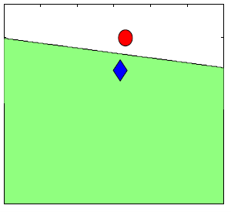
Introduction
2 labeled examples
Prior notion of simplicity

Slide 4
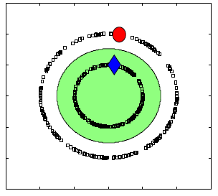
Introduction
Additional unlabeled examples
Geometric structure of marginal distribution

Slide 5


Reproducing Kernel Hilbert Space
Hilbert space :
Real or complex inner product space
Complete metric space
Reproducing Kernel Hilbert Space (RKHS):
is an arbitrary set
is a Hilbert space of functions on
is a RKHS if every linear map of the form
from to the complex numbers is continuous for

Slide 6


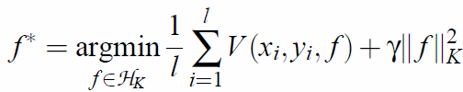



Standard Learning Framework
: a Mercer kernel
: associated RKHS of functions with norm
Standard framework
is the loss function:
: regularized least squares (RLS)
: support vector machines (SVM)
Classical Representer Theorem:

Slide 7
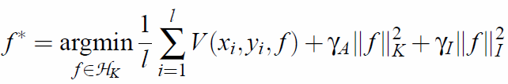




Geometric Regularization
New objective function:
reflects the intrinsic structure of
If is known, we have the new Representer Theorem:
where
Both regularizers are needed:
True underlying marginal distribution is usually not known.
Manifold assumption may not hold.

Slide 8


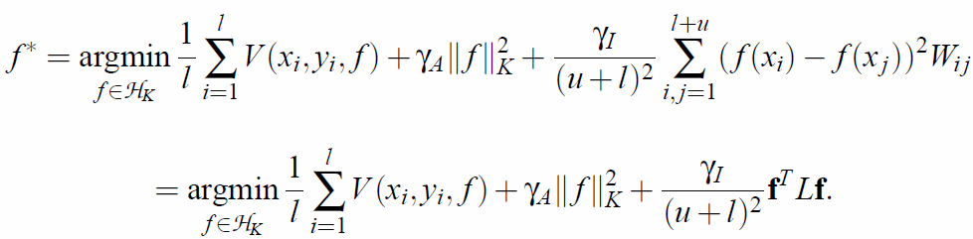



Geometric Regularization
If is not known, is approximated by labeled and unlabeled data
Given : label data and : unlabeled data, the optimization problem becomes
where : edge weights
: graph Laplacian
: diagonal matrix where

Slide 9
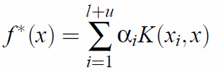

Geometric Regularization
Representer Theorem:
Remark: the normalized graph Laplacian
performed better in practice

Slide 10





Regularized Least Squares
Objective function:
Representer Theorem:
Replace into the objective function:
where is the Gram matrix, is the label vector
Solution:

Slide 11



Laplacian Regularized Least Squares
Objective function:
Representer Theorem:
Solution:
where and

Slide 12



Unsupervised Learning
Objective function:
Approximation:
Using Representer Theorem

Slide 13
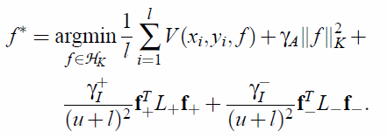
Fully-Supervised Learning
Objective function for a 2 class problem:

Slide 14
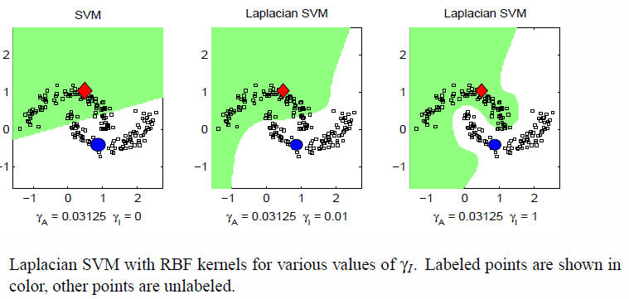
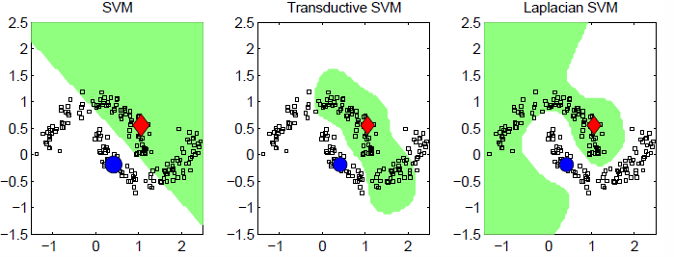
Experiments – Two Moon Dataset

Slide 15
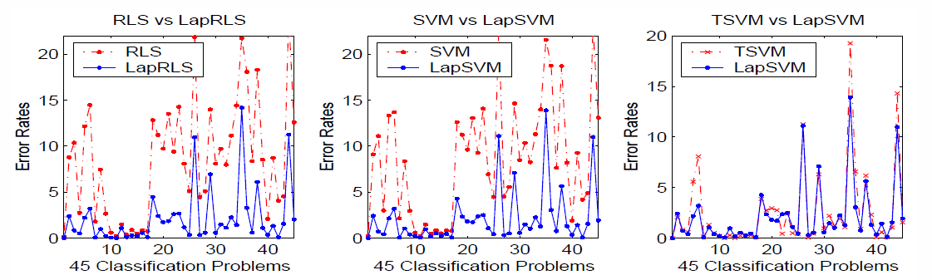
Experiments – Hand Digit Recognition
USPS dataset
45 binary classification problems

Slide 16
Conclusions
A framework for data-dependent geometric regularization
New Representer Theorem
Semi-supervised learning
Unsupervised learning
Fully-supervised learning
Pros:
Exploit the geometric structure of the marginal distribution of training samples.
Cons:
The marginal distribution does not have any geometric structure.
The geometric structure of the marginal distribution is hard to recover.

