Slide 1
Modularity Clustering
Presented by: Ming-Yu Liu

Slide 2
Reference
M.E.J. Newman and M. Girvan, “Finding and evaluating community structure in networks” PHYSICIS REVIEW E. 2004
U. Brandes, D. Delling, M. Gaertler, R. Gorke, M. Hoefer, Z. Nikoloski, and D. Wagner, “On Modulairty Clustering”, IEEE Transactions on Knowledge and Data Engineering, 2008

Slide 3
Outline
1. Motivation
community structure, agglomerative/decisive clustering,
2. Problem Formulation
betweenness, modulairty, integer programming
3. Experiments computer-generated network, Zachary’s karate club, collaboration network, dolphin community, a novel,
4. Conclusion

Slide 4
Motivation

Slide 5
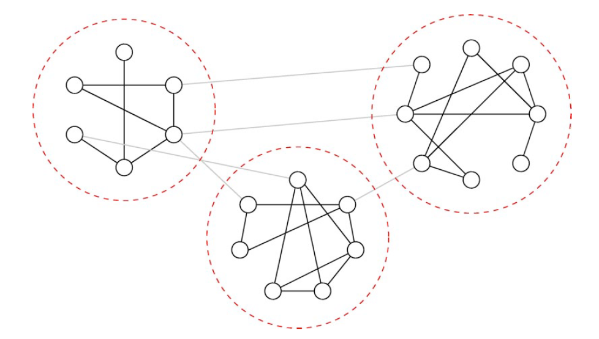
Community Structure
The division of network nodes into groups within which the network connections are dense, but between which they are sparser.
Wide range of applications: www, social networks, scientific collaboration, metabolism, and ecosystems

Slide 6
Graph partitioning vs. hierarchical clustering
Graph partitioning
Can be achieved with *-Cut algorithm
Usually require a known number of clusters.
Not particular helpful since we usually don’t know how many communities in a network.
Hierarchical clustering
Aim at discovering natural divisions of networks into groups, based on various metrics of similarity or strength of connection between vertices.

Slide 7
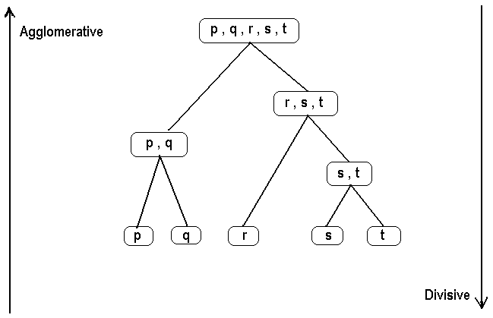
Agglomerative and divisive clustering
Agglomerative Clustering: An initially disconnected vertices grouped into larger and larger communities as we go from bottom to top
Divisive Clustering: An initially connected network splitting into smaller and smaller communities as we go from top to bottom

Slide 8
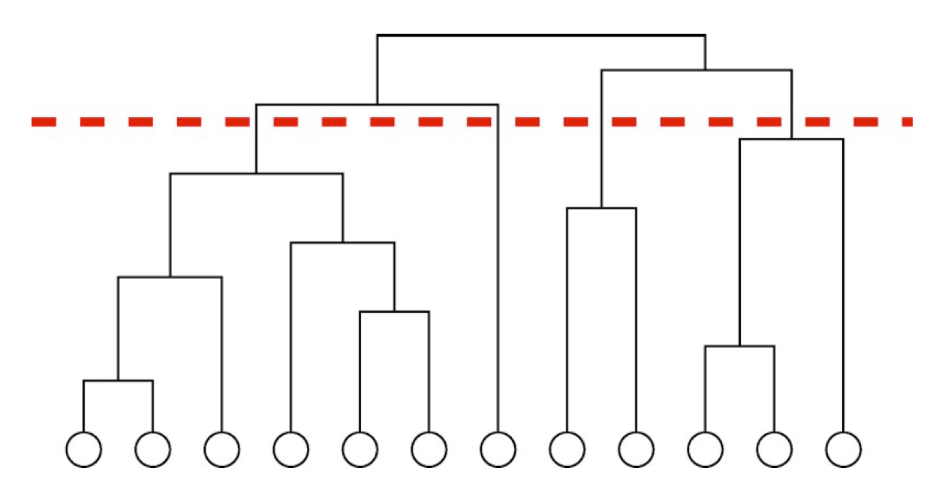
Dendrogram ( Hierarchical tree)

Slide 9


Agglomerative/divisive clustering
Metric (Similarity)
Euclidean distance
Manhattan distance
Maximum distance
Mahalanobis distance
Linkage criteria
The linkage criteria determines the distance between communities
Complete-linkage clustering
Single-linkage clustering

Slide 10
Agglomerative/divisive clustering
Metric (Similarity)
Euclidean distance
Manhattan distance
Maximum distance
Mahalanobis distance
Linkage criteria
Drawback: The distance is not adaptive!!!
The linkage criteria determines the distance between communities
Complete-linkage clustering
Single-linkage clustering

Slide 11
Agglomerative/divisive clustering
Drawback: Still don’t know how to determine the number of communities in the network.
Metric (Similarity)
Euclidean distance
Manhattan distance
Maximum distance
Mahalanobis distance
Linkage criteria
Drawback: The distance is not adaptive!!!
The linkage criteria determines the distance between communities
Complete-linkage clustering
Single-linkage clustering

Slide 12
Quick Review
Community Structure
Problem of identify the number of communities in a network
Non-adaptive nature of the similarity measure.

Slide 13
Problem Formulation

Slide 14
Problem Formulation
Betweenness - Used to update the distance between two nodes
Modularity - Used to determine the number of communities in a network.

Slide 15
Betweenness
Removing the edges between vertex pairs with the highest betweeness, instead of the lowest similarity
Betweenness: a measure favoring edges that lie between communities
Shortest-path betweenness
Compute the shortest paths between all pairs of vertices. Count how many run along each edge.
Random-walk betweenness
Count the expected net number of times that a random walk between a particular pair of vertices will pass down a particular edge and sum over all vertex pairs.

Slide 16
Algorithm 1
Input: vertices and edges of a network
(1). Compute the betweenness for all edges
(2). Find the edge with the highest betweenness and remove the edge
(3). Repeat (1) and (2) until no edge to remove.
Output: the dendrogram

Slide 17



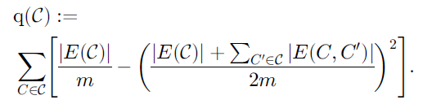
Modularity
Used to determine the number of community in the network.
Serve as a quality index for a clustering
with
the set of edges that have one end node in C_{i} and the other end node in C_{j}.
Modularity of a clustering

Slide 18

More on modularity
Coverage: many edges should be contained in clusters.
Splitting the graph into many clusters with small total degrees each.

Slide 19
Select the clustering with the largest modularity
Input: vertices and edges of a network
(1). Compute the betweenness for all edges
(2). Find the edge with the highest betweenness and remove the edge
(3). Repeat (1) and (2) until no edge to remove.
Output: the dendrogram

Slide 20

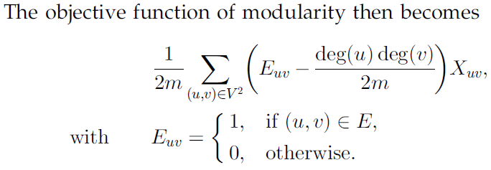
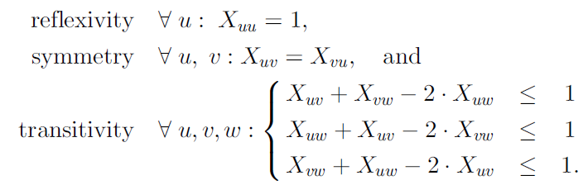
Equivalent Integer Programming Problem
Can be solved efficiently using branch-and-bound technique.

Slide 21
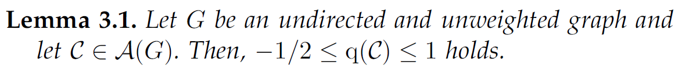
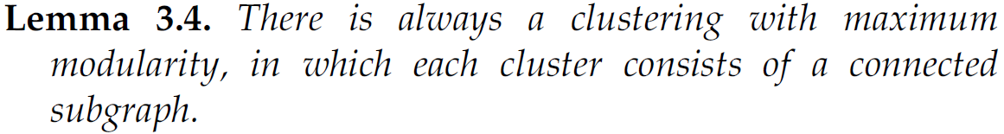
Some Analysis
=> We can remove isolated nodes freely.

Slide 22
Some Analysis
=> We can remove isolated nodes freely.

Slide 23
Some Analysis
=> We can remove isolated nodes freely.

Slide 24
Some Analysis
=> We can remove isolated nodes freely.

Slide 25
Some Analysis
=> We can remove isolated nodes freely.

Slide 26
Quick Review
Betweeness
Shortest-path betweenness
Random-walk betweenness
Modularity
Determining the optimal community number in a network
Algorithms
Compute a dendrogram and pick the layer with the largest modularity
Linear integer programming formulation
Analysis
Some properties of the optimal solutions for maximizing modulairty.

Slide 27
Experiments

Slide 28
Experiments
1. Computer-generated networks
2. Zachary’s karate club network
3. Collaboration network
Dolphin network
Les Miserables by Victor Hugo

Slide 29
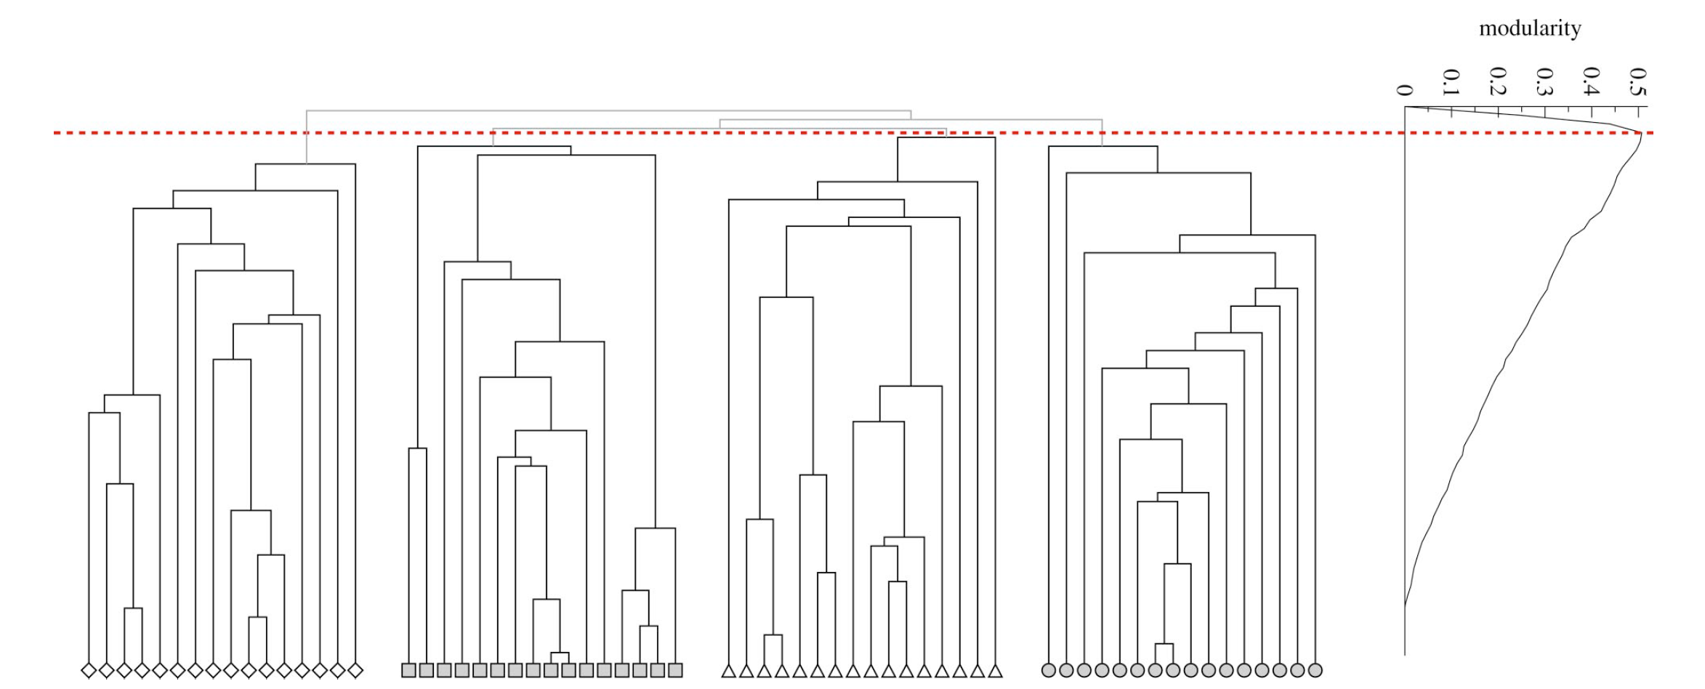
Computer-generated networks
Network with 128 vertices divided into four communities
E[ p_{in} + p_{out} ] = 16
E[ p_{in} ] = 12 E[ p_{out} ] = 4

Slide 30
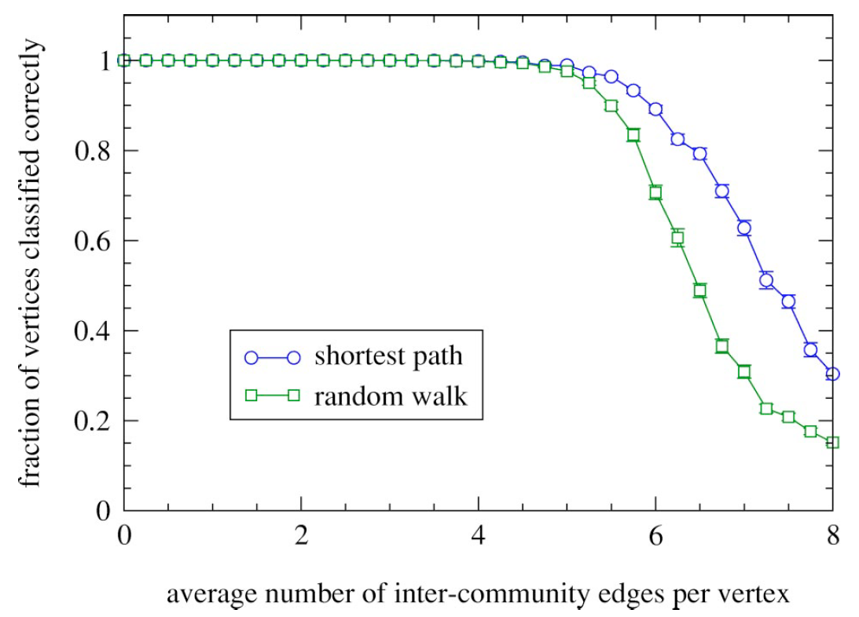
Computer-generated networks
NOTE: E[ p_{in} + p_{out} ] = 16
E[ p_{out} ]

Slide 31
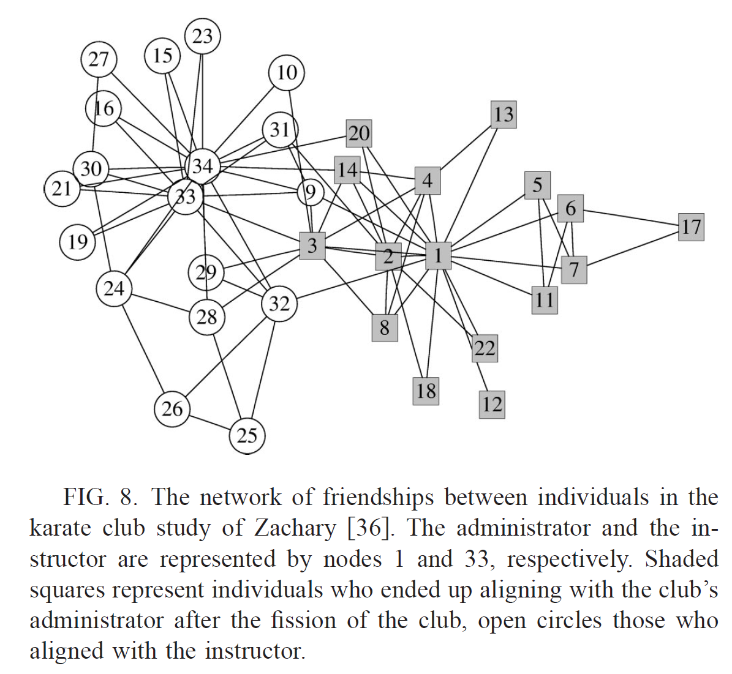
Zachary’s karate club network

Slide 32
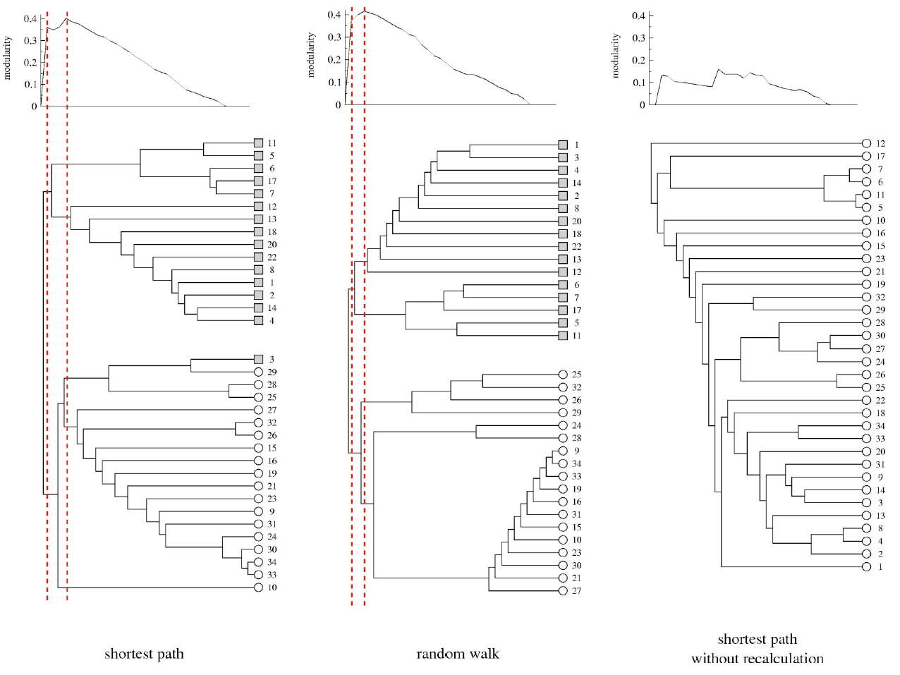
Zachary’s karate club network

Slide 33
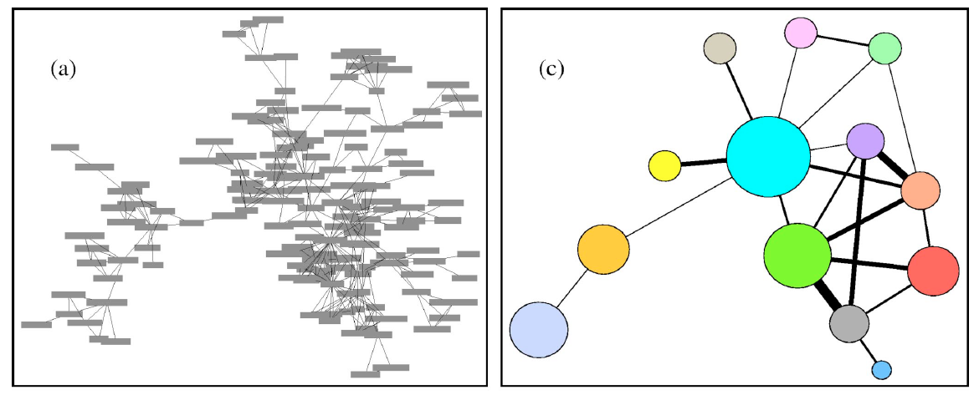
Collaboration Network
Vertices represents authors referred in the Bibliography of a paper.
An edge between two vertices exists if the two author co-publish a paper in arxiv.org
No priori knowledge about the network.
Modularity is peaked at 13 communities.

Slide 34
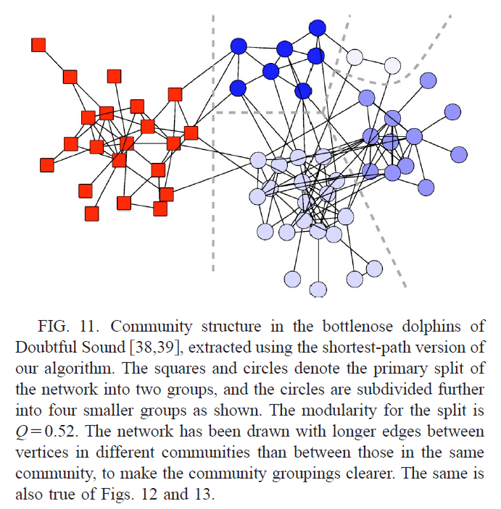
Dolphin network
A community of 62 bottlenose dolphins living in Doubtful Sound, New Zealand.
2-split, Q=0.38
5-split, Q=0.52
( matrilineage)

Slide 35
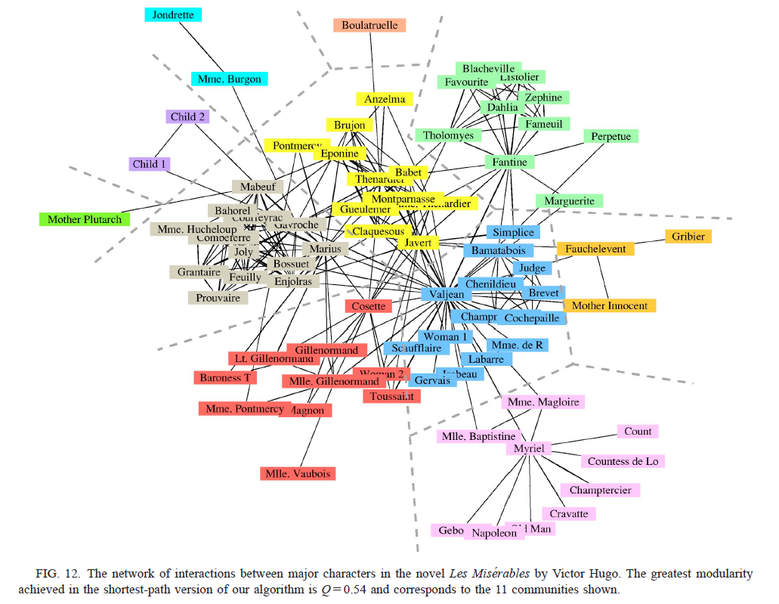
Les Miserable by Victor Hugo
The community clearly reflects the subplot structure of the novels.

Slide 36
Conclusion

Slide 37
Conclusion
Agglomerative/divisive clustering
Betweenness: Shortest-path betweenness and random-walk betweenness
Modulairty:
Greedy splitting algorithm and integer programming
Promising results for real-world examples.

Slide 38
THANK YOU

Slide 39
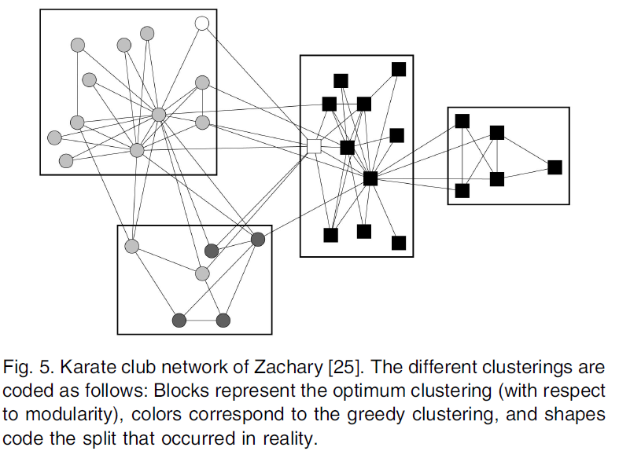
Greedy Splitting vs. Integer Programming
Integer programming
Q = 0.431
Greedy algorithm
Q = 0.397

