Slide 1
Convex clustering with exemplar based models
Authors- Daniel Lashkari and Polina Golland
Presented by: Priyanka Vageeswaran

Slide 2
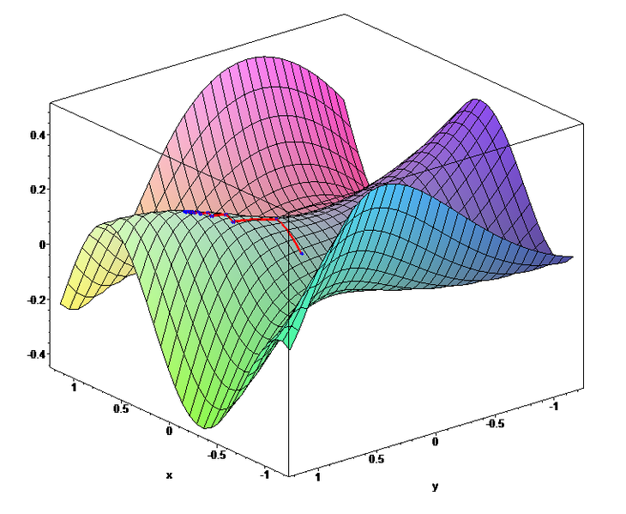
Motivation
Soft K-Means
Non-convex cost function
Local minima/maxima
Multiple initializations required
Affinity propagation
Hard assignments
No gaurantee of convergence
Objective: Convexify cost function

Slide 3
Convex cost function
Scenario:
Assumption:
Don’t have to search over the whole span
Still combinatorial search

Slide 4
relaxation
Initially assume all data points as cluster centers
Replace K with N
Notes:
P hat the emperical distribution

Slide 5
implementation
Iterate:
Initialization:
Update:
Check Convergence:
Label Assignment:

Slide 6
Speed/scalability
Use Interior Point methods
Complexity: O(N²) per iteration
Speed up:
Restrict search for clustering center to nearest N_{o} items
Reduced complexity: O(N*N_{o})
Threshold
Re-normalize Distribution

Slide 7
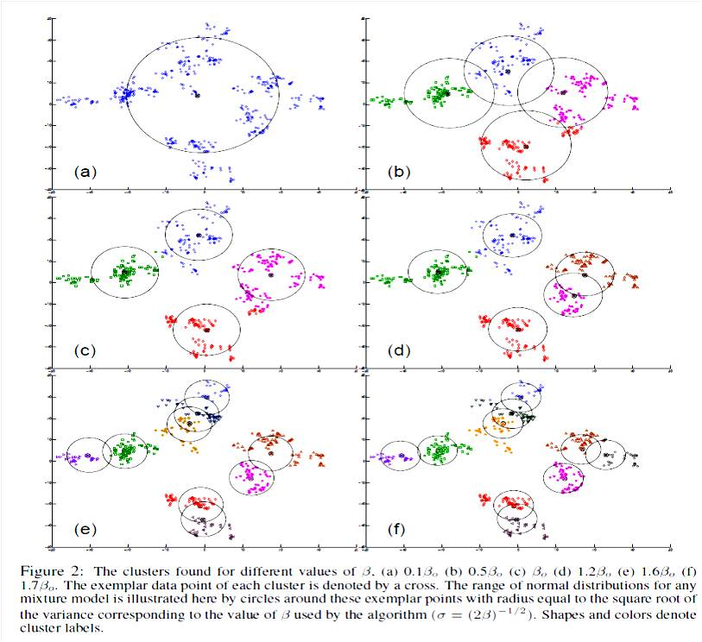
Experimental results

Slide 8
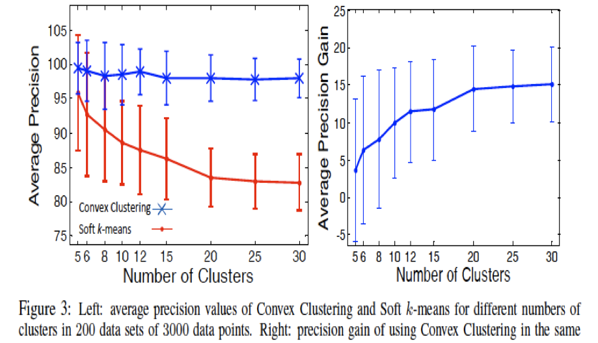

Slide 9
advantages
Exemplar-based models
Soft-labeling
Insensitive to initialization
Convex function enables it to reach the global optimum
Will get the optimal value of K
Χ can be vectorial data or proximity data

Slide 10
drawbacks
Have to estimate β, when K is fixed and known
Assume data clusters are dense
Convex relaxation may not be very tight
Convergence rates are slow
Convex formulation with hard assignments not possible
Sensitive to perturbation in data points

Slide 11
Improvements/modifications
Formulate the dual and incorporate the stability of cluster centers (Komodakis et al)
Define stability as the minimum perturbation required to ensure data point is never chosen as cluster center
Hard assignments obtained in linear integer program
Assume exemplars to be the centers of smoothing kernel and incorporate smoothed versions of the exemplars into the cost function

Slide 12
conclusion
Restrict search of parameters to exemplars
Replace log-likelihood objective with the KL divergence
Obtain soft label assignments along with optimal K
Relaxation of affinity propagation
Convergence to global optimum ensured
Scalable to large datasets

Slide 13
Discussion on Affinity propagation

