Slide 1
Mixture Models And Expectation Maximization
Abhijit Kiran Valluri

Slide 2
The Gaussian Distribution
It is a versatile distribution.
It lends itself for modeling several random variables.
The grades in a class, the human height, etc.
It is analytically tractable.
Central Limit Theorem
Sum of a large number of random variables approaches a Gaussian distribution
Notes:
Slide 2:
First, the normal distribution is very tractable analytically, that is, a large number of results involving this distribution can be derived in explicit form. Second, the normal distribution arises as the outcome of the central limit theorem, which states that under mild conditions the sum of a large number of random variables is distributed approximately normally. Finally, the "bell" shape of the normal distribution makes it a convenient choice for modelling a large variety of random variables encountered in practice.
-----------------------------
Slide 6:
Ex: A mixture of two normal distributions with different means can lead to a distribution with two modes, which can not be modeled via standard parametric distributions.
------------------------------

Slide 3
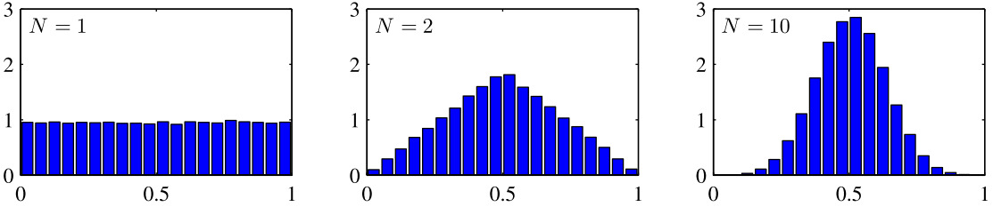
The Gaussian Distribution
Histogram plot of the mean of N uniformly distributed numbers for various value of N.
Note: All figures in the presentation unless otherwise mentioned, are taken from Christopher M. Bishop, “Pattern Recognition and Machine learning”.

Slide 4
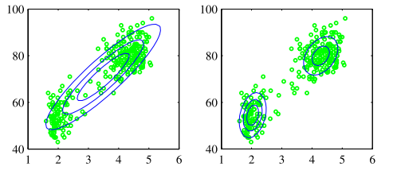
Mixture Models
Why mixture models?
A single Gaussian distribution has limitations when modeling several data sets.
If the data has two or more distinct modes as below:
Here, a mixture of Gaussians becomes useful.

Slide 5
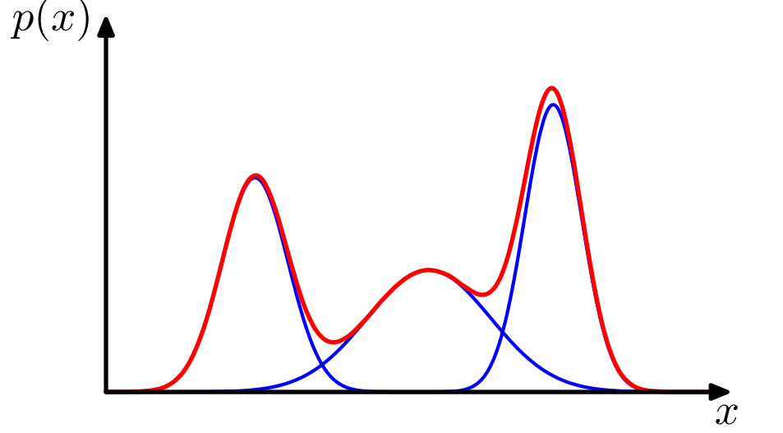
Mixture Models
Mixture distribution: It is the probability distribution of a random variable that can be derived from other random variables via simple manipulations.
Ex: A Gaussian mixture distribution in 1 dimension as a linear combination of three Gaussians

Slide 6
Mixture Models
Mixture Model: It is a probabilistic model corresponding to the mixture distribution that represents the elements in the data set.
They offer more mathematical flexibility than the underlying probability distributions that it is based upon.

Slide 7
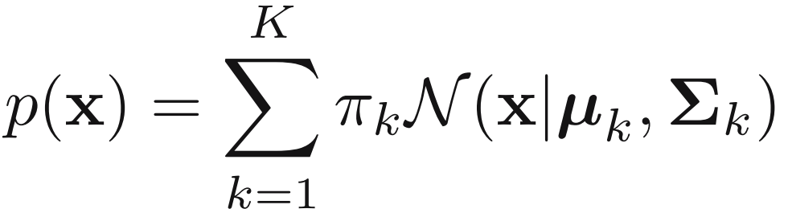
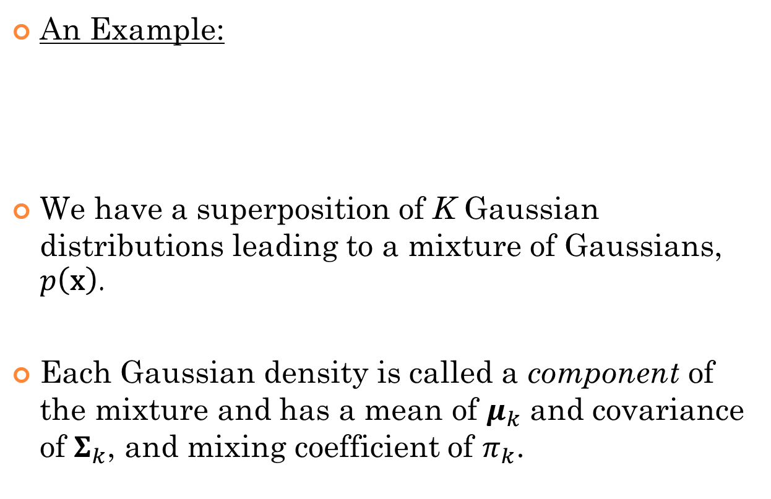
Mixture Models
An Example:
We have a superposition of K Gaussian distributions leading to a mixture of Gaussians, $p\left(\text{x}\right)$.
Each Gaussian density is called a component of the mixture and has a mean of $μ_{k}$ and covariance of $Σ_{k}$, and mixing coefficient of $π_{k}$.

Slide 8
Expectation Maximization
Why EM?
To estimate parameters of a mixture model, so as to best represent the given data.
Generally a difficult problem
The number and functional form of the components of the mixture must be found.
EM focuses on maximum likelihood techniques.
Notes:
Slide 8:
Given a data set, we would like to come up with a mixture model that best fits the observed data points. So, we use this algorithm to iteratively reach this desired model. Also, when using EM, one typically knows the number of components in the mixture.
------------------
Slide 9:
Solutions refers to estimates of parameters
EM obtains maximum likelihood estimates of parameter values.
-----------------------
Slide 10:
E step: Log likelihood function of a mixture model
-----------------------

Slide 9
Expectation Maximization
It is used to obtain maximum likelihood solutions for models with latent variables.
Latent variables are those variables that are not observed directly, but rather are inferred from other observed variables.
The EM algorithm is an iterative method and alternates between Expectation (E) step and the maximization (M) step.

Slide 10
EM Algorithm - Idea
E step: Calculates the expectation of the log likelihood function with the current values of the parameters.
M step: Reevaluate the parameters of the model by maximizing the expected log likelihood found in the E step.
The procedure is carried out till convergence.

Slide 11
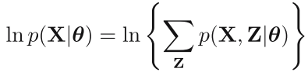
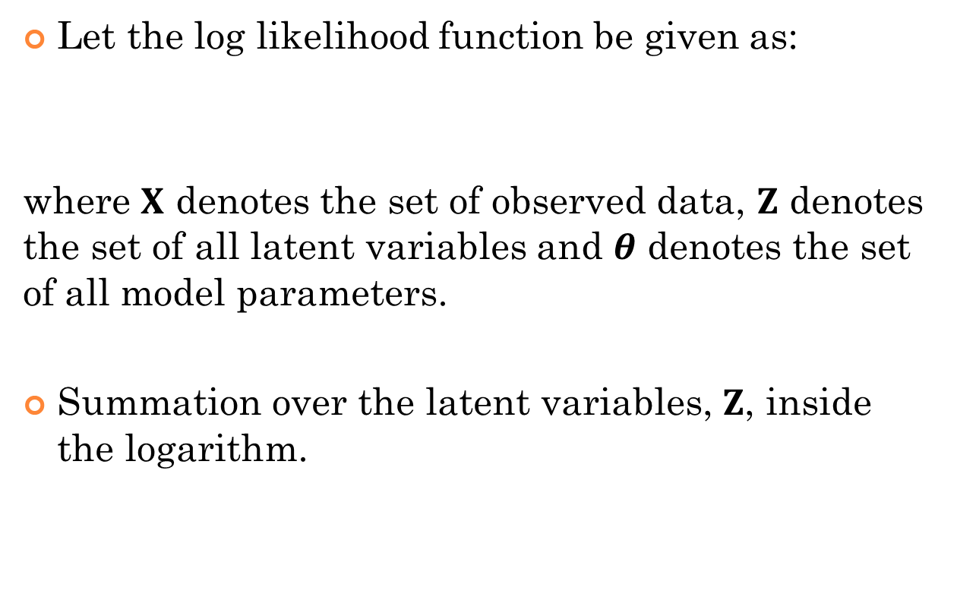
EM Algorithm - Details
Let the log likelihood function be given as:
where $X$ denotes the set of observed data, $Z$ denotes the set of all latent variables and $θ$ denotes the set of all model parameters.
Summation over the latent variables, $Z$, inside the logarithm.
Notes:
Slide 11:
The marginal distribution, $p\left(X | θ\right)$ needn’t be exponential, even if $p\left(X,Z | θ\right)$ is.
-----------------------
Slide 12:
1.
In practice, we are given only the incomplete data $X$.
Hence, we know about $Z$ only via $p(Z|X,θ)$.
2.
$p(Z|X,θ)$ => posterior probability distribution of latent variables.
------------------------
Slide 19:
3) EM algorithm makes a soft assignment to clusters using posterior probabilities.
*5) We also note that EM algorithm takes more iterations to converge to a solution, compared to K-means, with each cycle requiring considerably larger computations. Hence, K-means is used to find a suitable initialization that is then adapted using EM.

Slide 12

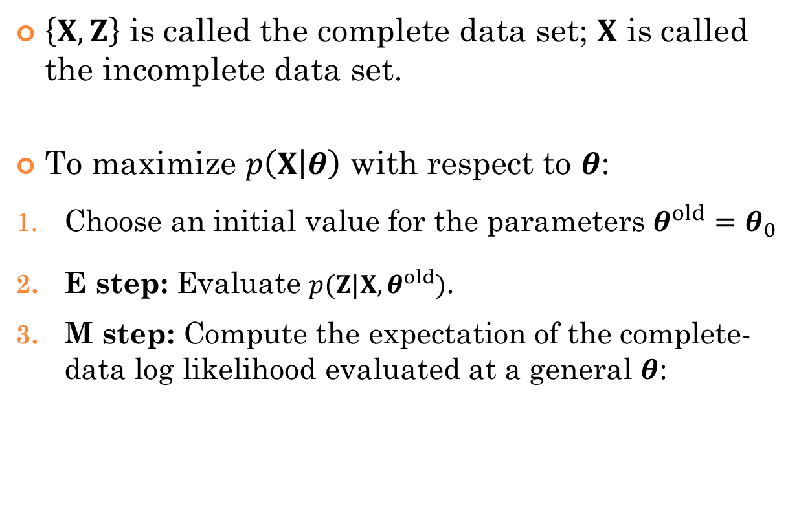
EM Algorithm - Details
$\left\{X,Z\right\}$ is called the complete data set; $X$ is called the incomplete data set.
To maximize $p\left(X | θ\right)$ with respect to $θ$:
Choose an initial value for the parameters $θ^{old}=θ_{0}$
E step: Evaluate $p(Z|X,θ^{old})$.
M step: Compute the expectation of the complete-data log likelihood evaluated at a general $θ$:

Slide 13
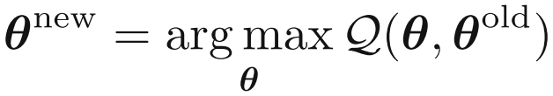

EM Algorithm - Details
(contd.) Then, compute $θ^{new}$ by:
Finally, check for convergence of the log likelihood or the parameter values. Go to step 2, with $θ^{old}←θ^{new}$, if not converging.

Slide 14
Example for EM
Consider the Gaussian mixture model (slide 7).

Slide 15
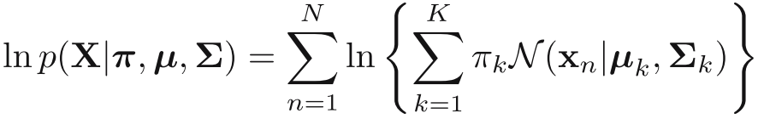
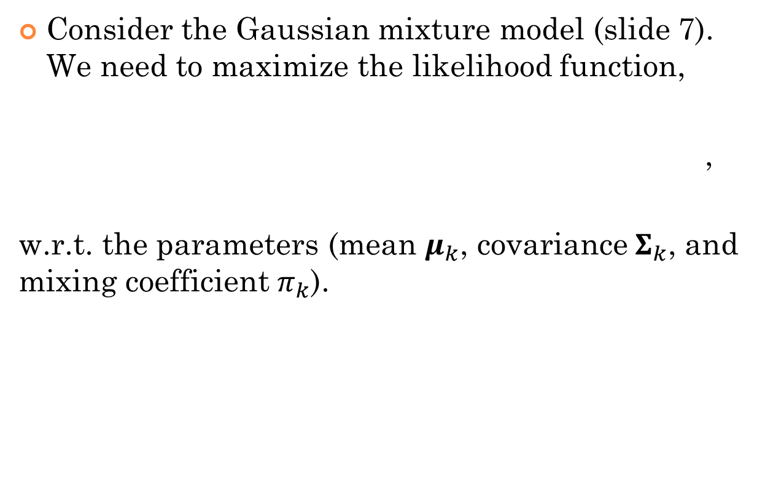
Example for EM
Consider the Gaussian mixture model (slide 7). We need to maximize the likelihood function,
,
w.r.t. the parameters (mean $μ_{k}$, covariance$Σ_{k}$, and mixing coefficient $π_{k}$).

Slide 16
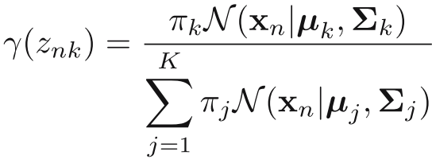
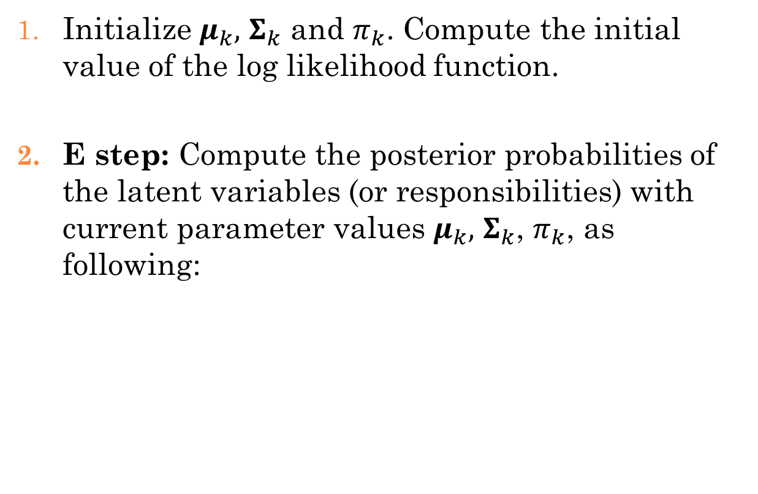
Example for EM
Initialize $μ_{k},$ $Σ_{k}$ and $π_{k}$. Compute the initial value of the log likelihood function.
E step: Compute the posterior probabilities of the latent variables (or responsibilities) with current parameter values $μ_{k},$ $Σ_{k}$, $π_{k}$, as following:

Slide 17
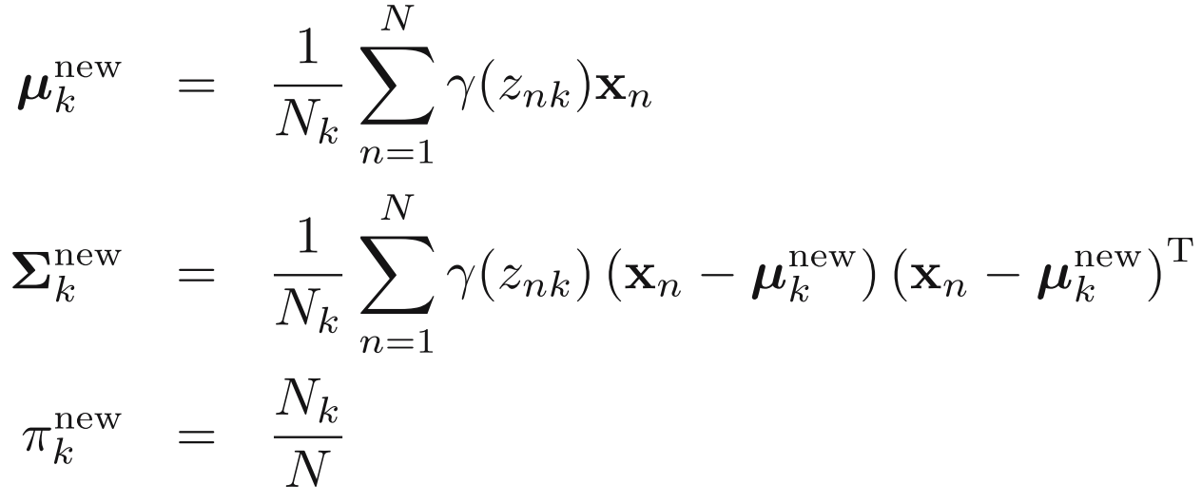

Example for EM
M step: Evaluate the new parameters using the current value of $γ(z_{nk})$ (responsibilities):

Slide 18
Example for EM
Update the log likelihood (slide 14) using the new parameter values. If the value hasn’t yet converged, then go to step 2.
The end result gives the required parameter values.

Slide 19
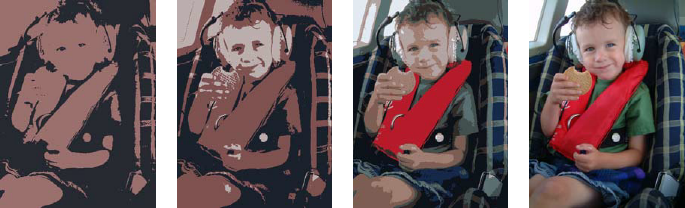
Applications of EM
Image segmentation
Image reconstruction in medicine, etc.
Data clustering

Slide 20
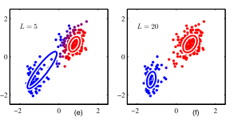
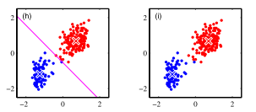
EM and K-means
There is a close similarity.
K-means algorithm performs a hard assignment of data points to clusters.
EM algorithm makes a soft assignment.
We can derive K-means algorithm as a limiting case of EM for Gaussian mixtures.

Slide 21
Q & A

