Slide 1
Virtual EIR
Week 4 milestone
Adaptive coaching and founder action planning
Mingzhi Hu / Faculty update / October 16, 2026
Notes:
Today I will show the Week 4 foundation: adaptive coaching style and an explicit Goal and Plan workspace. This extends my pre-existing GOAT AI platform. The examples are fictional and the system runs locally. We distinguish delivered application behavior from unvalidated coaching quality and future features. Sources: Week4-Progress-Report.md and approved Week 4 plans.

Slide 2
DELIVERED SCOPE
From a continuing chat to a founder workspace
Adapt the explanation to the founder — keep the facts unchanged.
Define a measurable goal, review a plan, then approve it.
Record real-world work explicitly; retain earlier plan versions.
Reuse GOAT AI inference and appearance; extend the EIR layer.
VIRTUAL EIR / WEEK 4 MILESTONE / OCT 16, 2026
02
Notes:
The faculty direction was to adapt the coaching persona and explore useful features, including Goal and Plan. Mingzhi supplied the four-profile mapping in the October 9 conversation. We implemented the Week 4 foundation, completed and reported on October 16, not retroactively on October 11. This is not delivery of all six future features. Sources: approved Week 4 plans; eir models/personas/planning/feature_store and web workspace; Week4-Progress-Report.md.

Slide 3
ADAPTIVE PERSONA
Four communication styles, one evidence standard
Engineer
Technical constraints, trade-offs, measurable tests
Artist
Experience, empathetic language, narrative framing
Scientist
Hypotheses, methods, observations, limitations
Business professional
Customer segment, value, cost and decision trade-offs
8 recorded English responses · Shared facts · User-selected preference
VIRTUAL EIR / WEEK 4 MILESTONE / OCT 16, 2026
03
Notes:
A self-described background selects a starting style; explicit preference overrides it. Mixed or unknown backgrounds use general coaching. The final comparison records four backgrounds times initial/follow-up, with the same fictional facts and model. Styles are observable but overlap; this is not evidence of improved outcomes. Some model answers still address the founder as the customer; the engineering follow-up uses a hypothetical price probe and overstates price-elasticity inference. These remain quality limitations. Sources: eir/personas.py; tests/test_personas.py; persona-real.json; Persona-Review.md.

Slide 4
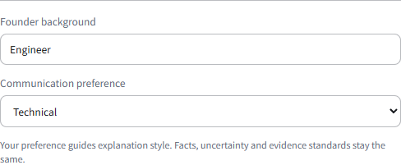
ACTUAL INTERFACE
The founder can choose and correct the style
Optional background
Explicit preference wins
Confirmation before use
Facts and counts stay separate
Captured from the running local app · fictional case
VIRTUAL EIR / WEEK 4 MILESTONE / OCT 16, 2026
04
Notes:
This is a real screenshot of the local isolated fictional case, not a design mockup. Founder background and communication preference are editable in Venture profile. Confirm and save profile is required; the next call uses the confirmed revision. Old profiles load with defaults. Tests cover preference override, mixed/unknown backgrounds, restart, correction and venture isolation. Source: screenshot persona-detail.png from capture-week4-eir.mjs; tests/test_personas.py.

Slide 5
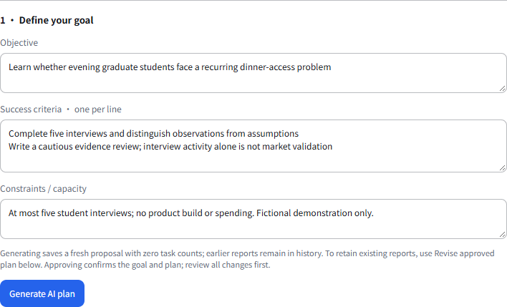
GOAL + PLAN
Plan first. Review before activation.
1 Define outcome and capacity
2 Generate an AI proposal
3 Edit and review the draft
4 Approve explicitly
VIRTUAL EIR / WEEK 4 MILESTONE / OCT 16, 2026
05
Notes:
The founder enters an objective, observable success criteria and constraints. The existing local GOAT API and Ollama model generate a typed JSON proposal. The real run proposed five interviews and two evidence-review tasks; the founder then simplified it to one counted task for the demonstration. The draft does not activate a goal or record completed work. Drafts are editable, approvable and rejectable. Invalid or unavailable model output leaves confirmed state unchanged. The screenshot shows the actual local goal form; source workflow-real.json, planning.py, feature_routes.py and UI verification.

Slide 6
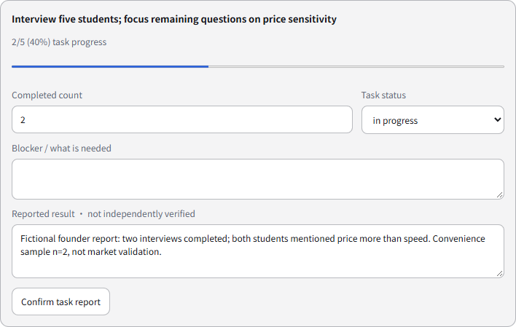
PROGRESS WITH BOUNDARIES
40% of the task — not 40% business validation
5 planned
2 reported complete
3 remaining
Activity is observable.
Market demand is still unproven.
VIRTUAL EIR / WEEK 4 MILESTONE / OCT 16, 2026
06
Notes:
Five planned interviews, two founder-reported completed interviews, three remaining. The task remains in progress. Absolute counts prevent repeat confirmation from double counting; stale revisions and counts above the target are rejected. Reported results are explicitly unverified. A done task requires full target count and a written result. Goal achievement is blocked until a future criterion-by-criterion evidence review exists. Source: actual progress-detail.png, feature_models.py, planning.py, test_workspace.py and workflow-real.json.

Slide 7
CONTINUITY AND VERSIONING
A new conversation remembers the approved plan
“Planned: 5 interviews
Completed: 2 interviews
Remaining: 3 interviews”
v1 is retained.
v2 is proposed.
Approval activates v2.
Real local-model follow-up · fictional founder report
The two-person sample is not generalized to market demand.
VIRTUAL EIR / WEEK 4 MILESTONE / OCT 16, 2026
07
Notes:
A real new-session response used the approved workspace and reported evidence without replaying old turns. It retained 5/2/3 and warned about the two-person convenience sample. Replanning uses a proposed v2, not an overwrite of v1. The Revise approved plan button retains reported counts for review; fresh AI generation starts new zero-count tasks with a visible warning and keeps prior reports in history. SQLite revisions survive re-instantiation/restart tests. Source: workflow-real.json; test_workspace.py; eir/web/workspace.js.

Slide 8
EVIDENCE AND LIMITATIONS
Verified behavior, with failures kept visible
79 deterministic tests passed
10 real-workflow + 21 legacy UI checks
8 final Persona responses reviewed in English
Known limits
Model wording and neutral probing still need work. No Ain/EIR expert validation yet.
Local single-user prototype; public Vercel recording remains unchanged.
VIRTUAL EIR / WEEK 4 MILESTONE / OCT 16, 2026
08
Notes:
Fresh automated results: 79 root EIR tests, including 42 workspace tests, 10 Persona tests and three context-budget tests. Ten isolated real-model workflow groups, 21 legacy UI checks and eight mock-network edge checks passed. Desktop 1440 and mobile 390, all three GOAT themes in light and dark were exercised. Eight final Persona outputs were read individually. An earlier workflow response called n=2 findings statistically insignificant without analysis; the original is preserved, policy strengthened and the workflow rerun. Remaining wording/probing weaknesses are recorded, not called expert-validated coaching. Sources: verification scripts, raw fictional outputs, Persona-Review.md and archive.

Slide 9
SIX-FEATURE ROADMAP
Next: turn recorded activity into better learning
1 Weekly Check-in
Results, blockers and proposed priorities
2 Experiment Designer
Neutral method and observable decision rules
3 Evidence Board
Sources, sample limits and conflicting evidence
4 Decision Lab
Options, explicit assumptions and next tests
5 Pitch Practice
Labeled simulation, focused feedback and revision
6 Mentor Brief
Reviewable one-page progress and questions
VIRTUAL EIR / WEEK 4 MILESTONE / OCT 16, 2026
09
Notes:
These six features remain planned, not implemented by this milestone. Dependency order is Weekly Check-in after Goal/Plan continuity; Experiment Designer and Evidence Board for linked methods and observations; Decision Lab, Pitch Practice and Mentor Brief next. Their inclusion was Mingzhi product scope, not documented Ain approval. Acceptance deliverables and owners must be agreed, not assumed. R26 full closure still needs evidence-criteria review and richer planning metadata. Source: approved Goal/Plan roadmap and implementation checklist.

Slide 10
DISCUSSION
What we need to validate with faculty and Ain
Which first-time founder journey should we prioritize?
What evidence should justify closing a learning goal?
Can an EIR review our four styles and neutral interview probes?
Next handoff: agreed evaluation cases, named owners and observable deliverables.
VIRTUAL EIR / WEEK 4 MILESTONE / OCT 16, 2026
10
Notes:
Ask for specific feedback, not a claim of approval. The three questions can be asked with the actual five-interview case. Team ownership remains unassigned until agreed. Existing GOAT AI remains Mingzhi pre-existing personal work; this milestone extends EIR-specific logic without changing the GOAT source, permissions or license. No legal interpretation of the Capstone agreement is implied. Sources: project boundaries and Week4 report.

