Slide 1
The effect of the termination of bilateral investment treaties on foreign investment flows
Minh Dao
Instructor: Prof. Dr. Ho

Slide 2
Outline
Background & Significance
Literature
Research question & Hypothesis
Preliminary result
Conclusion

Slide 3
Background & Significance
Goal: economic growth
Foreign Direct Investment: inward & outward
E.g., Purchasing assets of foreign companies, joint venture, building plants (greenfield FDI), M&A…
Tension between government and companies: risk of nationalization/ expropriation (level of “property rights”)
Obsolescing bargain model (Vernon, 1971)

Slide 4
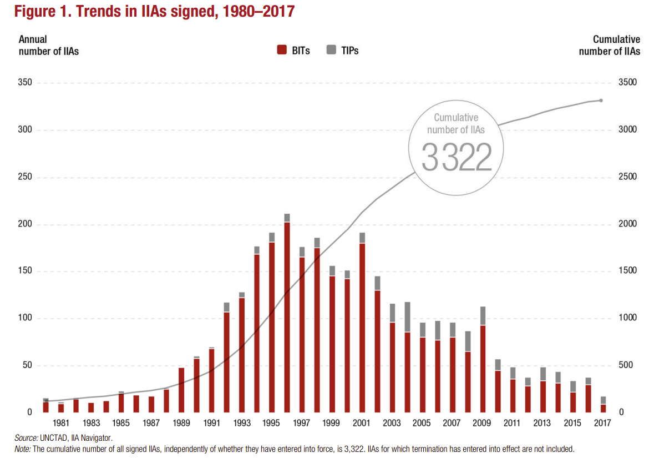
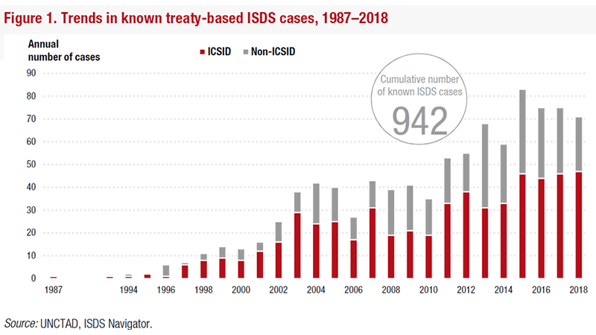
Background & Significance
International investment regime: BITs and TIPs (Treaties with investment provision, e.g., FTAs/RTAs) – credible commitment mechanism & arbitration
New signing of BIT (2000-2010) – ISDS cases: bureaucrat’s bounded rationality (Poulsen & Aisbett, 2013)

Slide 5
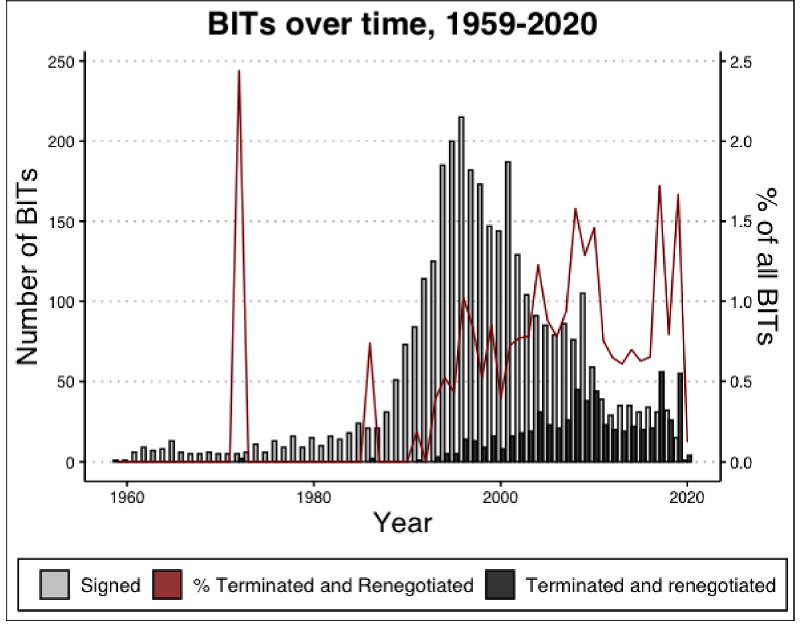
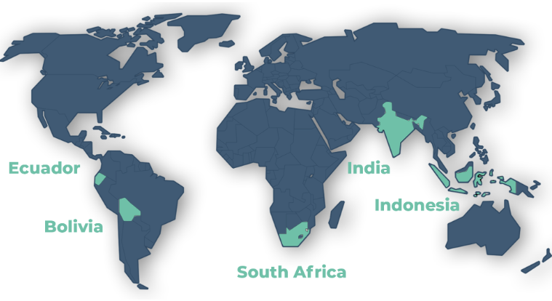
Background & Significance
Notably, 5 countries stand out from their progressive unilateral termination of BITs: (source: UNCTAD, citizen.org)
(i) Ecuador (from 2008)
(ii) Bolivia (from 2009)
(iii) South Africa (from 2012)
(iv) Indonesia (from 2014)
(v) India (early 2016)
“Termination” of BITs, image source: Huikuri (2023)

Slide 6
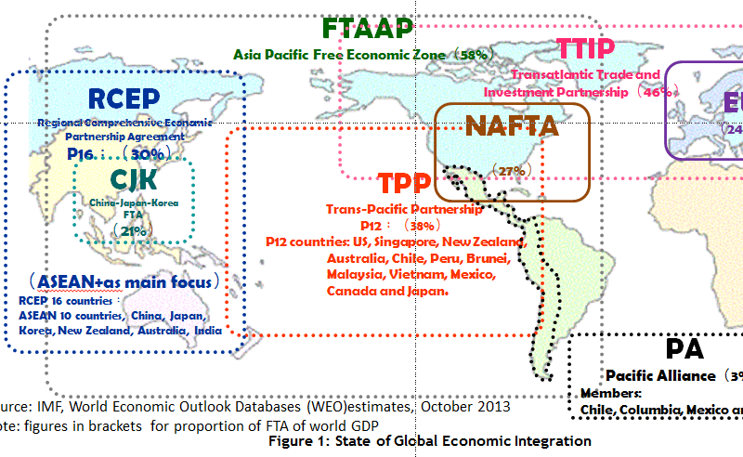
Background & Significance
Since 2000, there has been a decreasing rate of BIT ratification, and from 2010, there are 5 countries trying to terminate nearly all of their BITs.
Within this period, we see an increasing rate of TIPs (e.g., RTA/FTA).

Slide 7
Literature
Three stages of BIT (1970-2007): (1) Global North-South pairs, (2) South-South pairs & peer pressure, (3) realization of costs (Jandhyala et al, 2011)
The impact of BITs (Rose-Ackerman & Tobin, 2005), little effect (meta-study by Brada et al, 2021)
The negative impact of treaty violations (Allee, Peinhardt, 2011; Poulsen, Aisbett, 2013)
The impact of unilateral BIT terminations of FDI: instant negative effect in India using DID (Harmann & Spruk, 2023)

Slide 8
Research question & Hypothesis
What is the impact of the mass termination of BITs on the flow of foreign direct investment?
(What would have happened to the FDI inflows if one country had not terminated their BITs?)
Hypothesis: Terminating BITs will have negative impact on FDI.
Method: fix-effects counterfactual estimator (Liu et al., 2022): a more generalized of synthetic control method with different way of imputation.

Slide 9
Method: fix-effects counterfactual estimators
Data: 2000-2021.
UNCTAD for BIT information
WDI/World Bank for country indicators (GDP, urban population, labor participation),
Economic Freedom Index by Heritage/Fraser Institute
V-dem project (liberal democracy index & electoral/polyarchy index)

Slide 10
Treatment group and donor pools
Donor pools specification:
(1) Having a sizeable number of enforced BITs (before/after 2000);
(2) Maintaining that stable amount of BITs w/o terminating treaties, except treaties with the 5 treated countries, due to either FTA/RTA. There are cases of termination of BITs due to expiry, re-negotiation, replacement;
(3) From Global North/South, only “Southern” countries.
(4) No European countries.

Slide 11
Treatment group and donor pools
Azerbaijan | Bangladesh | Bahrain | Cambodia | China | Costa Rica | Dominican Republic | Egypt | Ethiopia | Gabon
Ghana | Guatemala | Guinea | Hong Kong (SAR) | Honduras | Iran | Jamaica | Kyrgyz | Korea Republic | Kuwait
Lao | Morocco | Madagascar | Mexico | Mali | Mongolia | Mozambique | Namibia | Oman | Pakistan
Panama | Peru | Philippines | Paraguay | Qatar | Russian Fed | Saudi Arabia | Senegal | Singapore | Thailand
United Arab | Turkmenistan | Tunisia | Turkiye | Uruguay | Vietnam | (Donor pool: 46 countries)
Bolivia | Ecuador | Indonesia | India | South Africa | (Treated units)

Slide 12
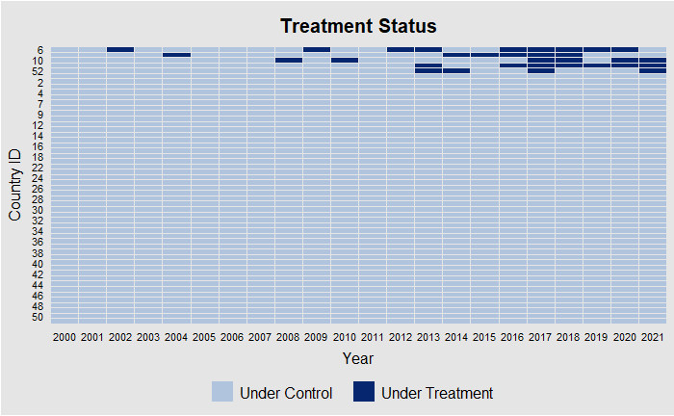
Panel view of treated units
 | Countries | Year having BITs termination
1 | Ecuador | 2008, 2010, 2017, 2018, 2020, 2021, 2022
2 | Bolivia | 2002, 2009, 2012, 2013, 2014, 2017, 2018, 2019, 2020
3 | Indonesia | 2004, 2014, 2015, 2016, 2017, 2018
4 | India | 2013, 2016, 2017, 2018, 2019, 2020, 2021
5 | South Africa | 2013, 2014, 2017, 2021

Slide 13
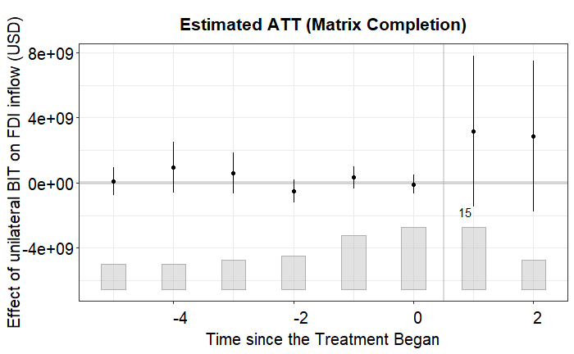
Overall effect (2000:2020)

Slide 14
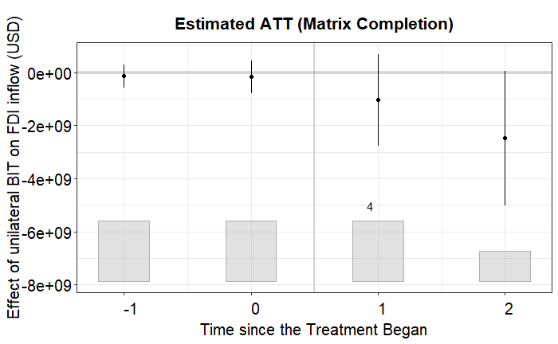
Bolivia

Slide 15
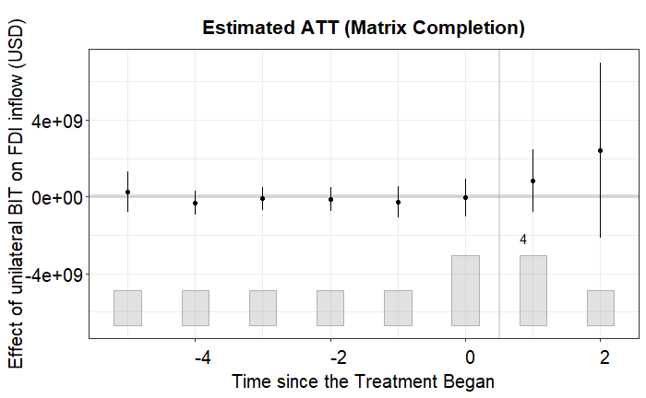
Ecuador

Slide 16
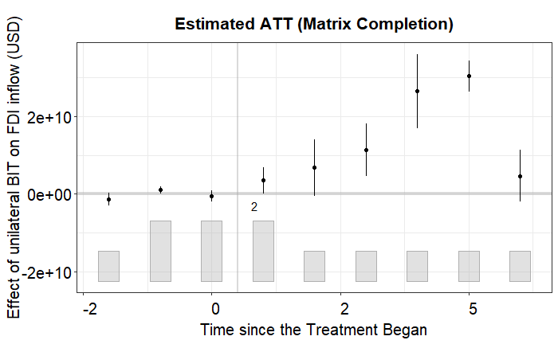
India
2010:2020

Slide 17
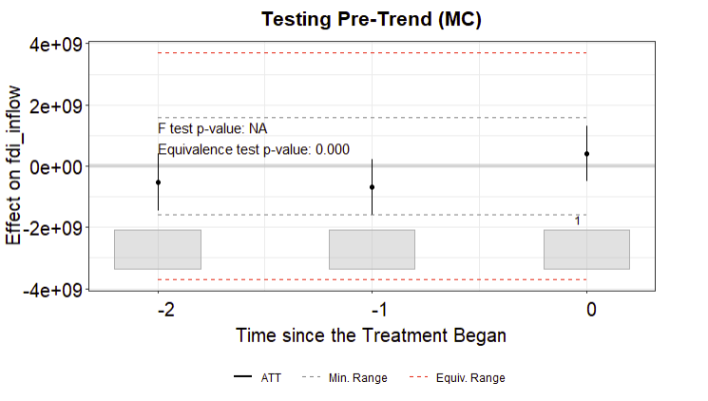
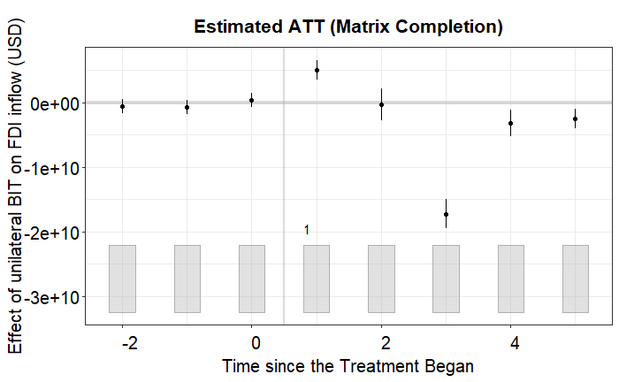
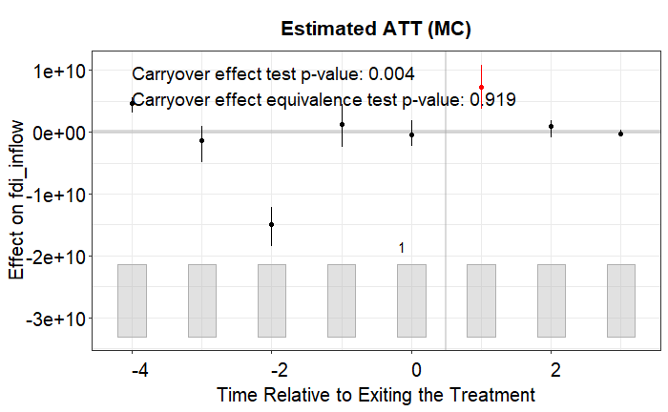
Indonesia
2011:2020
Not robust?

Slide 18
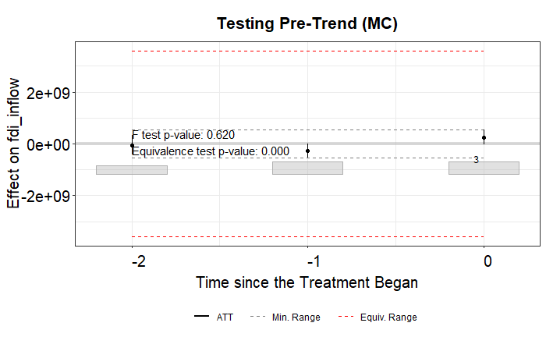
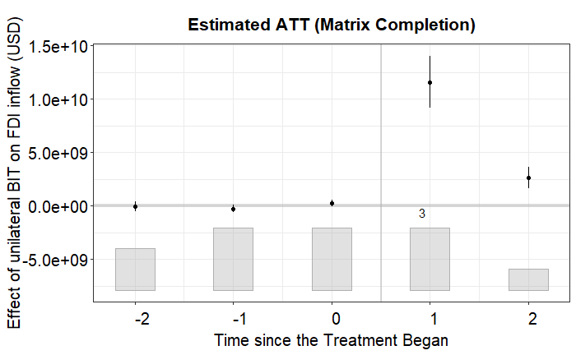
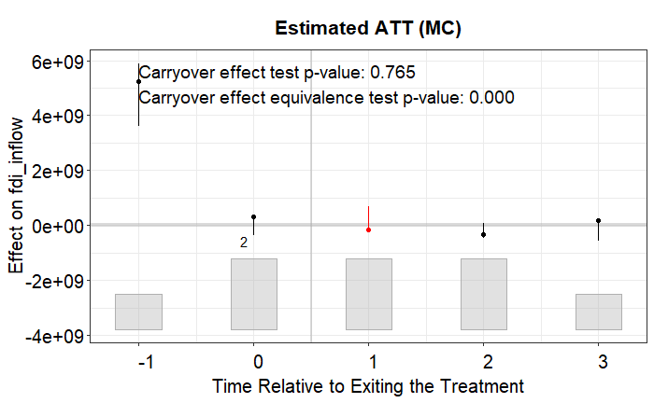
South Africa
2010:2020
Robust?

Slide 19
Limitation
Placebo tests for (1) pre-trend (balance before treatment), (2) carryover effect (“exiting” treatment placebo test)
The yearly frequency may not be optimal for some placebo tests!
We may think about quarterly data, but currently it is limited for only some certain countries.

Slide 20
Conclusion & Future direction
We may think about:
(1) data source for quarter FDI and possible covariates of the same frequency or even aggregated firm-level FDI,
(2) a more innovative way, such as Network concept for explaining the formation or the reverse concerning the bilateral investment treaty tie – FDI tie.

