Slide 1
Introduction to graph And shortest path algorithms
Members of group
Nguyen Duc Minh, Nguyen Van Loc, Nguyen Van Nam
Instructors
Nguyen Thi Hong Minh, Pham Huy Thong
Hanoi University of Science
1/33

Slide 2
Lecture outline
Graph definitions
Definitions and terminologies
Types of Graphs
Graph ADT
Data Structure for Graphs
Adjacency Matrix
Adjacency List
Edge List
Graph Algorithms and Applications
Shortest path problem
Dijkstra’s Shortest Path Algorithm
Bellman Ford Algorithm
Applications
2/33

Slide 3
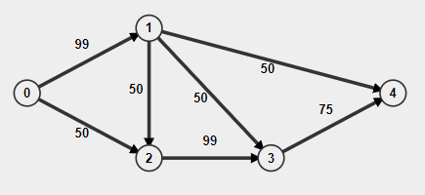
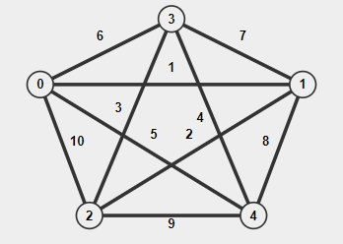
Graph Definition – Definition and Terminologies
Example about graphs.
https://visualgo.net/en/graphds
3/33

Slide 4
Graph Definition - Definition and Terminologies
A graph is a collection of nodes also called vertices which are connected between one another. Each connection between two vertices is called an edge (sometimes called a branch).
In other words, a graph is an ordered pair G = (V, E) where,
G specifies the graph.
V is the vertex-set whose elements are called the vertices, or nodes of the graph. This set is often denoted by V(G) or just V.
E is the edge-set whose elements are called the edges, or connections between vertices of the graph. This set is often denoted by E(G) or just E.
4/33

Slide 5
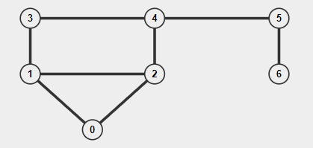
Graph Definition – Types of Graphs
An undirected/unweighted graph
An undirected/weighted graph
5/33

Slide 6
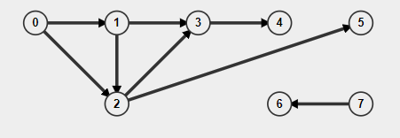
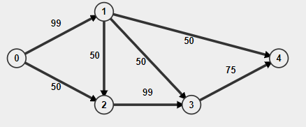
Graph Definition – Types of Graphs
A directed/unweight graph
A directed/weight graph
* The direction of an edge is not always needed. For instance: in a social network like Facebook,
there is no need to have directed edges to represent friendship, as if A if a friend of B,
then B is also a friend of A..
6/33

Slide 7
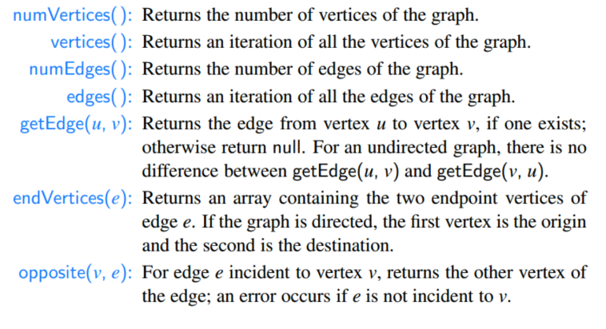
Graph Definition - Graph ADT
[M.Goodrich, sec. 14.1.1, p. 618]
7/33

Slide 8
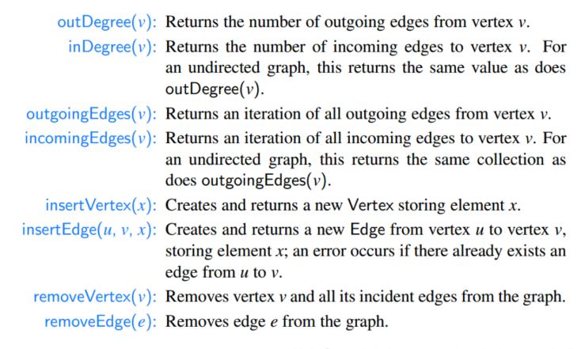
Graph Definition - Graph ADT
8/33

Slide 9
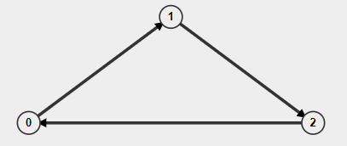

Data Structure for Graphs - Adjacency Matrix
Adjacency Matrix is a 2D array of size V x V where V is the
number of vertices in a graph. Adjacency matrix for undirected
graph is always symmetric. Adjacency Matrix is also used to
represent weighted graphs. If adj[i][j] = w, then there is an
edge from vertex i to vertex j with weight w, if w = 0 there is
no edge.
Pros: Representation is easier to implement and follow. Removing
an edge takes O(1) time. Queries like whether there is an edge
from vertex ‘u’ to vertex ‘v’ are efficient and can be done O (1).
Cons: Consumes more space O(V²). Even if the graph is sparse
(contains less number of edges), it consumes the same space.
Adding a vertex is O(V²) time.
https://visualgo.net/en/graphds
https://en.wikipedia.org/wiki/Adjacency_matrix
9/33

Slide 10

Data Structure for Graphs - Adjacency List
In graph theory and computer science, an adjacency list is a
collection of unordered lists used to represent a finite graph.
Each list describes the set of neighbors of a vertex in the graph.
This is one of several commonly used representations of graphs
for use in computer programs.
https://en.wikipedia.org/wiki/Adjacency_list
10/33

Slide 11

Data Structure for Graphs - Edge List
An edge list is a data structure used to represent a graph as a
list of its edges. An (unweighted) edge is defined by its start and
end vertex, so each edge may be represented by two numbers.
The entire edge list may be represented as a two-column matrix.
If weighted edges, add a column is weight of edges. An edge list
may be considered a variation on an adjacency list which is
represented as a length |V| array of lists. Since each edge contains
just two or three numbers.
https://en.wikipedia.org/wiki/Edge_list
11/33

Slide 12
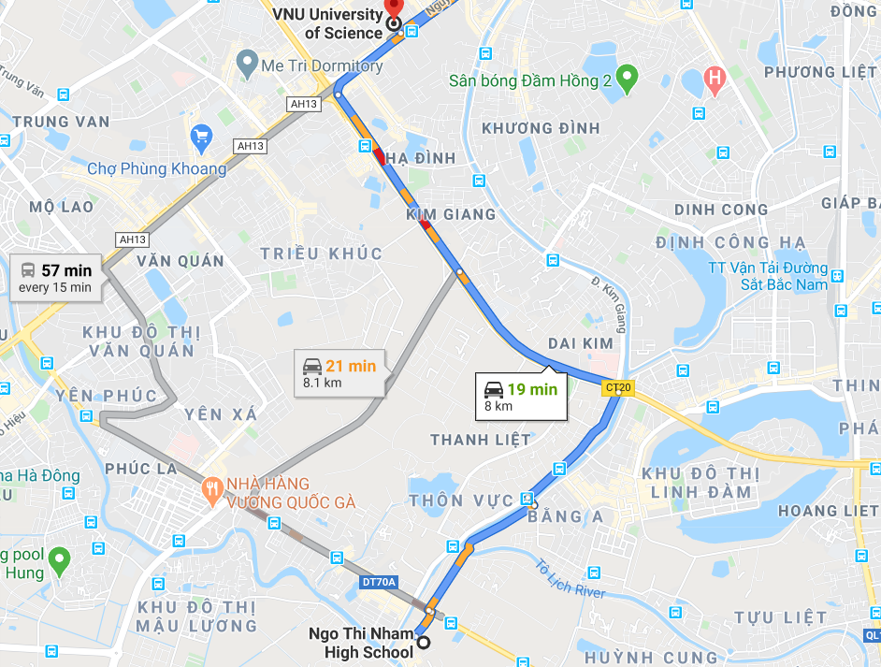
Graph Algorithms and Applications - Shortest Path Problem
Definication: the shortest path problem is the problem of finding a path between two vertices (or nodes) in a graph such that the sum of the weights of its constituent edges is minimized.
For instance: The problem of finding the shortest path between two intersections on a road map may be modeled as a special case of the shortest path problem in graphs, where the vertices correspond to intersections and the edges correspond to road segments, each weighted by the length of the segment.
12/33

Slide 13
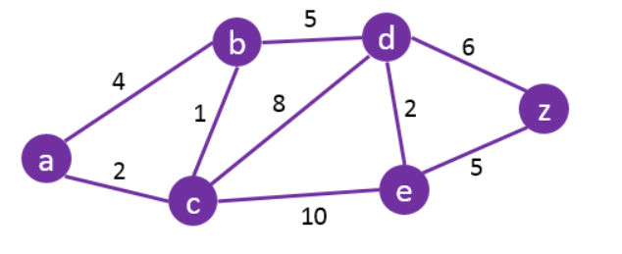
Shortest Path Problem - Dijkstra Algorithm
Method: Dijkstra's algorithm to find the shortest path between vertex in a graph(purple). It picks the unvisited vertex with the lowest distance (green), calculates the distance through it to each unvisited neighbor(blue), and updates the neighbor's distance if smaller. Mark visited (gray) when done with neighbors.
What is the shortest path to travel from A to Z ?
13/33

Slide 14
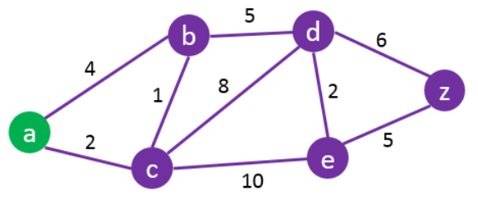
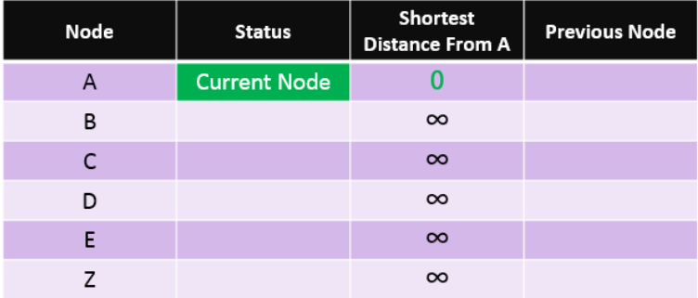
Shortest Path Problem - Dijkstra Algorithm
Start by setting the starting node
(A) as the current node.
14/33

Slide 15
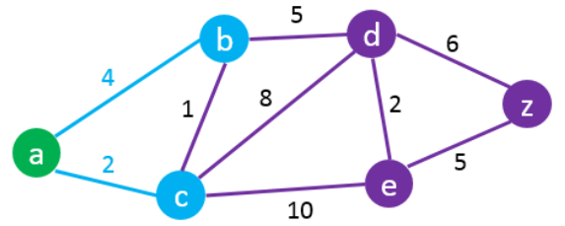
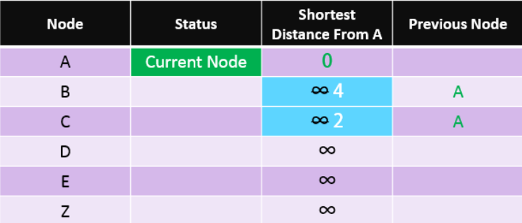
Shortest Path Problem - Dijkstra Algorithm
Check all the nodes connected to A
and update their “Distance from A”
and set their “previous node” to “A”.
15/33

Slide 16
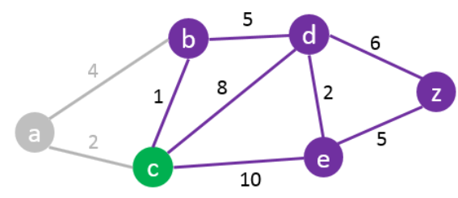
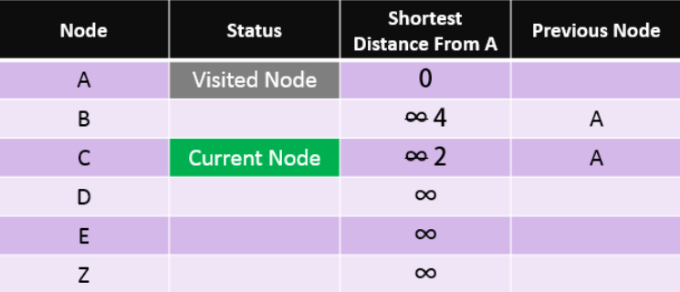
Shortest Path Problem - Dijkstra Algorithm
Set the current node (A) to “visited”
and use the closest unvisited node to
A as the current node
(e.g. in this case: Node C).
16/33

Slide 17
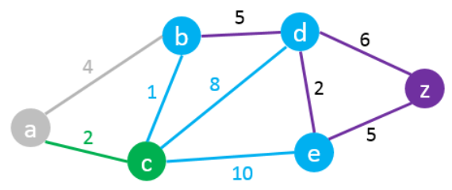
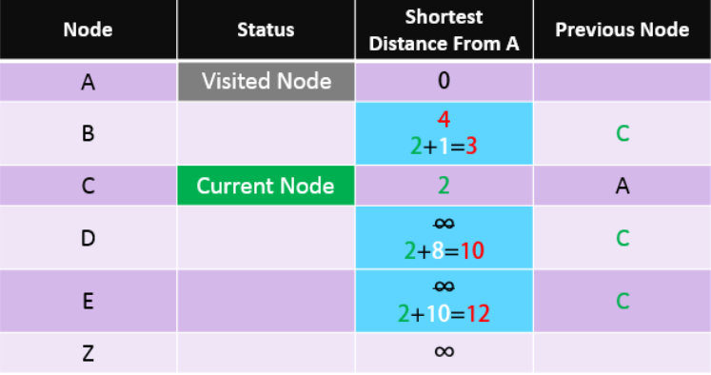
Shortest Path Problem - Dijkstra Algorithm
Check all unvisited nodes connected to the current
node and add the distance from A to C to all distances
from the connected nodes. Replace their values only
if the new distance is lower than the previous one.
C -> B: 2 + 1 = 3 < 4 – Change Node B C -> D: 2 + 8 = 10 < ∞ – Change Node D C -> E: 2 + 10 = 12 < ∞ – Change Node E
17/33

Slide 18
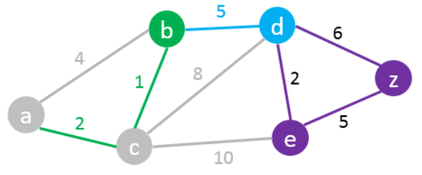
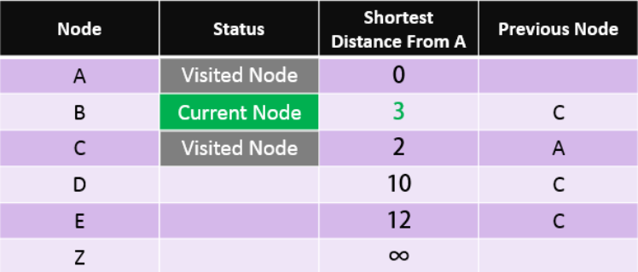
Shortest Path Problem - Dijkstra Algorithm
Set the current node C status to Visited. We then repeat the same process always
picking the closest unvisited node to A as the current node. In this case node B becomes the current node.
18/33

Slide 19
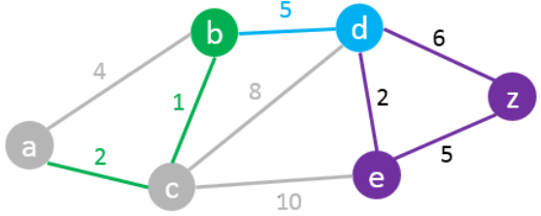
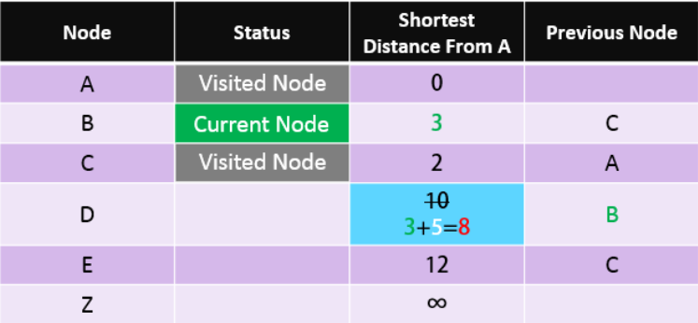
Shortest Path Problem - Dijkstra Algorithm
B -> D 3+5 = 8 < 10 – Change Node D
Next “Current Node” will be D as it has the
shortest distance from A amongst all unvisited nodes.
19/33

Slide 20
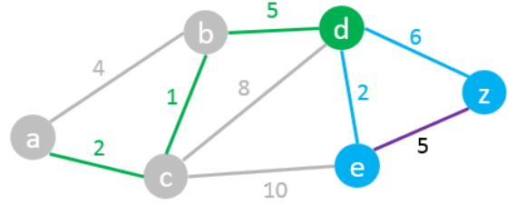
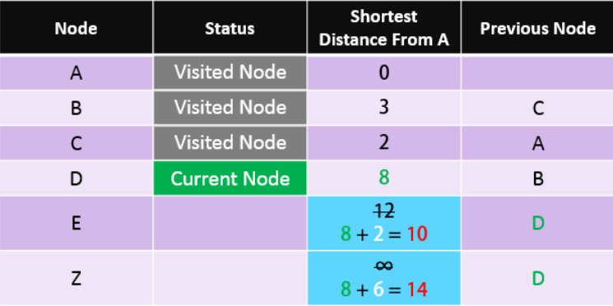
Shortest Path Problem - Dijkstra Algorithm
D -> E 8+2 = 10 < 12 – Change Node E D -> Z 8+6 = 14 < ∞ – Change Node Z
We found a path from A to Z but it may not
be the shortest one yet. So we need to
carry on the process.
Next “Current Node”: E
20/33

Slide 21
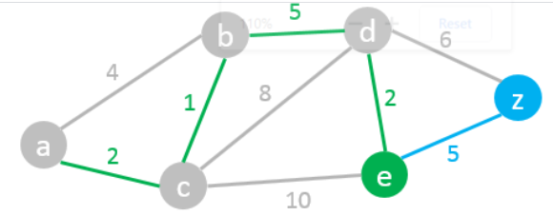
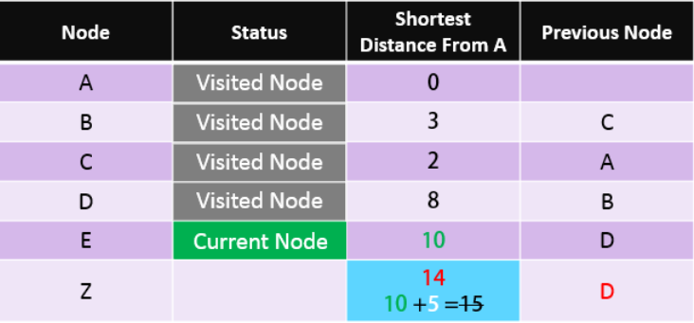
Shortest Path Problem - Dijkstra Algorithm
E -> Z 10+5 = 15 > 14 – We do not change node Z.
21/33

Slide 22
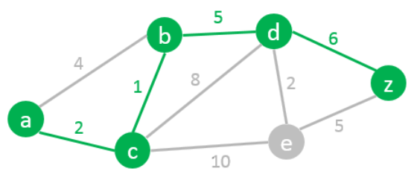
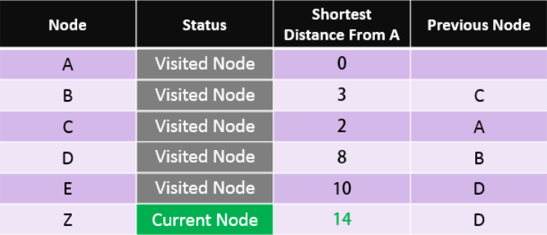
Shortest Path Problem - Dijkstra Algorithm
We found the shortest path from A to Z. Read the path from Z to A using the previous node column: Z > D > B > C > A So the Shortest Path is: A – C – B – D – Z with a length of 14
22/33

Slide 23
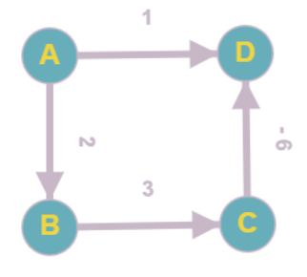
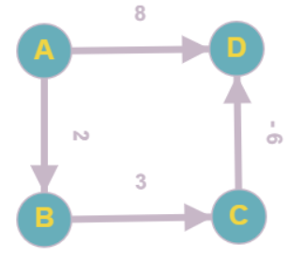
Dijkstra Algorithm – Example about Negative Weight Edges
Not work
Work
-> Conclusion: Dijkstra Algorithm may not work with negative weight edges
23/33

Slide 24
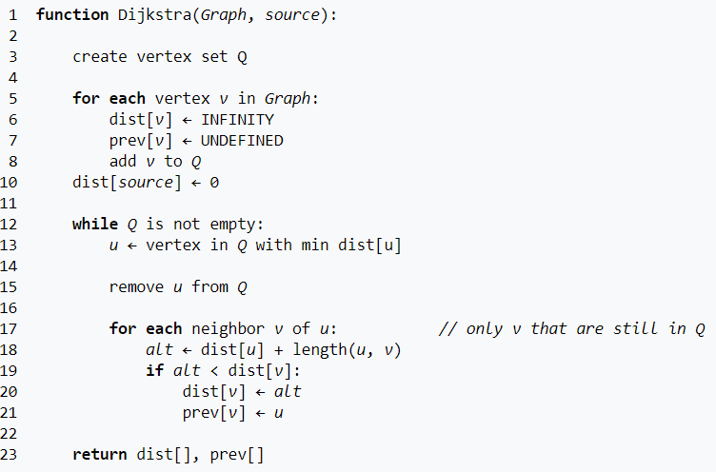
Shortest Path Problem - Dijkstra Algorithm
Time Complexity: O(n²) (n = V)
Time Complexity: O(n²) (n = V)
24/33

Slide 25
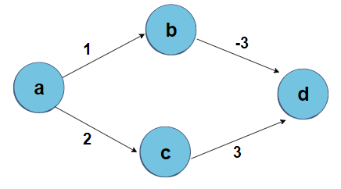
Shortest Path Problem - Bellman Ford Algorithm
Definication: Like Dijkstra’s shortest path algorithm, the Bellman-Ford algorithm is guaranteed to find the shortest path in a graph. Though it is slower than Dijkstra's algorithm, Bellman-Ford is capable of handling graphs that contain negative edge weights, so it is more versatile.
25/33

Slide 26
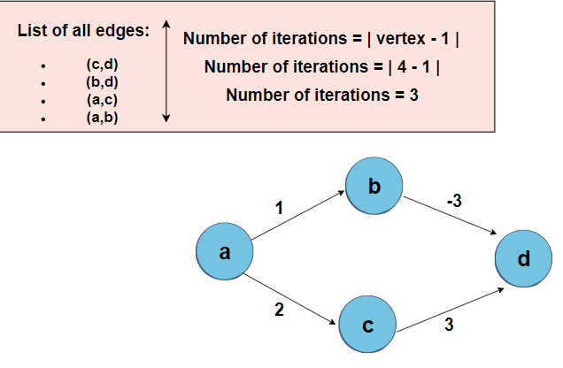
Shortest Path Problem - Bellman Ford Algorithm
26/33

Slide 27
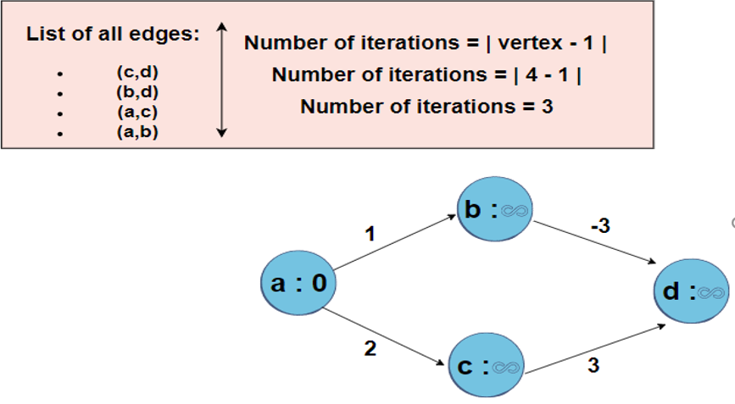
Shortest Path Problem - Bellman Ford Algorithm
Initially, make the starting point with zero and the other points with infinity
27/33

Slide 28
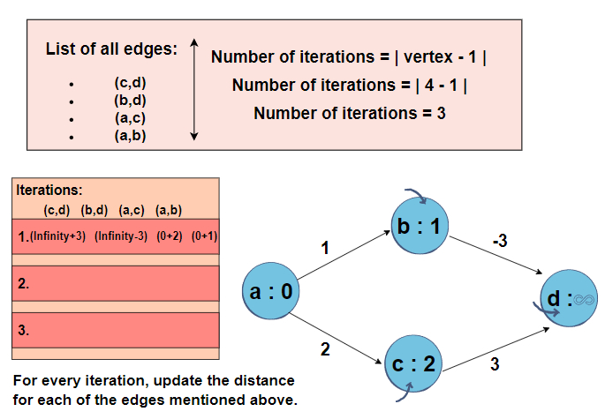
Shortest Path Problem - Bellman Ford Algorithm
28/33

Slide 29
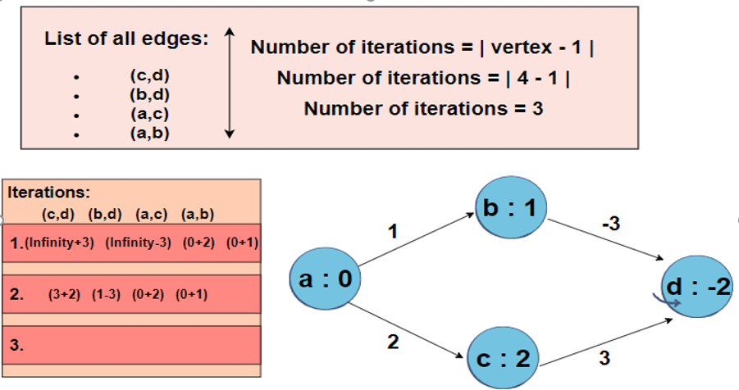
Shortest Path Problem - Bellman Ford Algorithm
As the shortest distance will be opted for, the distance of D will be equal to -2 instead of 5.
29/33

Slide 30
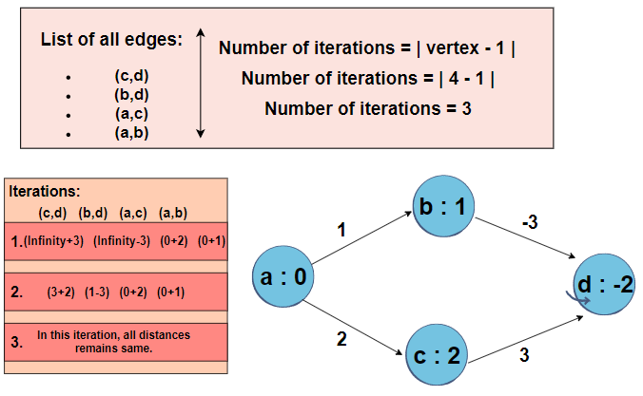
Shortest Path Problem - Bellman Ford Algorithm
30/33

Slide 31
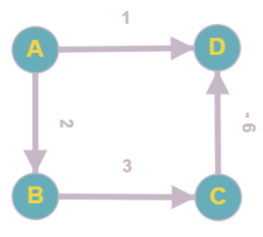
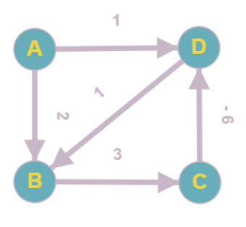
Bellman Ford Algorithm – Example about Negative Weight Edges and Negative Weight Cycles
negative weight cycles
Work
Not work
-> Conclusion: Bellman Ford Algorithm may work with negative weight edges but may not work with
negative weight cycles
https://www.youtube.com/watch?v=2raV0H9KqY8&list=PLDN4rrl48XKpZkf03iYFl-O29szjTrs_O&index=80
31/33

Slide 32
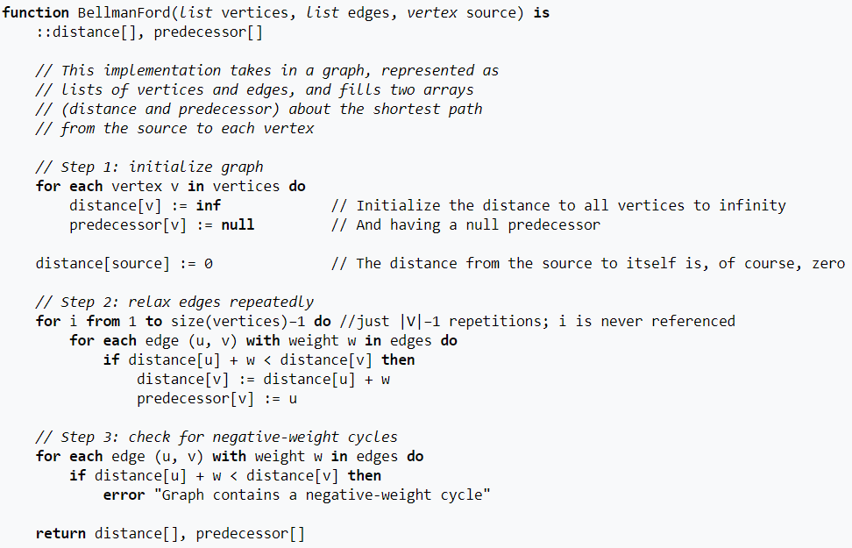
Shortest Path Problem - Bellman Ford Algorithm
Time Complexity: O(n³) (n = V)
32/33

Slide 33

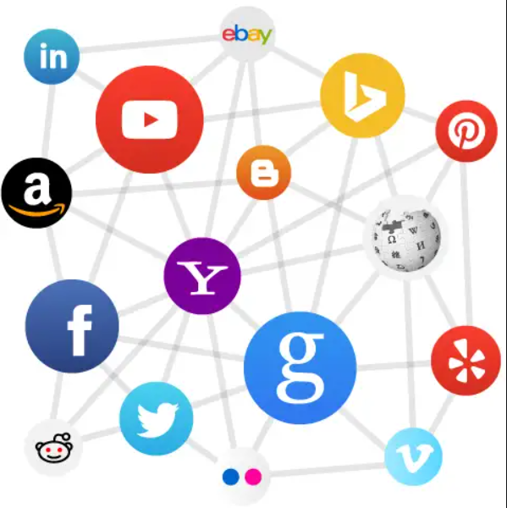
Graph Algorithms and Applications - Applications
Neural Networks
Social Network
Application of Graphs:
Computer Science: networks of communication, data organization, computational devices etc.
Physics and Chemistry: Graph theory is also used to study molecules in chemistry and physics.
Mathematics: In this, graphs are useful in geometry.
Biology: Graph theory is useful in biology …
33/33

